Slide 1









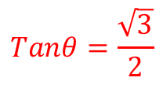
Prior Knowledge Check
1) Three forces act on a particle, as shown below. Given that the particle is in equilibrium, calculate the exact values of $F$ and $tanθ$.
2) A particle of mass 4kg is pulled along a rough horizontal table by a horizontal force of magnitude 12N. Given that the mass moves with constant velocity, work out the coefficient of friction between the particle and the table.
3) A smooth plane is inclined at 30˚ to the horizontal. A particle of mass 0.4kg slides down a line of greatest slope of the plane. The particle starts from rest at a point P and passes point Q with a speed of 5ms⁻¹. Use the principle of conservation of mechanical energy to find the distance PQ.
$$\frac{3}{g}$$
$$2\sqrt{7}N$$
$$4N$$
$$F$$
$$60^{°}$$
$$θ$$
$$Tanθ=\frac{\sqrt{3}}{2}$$
$$6N$$
$$2.55m$$

Slide 2
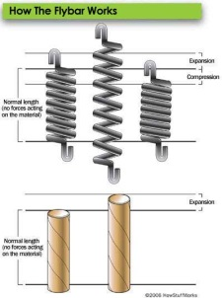


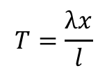

Elastic Strings and Springs
$$T=\frac{λx}{l}$$
You can use Hooke’s law to solve equilibrium problems involving elastic springs or strings
When an elastic string or spring is stretched, there will be Tension in it
The amount of Tension is determined by two factors:
The amount the string/spring has been extended, relative to its original length (so the Tension is proportional to the extension)
The modulus of elasticity of the string/spring – a value that is different depending on what material it is made from
The ratio of the extension of the string to its original length is given by:
$$\frac{x}{l}$$
Where x is the extension and l is the original, ‘natural’ length of the string
Higher extension relative to original length = higher tension
The modulus of elasticity is denoted by:
$$λ$$
Higher modulus of elasticity = more resistant to being stretched = higher tension
$$T=\frac{λx}{l}$$
Overall:
This relationship is known as ‘Hooke’s law’, discovered by British Physicist Robert Hooke in 1660.
3A

Slide 3
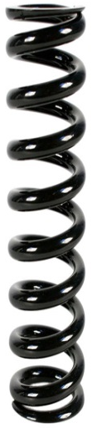
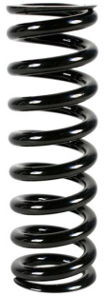
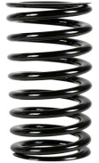
Elastic Strings and Springs
$$T=\frac{λx}{l}$$
Strings
You can use Hooke’s law to solve equilibrium problems involving elastic springs or strings
A couple of things you should also be aware of...
→ The modulus of elasticity, λ, is measured in Newtons (N)
Elastic strings and springs are modelled as being light, ie) they have no mass and will not stretch under their own weight
Both strings and springs can be stretched, returning to their original length after. Springs can also be compressed, in which case T will represent Thrust rather than Tension
…but if you try to ‘compress’ it, it will become slack
A string can be stretched…
T
Springs
A spring can be stretched, creating tension within it
T
It can also be compressed, creating thrust within it
T
3A

Slide 4












Elastic Strings and Springs
$$T=\frac{λx}{l}$$
You can use Hooke’s law to solve equilibrium problems involving elastic springs or strings
An elastic string of natural length 2m and modulus of elasticity 29.4N has one end fixed. A particle of mass 4kg is attached to the other end and hangs at rest. Find the extension of the string.
As always, draw and label diagrams!!
We can use Hooke’s law to find the extension
However, we need the Tension to do this
We can find the Tension by resolving vertically, as the system is in equilibrium
2m
$$l=2$$
$$λ=29.4$$
T
xm
$$x= ?$$
$$T= ?$$
$$T=4g$$
4g
Resolving Vertically
Using Hooke’s Law
$$F=ma$$
Sub in values
$$T=\frac{λx}{l}$$
Sub in values
$$T−4g=0$$
$$4g=\frac{29.4x}{2}$$
Rearrange
Multiply by 2
$$T=4g$$
$$8g=29.4x$$
Divide by 29.4
$$x=2\frac{2}{3}m$$
3A

Slide 5











Elastic Strings and Springs
$$T=\frac{λx}{l}$$
You can use Hooke’s law to solve equilibrium problems involving elastic springs or strings
An elastic spring of natural length 1.5m has one end attached to a fixed point. A horizontal force of magnitude 6N is applied to the other end and compresses the spring to a length of 1m. Find the modulus of elasticity of the spring.
As before, draw a diagram (you do not need to draw the ‘coils’ for a spring, a straight line is fine!)
You will again need to resolve first (in this case horizontally) to find the Tension in the spring
In this case the ‘extension’ is actually a ‘compression’, but this does not change how we solve it!
T
6N
$$l=1.5$$
$$λ= ?$$
1.5m
$$x=0.5$$
$$T= ?$$
0.5m
$$T=6$$
Resolving Horizontally
Using Hooke’s Law
$$F=ma$$
Sub in values
$$T=\frac{λx}{l}$$
Sub in values
$$T−6=0$$
$$6=\frac{λ(0.5)}{1.5}$$
Rearrange
Multiply by 1.5
$$T=6N$$
$$9=0.5λ$$
Divide by 0.5
$$λ=18N$$
You might have noticed that therefore in a spring, a compression of ‘x’ will create the same sized force (Tension or Thrust) as an extension of ‘x’!
3A

Slide 6
Elastic Strings and Springs
$$T=\frac{λx}{l}$$
4m
You can use Hooke’s law to solve equilibrium problems involving elastic springs or strings
The elastic springs PQ and QR are joined together at Q to form one long spring. The spring PQ has natural length 1.6m and modulus of elasticity 20N. The spring QR has natural length 1.4m and modulus of elasticity 28N. The ends, P and R, of the whole spring are attached to two fixed points that are 4m apart.
Find the tension in the combined spring.
Draw a diagram!
Q
T
T
P
R
1.6m
x
1-x
1.4m
The combined natural lengths of the springs is 3m
The total extension is therefore 1m
If the extension in PQ is x, the extension in QR can be expressed as ‘1 – x’
As there is no movement, the system is in equilibrium
Hence, the Tensions in each separate spring must be equal
Find a way to express each Tension separately, and then equate them!
3A

Slide 7






Elastic Strings and Springs
$$T=\frac{λx}{l}$$
4m
You can use Hooke’s law to solve equilibrium problems involving elastic springs or strings
The elastic springs PQ and QR are joined together at Q to form one long spring. The spring PQ has natural length 1.6m and modulus of elasticity 20N. The spring QR has natural length 1.4m and modulus of elasticity 28N. The ends, P and R, of the whole spring are attached to two fixed points that are 4m apart.
Find the tension in the combined spring.
Draw a diagram!
Q
T
T
P
R
1.6m
x
1-x
1.4m
Hooke’s law for PQ
Hooke’s law for QR
$$T=\frac{λx}{l}$$
$$T=\frac{λx}{l}$$
Sub in values
Sub in values
$$T=\frac{(20)(x)}{1.6}$$
$$T=\frac{(28)(1−x)}{1.4}$$
Simplify
Simplify
$$T=\frac{20x}{1.6}$$
$$T=\frac{28−28x}{1.4}$$
Set the equations equal to each other
$$\frac{20x}{1.6}=\frac{28−28x}{1.4}$$
3A

Slide 8







Elastic Strings and Springs
$$T=\frac{λx}{l}$$
4m
You can use Hooke’s law to solve equilibrium problems involving elastic springs or strings
The elastic springs PQ and QR are joined together at Q to form one long spring. The spring PQ has natural length 1.6m and modulus of elasticity 20N. The spring QR has natural length 1.4m and modulus of elasticity 28N. The ends, P and R, of the whole spring are attached to two fixed points that are 4m apart.
Find the tension in the combined spring.
Draw a diagram!
Q
T
T
P
R
1.6m
x
1-x
1.4m
$$\frac{20x}{1.6}=\frac{28−28x}{1.4}$$
Cross multiply
$$1.4(20x)=1.6(28−28x)$$
Simplify
$$28x=44.8−44.8x$$
Add 44.8x
$$72.8x=44.8$$
Divide by 72.8
$$x=\frac{8}{13}$$
$$T=\frac{20x}{1.6}$$
$$T=\frac{28−28x}{1.4}$$
Now we can find the Tension by substituting x back into one of the equations
3A

Slide 9



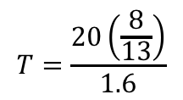
Elastic Strings and Springs
$$T=\frac{λx}{l}$$
4m
You can use Hooke’s law to solve equilibrium problems involving elastic springs or strings
The elastic springs PQ and QR are joined together at Q to form one long spring. The spring PQ has natural length 1.6m and modulus of elasticity 20N. The spring QR has natural length 1.4m and modulus of elasticity 28N. The ends, P and R, of the whole spring are attached to two fixed points that are 4m apart.
Find the tension in the combined spring.
Draw a diagram!
Q
T
T
P
R
1.6m
x
1-x
1.4m
$$T=\frac{20x}{1.6}$$
Sub in the value of x
$$T=\frac{20\left(\frac{8}{13}\right)}{1.6}$$
Calculate
$$T=7\frac{9}{13}$$
$$T=\frac{20x}{1.6}$$
$$T=\frac{28−28x}{1.4}$$
So the tension in the combined spring is 7⁹/₁₃N
→ It is a constant value along the whole combined spring. Hence, we don’t need to double this as there are 2 springs!
$$x=\frac{8}{13}$$
3A

Slide 10




Elastic Strings and Springs
$$T=\frac{λx}{l}$$
2l
You can use Hooke’s law to solve equilibrium problems involving elastic springs or strings
An elastic string of natural length 2l and modulus of elasticity 4mg is stretched between 2 points, A and B. The points A and B are on the same horizontal level and AB = 2l. A particle P is attached to the midpoint of the string and hangs in equilibrium with both parts of the string making an angle of 30° with line AB. Find the mass of the particle in terms of m.
The mass will end up directly below the midpoint of the original line (as this was where it is fixed)
Let the unknown mass of the particle be ‘M’
A
30°
B
30°
T
T
Tsin30
P
Tsin30
30°
30°
Tcos30
Tcos30
Mg
You need to find ways of creating equations with the data you’re given…
Resolving horizontally will not help as the equation will simplify to 0 = 0!
Resolving Vertically
$$F=ma$$
Sub in values
$$2Tsin30−Mg=0$$
Add Mg
$$2Tsin30=Mg$$
Sin30 = 0.5
$$T=Mg$$
3A

Slide 11





Elastic Strings and Springs
$$T=\frac{λx}{l}$$
Adj
2l
You can use Hooke’s law to solve equilibrium problems involving elastic springs or strings
An elastic string of natural length 2l and modulus of elasticity 4mg is stretched between 2 points, A and B. The points A and B are on the same horizontal level and AB = 2l. A particle P is attached to the midpoint of the string and hangs in equilibrium with both parts of the string making an angle of 30° with line AB. Find the mass of the particle in terms of m.
We have found an expression for Tension using the forces
We can also find an expression for the Tension using Hooke’s law…
l
A
30°
B
30°
T
Opp
T
Hyp
Tsin30
P
Tsin30
30°
30°
Tcos30
Tcos30
Mg
First, we will need to know the extension of the string – use Trigonometry!
$$Hyp=\frac{Adj}{Cosθ}$$
Sub in values
$$T=Mg$$
$$Hyp=\frac{l}{Cos30}$$
Cos30 = ^{√3}/₂
$$Hyp=\frac{2l}{\sqrt{3}}$$
Double this for the length of the whole string
$$Total length=\frac{4l}{\sqrt{3}}$$
3A

Slide 12
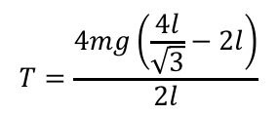


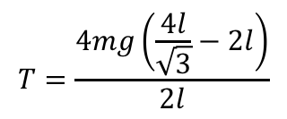
Elastic Strings and Springs
$$T=\frac{λx}{l}$$
2l
You can use Hooke’s law to solve equilibrium problems involving elastic springs or strings
An elastic string of natural length 2l and modulus of elasticity 4mg is stretched between 2 points, A and B. The points A and B are on the same horizontal level and AB = 2l. A particle P is attached to the midpoint of the string and hangs in equilibrium with both parts of the string making an angle of 30° with line AB. Find the mass of the particle in terms of m.
A
30°
B
30°
T
T
Tsin30
P
Tsin30
30°
30°
Tcos30
Tcos30
Mg
The total extension will be this new length, subtract the natural length of the string, 2l.
$$Extension=\frac{4l}{\sqrt{3}}−2l$$
$$T=Mg$$
Substitute this into Hooke’s law…
$$T=\frac{4mg\left(\frac{4l}{\sqrt{3}}−2l\right)}{2l}$$
$$T=\frac{λx}{l}$$
Replace λ, x and l
$$T=\frac{4mg\left(\frac{4l}{\sqrt{3}}−2l\right)}{2l}$$
3A

Slide 13
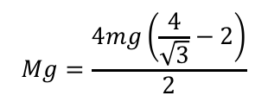
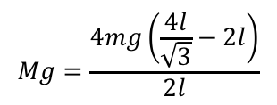


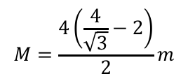
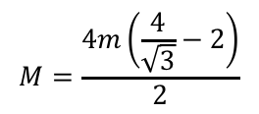
Elastic Strings and Springs
$$T=\frac{λx}{l}$$
$$Mg=\frac{4mg\left(\frac{4l}{\sqrt{3}}−2l\right)}{2l}$$
You can use Hooke’s law to solve equilibrium problems involving elastic springs or strings
An elastic string of natural length 2l and modulus of elasticity 4mg is stretched between 2 points, A and B. The points A and B are on the same horizontal level and AB = 2l. A particle P is attached to the midpoint of the string and hangs in equilibrium with both parts of the string making an angle of 30° with line AB. Find the mass of the particle in terms of m.
Set the equations equal to each other!
Divide the top and bottom of the right side by l
$$Mg=\frac{4mg\left(\frac{4}{\sqrt{3}}−2\right)}{2}$$
Divide both sides by g
$$M=\frac{4m\left(\frac{4}{\sqrt{3}}−2\right)}{2}$$
You can rewrite it with ‘m’ at the end
$$M=\frac{4\left(\frac{4}{\sqrt{3}}−2\right)}{2}m$$
Divide the top and bottom by 2
$$T=Mg$$
$$M=2\left(\frac{4}{\sqrt{3}}−2\right)m$$
$$T=\frac{4mg\left(\frac{4l}{\sqrt{3}}−2l\right)}{2l}$$
Calculate
$$M=0.62m$$
You don’t necessarily need to show all of the above steps!
3A

Slide 14
Elastic Strings and Springs
$$T=\frac{λx}{l}$$
2l
You can use Hooke’s law to solve equilibrium problems involving elastic springs or strings
An elastic string of natural length 2l and modulus of elasticity 4mg is stretched between 2 points, A and B. The points A and B are on the same horizontal level and AB = 2l. A particle P is attached to the midpoint of the string and hangs in equilibrium with both parts of the string making an angle of 30° with line AB. Find the mass of the particle in terms of m.
A
B
30°
30°
T
T
Tsin30
P
Tsin30
30°
30°
Tcos30
Tcos30
Mg
This question introduced a very important process in solving these types of problem
→ You can use F = ma to find a relationship between the forces, particularly the tension
→ You can use Trigonometry/Pythagoras to find missing lengths
→ You can then use Hooke’s law, which links lengths with tension, allowing you to form an equation linking everything!
3A

Slide 15
Elastic Strings and Springs
$$T=\frac{λx}{l}$$
2l
You can use Hooke’s law to solve equilibrium problems involving elastic springs or strings
An elastic string of natural length 2l and modulus of elasticity 4mg is stretched between 2 points, A and B. The points A and B are on the same horizontal level and AB = 2l. A particle P is attached to the midpoint of the string and hangs in equilibrium with both parts of the string making an angle of 30° with line AB. Find the mass of the particle in terms of m.
A
B
30°
30°
T
T
Tsin30
P
Tsin30
30°
30°
Tcos30
Tcos30
Mg
Another point that is very important relates to the Mass attached to the string.
The Mass will always move vertically downwards below the point where it is first attached, if it is a single string, or two identical strings
So if the mass was placed ³/₄ of the way along a string, when it moves down it will not move towards the centre (as it is fixed to the string)
If the example had 2 different strings, then the Mass could change its position as one may stretch more than the other…
3A

Slide 16








Elastic Strings and Springs
$$T=\frac{λx}{l}$$
O
You can use Hooke’s law to solve equilibrium problems involving elastic springs or strings
An elastic string has natural length 2m and modulus of elasticity 98N. One end of the string is attached to a fixed point O and the other end is attached to a particle P of mass 4kg. The particle is held in equilibrium by a horizontal force of magnitude 28N, with OP making an angle θ with the vertical, as shown.
Find:
The value of θ
The length OP
θ
T
θ
Tcosθ
P
28N
Tsinθ
4g
Resolving Horizontally
Resolving Vertically
$$F=ma$$
$$F=ma$$
Sub in values
Sub in values
$$Tsinθ−28=0$$
$$Tcosθ−4g=0$$
Add 28
Add 4g
$$Tsinθ=28$$
$$Tsinθ=28$$
$$Tcosθ=4g$$
$$Tcosθ=4g$$
3A

Slide 17



Elastic Strings and Springs
$$T=\frac{λx}{l}$$
O
You can use Hooke’s law to solve equilibrium problems involving elastic springs or strings
An elastic string has natural length 2m and modulus of elasticity 98N. One end of the string is attached to a fixed point O and the other end is attached to a particle P of mass 4kg. The particle is held in equilibrium by a horizontal force of magnitude 28N, with OP making an angle θ with the vertical, as shown.
Find:
The value of θ
The length OP
θ
T
θ
Tcosθ
P
28N
Tsinθ
4g
Now divide equation 1 by equation 2
$$\frac{Tsinθ}{Tcosθ}=\frac{28}{4g}$$
Simplify the left side
$$tanθ=\frac{28}{4g}$$
Use inverse Tan
1)
$$Tsinθ=28$$
2)
$$Tcosθ=4g$$
$θ=36°$ (2sf)
3A

Slide 18


Elastic Strings and Springs
$$T=\frac{λx}{l}$$
O
You can use Hooke’s law to solve equilibrium problems involving elastic springs or strings
An elastic string has natural length 2m and modulus of elasticity 98N. One end of the string is attached to a fixed point O and the other end is attached to a particle P of mass 4kg. The particle is held in equilibrium by a horizontal force of magnitude 28N, with OP making an angle θ with the vertical, as shown.
Find:
The value of θ → 36°
The length OP
θ
T
θ
Tcosθ
P
28N
Tsinθ
4g
We can use Hooke’s law to find the extension of the string
However, to do this we will first need the tension in the string
You can use the equations from before…
$$Tsinθ=28$$
1)
$$Tsinθ=28$$
Divide by sinθ
$$T=\frac{28}{sinθ}$$
$$T=\frac{28}{sinθ}$$
2)
$$Tcosθ=4g$$
3A

Slide 19





Elastic Strings and Springs
$$T=\frac{λx}{l}$$
O
You can use Hooke’s law to solve equilibrium problems involving elastic springs or strings
An elastic string has natural length 2m and modulus of elasticity 98N. One end of the string is attached to a fixed point O and the other end is attached to a particle P of mass 4kg. The particle is held in equilibrium by a horizontal force of magnitude 28N, with OP making an angle θ with the vertical, as shown.
Find:
The value of θ → 36°
The length OP
θ
T
θ
Tcosθ
P
28N
Tsinθ
4g
→ Now use Hooke’s law
$$T=\frac{λx}{l}$$
Replace T, λ and l with the information we have
$$\frac{28}{sinθ}=\frac{98x}{2}$$
Multiply by 2, Divide by 98
$$\frac{28}{sinθ}×\frac{2}{98}=x$$
1)
$$Tsinθ=28$$
$$T=\frac{28}{sinθ}$$
Calculate x (remember to use the exact value of θ)
2)
$$Tcosθ=4g$$
$$x=0.983$$
The total length is x + l, so add on 2!
$$OP=2.983$$
3A

Slide 20


Elastic Strings and Springs
$$T=\frac{λx}{l}$$
P
Let the extension of the first spring be ‘x’
The extension of the other will therefore be (2l – x)
(4l – l – l – x)
→ Also note that we have assumed the lower string is in tension (if we were to find a negative value, it would therefore actually be a thrust)
You can use Hooke’s law to solve equilibrium problems involving elastic springs or strings
Two identical elastic springs PQ and QR have natural length l and modulus of elasticity 2mg. The springs are joined together at Q. Their other ends, P and R, are attached to fixed points, with P being 4l vertically above R. A particle of mass m is attached at Q and hangs at rest in equilibrium. Find the distance of the particle below P.
In this case, the tensions in the springs will be different due to the mass, so use T₁ and T₂
If the mass was on the bottom end of the spring and it was hanging freely, the tension would be the same!
l
T₂
x
4l
Q
2l - x
mg
T₁
l
R
Resolving Vertically
$$F=ma$$
Sub in values
$$T_{2}−T_{1}−mg=0$$
Rearrange
$$T_{2}=T_{1}+mg$$
3A

Slide 21




Elastic Strings and Springs
$$T=\frac{λx}{l}$$
You can use Hooke’s law to solve equilibrium problems involving elastic springs or strings
Two identical elastic springs PQ and QR have natural length l and modulus of elasticity 2mg. The springs are joined together at Q. Their other ends, P and R, are attached to fixed points, with P being 4l vertically above R. A particle of mass m is attached at Q and hangs at rest in equilibrium. Find the distance of the particle below P.
→ Now we can use Hooke’s law to find expressions for T₁ and T₂ in terms of x, l and mg
P
l
T₂
x
4l
Q
2l - x
mg
T₁
l
R
Upper spring
Lower spring
$$T_{2}=T_{1}+mg$$
$$T=\frac{λx}{l}$$
$$T=\frac{λx}{l}$$
Sub in values
Sub in values
$$T_{2}=\frac{2mgx}{l}$$
$$T_{1}=\frac{2mg(2l−x)}{l}$$
$$T_{2}=\frac{2mgx}{l}$$
$$T_{1}=\frac{2mg(2l−x)}{l}$$
3A

Slide 22







Elastic Strings and Springs
$$T=\frac{λx}{l}$$
You can use Hooke’s law to solve equilibrium problems involving elastic springs or strings
Two identical elastic springs PQ and QR have natural length l and modulus of elasticity 2mg. The springs are joined together at Q. Their other ends, P and R, are attached to fixed points, with P being 4l vertically above R. A particle of mass m is attached at Q and hangs at rest in equilibrium. Find the distance of the particle below P.
→ Now we can replace T₁ and T₂ and find an expression for x in terms of l
$$T_{2}=T_{1}+mg$$
Replace T₁ and T₂
$$\frac{2mgx}{l}=\frac{2mg(2l−x)}{l}+mg$$
Multiply all by l
$$2mgx=2mg(2l−x)+mgl$$
Divide by mg
$$2x=2(2l−x)+l$$
Multiply out brackets
$$2x=4l−2x+l$$
Add 2x, group ‘l’ terms
$$T_{2}=T_{1}+mg$$
$$4x=5l$$
$$T_{2}=\frac{2mgx}{l}$$
$$T_{1}=\frac{2mg(2l−x)}{l}$$
Divide by 4
$$x=\frac{5l}{4}$$
3A

Slide 23



Elastic Strings and Springs
$$T=\frac{λx}{l}$$
You can use Hooke’s law to solve equilibrium problems involving elastic springs or strings
Two identical elastic springs PQ and QR have natural length l and modulus of elasticity 2mg. The springs are joined together at Q. Their other ends, P and R, are attached to fixed points, with P being 4l vertically above R. A particle of mass m is attached at Q and hangs at rest in equilibrium. Find the distance of the particle below P.
P
The particle will be ‘x + l’ below P
→ We know that x = ^{5l}/₄
l
T₂
x
4l
Q
2l - x
$$\frac{5l}{4}+l$$
mg
T₁
l
$$=\frac{9l}{4}$$
R
$$T_{2}=T_{1}+mg$$
$$T_{2}=\frac{2mgx}{l}$$
$$T_{1}=\frac{2mg(2l−x)}{l}$$
$$x=\frac{5l}{4}$$
3A

Slide 24



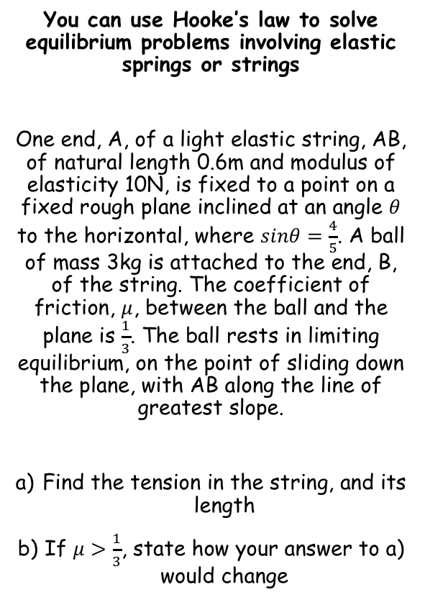











Elastic Strings and Springs
$$T=\frac{λx}{l}$$
$$μ=\frac{1}{3}$$
A
You can use Hooke’s law to solve equilibrium problems involving elastic springs or strings
One end, A, of a light elastic string, AB, of natural length 0.6m and modulus of elasticity 10N, is fixed to a point on a fixed rough plane inclined at an angle $θ$ to the horizontal, where $sinθ=\frac{4}{5}$. A ball of mass 3kg is attached to the end, B, of the string. The coefficient of friction, $μ$, between the ball and the plane is $\frac{1}{3}$. The ball rests in limiting equilibrium, on the point of sliding down the plane, with AB along the line of greatest slope.
Find the tension in the string, and its length
If $μ>\frac{1}{3}$, state how your answer to a) would change
R
$$Sinθ=\frac{4}{5}$$
3gcosθ
$$λ=10N$$
T
B
0.6m
x
$$Cosθ=\frac{3}{5}$$
F_{MAX}
$$0.6g$$
θ
3gcosθ
3g
$$Tanθ=\frac{4}{3}$$
θ
3gsinθ
To find the tension, we need the frictional force, and to find this, we need the normal reaction.
Resolving Perpendicular $\left(↖\right)$
$$F=ma$$
Sub in values
$$R−3gcosθ=(3g)(0)$$
Calculate
$$R=3gcosθ$$
Finding Friction
$$F_{MAX}=μR$$
$$F_{MAX}=\left(\frac{1}{3}\right)\left(3gcosθ\right)$$
Sub in values
Calculate (using the value of $cosθ$ above)
$$F_{MAX}=0.6g$$
3A

Slide 25






Elastic Strings and Springs
$$T=\frac{λx}{l}$$
$$μ=\frac{1}{3}$$
A
You can use Hooke’s law to solve equilibrium problems involving elastic springs or strings
One end, A, of a light elastic string, AB, of natural length 0.6m and modulus of elasticity 10N, is fixed to a point on a fixed rough plane inclined at an angle $θ$ to the horizontal, where $sinθ=\frac{4}{5}$. A ball of mass 3kg is attached to the end, B, of the string. The coefficient of friction, $μ$, between the ball and the plane is $\frac{1}{3}$. The ball rests in limiting equilibrium, on the point of sliding down the plane, with AB along the line of greatest slope.
Find the tension in the string, and its length
If $μ>\frac{1}{3}$, state how your answer to a) would change
3gcosθ
$$Sinθ=\frac{4}{5}$$
$$λ=10N$$
1.8g
T
0.6m
B
$$Cosθ=\frac{3}{5}$$
x
$$0.6g$$
θ
3gcosθ
3g
$$Tanθ=\frac{4}{3}$$
θ
3gsinθ
Resolving Parallel $\left(↗\right)$
$$F=ma$$
Sub in values
$$T+0.6g−3gsinθ=(3g)(0)$$
Rearrange
$$T=3gsinθ−0.6g$$
Calculate using the value of $sinθ$ above
$$T=1.8g$$
3A

Slide 26






Elastic Strings and Springs
$$T=\frac{λx}{l}$$
$$μ=\frac{1}{3}$$
A
You can use Hooke’s law to solve equilibrium problems involving elastic springs or strings
One end, A, of a light elastic string, AB, of natural length 0.6m and modulus of elasticity 10N, is fixed to a point on a fixed rough plane inclined at an angle $θ$ to the horizontal, where $sinθ=\frac{4}{5}$. A ball of mass 3kg is attached to the end, B, of the string. The coefficient of friction, $μ$, between the ball and the plane is $\frac{1}{3}$. The ball rests in limiting equilibrium, on the point of sliding down the plane, with AB along the line of greatest slope.
Find the tension in the string, and its length
If $μ>\frac{1}{3}$, state how your answer to a) would change
3gcosθ
$$Sinθ=\frac{4}{5}$$
$$λ=10N$$
1.8g
B
0.6m
x
$$Cosθ=\frac{3}{5}$$
$$0.6g$$
θ
3gcosθ
3g
$$Tanθ=\frac{4}{3}$$
θ
3gsinθ
$$T=\frac{λx}{l}$$
Sub in values
$$1.8g=\frac{(10)x}{0.6}$$
Calculate $x$
$$x=1.0584$$
This is the extension, so add on the natural length
$$Total=1.6584$$
Round to 3sf
$$Total=1.66m$$
3A

Slide 27


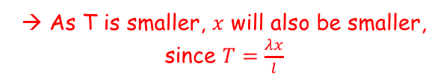
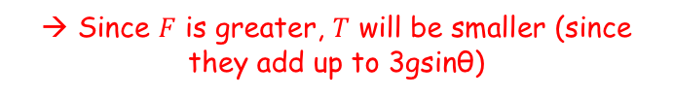



Elastic Strings and Springs
$$T=\frac{λx}{l}$$
$$μ=\frac{1}{3}$$
A
You can use Hooke’s law to solve equilibrium problems involving elastic springs or strings
One end, A, of a light elastic string, AB, of natural length 0.6m and modulus of elasticity 10N, is fixed to a point on a fixed rough plane inclined at an angle $θ$ to the horizontal, where $sinθ=\frac{4}{5}$. A ball of mass 3kg is attached to the end, B, of the string. The coefficient of friction, $μ$, between the ball and the plane is $\frac{1}{3}$. The ball rests in limiting equilibrium, on the point of sliding down the plane, with AB along the line of greatest slope.
Find the tension in the string, and its length
If $μ>\frac{1}{3}$, state how your answer to a) would change
R
$$Sinθ=\frac{4}{5}$$
$$λ=10N$$
T
B
0.6m
x
$$Cosθ=\frac{3}{5}$$
$$F$$
θ
3gcosθ
3g
$$Tanθ=\frac{4}{3}$$
θ
3gsinθ
If $μ>\frac{1}{3}$…
→ F would be greater since $F=μR$
→ Since $F$ is greater, $T$ will be smaller (since they add up to 3gsinθ)
$$1.8g$$
→ As T is smaller, $x$ will also be smaller, since $T=\frac{λx}{l}$
$$1.66m$$
3A

Slide 28
Elastic Strings and Springs
$$T=\frac{λx}{l}$$
You can use Hooke’s law to solve equilibrium problems involving elastic springs or strings
Some important things to be aware of in this section:
If a particle is attached to the end of joined strings and hangs at rest, the Tension will be constant throughout both strings (even if the strings are different)
If it is attached part-way along the string, and the string is fixed at a lower point, the Tension will vary as the mass affects each part of it differently
If there are different strings suspended at different angles, the Tension will be different
T
String 1
The overall Tension is still T, NOT 2T!
T
String 2
T₂
mg
mg
T₁
T₁
T₂
Of course though, every question is unique and getting the Tensions represented correctly is key to solving these questions!
mg
3A

Slide 29
Exercise 3A
Pearson Further Mechanics 1
Pages 44-45 questions 1-7
Complete before the lesson Q1-4
In Class:
Green Q5-7
Amber Q8-9
Red Q10-11

