Slide 1






Elastic Collisions in two dimensions
You need to be able to solve problems involving the oblique impact of two smooth spheres
An oblique impact between two spheres is when the two are not travelling along the same straight line (as you saw in the previous chapter)
Imagine sphere A is moving toward sphere B, which is stationary
The impulses on each sphere act along the ‘line of centres’, a line connecting the centres of the spheres at the moment of impact
Before collision
Moment of collision
B
$$4sin20 {ms}^{−1}$$
B
$$4cos20 {ms}^{−1}$$
I
I
Line of centres
$$v {ms}^{−1}$$
$${20}^{°}$$
$$4sin20 {ms}^{−1}$$
A
$$4 {ms}^{−1}$$
The perpendicular component will remain unchanged by the impact (similar to when the sphere bounces off a wall), but the parallel part will be affected
The initial velocity can be split into its component parts, parallel and perpendicular to the ‘line of centres’
A
5C

Slide 2



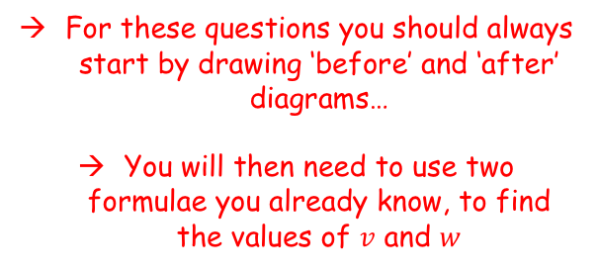



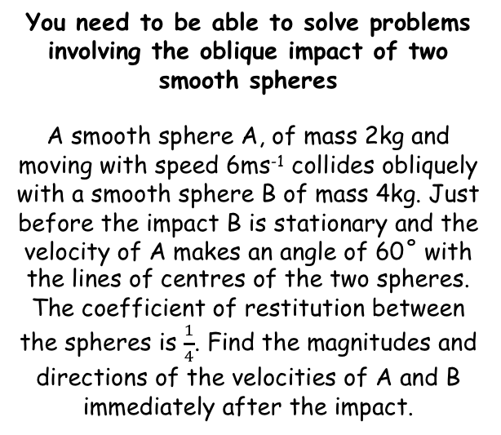










Elastic Collisions in two dimensions
$$m_{1}u_{1}+m_{2}u_{2}=m_{1}v_{1}+m_{2}v_{2}$$
$$e=\frac{speed of separation of particles}{speed of approach of particles}$$
You need to be able to solve problems involving the oblique impact of two smooth spheres
A smooth sphere A, of mass 2kg and moving with speed 6ms⁻¹ collides obliquely with a smooth sphere B of mass 4kg. Just before the impact B is stationary and the velocity of A makes an angle of 60˚ with the lines of centres of the two spheres. The coefficient of restitution between the spheres is $\frac{1}{4}$. Find the magnitudes and directions of the velocities of A and B immediately after the impact.
Before
After
$$6sin60$$
A
B
A
B
$$6cos60$$
$$v$$
$$w$$
$${60}^{°}$$
$$2kg$$
$$4kg$$
$$2kg$$
$$4kg$$
$$6sin60$$
$$6 {ms}^{−1}$$
$$3=v+2w$$
You only need to consider the parallel velocities here
The reason is that the perpendicular component is identical in both situations for both particles, so it would be cancelled out if we put it into the equations anyway!
$$m_{1}u_{1}+m_{2}u_{2}=m_{1}v_{1}+m_{2}v_{2}$$
Sub in values
For these questions you should always start by drawing ‘before’ and ‘after’ diagrams…
You will then need to use two formulae you already know, to find the values of $v$ and $w$
$$\left(2\right)\left(6cos60\right)+0=\left(2\right)\left(v\right)+(4)(w)$$
Simplify
$$12cos60=2v+4w$$
Cos60 = 0.5
$$6=2v+4w$$
Divide by 2
$$3=v+2w$$
5C

Slide 3





Elastic Collisions in two dimensions
$$m_{1}u_{1}+m_{2}u_{2}=m_{1}v_{1}+m_{2}v_{2}$$
$$e=\frac{speed of separation of particles}{speed of approach of particles}$$
You need to be able to solve problems involving the oblique impact of two smooth spheres
A smooth sphere A, of mass 2kg and moving with speed 6ms⁻¹ collides obliquely with a smooth sphere B of mass 4kg. Just before the impact B is stationary and the velocity of A makes an angle of 60˚ with the lines of centres of the two spheres. The coefficient of restitution between the spheres is $\frac{1}{4}$. Find the magnitudes and directions of the velocities of A and B immediately after the impact.
Before
After
$$6sin60$$
A
B
A
B
$$6cos60$$
$$v$$
$$w$$
$${60}^{°}$$
$$2kg$$
$$4kg$$
$$2kg$$
$$4kg$$
$$6sin60$$
$$6 {ms}^{−1}$$
$$3=v+2w$$
$$3=4w−4v$$
$$e=\frac{speed of separation of particles}{speed of approach of particles}$$
Sub in values (consider directions if needed)
$$\frac{1}{4}=\frac{w−v}{6cos60}$$
Cross-multiply
$$6cos60=4w−4v$$
Cos60 = 0.5
$$3=4w−4v$$
5C

Slide 4








Elastic Collisions in two dimensions
$$m_{1}u_{1}+m_{2}u_{2}=m_{1}v_{1}+m_{2}v_{2}$$
$$e=\frac{speed of separation of particles}{speed of approach of particles}$$
You need to be able to solve problems involving the oblique impact of two smooth spheres
A smooth sphere A, of mass 2kg and moving with speed 6ms⁻¹ collides obliquely with a smooth sphere B of mass 4kg. Just before the impact B is stationary and the velocity of A makes an angle of 60˚ with the lines of centres of the two spheres. The coefficient of restitution between the spheres is $\frac{1}{4}$. Find the magnitudes and directions of the velocities of A and B immediately after the impact.
Before
After
$$6sin60$$
A
B
A
B
$$6cos60$$
$$0.5$$
$$1.2$$
$$v$$
$$w$$
$${60}^{°}$$
$$2kg$$
$$4kg$$
$$2kg$$
$$4kg$$
$$6sin60$$
$$6 {ms}^{−1}$$
$$3=v+2w$$
$$3=4w−4v$$
x 2
1
$$3=v+2w$$
$$6=2v+4w$$
2
$$3=4w−4v$$
1 - 2
$$3=6v$$
Solve
$$0.5=v$$
Use to find $w$
$$1.2=w$$
5C

Slide 5
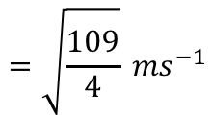
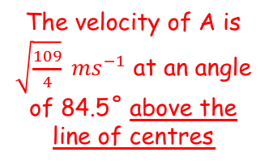






Elastic Collisions in two dimensions
$$m_{1}u_{1}+m_{2}u_{2}=m_{1}v_{1}+m_{2}v_{2}$$
$$e=\frac{speed of separation of particles}{speed of approach of particles}$$
You need to be able to solve problems involving the oblique impact of two smooth spheres
A smooth sphere A, of mass 2kg and moving with speed 6ms⁻¹ collides obliquely with a smooth sphere B of mass 4kg. Just before the impact B is stationary and the velocity of A makes an angle of 60˚ with the lines of centres of the two spheres. The coefficient of restitution between the spheres is $\frac{1}{4}$. Find the magnitudes and directions of the velocities of A and B immediately after the impact.
Before
After
$$6sin60$$
A
B
A
B
$$6cos60$$
$$0.5$$
$$1.2$$
$${60}^{°}$$
$$2kg$$
$$4kg$$
$$2kg$$
$$4kg$$
$$6sin60$$
$$6 {ms}^{−1}$$
Velocity of sphere A after impact
$$6sin60$$
$$6sin60$$
You need to find the resultant of the parallel and perpendicular components
$$θ$$
$$0.5$$
$$tanθ=\frac{6sin60}{0.5}$$
The velocity of A is $\sqrt{\frac{109}{4}} {ms}^{−1}$ at an angle of 84.5˚ above the line of centres
$$\sqrt{{\left(0.5\right)}^{2}+{\left(6sin60\right)}^{2}}$$
$$=\sqrt{\frac{109}{4}} {ms}^{−1}$$
$$θ=84.5^{°}$$
5C

Slide 6
Elastic Collisions in two dimensions
$$m_{1}u_{1}+m_{2}u_{2}=m_{1}v_{1}+m_{2}v_{2}$$
$$e=\frac{speed of separation of particles}{speed of approach of particles}$$
You need to be able to solve problems involving the oblique impact of two smooth spheres
A smooth sphere A, of mass 2kg and moving with speed 6ms⁻¹ collides obliquely with a smooth sphere B of mass 4kg. Just before the impact B is stationary and the velocity of A makes an angle of 60˚ with the lines of centres of the two spheres. The coefficient of restitution between the spheres is $\frac{1}{4}$. Find the magnitudes and directions of the velocities of A and B immediately after the impact.
Before
After
$$6sin60$$
A
B
A
B
$$6cos60$$
$$0.5$$
$$1.2$$
$${60}^{°}$$
$$2kg$$
$$4kg$$
$$2kg$$
$$4kg$$
$$6sin60$$
$$6 {ms}^{−1}$$
Velocity of sphere B after impact
→ Sphere B will be travelling at 1.2ms⁻¹ along the line of centres
5C

Slide 7





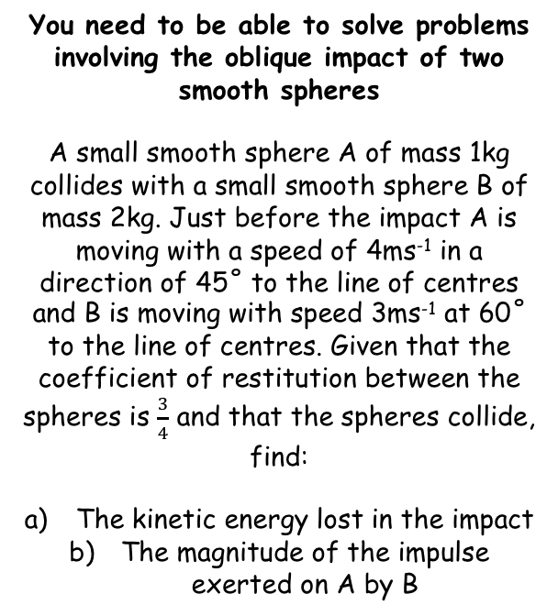







Elastic Collisions in two dimensions
$$m_{1}u_{1}+m_{2}u_{2}=m_{1}v_{1}+m_{2}v_{2}$$
$$e=\frac{speed of separation of particles}{speed of approach of particles}$$
You need to be able to solve problems involving the oblique impact of two smooth spheres
A small smooth sphere A of mass 1kg collides with a small smooth sphere B of mass 2kg. Just before the impact A is moving with a speed of 4ms⁻¹ in a direction of 45˚ to the line of centres and B is moving with speed 3ms⁻¹ at 60˚ to the line of centres. Given that the coefficient of restitution between the spheres is $\frac{3}{4}$ and that the spheres collide, find:
The kinetic energy lost in the impact
The magnitude of the impulse exerted on A by B
Before
After
$$4sin45$$
$$3sin60$$
A
B
A
B
$$4cos45$$
$$3cos60$$
$$v$$
$$w$$
$${45}^{°}$$
$${60}^{°}$$
$$4sin45$$
$$4 {ms}^{−1}$$
$$3 {ms}^{−1}$$
$$3sin60$$
$$2\sqrt{2}−3=v+2w$$
As before, consider the parallel velocities and conservation of momentum
$$m_{1}u_{1}+m_{2}u_{2}=m_{1}v_{1}+m_{2}v_{2}$$
Sub in values, being careful with the directions of the speeds
$$\left(1\right)\left(4cos45\right)+\left(2\right)\left(−3cos60\right)=\left(1\right)\left(v\right)+(2)(w)$$
Simplify, using exact trig values if possible!
$$2\sqrt{2}−3=v+2w$$
Since the spheres will collide, draw the diagram in such a way that this will happen (the spheres should be initially moving together, not apart)
5C

Slide 8





Elastic Collisions in two dimensions
$$m_{1}u_{1}+m_{2}u_{2}=m_{1}v_{1}+m_{2}v_{2}$$
$$e=\frac{speed of separation of particles}{speed of approach of particles}$$
You need to be able to solve problems involving the oblique impact of two smooth spheres
A small smooth sphere A of mass 1kg collides with a small smooth sphere B of mass 2kg. Just before the impact A is moving with a speed of 4ms⁻¹ in a direction of 45˚ to the line of centres and B is moving with speed 3ms⁻¹ at 60˚ to the line of centres. Given that the coefficient of restitution between the spheres is $\frac{3}{4}$ and that the spheres collide, find:
The kinetic energy lost in the impact
The magnitude of the impulse exerted on A by B
Before
After
$$4sin45$$
$$3sin60$$
A
B
A
B
$$4cos45$$
$$3cos60$$
$$v$$
$$w$$
$${45}^{°}$$
$${60}^{°}$$
$$4sin45$$
$$4 {ms}^{−1}$$
$$3 {ms}^{−1}$$
$$3sin60$$
$$2\sqrt{2}−3=v+2w$$
$$6\sqrt{2}+\frac{9}{2}=4w−4v$$
$$e=\frac{speed of separation}{speed of approach}$$
Sub in values – be careful with signs here (see methods in chapter 4 for a reminder!)
$$\frac{3}{4}=\frac{w−v}{4cos45+3cos60}$$
Cross multiply
$$3\left(4cos45+3cos60\right)=4w−4v$$
Use trig ratios to simplify if possible!
$$6\sqrt{2}+\frac{9}{2}=4w−4v$$
5C

Slide 9









Elastic Collisions in two dimensions
$$m_{1}u_{1}+m_{2}u_{2}=m_{1}v_{1}+m_{2}v_{2}$$
$$e=\frac{speed of separation of particles}{speed of approach of particles}$$
You need to be able to solve problems involving the oblique impact of two smooth spheres
A small smooth sphere A of mass 1kg collides with a small smooth sphere B of mass 2kg. Just before the impact A is moving with a speed of 4ms⁻¹ in a direction of 45˚ to the line of centres and B is moving with speed 3ms⁻¹ at 60˚ to the line of centres. Given that the coefficient of restitution between the spheres is $\frac{3}{4}$ and that the spheres collide, find:
The kinetic energy lost in the impact
The magnitude of the impulse exerted on A by B
Before
After
$$4sin45$$
$$3sin60$$
A
B
A
B
$$4cos45$$
$$3cos60$$
$$v$$
$$w$$
$${45}^{°}$$
$${60}^{°}$$
$$4sin45$$
$$4 {ms}^{−1}$$
$$3 {ms}^{−1}$$
$$3sin60$$
$$2\sqrt{2}−3=v+2w$$
$$6\sqrt{2}+\frac{9}{2}=4w−4v$$
x 2
1
$$2\sqrt{2}−3=v+2w$$
$$4\sqrt{2}−6=2v+4w$$
$$6\sqrt{2}+\frac{9}{2}=4w−4v$$
2
$$−2\sqrt{2}−\frac{21}{2}=6v$$
1 - 2
Divide by 6, then use this answer to find $w$
$$−\frac{\sqrt{2}}{3}−\frac{7}{4}=v$$
$$(−2.2214)$$
$$v=−\frac{\sqrt{2}}{3}−\frac{7}{4}$$
$$w=\frac{7\sqrt{2}}{6}−\frac{5}{8}$$
→ If you get an answer with surds, it is a good idea to check the actual value so you know what the direction will be (in this case the direction has been reversed)
5C

Slide 10



Elastic Collisions in two dimensions
$$m_{1}u_{1}+m_{2}u_{2}=m_{1}v_{1}+m_{2}v_{2}$$
$$e=\frac{speed of separation of particles}{speed of approach of particles}$$
You need to be able to solve problems involving the oblique impact of two smooth spheres
A small smooth sphere A of mass 1kg collides with a small smooth sphere B of mass 2kg. Just before the impact A is moving with a speed of 4ms⁻¹ in a direction of 45˚ to the line of centres and B is moving with speed 3ms⁻¹ at 60˚ to the line of centres. Given that the coefficient of restitution between the spheres is $\frac{3}{4}$ and that the spheres collide, find:
The kinetic energy lost in the impact
The magnitude of the impulse exerted on A by B
Before
After
$$4sin45$$
$$3sin60$$
A
B
A
B
$$4cos45$$
$$3cos60$$
$$v$$
$$w$$
$${45}^{°}$$
$${60}^{°}$$
$$4sin45$$
$$4 {ms}^{−1}$$
$$3 {ms}^{−1}$$
$$3sin60$$
$$2\sqrt{2}−3=v+2w$$
$$6\sqrt{2}+\frac{9}{2}=4w−4v$$
Comparing Kinetic Energies
$$KE before=17J$$
Since the only change in velocities has been in the parallel direction, we can compare these to find the loss in kinetic energy
$$KE before=\frac{1}{2}m_{1}u_{1}^{2}+\frac{1}{2}m_{2}u_{2}^{2}$$
Sub in values
$$KE before=\frac{1}{2}(1){\left(4cos45\right)}^{2} +\frac{1}{2}(2){\left(−3cos60\right)}^{2}$$
Calculate
$$v=−\frac{\sqrt{2}}{3}−\frac{7}{4}$$
$$w=\frac{7\sqrt{2}}{6}−\frac{5}{8}$$
$$KE before=17J$$
5C

Slide 11




Elastic Collisions in two dimensions
$$m_{1}u_{1}+m_{2}u_{2}=m_{1}v_{1}+m_{2}v_{2}$$
$$e=\frac{speed of separation of particles}{speed of approach of particles}$$
You need to be able to solve problems involving the oblique impact of two smooth spheres
A small smooth sphere A of mass 1kg collides with a small smooth sphere B of mass 2kg. Just before the impact A is moving with a speed of 4ms⁻¹ in a direction of 45˚ to the line of centres and B is moving with speed 3ms⁻¹ at 60˚ to the line of centres. Given that the coefficient of restitution between the spheres is $\frac{3}{4}$ and that the spheres collide, find:
The kinetic energy lost in the impact
The magnitude of the impulse exerted on A by B
Before
After
$$4sin45$$
$$3sin60$$
A
B
A
B
$$4cos45$$
$$3cos60$$
$$v$$
$$w$$
$${45}^{°}$$
$${60}^{°}$$
$$4sin45$$
$$4 {ms}^{−1}$$
$$3 {ms}^{−1}$$
$$3sin60$$
$$2\sqrt{2}−3=v+2w$$
$$6\sqrt{2}+\frac{9}{2}=4w−4v$$
Comparing Kinetic Energies
$$KE before=17J$$
Since the only change in velocities has been in the parallel direction, we can compare these to find the loss in kinetic energy
$$KE after=\frac{1}{2}m_{1}v_{1}^{2}+\frac{1}{2}m_{2}v_{2}^{2}$$
Sub in values
$$KE after=\frac{1}{2}(1){\left(−\frac{\sqrt{2}}{3}−\frac{7}{4}\right)}^{2} +\frac{1}{2}(2){\left(\frac{7\sqrt{2}}{6}−\frac{5}{8}\right)}^{2}$$
Calculate
$$v=−\frac{\sqrt{2}}{3}−\frac{7}{4}$$
$$w=\frac{7\sqrt{2}}{6}−\frac{5}{8}$$
$$KE after=14.267…$$
Find the difference
$$KE lost=17−14.267=2.73J$$
5C

Slide 12





Elastic Collisions in two dimensions
$$m_{1}u_{1}+m_{2}u_{2}=m_{1}v_{1}+m_{2}v_{2}$$
$$e=\frac{speed of separation of particles}{speed of approach of particles}$$
You need to be able to solve problems involving the oblique impact of two smooth spheres
A small smooth sphere A of mass 1kg collides with a small smooth sphere B of mass 2kg. Just before the impact A is moving with a speed of 4ms⁻¹ in a direction of 45˚ to the line of centres and B is moving with speed 3ms⁻¹ at 60˚ to the line of centres. Given that the coefficient of restitution between the spheres is $\frac{3}{4}$ and that the spheres collide, find:
The kinetic energy lost in the impact
The magnitude of the impulse exerted on A by B
Before
After
$$4sin45$$
$$3sin60$$
A
B
A
B
$$4cos45$$
$$3cos60$$
$$v$$
$$w$$
$${45}^{°}$$
$${60}^{°}$$
$$4sin45$$
$$4 {ms}^{−1}$$
$$3 {ms}^{−1}$$
$$3sin60$$
$$2\sqrt{2}−3=v+2w$$
$$6\sqrt{2}+\frac{9}{2}=4w−4v$$
$$Impulse=change in momentum$$
Write the formula for this
$$Impulse=mv−mu$$
$$2.73J$$
Sub in values for sphere B
$$Impulse=(2)\left(\frac{7\sqrt{2}}{6}−\frac{5}{8}\right)−(2)\left(−3cos60\right)$$
Calculate
$$Impulse=5.05Ns$$
$$v=−\frac{\sqrt{2}}{3}−\frac{7}{4}$$
$$w=\frac{7\sqrt{2}}{6}−\frac{5}{8}$$
5C

Slide 13






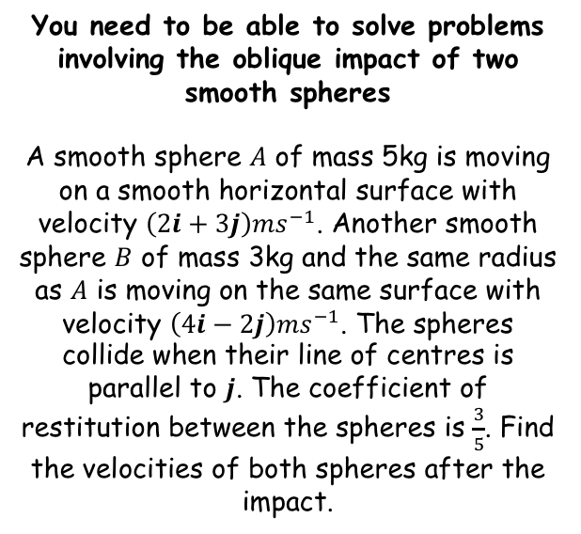








Elastic Collisions in two dimensions
$$m_{1}u_{1}+m_{2}u_{2}=m_{1}v_{1}+m_{2}v_{2}$$
$$e=\frac{speed of separation of particles}{speed of approach of particles}$$
$$4i−2j$$
$$2j$$
B
B
$$vj$$
You need to be able to solve problems involving the oblique impact of two smooth spheres
A smooth sphere $A$ of mass 5kg is moving on a smooth horizontal surface with velocity ${\left(2i+3j\right)ms}^{−1}$. Another smooth sphere $B$ of mass 3kg and the same radius as $A$ is moving on the same surface with velocity ${\left(4i−2j\right)ms}^{−1}$. The spheres collide when their line of centres is parallel to $j$. The coefficient of restitution between the spheres is $\frac{3}{5}$. Find the velocities of both spheres after the impact.
$$4i$$
$$4i$$
Before
A
After
A
$$wj$$
$$2i+3j$$
$$2i$$
$$3j$$
$$2i$$
$$5w+3v=9$$
The velocity perpendicular to the line of centres remains constant…
Conservation of momentum parallel to the line of centres
$$m_{1}u_{1}+m_{2}u_{2}=m_{1}v_{1}+m_{2}v_{2}$$
Sub in values, be careful with negatives
Since the spheres will collide, draw the diagram in such a way that this will happen (the spheres should be initially moving together, not apart)
Note that the line of centres is vertical this time (read the question!)
$$(5)\left(3j\right) +(3)\left(−2j\right)=(5)(wj)+(3)(vj)$$
Add/group together
$$9j=\left(5w+3v\right)j$$
The coefficient of $j$ must be the same on each side
$$5w+3v=9$$
5C

Slide 14








Elastic Collisions in two dimensions
$$m_{1}u_{1}+m_{2}u_{2}=m_{1}v_{1}+m_{2}v_{2}$$
$$e=\frac{speed of separation of particles}{speed of approach of particles}$$
$$4i−2j$$
$$2j$$
B
B
$$vj$$
You need to be able to solve problems involving the oblique impact of two smooth spheres
A smooth sphere $A$ of mass 5kg is moving on a smooth horizontal surface with velocity ${\left(2i+3j\right)ms}^{−1}$. Another smooth sphere $B$ of mass 3kg and the same radius as $A$ is moving on the same surface with velocity ${\left(4i−2j\right)ms}^{−1}$. The spheres collide when their line of centres is parallel to $j$. The coefficient of restitution between the spheres is $\frac{3}{5}$. Find the velocities of both spheres after the impact.
$$4i$$
$$4i$$
Before
A
After
A
$$wj$$
$$2i+3j$$
$$2i$$
$$3j$$
$$2i$$
$$5w+3v=9$$
$$v−w=3$$
$$e=\frac{speed of separation}{speed of approach}$$
Sub in values, considering directions carefully
$$\frac{3}{5}=\frac{vj−wj}{2j+3j}$$
Cross-multiply
$$6j+9j=5vj−5wj$$
Group terms on the left side
$$15j=5vj−5wj$$
Divide by 5
$$3j=vj−wj$$
The coefficient of $j$ on each side must be the same
$$3=v−w$$
5C

Slide 15








Elastic Collisions in two dimensions
$$m_{1}u_{1}+m_{2}u_{2}=m_{1}v_{1}+m_{2}v_{2}$$
$$e=\frac{speed of separation of particles}{speed of approach of particles}$$
$$4i−2j$$
$$vj$$
$$2j$$
B
B
$$3j$$
You need to be able to solve problems involving the oblique impact of two smooth spheres
A smooth sphere $A$ of mass 5kg is moving on a smooth horizontal surface with velocity ${\left(2i+3j\right)ms}^{−1}$. Another smooth sphere $B$ of mass 3kg and the same radius as $A$ is moving on the same surface with velocity ${\left(4i−2j\right)ms}^{−1}$. The spheres collide when their line of centres is parallel to $j$. The coefficient of restitution between the spheres is $\frac{3}{5}$. Find the velocities of both spheres after the impact.
$$4i$$
$$4i$$
Before
A
After
A
$$wj$$
$$2i+3j$$
$$2i$$
$$3j$$
$$2i$$
$$5w+3v=9$$
$$v−w=3$$
$$5w+3v=9$$
2
1
x 3
$$v−w=3$$
$$3v−3w=9$$
2 - 1
$$8w=0$$
Divide by 8
$$w=0$$
Use this to find $v$
$$v=3$$
5C

Slide 16


Elastic Collisions in two dimensions
$$m_{1}u_{1}+m_{2}u_{2}=m_{1}v_{1}+m_{2}v_{2}$$
$$e=\frac{speed of separation of particles}{speed of approach of particles}$$
$$4i−2j$$
$$2j$$
B
B
$$3j$$
You need to be able to solve problems involving the oblique impact of two smooth spheres
A smooth sphere $A$ of mass 5kg is moving on a smooth horizontal surface with velocity ${\left(2i+3j\right)ms}^{−1}$. Another smooth sphere $B$ of mass 3kg and the same radius as $A$ is moving on the same surface with velocity ${\left(4i−2j\right)ms}^{−1}$. The spheres collide when their line of centres is parallel to $j$. The coefficient of restitution between the spheres is $\frac{3}{5}$. Find the velocities of both spheres after the impact.
$$4i$$
$$4i$$
Before
A
After
A
$$2i+3j$$
$$2i$$
$$3j$$
$$2i$$
$$5w+3v=9$$
$$v−w=3$$
The velocity of $A$ is $2i ms^{−1}$
The velocity of $B$ is $(4i+3j) ms^{−1}$
5C

Slide 17




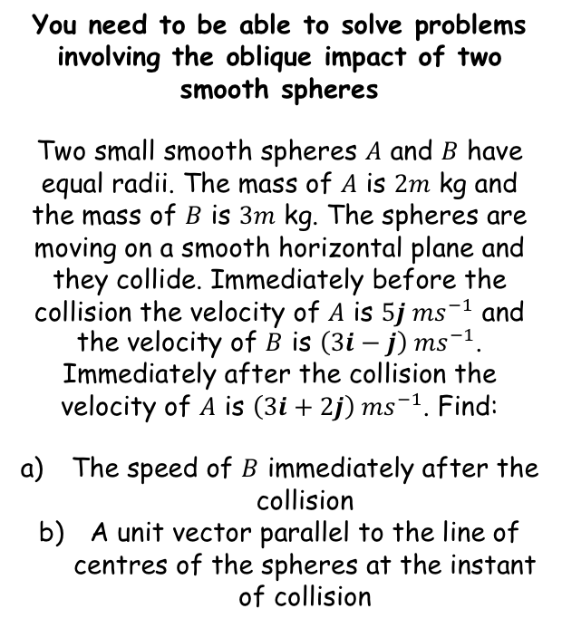






Elastic Collisions in two dimensions
$$m_{1}u_{1}+m_{2}u_{2}=m_{1}v_{1}+m_{2}v_{2}$$
$$e=\frac{speed of separation of particles}{speed of approach of particles}$$
You need to be able to solve problems involving the oblique impact of two smooth spheres
Two small smooth spheres $A$ and $B$ have equal radii. The mass of $A$ is $2m$ kg and the mass of $B$ is $3m$ kg. The spheres are moving on a smooth horizontal plane and they collide. Immediately before the collision the velocity of $A$ is $5j {ms}^{−1}$ and the velocity of $B$ is $\left(3i−j\right) {ms}^{−1}$. Immediately after the collision the velocity of $A$ is $\left(3i+2j\right) {ms}^{−1}$. Find:
The speed of $B$ immediately after the collision
A unit vector parallel to the line of centres of the spheres at the instant of collision
Sometimes when using vectors, drawing a diagram can be quite awkward. As velocities given as vectors have already been resolved, you can just use the formulae above with vectors in!
$$m_{1}u_{1}+m_{2}u_{2}=m_{1}v_{1}+m_{2}v_{2}$$
Sub in values
$$(2m)(5j) +(3m)(3i−j)=(2m)(3i+2j) +(3m)v_{2}$$
Simplify
$$9mi+7mj=6mi+4mj+3mv_{2}$$
Divide by $m$
$$9i+7j=6i+4j+3v_{2}$$
Subtract $6i$ and $4j$
$$3i+3j=3v_{2}$$
$$\sqrt{2} {ms}^{−1}$$
Divide by 3
$$i+j=v_{2}$$
$$\left|v_{2}\right|=\sqrt{{(1)}^{2}+{(1)}^{2}}$$
Calculate
$$\left|v_{2}\right|=\sqrt{2} {ms}^{−1}$$
5C

Slide 18




Elastic Collisions in two dimensions
$$m_{1}u_{1}+m_{2}u_{2}=m_{1}v_{1}+m_{2}v_{2}$$
$$e=\frac{speed of separation of particles}{speed of approach of particles}$$
A
B
You need to be able to solve problems involving the oblique impact of two smooth spheres
Two small smooth spheres $A$ and $B$ have equal radii. The mass of $A$ is $2m$ kg and the mass of $B$ is $3m$ kg. The spheres are moving on a smooth horizontal plane and they collide. Immediately before the collision the velocity of $A$ is $5j {ms}^{−1}$ and the velocity of $B$ is $\left(3i−j\right) {ms}^{−1}$. Immediately after the collision the velocity of $A$ is $\left(3i+2j\right) {ms}^{−1}$. Find:
The speed of $B$ immediately after the collision
A unit vector parallel to the line of centres of the spheres at the instant of collision
I
I
Line of centres
Remember that the impulse acts along the line of centres
So if we can find a vector for the impulse, we can find the direction of the line of centres
Remember that impulse is equal to change in momentum…
Impulse on A
$$\sqrt{2} {ms}^{−1}$$
$$I=mv−mu$$
Sub in values
$$I=(2m)(3i+2j)−(2m)(5j)$$
Calculate
$$I=6mi−6mj$$
Simplify
$$I=6m(i−j)$$
So the line of centres is in the direction $(i−j)$
5C

Slide 19

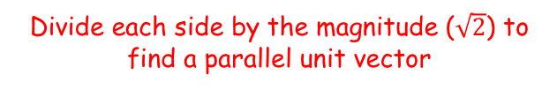





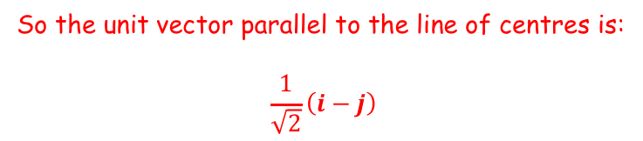
Elastic Collisions in two dimensions
$$m_{1}u_{1}+m_{2}u_{2}=m_{1}v_{1}+m_{2}v_{2}$$
$$e=\frac{speed of separation of particles}{speed of approach of particles}$$
You need to be able to solve problems involving the oblique impact of two smooth spheres
Two small smooth spheres $A$ and $B$ have equal radii. The mass of $A$ is $2m$ kg and the mass of $B$ is $3m$ kg. The spheres are moving on a smooth horizontal plane and they collide. Immediately before the collision the velocity of $A$ is $5j {ms}^{−1}$ and the velocity of $B$ is $\left(3i−j\right) {ms}^{−1}$. Immediately after the collision the velocity of $A$ is $\left(3i+2j\right) {ms}^{−1}$. Find:
The speed of $B$ immediately after the collision
A unit vector parallel to the line of centres of the spheres at the instant of collision
So the line of centres is in the direction $(i−j)$
$$\frac{1}{\sqrt{2}}i$$
$$i$$
$$j$$
$$\frac{1}{\sqrt{2}}j$$
$$\sqrt{2}$$
$$1$$
Divide each side by the magnitude ($\sqrt{2}$) to find a parallel unit vector
$$\sqrt{2} {ms}^{−1}$$
So the unit vector parallel to the line of centres is:
$$\frac{1}{\sqrt{2}}\left(i−j\right)$$
5C

Slide 20
Exercise 5C
Pearson Further Mechanics 1
Pages 99-101 questions 15 - 18
Complete before the lesson Q1-3
In Class:
Green Q4-7
Amber Q8-13
Red Q14- 16 & challenge

