Slide 1
Year 2 Pure Mathematics
Numerical Methods
- Modelling
Chapter 10
(Part 4 of 4)

Slide 2
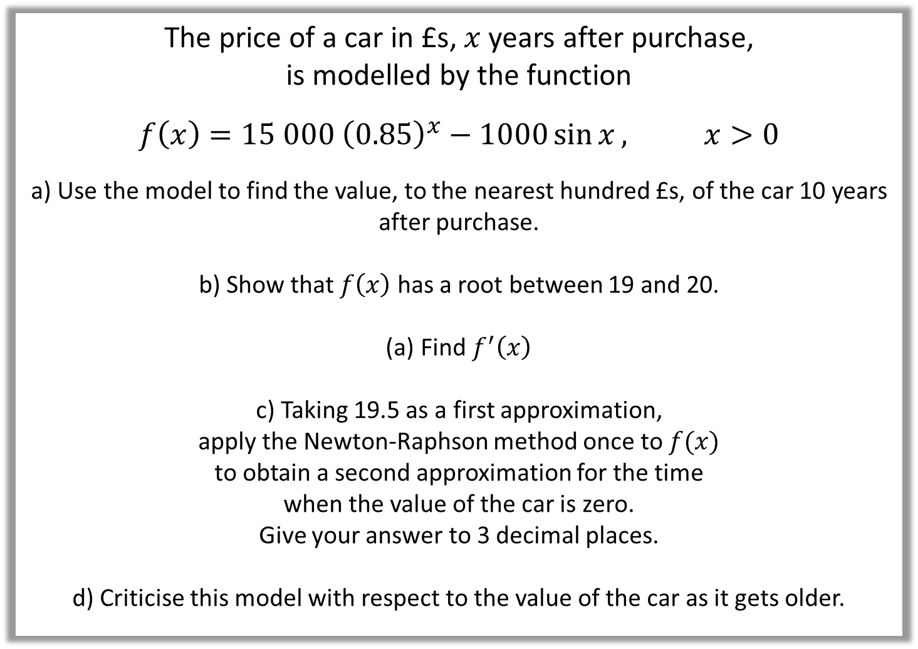
Modelling
The price of a car in £s, $x$ years after purchase,
is modelled by the function
$$f\left(x\right)=15 000 {\left(0.85\right)}^{x}−1000\sin{x}, x>0$$
a) Use the model to find the value, to the nearest hundred £s, of the car 10 years after purchase.
b) Show that $f\left(x\right)$ has a root between 19 and 20.
Find $f^{′}\left(x\right)$
c) Taking 19.5 as a first approximation,
apply the Newton-Raphson method once to $f(x)$
to obtain a second approximation for the time
when the value of the car is zero.
Give your answer to 3 decimal places.
d) Criticise this model with respect to the value of the car as it gets older.

Slide 3
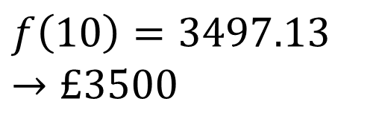
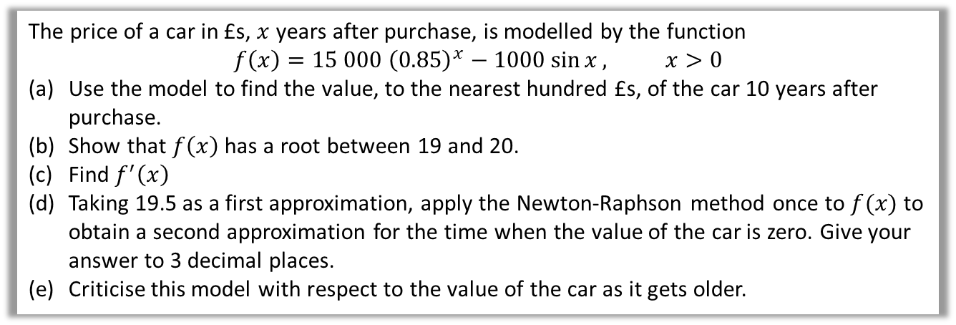
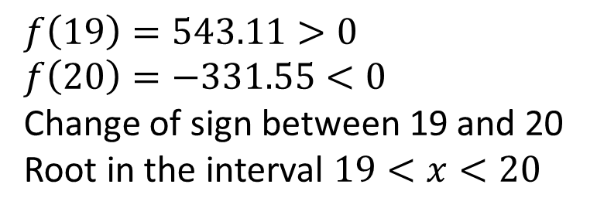
Modelling
The price of a car in £s, $x$ years after purchase, is modelled by the function
$$f\left(x\right)=15 000 {\left(0.85\right)}^{x}−1000\sin{x}, x>0$$
Use the model to find the value, to the nearest hundred £s, of the car 10 years after purchase.
Show that $f\left(x\right)$ has a root between 19 and 20.
Find $f^{′}\left(x\right)$
Taking 19.5 as a first approximation, apply the Newton-Raphson method once to $f(x)$ to obtain a second approximation for the time when the value of the car is zero. Give your answer to 3 decimal places.
Criticise this model with respect to the value of the car as it gets older.
a
b
$$f\left(10\right)=3497.13$$
$$→£3500$$
$$f\left(19\right)=543.11>0 \\ f\left(20\right)=−331.55<0$$
Change of sign between 19 and 20
Root in the interval $19<x<20$

Slide 4
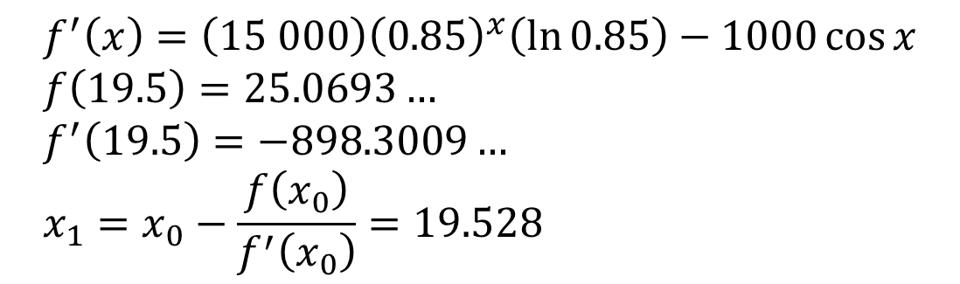
Modelling
The price of a car in £s, $x$ years after purchase, is modelled by the function
$$f\left(x\right)=15 000 {\left(0.85\right)}^{x}−1000\sin{x}, x>0$$
Use the model to find the value, to the nearest hundred £s, of the car 10 years after purchase.
Show that $f\left(x\right)$ has a root between 19 and 20.
Find $f^{′}\left(x\right)$
Taking 19.5 as a first approximation, apply the Newton-Raphson method once to $f(x)$ to obtain a second approximation for the time when the value of the car is zero. Give your answer to 3 decimal places.
Criticise this model with respect to the value of the car as it gets older.
c
$$f^{′}\left(x\right)=\left(15 000\right){\left(0.85\right)}^{x}\left(\ln{0.85}\right)−1000\cos{x} \\ f\left(19.5\right)=25.0693… \\ f^{′}\left(19.5\right)=−898.3009… \\ x_{1}=x_{0}−\frac{f\left(x_{0}\right)}{f^{′}\left(x_{0}\right)}=19.528$$
d
In reality, the car can never have a negative value so this model is not reasonable for cars that are approximately 20 or more years old.

Slide 5
Exercise 10D
Pearson Pure Mathematics Year 2/AS
Pages 287-289
Complete before the lesson Q1-2
In Class:
Green Q3
Amber Q4
Red Q5

