Slide 1
Polar Coordinates
Twitter: @Owen134866
www.mathsfreeresourcelibrary.com

Slide 2
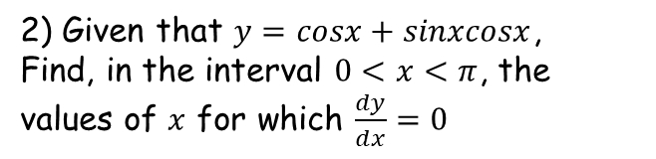

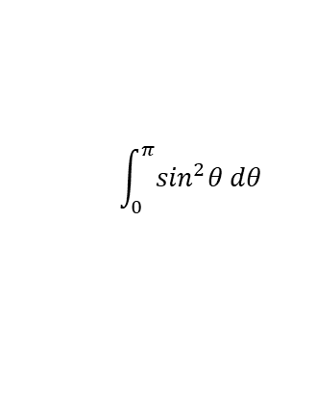


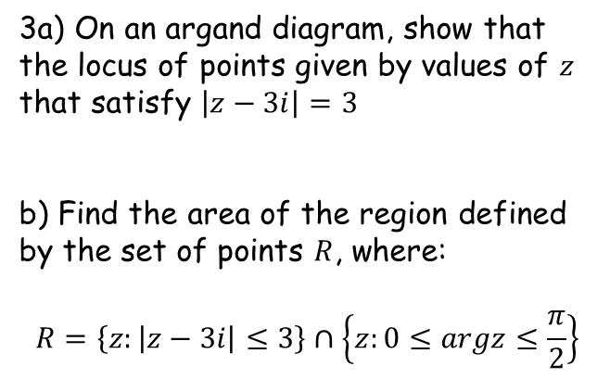
Prior Knowledge Check
1) Find the exact value of:
3a) On an argand diagram, show that the locus of points given by values of $z$ that satisfy $\left|z−3i\right|=3$
b) Find the area of the region defined by the set of points $R$, where:
$$R=\left\{z:\left|z−3i\right|≤3\right\}∩\left\{z:0≤argz≤\frac{π}{2}\right\}$$
$$\int_{0}^{π}{\sin^{2}θ dθ}$$
$$\frac{π}{2}$$
Circle, centre (0,3) radius 3
2) Given that $y=cosx+sinxcosx$,
Find, in the interval $0<x<π$, the values of $x$ for which $\frac{dy}{dx}=0$
$$\frac{9π}{2}$$
$$\frac{π}{6}, \frac{5π}{6}$$

Slide 3
Teachings for
Exercise 5A

Slide 4
Polar Coordinates
Cartesian coordinates – use horizontal and vertical position
You need to be able to use both Polar and Cartesian Coordinates
You will no doubt be very familiar with the Cartesian way of describing coordinates using x and y as the horizontal and vertical distances from the origin
Polar coordinates describe equivalent points, but in a different way
Polar coordinates use the distance from the origin, and the angle from the positive x-axis
(3,4)
4
4
3
1
(-4,-1)
Polar coordinates – use the distance and the angle
(5, 0.93)
5
0.93^{c}
3.39^{c}
You can use radians or degrees, but radians will be most commonly used in this chapter
→ You can also use negative equivalent values for the angles (being measured the opposite way)
4.2
(4.2, 3.39)
5A

Slide 5
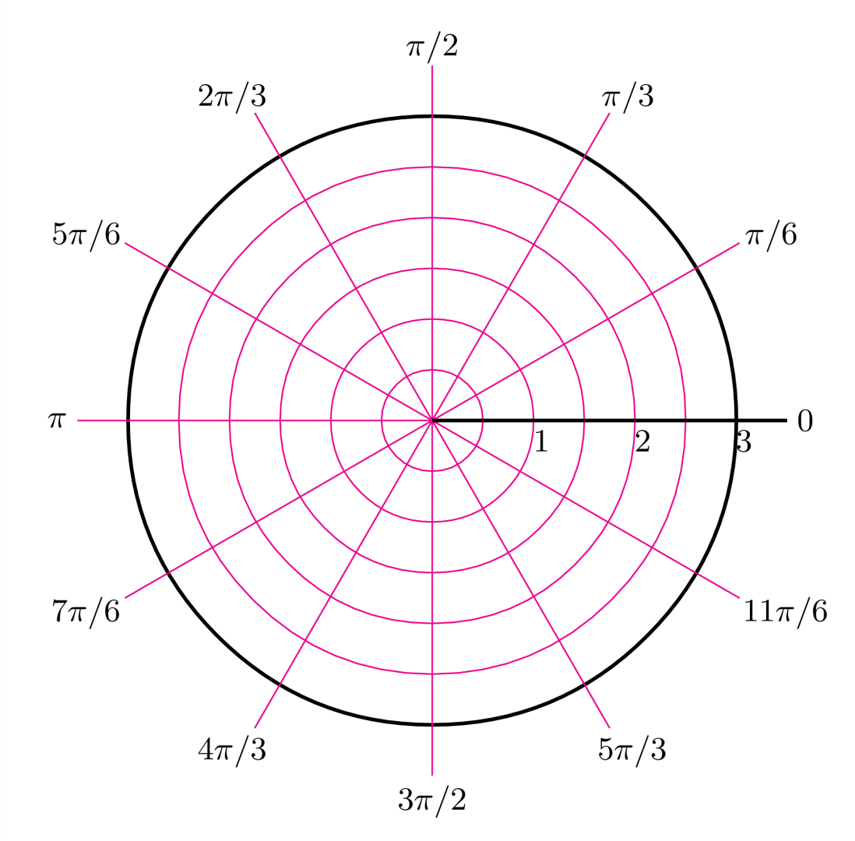
Polar Coordinates
You need to be able to use both Polar and Cartesian Coordinates
You will no doubt be very familiar with the Cartesian way of describing coordinates using x and y as the horizontal and vertical distances from the origin
Polar coordinates describe equivalent points, but in a different way
Polar coordinates use the distance from the origin, and the angle from the positive x-axis
You sometimes see Polar coordinates plotted on a Polar grid, but a Cartesian set of axes are fine as well!
5A

Slide 6













Polar Coordinates
$$y=rsinθ$$
$$x=rcosθ$$
$$r^{2}=x^{2}+y^{2}$$
$$θ=arctan\left(\frac{y}{x}\right)$$
You need to be able to use both Polar and Cartesian Coordinates
You need to know some simple formulae linking Cartesian and Polar coordinates
These come from using GCSE Trigonometry and Pythagoras…
(x,y)
Hyp
r
Opp
y
θ
x
Adj
$$Tanθ=\frac{Opp}{Adj}$$
$$Adj=cosθ×Hyp$$
Sub in Adj and Hyp
Sub in Opp and Adj
$$x=rcosθ$$
$$Tanθ=\frac{y}{x}$$
Tan⁻¹ (also known as arctan)
$$c^{2}=a^{2}+b^{2}$$
$$Opp=sinθ×Hyp$$
$$θ=arctan\left(\frac{y}{x}\right)$$
Sub in r, x and y
Sub in Opp and Hyp
$$r^{2}=x^{2}+y^{2}$$
$$y=rsinθ$$
5A

Slide 7





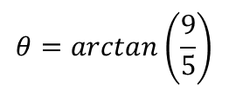



Polar Coordinates
$$y=rsinθ$$
$$x=rcosθ$$
$$r^{2}=x^{2}+y^{2}$$
$$θ=arctan\left(\frac{y}{x}\right)$$
(5,9)
Draw a diagram
You need to be able to use both Polar and Cartesian Coordinates
Find the Polar coordinates of the following point:
You need to find the values of r and θ
The Polar coordinate is then written as (r, θ)
r
9
θ
$$(5,9)$$
5
$$r^{2}=x^{2}+y^{2}$$
Sub in x and y
$$r^{2}=5^{2}+9^{2}$$
Calculate
$$r=10.3$$
Cartesian
Polar
$$θ=arctan\left(\frac{y}{x}\right)$$
$$(5,9)$$
$$(10.3, 60.9°)$$
Sub in x and y
$$θ=arctan\left(\frac{9}{5}\right)$$
Calculate in degrees or radians
$$θ=60.9°$$
5A

Slide 8

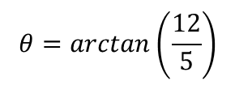







Polar Coordinates
$$y=rsinθ$$
$$x=rcosθ$$
$$r^{2}=x^{2}+y^{2}$$
$$θ=arctan\left(\frac{y}{x}\right)$$
Draw a diagram
You need to be able to use both Polar and Cartesian Coordinates
Find the Polar coordinates of the following point:
You need to find the values of r and θ
The Polar coordinate is then written as (r, θ)
5
$$(5,−12)$$
θ
$$r^{2}=x^{2}+y^{2}$$
12
Sub in x and y
r
$$r^{2}=5^{2}+12^{2}$$
Calculate
$$r=13$$
(5,-12)
Cartesian
Polar
$$θ=arctan\left(\frac{y}{x}\right)$$
$$(5,−12)$$
$$(13, −67.4°)$$
Sub in x and y
$$θ=arctan\left(\frac{12}{5}\right)$$
Notice the angle is negative, as we have measured it the opposite way (clockwise)
Calculate in degrees or radians
$$θ=67.4°$$
5A

Slide 9
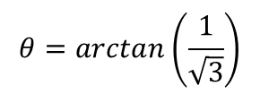








Polar Coordinates
$$y=rsinθ$$
$$x=rcosθ$$
$$r^{2}=x^{2}+y^{2}$$
$$θ=arctan\left(\frac{y}{x}\right)$$
Draw a diagram
You need to be able to use both Polar and Cartesian Coordinates
Find the Polar coordinates of the following point:
You need to find the values of r and θ
The Polar coordinate is then written as (r, θ)
√3
$$(−\sqrt{3},−1)$$
1
θ
r
(√3,-1)
$$r^{2}=x^{2}+y^{2}$$
$$θ=arctan\left(\frac{y}{x}\right)$$
Cartesian
Polar
Sub in x and y
$$\left(2,\frac{7π}{6}\right)$$
Sub in x and y
$$(−\sqrt{3},−1)$$
$$r^{2}={(\sqrt{3})}^{2}+1^{2}$$
$$θ=arctan\left(\frac{1}{\sqrt{3}}\right)$$
Calculate
Calculate in degrees or radians
$$r=2$$
Notice we added π to the angle, so it would be in the correct quadrant (^{π}/₆ on its own when measured clockwise would not be in the right place!)
$$θ=\frac{π}{6}$$
5A

Slide 10







Polar Coordinates
$$y=rsinθ$$
$$x=rcosθ$$
$$r^{2}=x^{2}+y^{2}$$
$$θ=arctan\left(\frac{y}{x}\right)$$
^{π}/₂
Draw a diagram
You need to be able to use both Polar and Cartesian Coordinates
Convert the following Polar coordinate into Cartesian form.
As usual draw a diagram, and think carefully about which quadrant this point is in
A half turn would be π, and a ³/₄ turn would be ^{3π}/₂, so this will be between those
The angle in the triangle will be ^{π}/₃, as π has been ‘used’ in the half-turn…
$$\left(10, \frac{4π}{3}\right)$$
5
π
^{π}/₃
0
5√3
10
(10,^{4π}/₃)
^{3π}/₂
$$x=rcosθ$$
$$y=rsinθ$$
Sub in values
Sub in values
$$x=10cos\left(\frac{π}{3}\right)$$
$$y=10sin\left(\frac{π}{3}\right)$$
Calculate
Calculate
$$x=5$$
$$y=5\sqrt{3}$$
So the Cartesian coordinate is (-5,-5√3) (remember to interpret whether values should be negative or positive from the diagram!)
5A

Slide 11





Polar Coordinates
$$y=rsinθ$$
$$x=rcosθ$$
$$r^{2}=x^{2}+y^{2}$$
$$θ=arctan\left(\frac{y}{x}\right)$$
(8,^{2π}/₃)
^{π}/₂
Draw a diagram
You need to be able to use both Polar and Cartesian Coordinates
Convert the following Polar coordinate into Cartesian form.
As usual draw a diagram, and think carefully about which quadrant this point is in
The angle in the triangle will be ^{π}/₃, calculated by subtracting ^{2π}/₃ from π
8
4√3
$$\left(8, \frac{2π}{3}\right)$$
^{π}/₃
π
0
4
^{3π}/₂
$$x=rcosθ$$
$$y=rsinθ$$
Sub in values
Sub in values
$$x=8cos\left(\frac{π}{3}\right)$$
$$y=8sin\left(\frac{π}{3}\right)$$
Calculate
Calculate
$$x=4$$
$$y=4\sqrt{3}$$
So the Cartesian coordinate is (-4,4√3) (remember to interpret whether values should be negative or positive from the diagram!)
5A

Slide 12



Polar Coordinates
$$θ=arctan\left(\frac{y}{x}\right)$$
$$r^{2}=x^{2}+y^{2}$$
$$y=rsinθ$$
$$x=rcosθ$$
You can switch between Polar and Cartesian equations of curves
You can convert between Cartesian equations of lines and Polar equations by using the relationships from the previous section (above)
Remember that a Cartesian equation of a line is telling you the relationship between the x and y values for the points on the line
A polar equation of a line is telling you the relationship between the distance from the origin, and the angle from the origin, of all the points on the line
5A

Slide 13




Polar Coordinates
$$θ=arctan\left(\frac{y}{x}\right)$$
$$r^{2}=x^{2}+y^{2}$$
$$y=rsinθ$$
$$x=rcosθ$$
You can switch between Polar and Cartesian equations of curves
Find a Cartesian equation of the following curve:
This process relies on creating some of the expressions above, in the equation you’re given
For example, if you can manipulate the equation to have ‘rsinθ’ in it, this can then be replaced with ‘y’
$$r=5$$
Square both sides
$$r^{2}=25$$
You can replace r² with an expression in x and y, from above
$$x^{2}+y^{2}=25$$
$$r=5$$
From your knowledge of equations, you should recognise this as a circle, centre (0,0) and radius 5
→ This makes sense as the Polar equation just states that the distance from the origin is 5, and doesn’t mention the angle
5A

Slide 14





Polar Coordinates
$$θ=arctan\left(\frac{y}{x}\right)$$
$$r^{2}=x^{2}+y^{2}$$
$$y=rsinθ$$
$$x=rcosθ$$
You can switch between Polar and Cartesian equations of curves
Find a Cartesian equation of the following curve:
Try to create one or more of the expressions above in the equation…
$$r=6cosecθ$$
Cosecθ = ¹/_{sinθ}
$$r=\frac{6}{sinθ}$$
Multiply by sinθ
$$r=6cosecθ$$
$$rsinθ=6$$
Replace rsinθ using an equation above
$$y=6$$
5A

Slide 15







Polar Coordinates
$$θ=arctan\left(\frac{y}{x}\right)$$
$$r^{2}=x^{2}+y^{2}$$
$$y=rsinθ$$
$$x=rcosθ$$
$$Cos2θ≡{2Cos}^{2}θ−1$$
You can switch between Polar and Cartesian equations of curves
Find a Cartesian equation of the following curve:
You will sometimes need to use the double angle formulae from the regular maths course, since our equations above only contain θ, rather than multiplies of it
$$Sin\left(A±B\right)≡SinACosB±CosASinB$$
$$Cos\left(A±B\right)≡CosACosB∓SinASinB$$
You get given these in the formula booklet, and they lead to the following:
$$r=2+cos2θ$$
$$Sin2θ≡2SinθCosθ$$
$${Cos}^{2}θ−{Sin}^{2}θ$$
Remember there are 3 possibilities for Cos2θ!
$$Cos2θ≡$$
$${2Cos}^{2}θ−1$$
$${1−2Sin}^{2}θ$$
You can use these to replace the 2θ in the expression with an expression using θ instead…
5A

Slide 16











Polar Coordinates
$$θ=arctan\left(\frac{y}{x}\right)$$
$$r^{2}=x^{2}+y^{2}$$
$$y=rsinθ$$
$$x=rcosθ$$
$$Cos2θ≡{2Cos}^{2}θ−1$$
You can switch between Polar and Cartesian equations of curves
Find a Cartesian equation of the following curve:
Replace the cos 2θ with an equivalent expression in θ
Find a way to replace r³
$$r=2+cos2θ$$
Replace cos2θ using the equation above
$$r=2+({2Cos}^{2}θ−1)$$
Simplify
$$r=1+{2Cos}^{2}θ$$
Multiply by r² (this will allow us to replace the trigonometric part)
$$r=2+cos2θ$$
$$r^{3}=r^{2}+{2r^{2}Cos}^{2}θ$$
Replace the r and cos terms with equivalents in x and y
$${\left(x^{2}+y^{2}\right)}^{\frac{3}{2}}=$$
$$x^{2}+y^{2}+$$
$$2x^{2}$$
Simplify
$${\left(x^{2}+y^{2}\right)}^{\frac{3}{2}}={3x}^{2}+y^{2}$$
$$r^{2}=x^{2}+y^{2}$$
$$r={\left(x^{2}+y^{2}\right)}^{\frac{1}{2}}$$
Square root
One of the key advantages of Polar equations is that they can explain very complicated Cartesian equations in a much simpler way!
Multiply both to find an expression for r³
$$r^{3}={\left(x^{2}+y^{2}\right)}^{\frac{3}{2}}$$
5A

Slide 17








Polar Coordinates
$$θ=arctan\left(\frac{y}{x}\right)$$
$$r^{2}=x^{2}+y^{2}$$
$$y=rsinθ$$
$$x=rcosθ$$
$$Sin2θ≡2sinθcosθ$$
You can switch between Polar and Cartesian equations of curves
Find a Cartesian equation of the following curve:
Sometimes you cannot just replace everything straight away!
Replacing r² immediately would still leave us with the trigonometric part…
$$r^{2}=Sin2θ$$
Replace sin2θ using a double angle formula
$$r^{2}=2sinθcosθ$$
Multiply by r²
$$r^{4}=2r^{2}sinθcosθ$$
Imagine rewriting each side (makes it easier to see the simplification)
$r^{2}=Sin2θ$, $0<θ<\frac{π}{2}$
$${\left(r^{2}\right)}^{2}=2rsinθrcosθ$$
Replace the r and trig terms with equivalents in x and y
$${\left(x^{2}+y^{2}\right)}^{2}=$$
$$2xy$$
5A

Slide 18
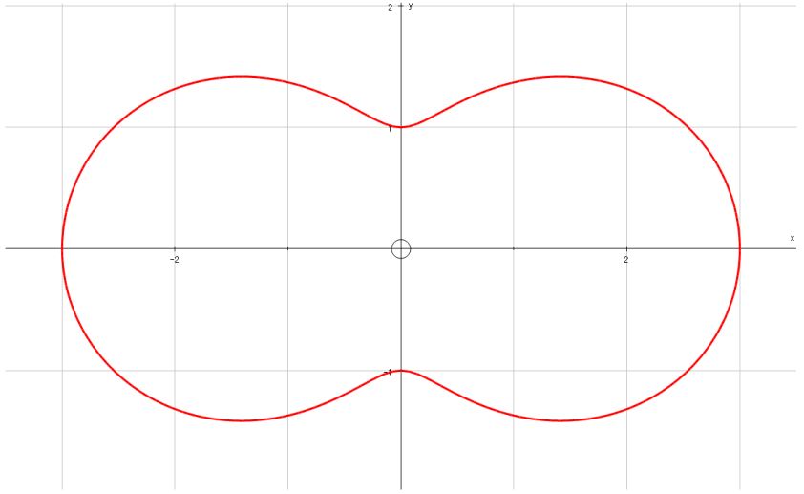
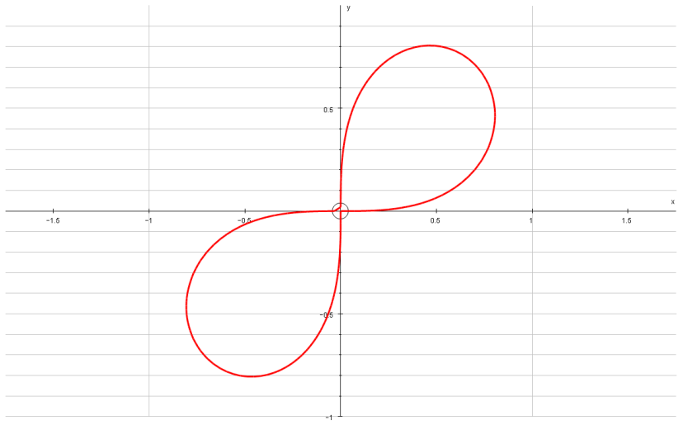



Polar Coordinates
$$θ=arctan\left(\frac{y}{x}\right)$$
$$r^{2}=x^{2}+y^{2}$$
$$y=rsinθ$$
$$x=rcosθ$$
$$Sin2θ≡2sinθcosθ$$
You can switch between Polar and Cartesian equations of curves
$${\left(x^{2}+y^{2}\right)}^{\frac{3}{2}}={3x}^{2}+y^{2}$$
$${\left(x^{2}+y^{2}\right)}^{2}=$$
$$2xy$$
5A

Slide 19







Polar Coordinates
$$θ=arctan\left(\frac{y}{x}\right)$$
$$r^{2}=x^{2}+y^{2}$$
$$y=rsinθ$$
$$x=rcosθ$$
You can switch between Polar and Cartesian equations of curves
Find a Polar equivalent for the following Cartesian equation:
Polar equations are usually written as ‘r = ‘ or ‘r² = ‘, so use the equations above to try and achieve this
$$y^{2}=4x$$
Replace y and x with equivalents
$$r^{2}\sin^{2}θ=4rcosθ$$
Divide by r
$$r\sin^{2}θ=4cosθ$$
$$r=\frac{4cosθ}{\sin^{2}θ}$$
Divide by sin²θ
$$y^{2}=4x$$
Imagine the fraction was split up
$$r=\frac{4cosθ}{sinθ}×\frac{1}{sinθ}$$
Both parts can be re-written
$$r=4cotθcosecθ$$
5A

Slide 20








Polar Coordinates
$$θ=arctan\left(\frac{y}{x}\right)$$
$$r^{2}=x^{2}+y^{2}$$
$$y=rsinθ$$
$$x=rcosθ$$
$$Cos2θ≡{Cos}^{2}θ−{Sin}^{2}θ$$
You can switch between Polar and Cartesian equations of curves
Find a Polar equivalent for the following Cartesian equation:
Polar equations are usually written as ‘r = ‘ or ‘r² = ‘, so use the equations above to try and achieve this
$$x^{2}−y^{2}=5$$
Replace x and y from above
$$r^{2}\cos^{2}θ−r^{2}\sin^{2}θ=5$$
Factorise
$$r^{2}\left(\cos^{2}θ−\sin^{2}θ\right)=5$$
The expression in brackets is one we saw earlier for cos2θ
$$x^{2}−y^{2}=5$$
$$r^{2}cos2θ=5$$
$$r^{2}=\frac{5}{cos2θ}$$
Divide by cos2θ
Rewrite
$$r^{2}=5sec2θ$$
5A

Slide 21










Polar Coordinates
$$θ=arctan\left(\frac{y}{x}\right)$$
$$r^{2}=x^{2}+y^{2}$$
$$y=rsinθ$$
$$x=rcosθ$$
You can switch between Polar and Cartesian equations of curves
Find a Polar equivalent for the following Cartesian equation:
Polar equations are usually written as ‘r = ‘ or ‘r² = ‘, so use the equations above to try and achieve this
This next step is tricky to spot, but it is possible to write the bracket using sine only
This again relies on the formulae from the regular Maths course
$$y\sqrt{3}=x+4$$
Replace x and y from above
$$r\sqrt{3}sinθ=rcosθ+4$$
Subtract rcosθ
$$r\sqrt{3}sinθ−rcosθ=4$$
Factorise the left side
$$y\sqrt{3}=x+4$$
$$r\left(\sqrt{3}sinθ−cosθ\right)=4$$
Divide both sides by 2 (do this inside the bracket rather than outside – the reason will become apparent in a moment…)
$$r\left(\frac{\sqrt{3}}{2}sinθ−\frac{1}{2}cosθ\right)=2$$
Replace the bracket with the expression we found
$$rsin\left(θ−\frac{π}{6}\right)=2$$
$$Sin\left(A−B\right)≡SinACosB−CosASinB$$
Let A = θ and B = ^{π}/₆
$$Sin\left(θ−\frac{π}{6}\right)≡SinθCos\frac{π}{6}−CosθSin\frac{π}{6}$$
$$Sin\left(θ−\frac{π}{6}\right)≡\frac{\sqrt{3}}{2}Sinθ−\frac{1}{2}Cosθ$$
Calculate the parts with ^{π}/₆
This is equivalent to the part in the brackets, so we can replace it!
5A

Slide 22

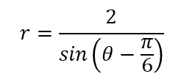
Polar Coordinates
$$θ=arctan\left(\frac{y}{x}\right)$$
$$r^{2}=x^{2}+y^{2}$$
$$y=rsinθ$$
$$x=rcosθ$$
You can switch between Polar and Cartesian equations of curves
Find a Polar equivalent for the following Cartesian equation:
Polar equations are usually written as ‘r = ‘ or ‘r² = ‘, so use the equations above to try and achieve this
This next step is tricky to spot, but it is possible to write the bracket using sine only
This again relies on the formulae from the regular Maths course
$$y\sqrt{3}=x+4$$
Replace x and y from above
$$r\sqrt{3}sinθ=rcosθ+4$$
Subtract rcosθ
$$r\sqrt{3}sinθ−rcosθ=4$$
Factorise the left side
$$y\sqrt{3}=x+4$$
$$r\left(\sqrt{3}sinθ−cosθ\right)=4$$
Divide both sides by 2 (do this inside the bracket rather than outside – the reason will become apparent in a moment…)
$$r\left(\frac{\sqrt{3}}{2}sinθ−\frac{1}{2}cosθ\right)=2$$
Replace the bracket with the expression we found
$$rsin\left(θ−\frac{π}{6}\right)=2$$
Divide by the expression in sine
$$r=\frac{2}{sin\left(θ−\frac{π}{6}\right)}$$
Rewrite
$$r=2cosec\left(θ−\frac{π}{6}\right)$$
5A

Slide 23

Polar Coordinates
$$θ=arctan\left(\frac{y}{x}\right)$$
$$r^{2}=x^{2}+y^{2}$$
$$y=rsinθ$$
$$x=rcosθ$$
You can switch between Polar and Cartesian equations of curves
$$r\left(\frac{\sqrt{3}}{2}sinθ−\frac{1}{2}cosθ\right)=2$$
An expression like this can be simplified in the way we just did
Both the numerical parts need to be able to be rewritten as sin and cos of the same angle (in the previous example, ^{π}/₆ gave us the answers we needed)
You can manipulate the expression to give values that work
If it is possible you need to consider whether it is an expansion of sin or cos, and also whether it is an addition or a subtraction…
5A

Slide 24
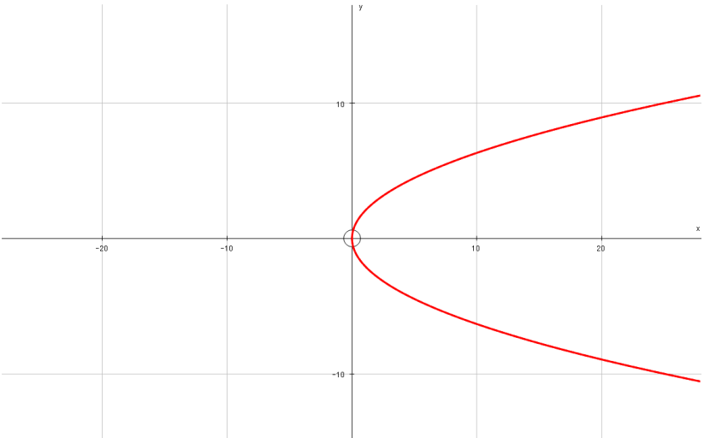
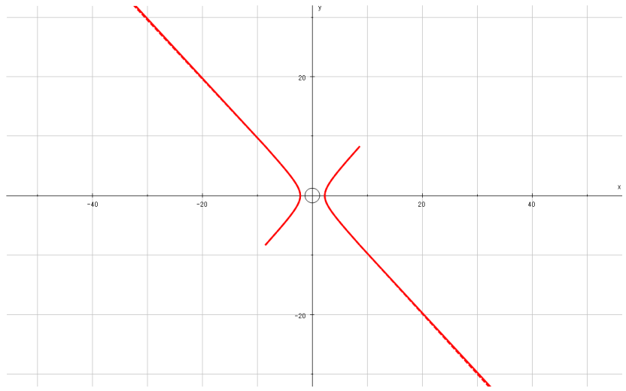
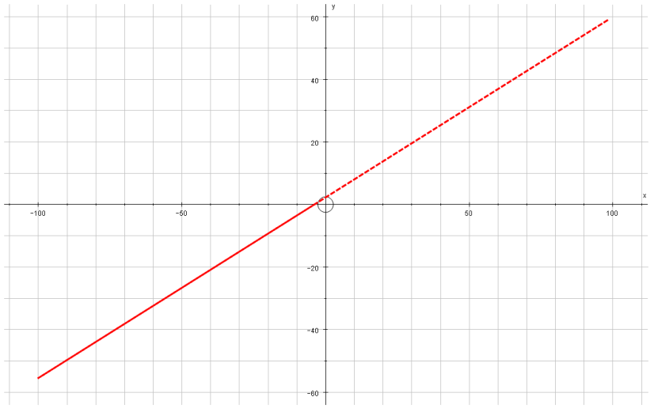



Polar Coordinates
$$θ=arctan\left(\frac{y}{x}\right)$$
$$r^{2}=x^{2}+y^{2}$$
$$y=rsinθ$$
$$x=rcosθ$$
You can switch between Polar and Cartesian equations of curves
$$r=4cotθcosecθ$$
$$r^{2}=5sec2θ$$
$$r=2cosec\left(θ−\frac{π}{6}\right)$$
5A

Slide 25
Exercise 5A
Pearson Core Pure Year 2
Page 104
Complete before the lesson Q1-2
In Class:
Green Q3
Amber Q4
Red Challenge

