Slide 1
Year 2 Pure Mathematics
Integration
- Trig Identities
Chapter 11
(Part 3 of 11)

Slide 2
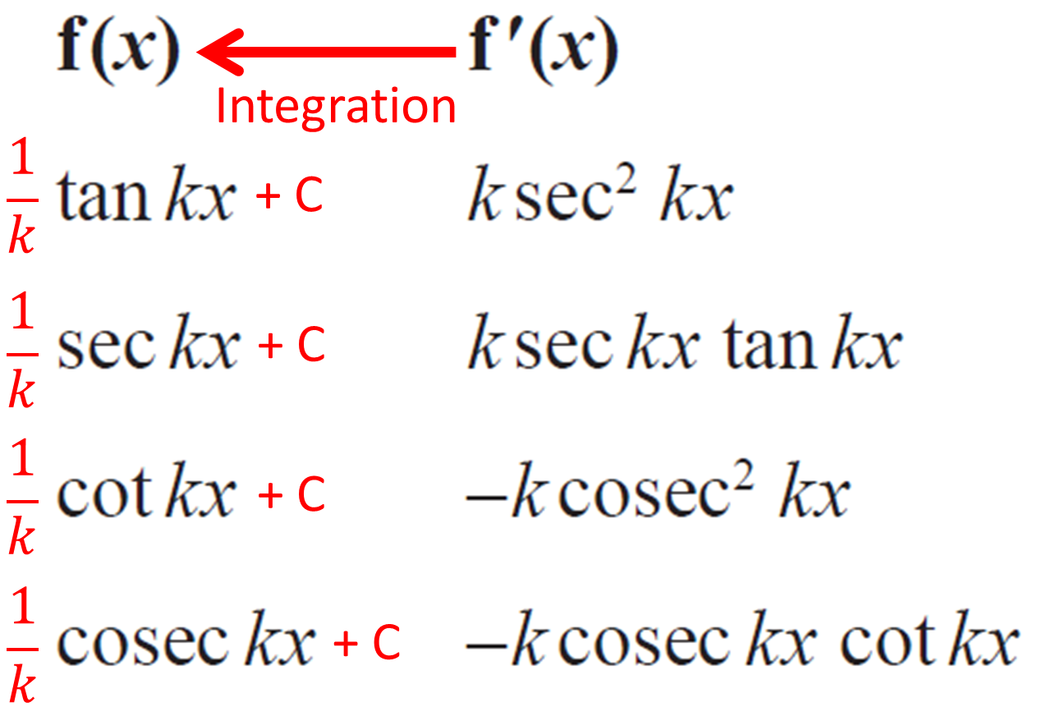
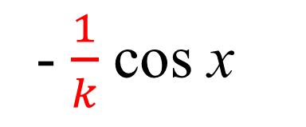
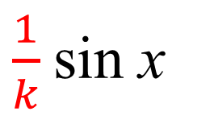
Integrating - Standard Functions
- $\frac{1}{k}$ cos x
sin kx
+ C
$\frac{1}{k}$sin x
cos kx
+ C

Slide 3
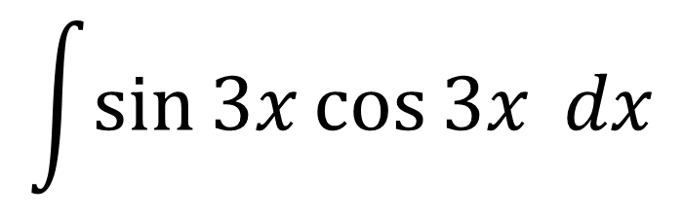
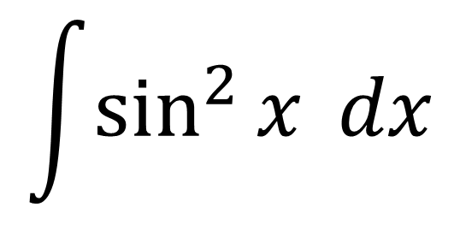
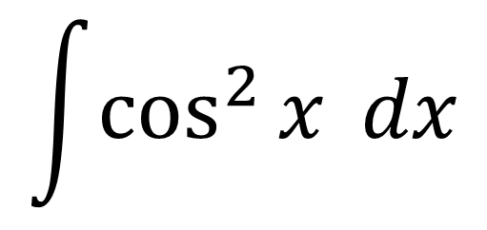
Integrating using Trig Identities
If it is not a standard trigonometric function as
$$\int{\sin^{2}{x} dx}$$
$$\int{\sin{3x}\cos{3x} dx}$$
$$\int{\cos^{2}{x} dx}$$
then you need to rewrite the questions so it is!

Slide 4
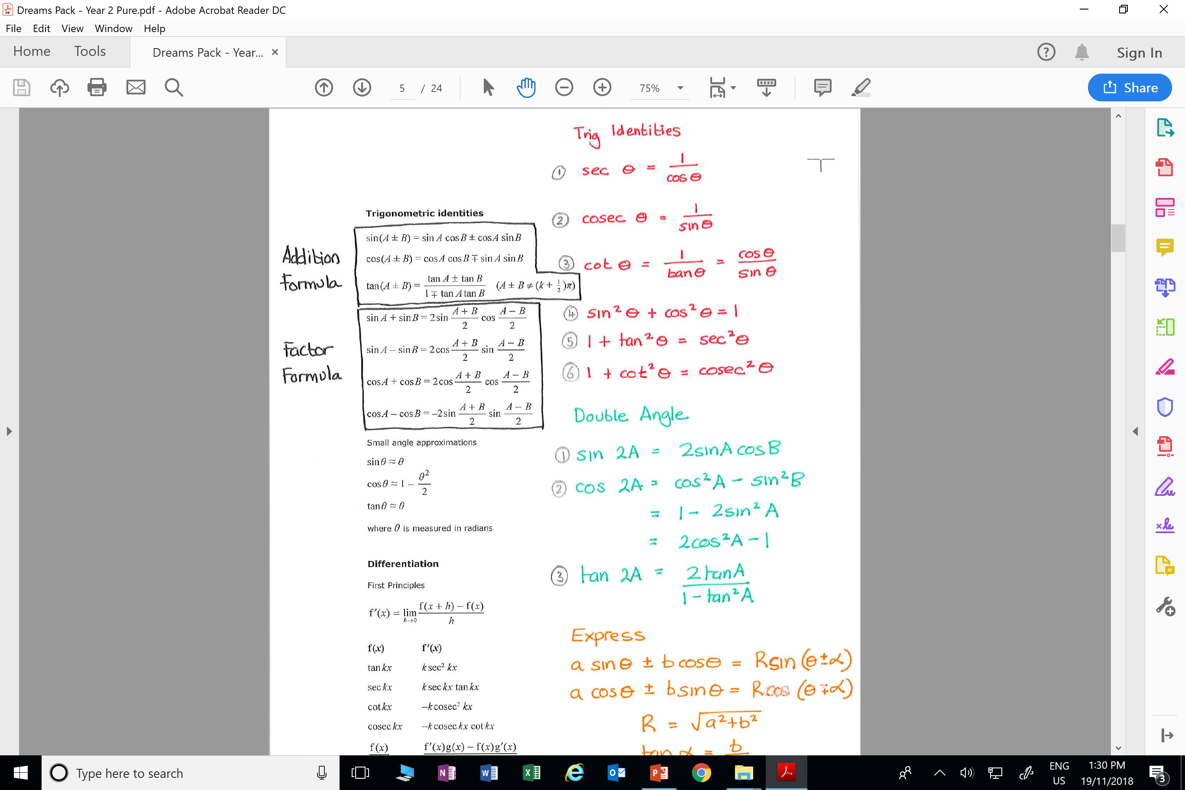
Integrating using Trig Identities

Slide 5
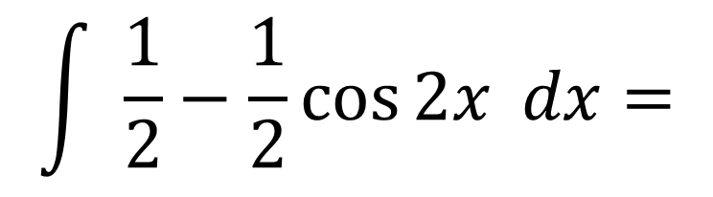

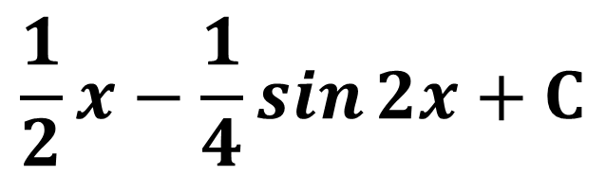
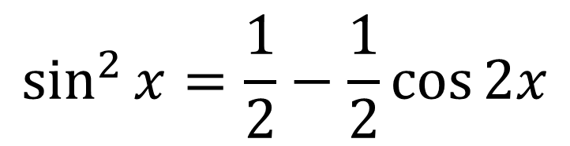
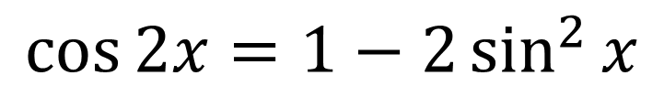
Integrating using Trig Identities – Example A
Find $\int{\sin^{2}{x} dx}$
Double Angle:
$$\cos{2x}=1−2\sin^{2}{x}$$
$$\sin^{2}{x}=\frac{1}{2}−\frac{1}{2}\cos{2x}$$
Make sin 2⁡𝑥 the
subject of the equation:
$$\int{ \frac{1}{2}−\frac{1}{2}\cos{2x} dx}=$$
$$\frac{1}{2}x−\frac{1}{4}\sin{2x}+C$$

Slide 6
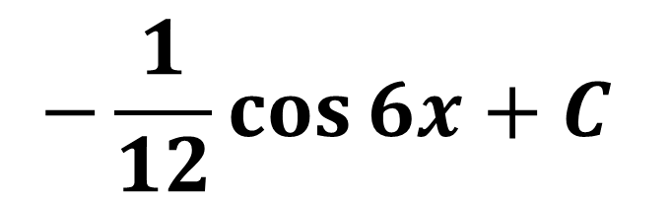

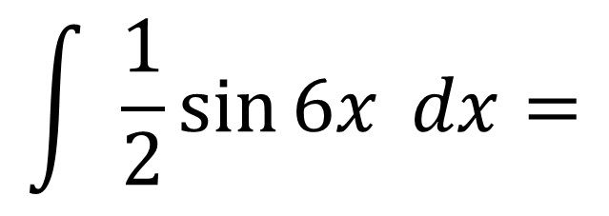
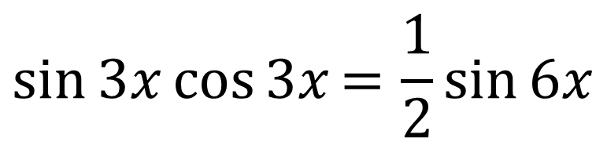
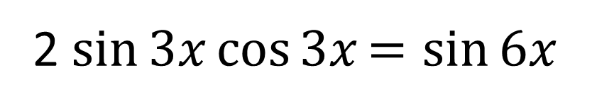
Integrating using Trig Identities– Example B
Find $\int{\sin{3x}\cos{3x} dx}$
Double Angle:
2 $\sin{3x}\cos{3x}=sin{6x }$
$$\sin{3x}\cos{3x}=\frac{1}{2}sin{6x }$$
Make sin 𝑥 cos 𝑥 the
subject of the equation:
$$\int{ \frac{1}{2}sin{6x }dx}=$$
$$−\frac{1}{12}\cos{6x}+C$$

Slide 7
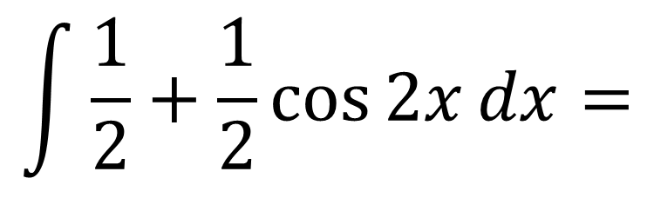
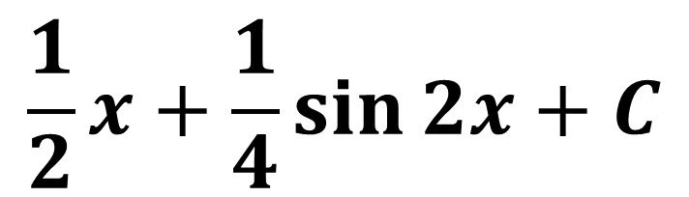

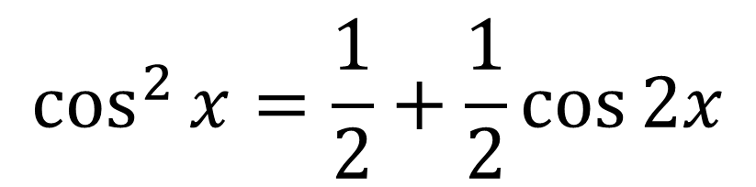

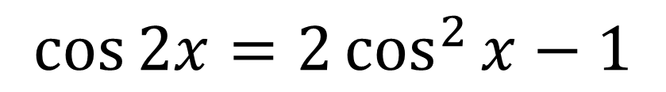
Integrating using Trig Identities – Example C
Find $\int{\cos^{2}{x} dx}$
$$\cos{2x}=2\cos^{2}{x}−1$$
Double Angle:
$$\cos^{2}{x}=\frac{1}{2}+\frac{1}{2}\cos{2x}$$
Make $\cos^{2}{x}$ the
subject of the equation:
$$\int{\frac{1}{2}+\frac{1}{2}\cos{2x}dx}=$$
$$\frac{1}{2}x+\frac{1}{4}\sin{2x+C}$$

Slide 8
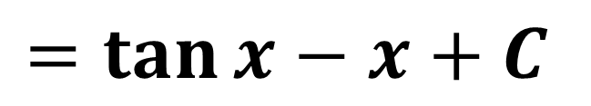
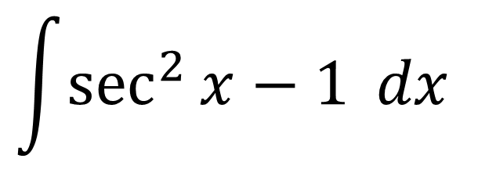

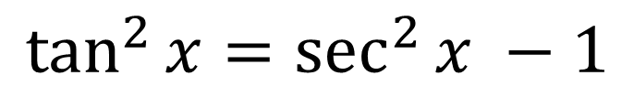
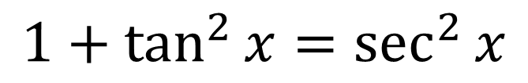

Integrating using Trig Identities – Example D
Find $\int{\tan^{2}{x} dx}$
Use the identity:
$$1+\tan^{2}{x}=\sec^{2}{x}$$
Make$\tan^{2}{x}$ the
subject of the equation:
$$\tan^{2}{x}=\sec^{2}{x} −1$$
$$\int{\sec^{2}{x}−1} dx$$
$$=\tan{x}−x+C$$

Slide 9
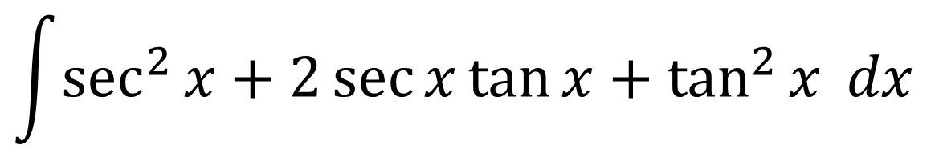

Integrating using Trig Identities – Example E
Find $\int{{\left(\sec{x}+\tan{x}\right)}^{2} dx}$
$$\int{\sec^{2}{x}+2\sec{x}\tan{x}+\tan^{2}{x} dx}$$
Expand:
$$=\tan{x}+2\sec{x}+\tan{x}−x+C$$
$$=2\tan{x}+2\sec{x}−x+C$$

Slide 10
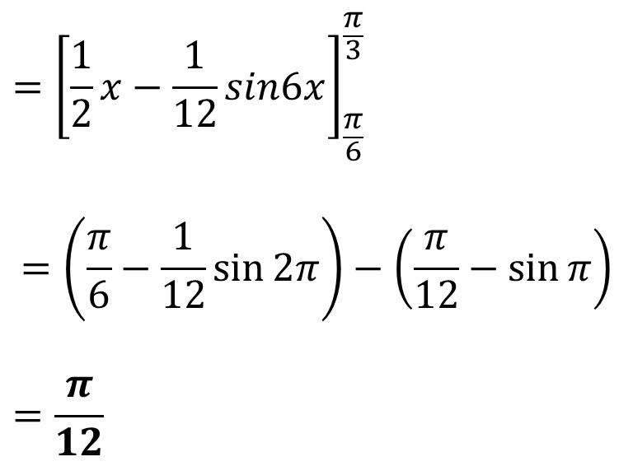
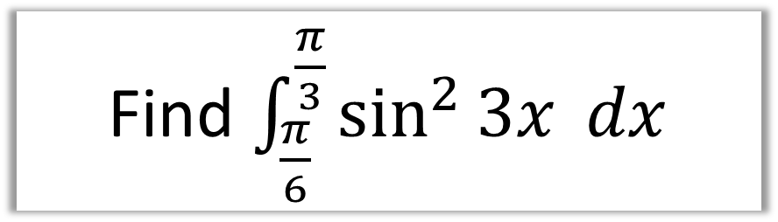
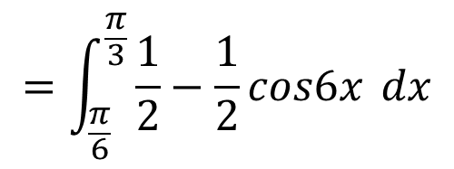
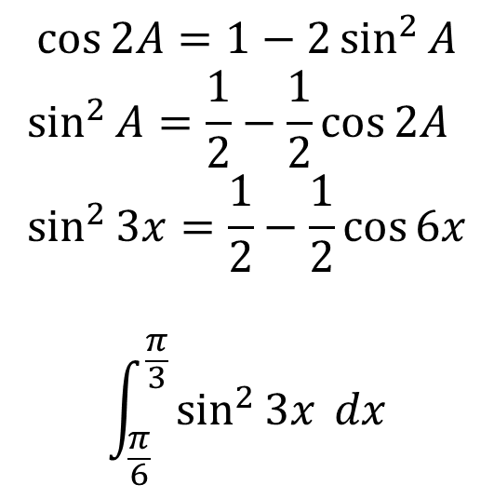
Integrating using Trig Identities – Example F
Find $\int_{\frac{π}{6}}^{\frac{π}{3}}{\sin^{2}{3x}} dx$
$$\cos{2A}=1−2\sin^{2}{A}$$
$$\sin^{2}{A}=\frac{1}{2}−\frac{1}{2}\cos{2A} \\ \sin^{2}{3x}=\frac{1}{2}−\frac{1}{2}\cos{6x}$$
$$\int_{\frac{π}{6}}^{\frac{π}{3}}{\sin^{2}{3x}} dx$$
$$={\left[\frac{1}{2}x−\frac{1}{12}sin6x\right]}_{\frac{π}{6}}^{\frac{π}{3}}$$
$$=\left(\frac{π}{6}−\frac{1}{12}\sin{2π}\right)−\left(\frac{π}{12}−\sin{π}\right)$$
$$=\frac{π}{12}$$
$$=\int_{\frac{π}{6}}^{\frac{π}{3}}{\frac{1}{2}−\frac{1}{2}cos6x} dx$$

Slide 11
Integrating using Trig Identities – Example F
Find $\int_{\frac{π}{6}}^{\frac{π}{3}}{\sin^{2}{3x}} dx$
$$\cos{2A}=1−2\sin^{2}{A}$$
$$\sin^{2}{A}=\frac{1}{2}−\frac{1}{2}\cos{2A} \\ \sin^{2}{3x}=\frac{1}{2}−\frac{1}{2}\cos{6x}$$
$$\int_{\frac{π}{6}}^{\frac{π}{3}}{\sin^{2}{3x}} dx$$
$$={\left[\frac{1}{2}x−\frac{1}{12}sin6x\right]}_{\frac{π}{6}}^{\frac{π}{3}}$$
$$=\left(\frac{π}{6}−\frac{1}{12}\sin{2π}\right)−\left(\frac{π}{12}−\sin{π}\right)$$
$$=\frac{π}{12}$$
$$=\int_{\frac{π}{6}}^{\frac{π}{3}}{\frac{1}{2}−\frac{1}{2}cos6x} dx$$

Slide 12
Exercise 11C
Pearson Pure Mathematics Year 2/AS
Page 300
Complete before the lesson Q1-2
In Class:
Green Q3
Amber Q4-5
Red Q6-7

