Slide 1

P2 Chapter 8 :: Parametric Equations
jfrost@tiffin.kingston.sch.uk
www.drfrostmaths.com
@DrFrostMaths
Last modified: 6th September 2018

Slide 2








www.drfrostmaths.com
Everything is completely free.
Why not register?
Register now to interactively practise questions on this topic, including past paper questions and extension questions (including MAT + UKMT).
Teachers: you can create student accounts (or students can register themselves), to set work, monitor progress and even create worksheets.
With questions by:
Dashboard with points, trophies, notifications and student progress.
Questions organised by topic, difficulty and past paper.
Teaching videos with topic tests to check understanding.

Slide 3
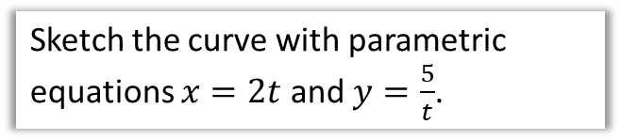
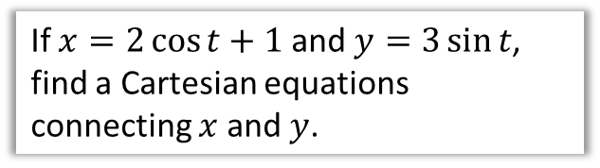
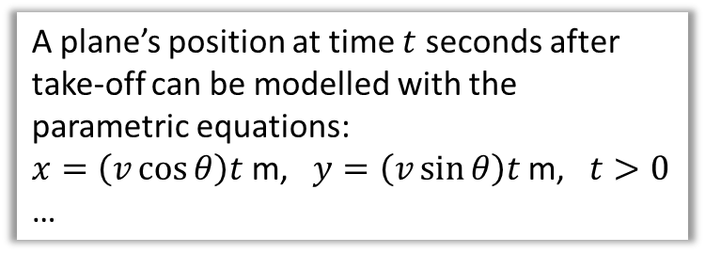
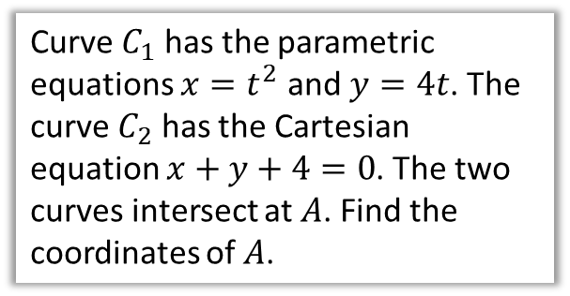
Chapter Overview
This chapter is very similar to the trigonometry chapters in Year 1. The only difference is that new trig functions: $sec, cosec$ and $cot$, are introduced.
1:: Converting from parametric to Cartesian form.
2:: Sketching parametric curves.
Sketch the curve with parametric equations $x=2t$ and $y=\frac{5}{t}$.
If $x=2\cos{t}+1$ and $y=3\sin{t}$, find a Cartesian equations connecting $x$ and $y$.
3:: Finding points of intersection.
4:: Modelling
Curve $C_{1}$ has the parametric equations $x=t^{2}$ and $y=4t$. The curve $C_{2}$ has the Cartesian equation $x+y+4=0$. The two curves intersect at $A$. Find the coordinates of $A$.
A plane’s position at time $t$ seconds after take-off can be modelled with the parametric equations:
$x=\left(v\cos{θ}\right)t$ m, $y=\left(v\sin{θ}\right)t$ m, $t>0$
…
Teacher Note: There is no change in this chapter relative to the old pre-2017 syllabus.

Slide 4
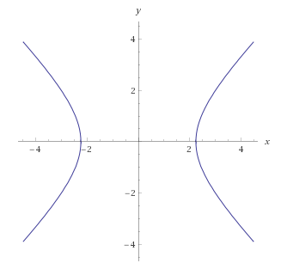
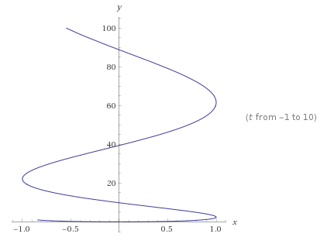


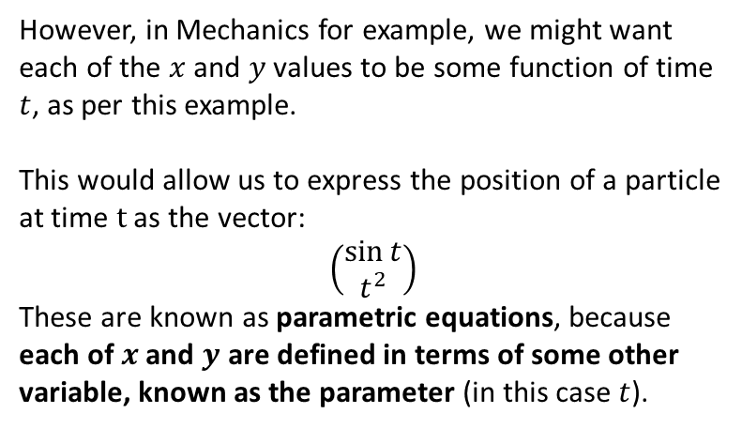

What are they and what is the point?
$$x^{2}−y^{2}=5$$
Typically, with two variables $x$ and $y$, we can relate the two by a single equation involving just $x$ and $y$.
This is known as a Cartesian equation.
The line shows all points $\left(x,y\right)$ which satisfy the Cartesian equation.
$$x=\sin\left(t\right) \\ y=t^{2}$$
However, in Mechanics for example, we might want each of the $x$ and $y$ values to be some function of time $t$, as per this example.
This would allow us to express the position of a particle at time $t$ as the vector:
$$\left(\begin{matrix}\sin{t} \\ t^{2}\end{matrix}\right)$$
These are known as parametric equations, because each of $x$ and $y$ are defined in terms of some other variable, known as the parameter (in this case $t$).

Slide 5

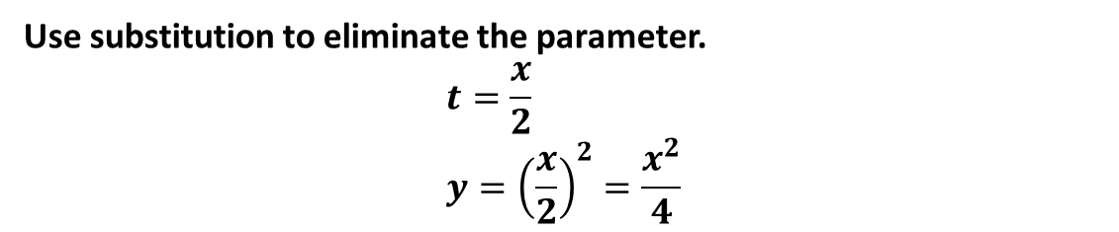




Converting parametric to Cartesian
How could we convert these parametric equations into a single Cartesian one?
$$x=2t, y=t^{2}, −3<t<3$$
?
Use substitution to eliminate the parameter.
$$t=\frac{x}{2} \\ y={\left(\frac{x}{2}\right)}^{2}=\frac{x^{2}}{4}$$
What is the domain of the function?
! If $x=p(t)$ and $y=q(t)$ can be written as $y=f\left(x\right)$, then the domain of $f$ is the range of $p$...
?
If $−3<t<3$ then $−6<x<6$.
Use $x=2t$ for each of the bounds.
! and the range of $f$ is the range of $q$.
?
If $−3<t<3$ then $0≤y<9$.
This one is harder. ${\left(−3\right)}^{2}=9$ and $3^{2}=9$.
However, the minimum value is clearly $0^{2}=0$.

Slide 6

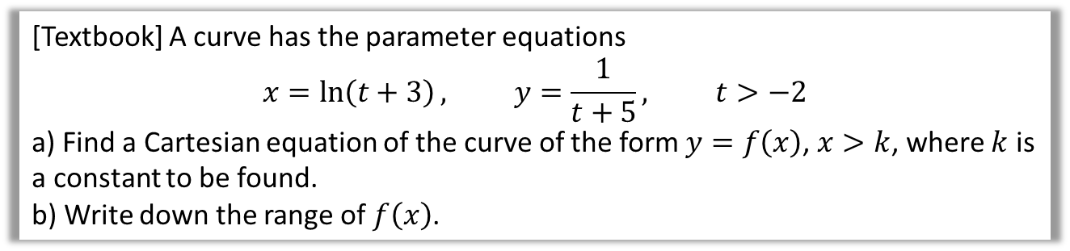

Further Example
[Textbook] A curve has the parameter equations
$$x=\ln\left(t+3\right), y=\frac{1}{t+5}, t>−2$$
a) Find a Cartesian equation of the curve of the form $y=f\left(x\right)$, $x>k$, where $k$ is a constant to be found.
b) Write down the range of $f\left(x\right)$.
? a
$$x=\ln\left(t+3\right) \\ e^{x}=t+3 \\ e^{x}−3=t \\ ∴y=\frac{1}{e^{x}−3+5}=\frac{1}{e^{x}+2}$$
When $t=−2$, $x=\ln\left(−2+3\right)=\ln\left(1\right)=0$
As $t$ increases, $\ln\left(t+3\right)$ increases, therefore $x>0$.
$∴k=0$
b) When $t=−2, y=\frac{1}{−2+5}=\frac{1}{3}$
As $t$ increases, $\frac{1}{t+5}$ decreases, therefore $y<\frac{1}{3}$
A common strategy for domain/range questions is to consider what happens are the boundary value (in this case -2), then since $t>−2$, consider what happens as $t$ increases.
? b

Slide 7
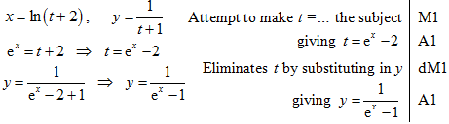
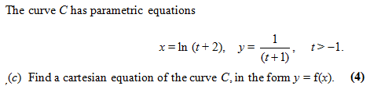
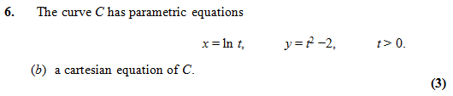

Test Your Understanding
Edexcel C4 Jan 2008 Q7
?
Edexcel C4 Jan 2011
?
$$t=e^{x} \\ y={\left(e^{x}\right)}^{2}−2 \\ =e^{2x}−2$$

Slide 8
Exercise 8A
Pearson Pure Mathematics Year 2/AS
Pages 200-202
Complete before the lesson Q1-2
In Class:
Green Q4
Amber Q3&5
Red Q6-9 & Challenge

Slide 9

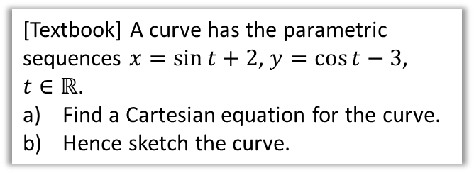





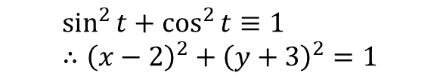
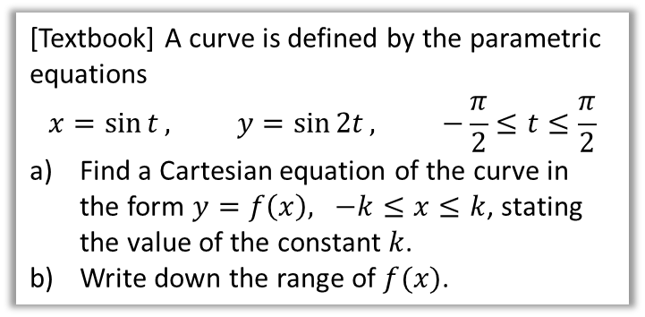
…when you have trig identities
It’s often helpful to use $\sin^{2}{t}+\cos^{2}{t}≡1$ or $1+\tan^{2}{t}≡\sec^{2}{t}$ to turn parametric equations into a single Cartesian one.
[Textbook] A curve has the parametric sequences $x=\sin{t}+2$, $y=\cos{t}−3$, $t∈ℝ$.
Find a Cartesian equation for the curve.
Hence sketch the curve.
[Textbook] A curve is defined by the parametric equations
$$x=\sin{t}, y=\sin{2t}, −\frac{π}{2}≤t≤\frac{π}{2}$$
Find a Cartesian equation of the curve in the form $y=f\left(x\right), −k≤x≤k$, stating the value of the constant $k$.
Write down the range of $f(x)$.
?
$$\sin^{2}{t}+\cos^{2}{t}≡1 \\ ∴{\left(x−2\right)}^{2}+{\left(y+3\right)}^{2}=1$$
a
$$y=2\sin{t}\cos{t} \\ =2\sin{t} \sqrt{1−\sin^{2}{t}} \\ =2x\sqrt{1−x^{2}}$$
When $t=−\frac{π}{2}$,
$x=\sin\left(−\frac{π}{2}\right)=−1$.
When $t=\frac{π}{2}, x=\sin\left(\frac{π}{2}\right)=1$
$$∴k=1$$
$\sin\left(2t\right)$ varies between -1 and 1 when $−\frac{π}{2}≤t≤\frac{π}{2}$, therefore range is $−1≤y≤1$.
?
$$y$$
If we have $\cos{t}$, we need to turn in into $\sin{t}$ so that we can replace it with $x$. It’s quite common to have to interchange between $\sin{t}$ and $\cos{t}$ in this way. You may find it helpful to write out the identity $\sin^{2}{t}+\cos^{2}{t}=1$ first.
$$x$$
$$(2,−3)$$
$$1$$
b
?

Slide 10
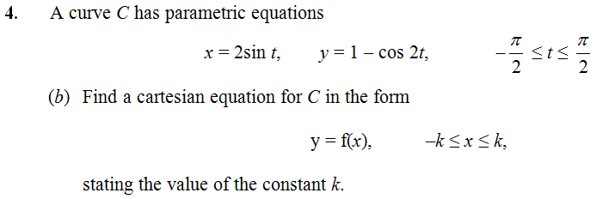




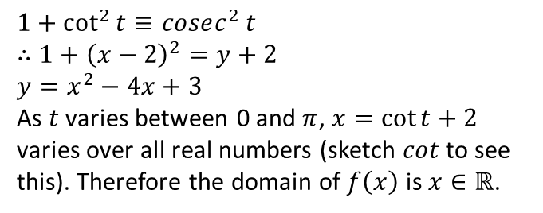
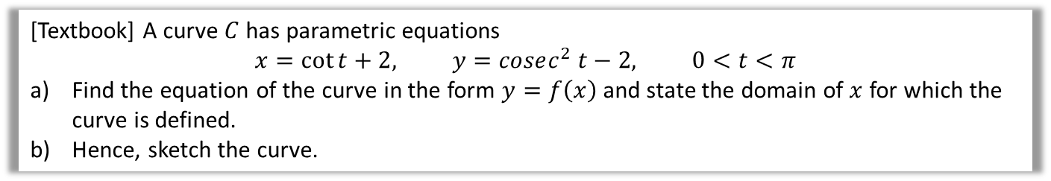

Test Your Understanding
C4 June 2013
which double angle formula would be best here?
?
$$\sin{t}=\frac{x}{2} \\ y=1−\left(1−2\sin^{2}{t}\right) \\ =2\sin^{2}{t} \\ =2{\left(\frac{x}{2}\right)}^{2} \\ =\frac{x^{2}}{2}$$
$$k=2$$
[Textbook] A curve $C$ has parametric equations
$$x=\cot{t}+2, y=cosec^{2} t−2, 0<t<π$$
Find the equation of the curve in the form $y=f\left(x\right)$ and state the domain of $x$ for which the curve is defined.
Hence, sketch the curve.
? a
? b
$$1+\cot^{2}{t}≡cosec^{2} t \\ ∴1+{\left(x−2\right)}^{2}=y+2 \\ y=x^{2}−4x+3$$
As $t$ varies between 0 and $π$, $x=\cot{t+2}$ varies over all real numbers (sketch $cot$ to see this). Therefore the domain of $f\left(x\right)$ is $x∈ℝ$.
$$y$$
$$3$$
$$x$$
$$1$$
$$3$$

Slide 11
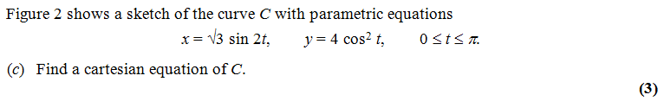

Exercise 8B
Pearson Pure Mathematics Year 2/AS
Pages 204-206
Complete before the lesson Q1-2
In Class:
Green Q4-5
Amber Q6-8
Red Q9-11 & Challenge & Ext
Further Exam Practice
?
$$x=2\sqrt{3}\sin{t}\cos{t} \\ x^{2}=12\sin^{2}{t}\cos^{2}{t} \\ x^{2}=12\left(1−\cos^{2}{t}\right)\cos^{2}{t} \\ x^{2}=12\left(1−\frac{y}{4}\right)\left(\frac{y}{4}\right)$$
C4 June 2012 Q6

Slide 12
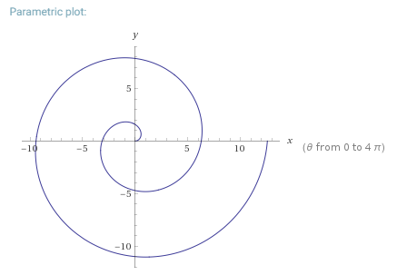
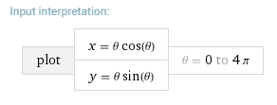
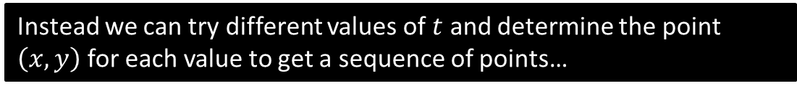
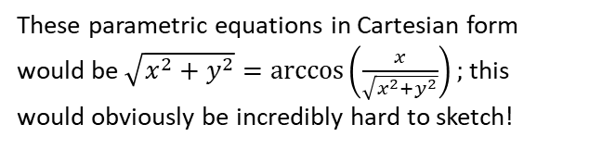
Sketching Parametric Curves
We saw that one strategy for sketching parametric curves is to convert into a Cartesian equation, and hope this is a form we recognise (e.g. quadratic or equation of circle) to appropriately sketch.
However, some parametric equations can’t easily be turned into Cartesian form:
These parametric equations in Cartesian form would be $\sqrt{x^{2}+y^{2}}=\arccos\left(\frac{x}{\sqrt{x^{2}+y^{2}}}\right);$ this would obviously be incredibly hard to sketch!
Instead we can try different values of $t$ and determine the point $\left(x,y\right)$ for each value to get a sequence of points…

Slide 13

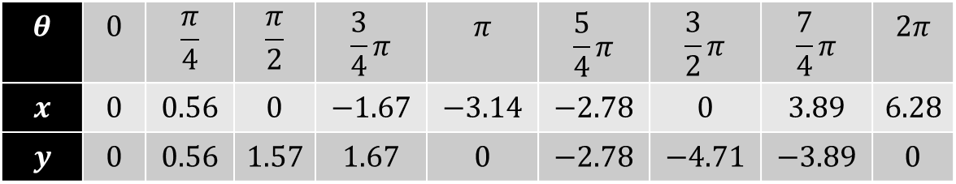








Sketching Parametric Curves
$$θ$$ | $$0$$ | $$\frac{π}{4}$$ | $$\frac{π}{2}$$ | $$\frac{3}{4}π$$ | $$π$$ | $$\frac{5}{4}π$$ | $$\frac{3}{2}π$$ | $$\frac{7}{4}π$$ | $$2π$$
$$x$$ | $$0$$ | $$0.56$$ | $$0$$ | $$−1.67$$ | $$−3.14$$ | $$−2.78$$ | $$0$$ | $$3.89$$ | $$6.28$$
$$y$$ | $$0$$ | $$0.56$$ | $$1.57$$ | $$1.67$$ | $$0$$ | $$−2.78$$ | $$−4.71$$ | $$−3.89$$ | $$0$$
?
?
?
?
?
?
?
?
?
$$y$$
$$\left(−1.67,1.57\right)$$
$$\left(0,1.57\right)$$
$$\left(0.56,0.56\right)$$
$$x$$
$$\left(−3.14,0\right)$$
$$\left(0,0\right)$$
$$\left(−2.78,−2.78\right)$$
$$\left(0, −4.71\right)$$

Slide 14
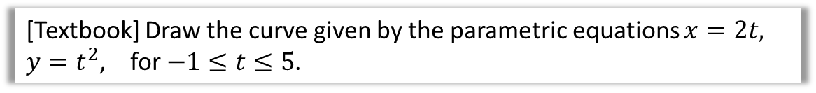
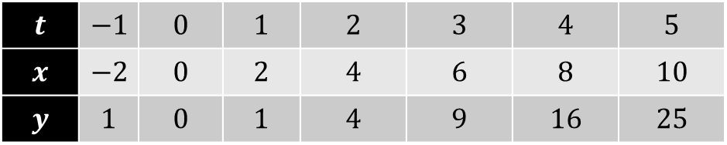


Test Your Understanding
[Textbook] Draw the curve given by the parametric equations $x=2t,$
$y=t^{2}$, for $−1≤t≤5$.
?
$$t$$ | $$−1$$ | $$0$$ | $$1$$ | $$2$$ | $$3$$ | $$4$$ | $$5$$
$$x$$ | $$−2$$ | $$0$$ | $$2$$ | $$4$$ | $$6$$ | $$8$$ | $$10$$
$$y$$ | $$1$$ | $$0$$ | $$1$$ | $$4$$ | $$9$$ | $$16$$ | $$25$$
$$y$$
25
20
15
10
5
$$x$$
-2 2 4 6 8 10

Slide 15
Exercise 8C
Pearson Pure Mathematics Year 2/AS
Pages 207-208
See next slide

Slide 16

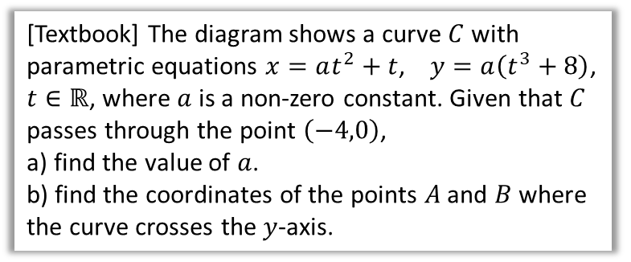


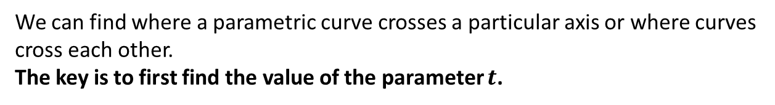




Points of Intersection
We can find where a parametric curve crosses a particular axis or where curves cross each other.
The key is to first find the value of the parameter $t$.
$$y$$
[Textbook] The diagram shows a curve $C$ with parametric equations $x=at^{2}+t$, $y=a\left(t^{3}+8\right)$, $t∈ℝ$, where $a$ is a non-zero constant. Given that $C$ passes through the point $\left(−4,0\right)$,
a) find the value of $a$.
b) find the coordinates of the points $A$ and $B$ where the curve crosses the $y$-axis.
$$C$$
$$−4$$
$$x$$
$$O$$
$$A$$
$$B$$
a
$$−4=at^{2}+t \\ 0=a\left(t^{3}+8\right)$$
From equation (2), because $a≠0$, $t^{3}+8=0 → t=−2$
Substituting into (1):
$$−4=4a−2 → a=−\frac{1}{2}$$
On the $y$-axis, $x=0$:
$$0=at^{2}+t=−\frac{1}{2}t^{2}+t \\ t\left(−\frac{1}{2}t+1\right)=0 \\ t=0 or t=2$$
At $t=0, y=−\frac{1}{2}\left(0^{3}+8\right)=−4 →(0,−4)$
At $t=2, y=−\frac{1}{2}\left(2^{3}+8\right)=−8 →\left(0,−8\right)$
?
b
?

Slide 17

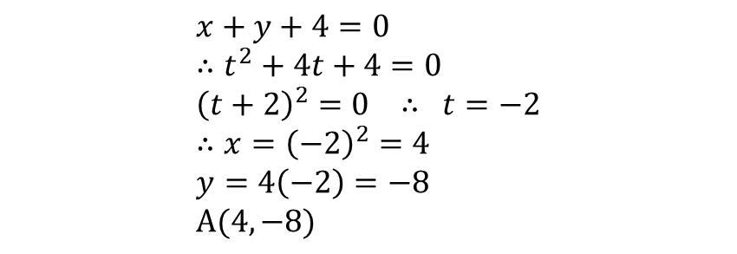


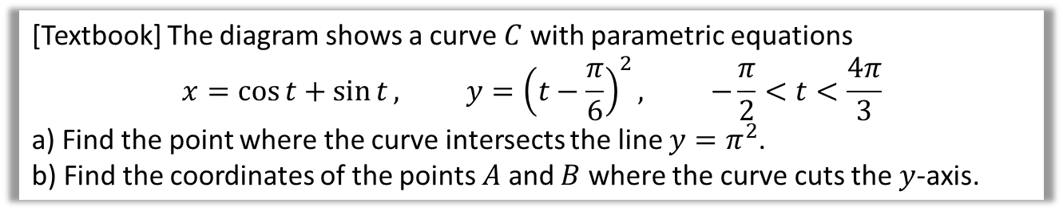
Points of Intersection
[Textbook] A curve is given parametrically by the equations $x=t^{2}, y=4t$. The line $x+y+4=0$ meets the curve at $A$. Find the coordinates of $A$.
$$x+y+4=0 \\ ∴t^{2}+4t+4=0 \\ {\left(t+2\right)}^{2}=0 ∴ t=−2 \\ ∴x={\left(−2\right)}^{2}=4 \\ y=4\left(−2\right)=−8 \\ A(4,−8)$$
Whenever you want to solve a Cartesian equation and pair of parametric equations simultaneously, substitute the parametric equations into the Cartesian one.
[Textbook] The diagram shows a curve $C$ with parametric equations
$$x=\cos{t}+\sin{t}, y={\left(t−\frac{π}{6}\right)}^{2}, −\frac{π}{2}<t<\frac{4π}{3}$$
a) Find the point where the curve intersects the line $y=π^{2}$.
b) Find the coordinates of the points $A$ and $B$ where the curve cuts the $y$-axis.
$$π^{2}={\left(t−\frac{π}{6}\right)}^{2} → t=\frac{7}{6}π or −\frac{5}{6}π$$
(But reject $−\frac{5}{6}π$ as outside domain of $t$)
If $t=\frac{7}{6}π$, $x=−\frac{1+\sqrt{3}}{2}$
$$\left(−\frac{1+\sqrt{3}}{2},π^{2}\right)$$
b
When $x=0$,
$$\cos{t}+\sin{t}=0 \\ \sin{t}=−\cos{t} \\ \tan{t}=−1$$
Since $−\frac{π}{2}<t<\frac{3π}{4}$, $t=−\frac{π}{4} or\frac{3π}{4}$
$$t=−\frac{π}{4} → \left(0,\frac{25π}{144}\right)$$
$$t=\frac{3π}{4} → \left(0,\frac{121π}{144}\right)$$
a
?
?
$$y$$
$$B$$
$$A$$
$$O$$
$$x$$

Slide 18
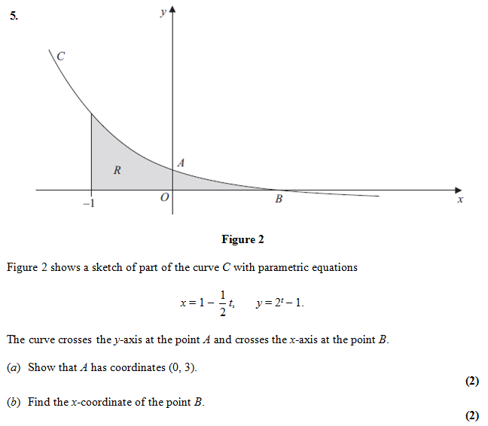


Test Your Understanding
C4 Jan 2013
If $x=0$,
$$0=1−\frac{1}{2}t \\ t=2$$
Then:
$$y=2^{2}−1=3$$
a ?
If $y=0$,
$$2^{t}−1=0 \\ t=0 \\ x=1−\frac{1}{2}\left(0\right)=1$$
b ?

Slide 19
Exercise 8D
Pearson Pure Mathematics Year 2/AS
Pages 211-213
Complete before the lesson Ex8C Q1-3 & Ex8D Q1-2
In Class:
Green Q3-10
Amber Q11-14
Red Q15-17 & Challenge

Slide 20

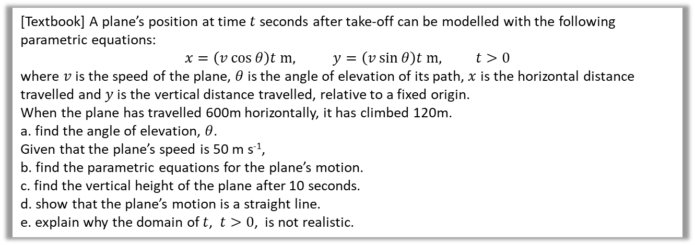
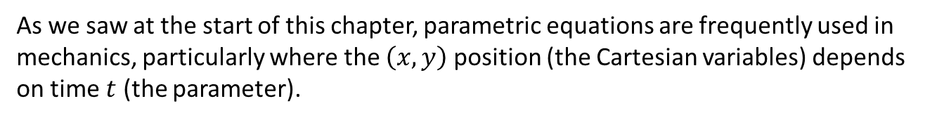


Modelling
As we saw at the start of this chapter, parametric equations are frequently used in mechanics, particularly where the $\left(x,y\right)$ position (the Cartesian variables) depends on time $t$ (the parameter).
[Textbook] A plane’s position at time $t$ seconds after take-off can be modelled with the following parametric equations:
$$x=\left(v\cos{θ}\right)t m, y=\left(v\sin{θ}\right)t m, t>0$$
where $v$ is the speed of the plane, $θ$ is the angle of elevation of its path, $x$ is the horizontal distance travelled and $y$ is the vertical distance travelled, relative to a fixed origin.
When the plane has travelled 600m horizontally, it has climbed 120m.
a. find the angle of elevation, $θ$.
Given that the plane’s speed is 50 m s⁻¹,
b. find the parametric equations for the plane’s motion.
c. find the vertical height of the plane after 10 seconds.
d. show that the plane’s motion is a straight line.
e. explain why the domain of $t$, $t>0$, is not realistic.
DFM
$$θ$$
$$θ=\tan^{−1}\left(\frac{120}{600}\right)=11.3° \left(1dp\right)$$
$$x=\left(v\cos{θ}\right)t \\ =(50×\cos{11.3…)t=49.0t m (3sf)} \\ y=\left(v\sin{θ}\right)t=(50×\sin{11.3…)=9.80t m (3sf)}$$
At $t=10$, $y=9.80t=98 m$
$x=49t → t=\frac{x}{49}$ and $y=9.8×\frac{x}{49}=\frac{1}{5}x$
$∴y=\frac{1}{5}x$ which is a linear equation.
a
?
e
Plane would continue to climb forever!
?
b
?
c
?
d
?

Slide 21
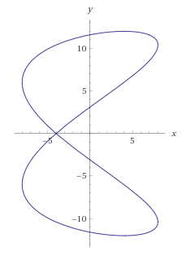
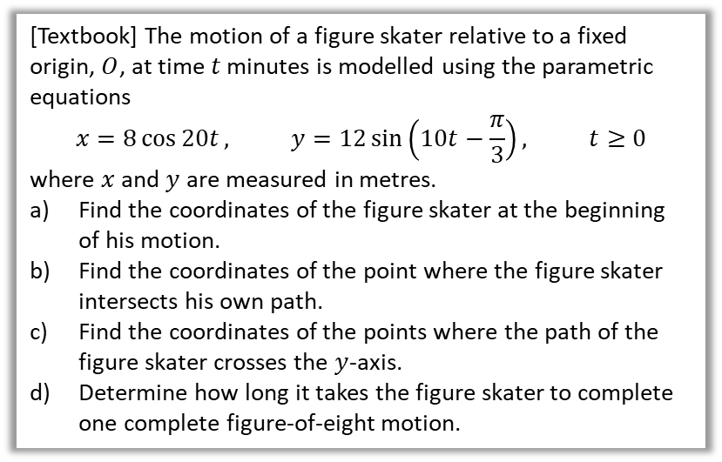


Further Example
[Textbook] The motion of a figure skater relative to a fixed origin, $O$, at time $t$ minutes is modelled using the parametric equations
$$x=8\cos{20t}, y=12\sin\left(10t−\frac{π}{3}\right), t≥0$$
where $x$ and $y$ are measured in metres.
Find the coordinates of the figure skater at the beginning of his motion.
Find the coordinates of the point where the figure skater intersects his own path.
Find the coordinates of the points where the path of the figure skater crosses the $y$-axis.
Determine how long it takes the figure skater to complete one complete figure-of-eight motion.
c
?
At $t=0,$
$$x=8\cos{0}=8, y=12\sin\left(−\frac{π}{3}\right)=−6\sqrt{3}$$
From the graph, the intersection is when $y=0$:
$$12\sin\left(10t−\frac{π}{3}\right)=0 \\ … \\ t=\frac{π}{30},\frac{2π}{15},\frac{7π}{30}, …$$
(Any of these values will do)
$$x=8\cos\left(20×\frac{π}{30}\right)=−4 → (−4,0)$$
When $x=0$:
$$0=8\cos{t} \\ t=\frac{π}{2},\frac{3π}{2},\frac{5π}{2},\frac{7π}{2}, …$$
Substitute these $t$-values into $y$.
$$t=\frac{π}{2} → y=3.11 \left(2dp\right) \\ t=\frac{3π}{2} → y=11.59 … \\ \left(0,−3.11\right), \left(0,11.59\right), \left(0,3.11\right),\left(0,−11.59\right)$$
The period of $\cos{t}$ is $2π$, so the period of $\cos{20t}$ is $\frac{2π}{20}$ (as graph stretched by factor of $\frac{1}{20}$). Similarly period of $y$ is $\frac{2π}{10}$. Both parametric equations must complete full periods (in this case so that skater returns to original $y$ position), so period is $\frac{2π}{10}$ min = 38 seconds.
a
?
b
?
d
?

Slide 22
Exercise 8E
Pearson Pure Mathematics Year 2/AS
Pages 218-220
Complete before the lesson Q1-4
In Class:
Red Q5-10

Slide 23

Just For Fun…
$$\sin\left(\sin\left(x\right)+\cos\left(y\right)\right)=\cos\left(\sin\left(xy\right)+\cos\left(x\right)\right)$$
(Yes, I realise this is a Cartesian equation, not parametric ones – but it looked pretty!)

