Slide 1
Year 1 Applied Mathematics
Variable Acceleration
- Max and Min
Chapter 11
(Part 3 of 4)

Slide 2
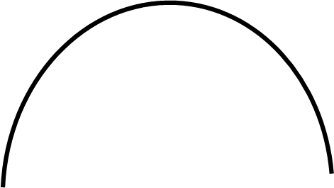
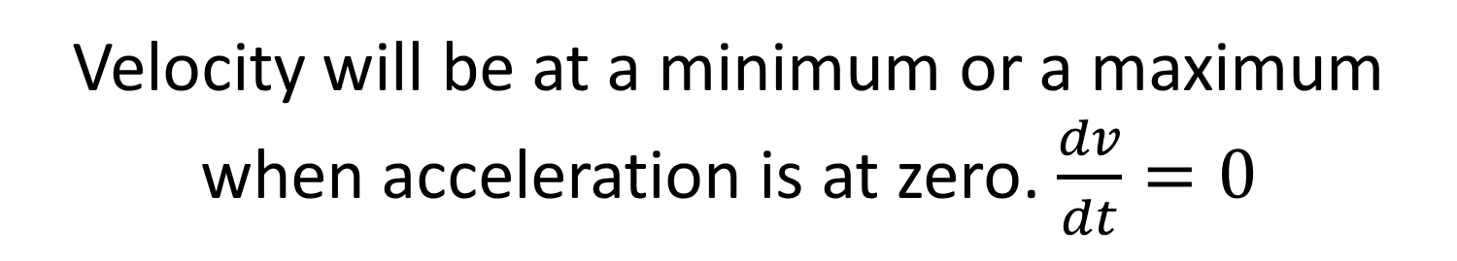
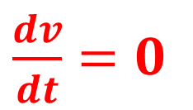
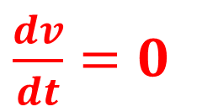
Variable Acceleration - Maxima and Minima
Velocity will be at a minimum or a maximum
when acceleration is at zero. $\frac{dv}{dt}=0$
$\frac{dv}{dt}=0$
$\frac{dv}{dt}=0$

Slide 3
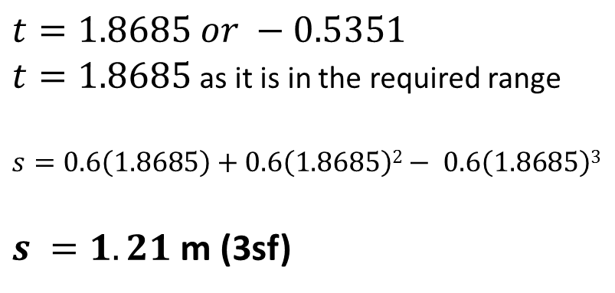
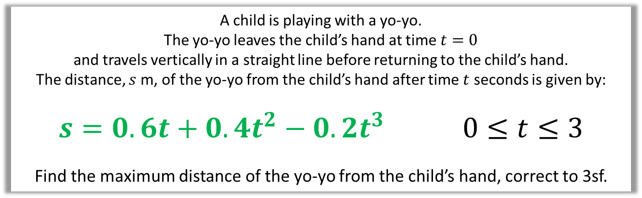
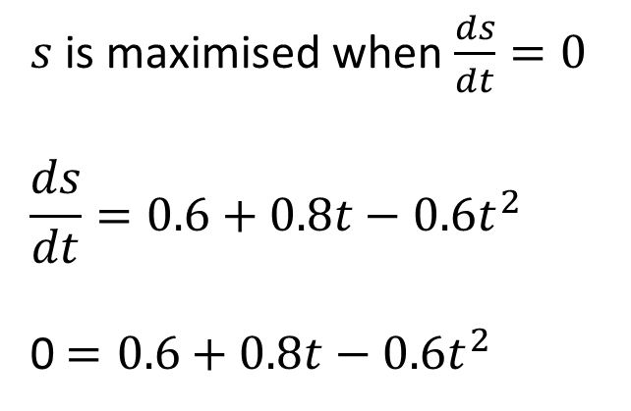
Variable Acceleration - Maxima and Minima
A child is playing with a yo-yo.
The yo-yo leaves the child’s hand at time $t=0$
and travels vertically in a straight line before returning to the child’s hand.
The distance, $s$ m, of the yo-yo from the child’s hand after time $t$ seconds is given by:
$$s=0.6t+0.4t^{2}−0.2t^{3} 0≤t≤3$$
Find the maximum distance of the yo-yo from the child’s hand, correct to 3sf.
$s$ is maximised when $\frac{ds}{dt}=0$
$$\frac{ds}{dt}=0.6+0.8t−0.6t^{2}$$
0 $=0.6+0.8t−0.6t^{2}$
$$t=1.8685 or −0.5351$$
$t=1.8685$ as it is in the required range
$s=0.6\left(1.8685\right)+$ $0.6\left(1.8685\right)2− 0.6\left(1.8685\right)$³
$s =1.21$ m (3sf)

Slide 4
Exercise 11C
Pearson Stats/Mechanics Year 1
Page 187-188
Complete before the lesson Q1
In Class:
Green Q2-3
Amber Q4
Red Q5-6

