Slide 1

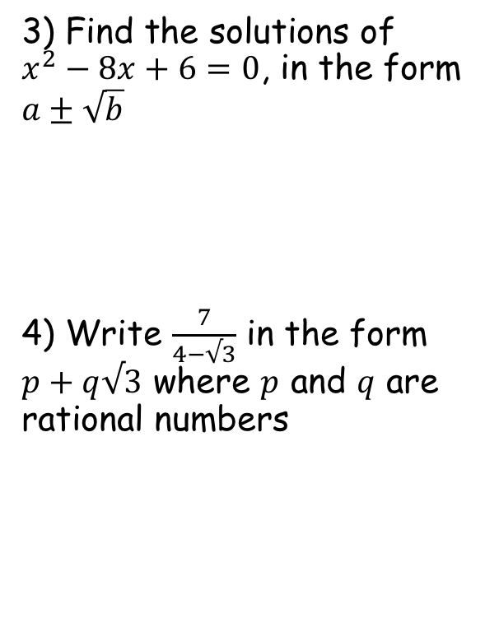

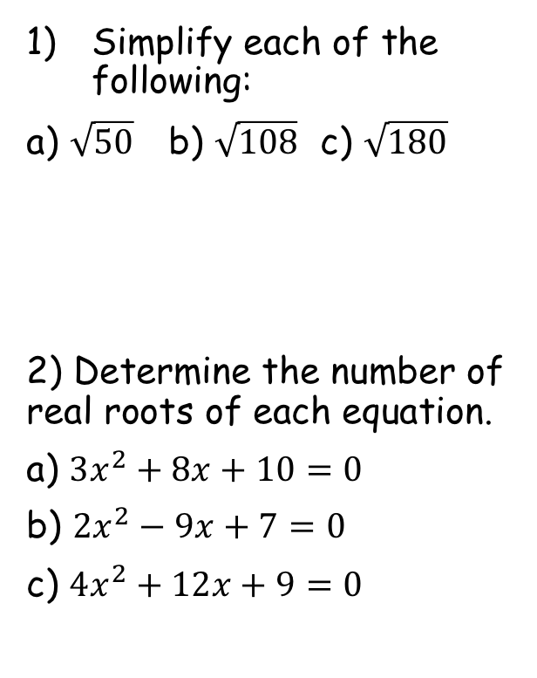

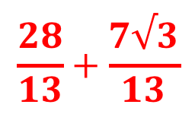




Prior Knowledge Check
Simplify each of the following:
a) $\sqrt{50}$ b) $\sqrt{108}$ c) $\sqrt{180}$
2) Determine the number of real roots of each equation.
a) ${3x}^{2}+8x+10=0$
b) ${2x}^{2}−9x+7=0$
c) ${4x}^{2}+12x+9=0$
3) Find the solutions of $x^{2}−8x+6=0$, in the form $a±\sqrt{b}$
4) Write $\frac{7}{4−√3}$ in the form $p+q√3$ where $p$ and $q$ are rational numbers
$$4±\sqrt{10}$$
$$5\sqrt{2}$$
$$6\sqrt{3}$$
$$6\sqrt{5}$$
$$0$$
$$2$$
$$\frac{28}{13}+\frac{7√3}{13}$$
$$1$$

Slide 2









Complex Numbers
You can use both real and imaginary numbers to solve equations
At GCSE level you met the Quadratic formula:
The part under the square root sign is known as the ‘discriminant’, and can be used to determine how many solutions the equation has:
The problem is that we cannot square root a negative number, hence the lack of real roots in the 3rd case above
To solve these equations, we can use the imaginary number ‘i’
The imaginary number ‘i’ can be combined with real numbers to create ‘complex numbers’
An example of a complex number would be:
Complex numbers can be added, subtracted, multiplied and divided in the same way you would with an algebraic expression
$$i=\sqrt{−1}$$
$$x=\frac{−b±\sqrt{b^{2}−4ac}}{2a}$$
$$5+2i$$
$$b^{2}−4ac>0$$
$$−→ 2 real roots$$
$$b^{2}−4ac=0$$
$$−→1 real root$$
$$b^{2}−4ac<0$$
$$−→0 real roots$$
1A/B

Slide 3









Complex Numbers
You can use both real and imaginary numbers to solve equations
Simplify each of the following, giving your answers in the form:
where:
1)
$$\left(2+5i\right)+(7+3i)$$
Group terms together
$$=9+8i$$
2)
$$\left(2−5i\right)−(5−11i)$$
‘Multiply out’ the bracket
$$a+bi$$
$$=2−5i−5+11i$$
Group terms
$$=−3+6i$$
$$a∈R and b∈R$$
3)
$$6\left(1+3i\right)$$
Multiply out the bracket
This means a and b are real numbers
$$=6+18i$$
1A/B

Slide 4








Complex Numbers
This sign means the positive square root
You can use both real and imaginary numbers to solve equations
Write √-36 in terms of i
Write √-28 in terms of i
$$\sqrt{−36}$$
Split up using surd manipulation
$$\sqrt{36}\sqrt{−1}$$
Simplify each part
→ √-1 = i
$$=6i$$
$$\sqrt{−28}$$
Split up into a positive and negative part
$$\sqrt{28}\sqrt{−1}$$
Split up the 28 further…
$$\sqrt{4}\sqrt{7}\sqrt{−1}$$
Simplify each part
$$=2\sqrt{7}i$$
This is usually written in this way
$$=2i\sqrt{7}$$
1A/B

Slide 5






Complex Numbers
You can use both real and imaginary numbers to solve equations
Solve the equation:
$$x^{2}+9=0$$
Subtract 9
$$x^{2}=−9$$
Square root – we need to consider both positive and negative as we are solving an equation
$$x^{2}+9=0$$
$$x=±\sqrt{−9}$$
Split up
$$x=±\sqrt{9}\sqrt{−1}$$
Write in terms of i
$$x=±3i$$
You should ensure you write full workings – once you have had a lot of practice you can do more in your head!
1A/B

Slide 6












Complex Numbers
You can use both real and imaginary numbers to solve equations
Solve the equation:
You can use one of two methods for this
Either ‘Completing the square’ or the Quadratic formula
Completing the square
$$x^{2}+6x+25=0$$
Write a squared bracket, with the number inside being half the x-coefficient
$${\left(x+3\right)}^{2}$$
$$+ 16$$
$$= 0$$
$$x^{2}+6x+25=0$$
Subtract 16
$${\left(x+3\right)}^{2}=−16$$
Square root
$$x+3=±\sqrt{−16}$$
Subtract 3
$$x=−3±\sqrt{−16}$$
Split the root up
$${\left(x+3\right)}^{2}$$
$$x=−3±\sqrt{16}\sqrt{−1}$$
Imagine squaring the bracket
Simplify
$$(x+3)(x+3)$$
$$x=−3±4i$$
This is the answer we get
$$x^{2}+6x+9$$
If the x term is even, and there is only a single x², then completing the square will probably be the quickest method!
The squared bracket gives us both the x² term and the 6x term
→ It only gives us a number of 9, whereas we need 25 – add 16 on!
1A/B

Slide 7
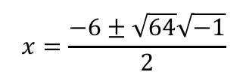
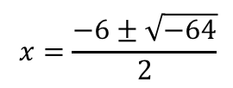
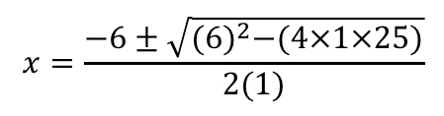
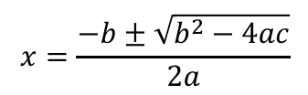


Complex Numbers
You can use both real and imaginary numbers to solve equations
Solve the equation:
You can use one of two methods for this
Either ‘Completing the square’ or the Quadratic formula
The Quadratic formula
$$x=\frac{−b±\sqrt{b^{2}−4ac}}{2a}$$
Sub in values
$$x^{2}+6x+25=0$$
$$x=\frac{−6±\sqrt{{(6)}^{2}−(4×1×25)}}{2(1)}$$
Calculate the part under the root sign
$$x=\frac{−6±\sqrt{−64}}{2}$$
Split it up
$$x=\frac{−6±\sqrt{64}\sqrt{−1}}{2}$$
a = 1
Simplify the roots
b = 6
$$x=\frac{−6±8i}{2}$$
c = 25
Divide all by 2
$$x=−3±4i$$
If the x² coefficient is greater than 1, or the x term is odd, the Quadratic formula will probably be the easiest method!
1A/B

Slide 8
Exercise 1A/ B
Pearson Further Core Mathematics Year 1/AS
Complete before the lesson Q1-3 from Ex1A&B
In Class:
Green Ex1A Q4-6
Amber Ex1A Q7-8 & Ex1B Q4
Red Ex1B Q5 & 6

