Slide 1
Year 2 Pure Mathematics
Sequences and Series
- Sum of
Chapter 3
(Part 4 of 7)

Slide 2
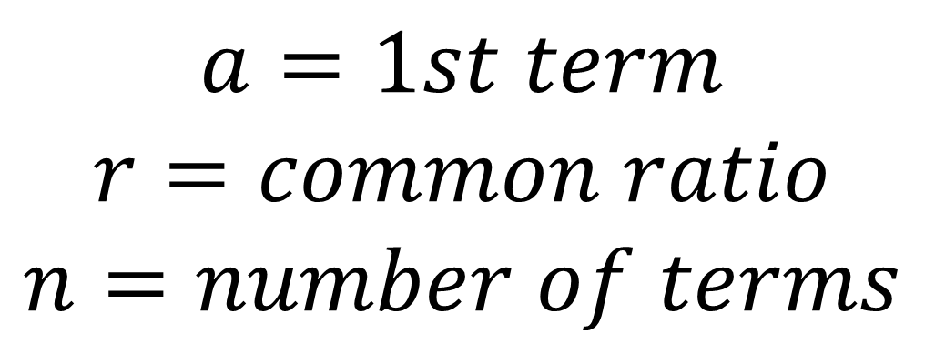
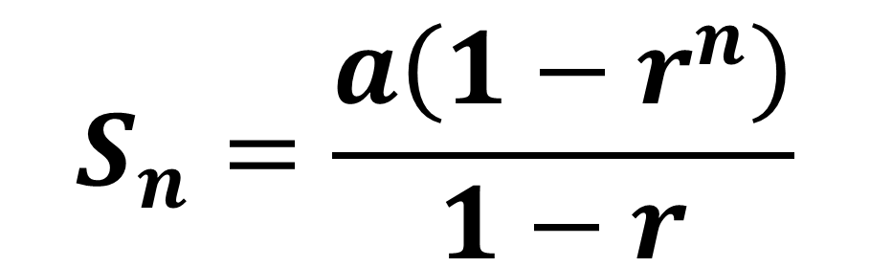
Geometric Series
Geometric Series
$$S_{n}=\frac{a\left(1−r^{n}\right)}{1−r}$$
$$a=1st term$$
$$r=common ratio$$
$$n=number of terms$$

Slide 3

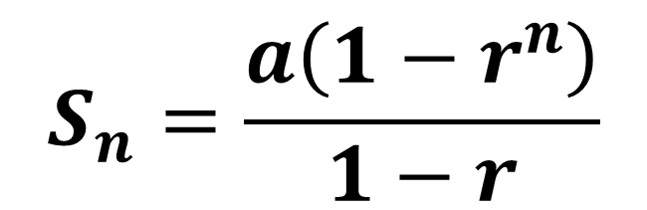
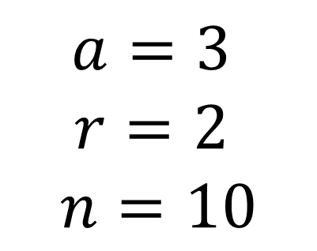
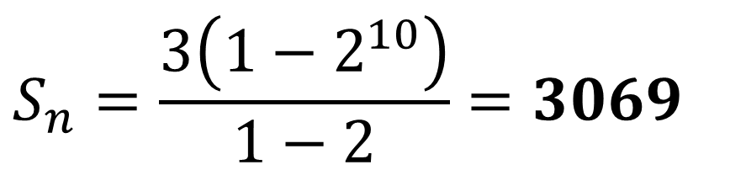
Geometric Series – Example
Find the sum of the first 10 terms.
$$3, 6, 12, 24, 48, …$$
$$S_{n}=\frac{a\left(1−r^{n}\right)}{1−r}$$
$$a=3$$
$$r=2$$
$$n=10$$
$$S_{n}=\frac{3\left(1−2^{10}\right)}{1−2}=3069$$

Slide 4
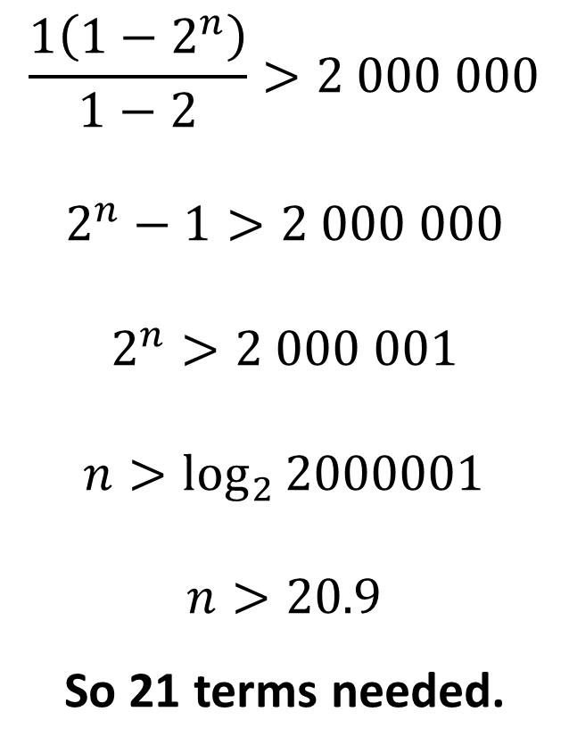
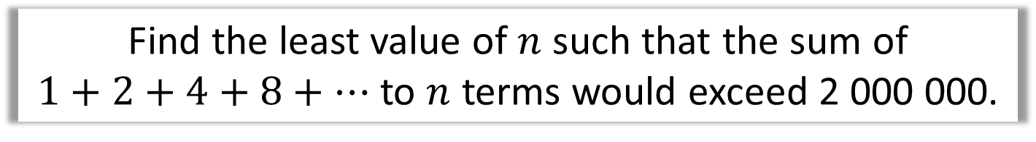
Geometric Series - Example
Find the least value of $n$ such that the sum of
$1+2+4+8+…$ to $n$ terms would exceed 2 000 000.
$$\frac{1\left(1−2^{n}\right)}{1−2}>2 000 000$$
$$2^{n}−1>2 000 000$$
$$2^{n}>2 000 001$$
$$n>\log_{2}{2000001}$$
$$n>20.9$$
So 21 terms needed.

Slide 5
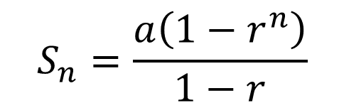

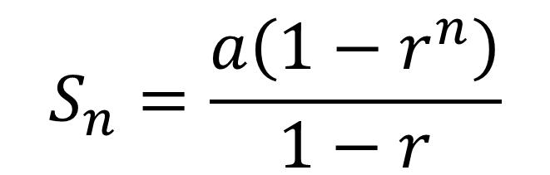
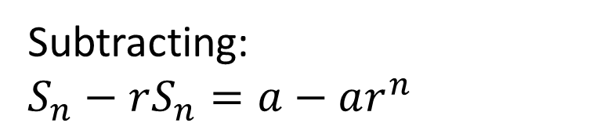
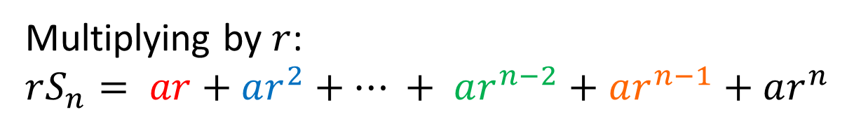
Geometric Series - Proof
$$S_{n}=\frac{a\left(1−r^{n}\right)}{1−r}$$
Prove:
$$S_{n} =a+ar+ar^{2}+…+ar^{n−2}+ar^{n−1}$$
Multiplying by $r$:
$$rS_{n}= ar+ar^{2}+… + ar^{n−2}+ar^{n−1}+ar^{n}$$
Subtracting:
$$S_{n}−rS_{n}=a−ar^{n}$$
$$S_{n}\left(1−r\right)=a\left(1−r^{n}\right)$$
$$S_{n}=\frac{a\left(1−r^{n}\right)}{1−r}$$

Slide 6

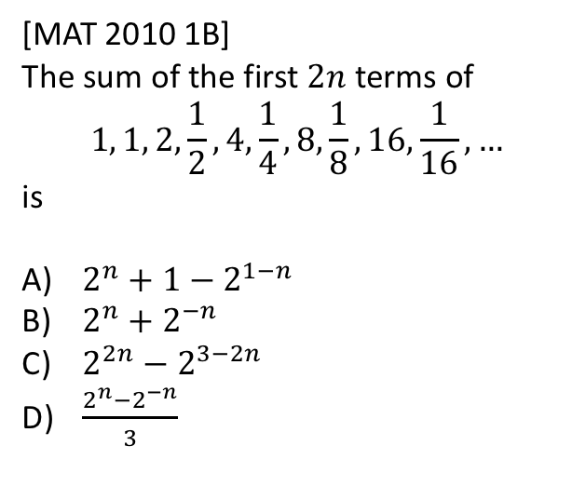
Exercise 3D
Pearson Pure Mathematics Year 2/AS
Pages 72-73
Complete before the lesson Q1-4
In Class:
Green Q5-6
Amber Q7-9
Red Q 10 -11 & Ext
Extension
There are interleaved sequences. If we want $2n$ terms, we want $n$ terms of $1, 2, 4, 8, …$ and $n$ terms of $1,\frac{1}{2},\frac{1}{4},…$
For first sequence:
$$S_{n}=\frac{1\left(1−2^{n}\right)}{1−2}=2^{n}−1$$
For second sequence:
$$S_{n}=\frac{1\left(1−{\left(\frac{1}{2}\right)}^{n}\right)}{1−\frac{1}{2}}=\frac{1−2^{−n}}{1/2}=2−2^{1−n}$$
Therefore the sum of both is (A).
[MAT 2010 1B]
The sum of the first $2n$ terms of
$$1, 1, 2,\frac{1}{2}, 4,\frac{1}{4},8,\frac{1}{8},16,\frac{1}{16},…$$
is
$2^{n}+1−2^{1−n}$
$2^{n}+2^{−n}$
$2^{2n}−2^{3−2n}$
$\frac{2^{n}−2^{−n}}{3}$
?

