Slide 1
Year 2 Pure Mathematics
Radians
- Trigonometric Equations
Chapter 5
(Part 4 of 5)

Slide 2
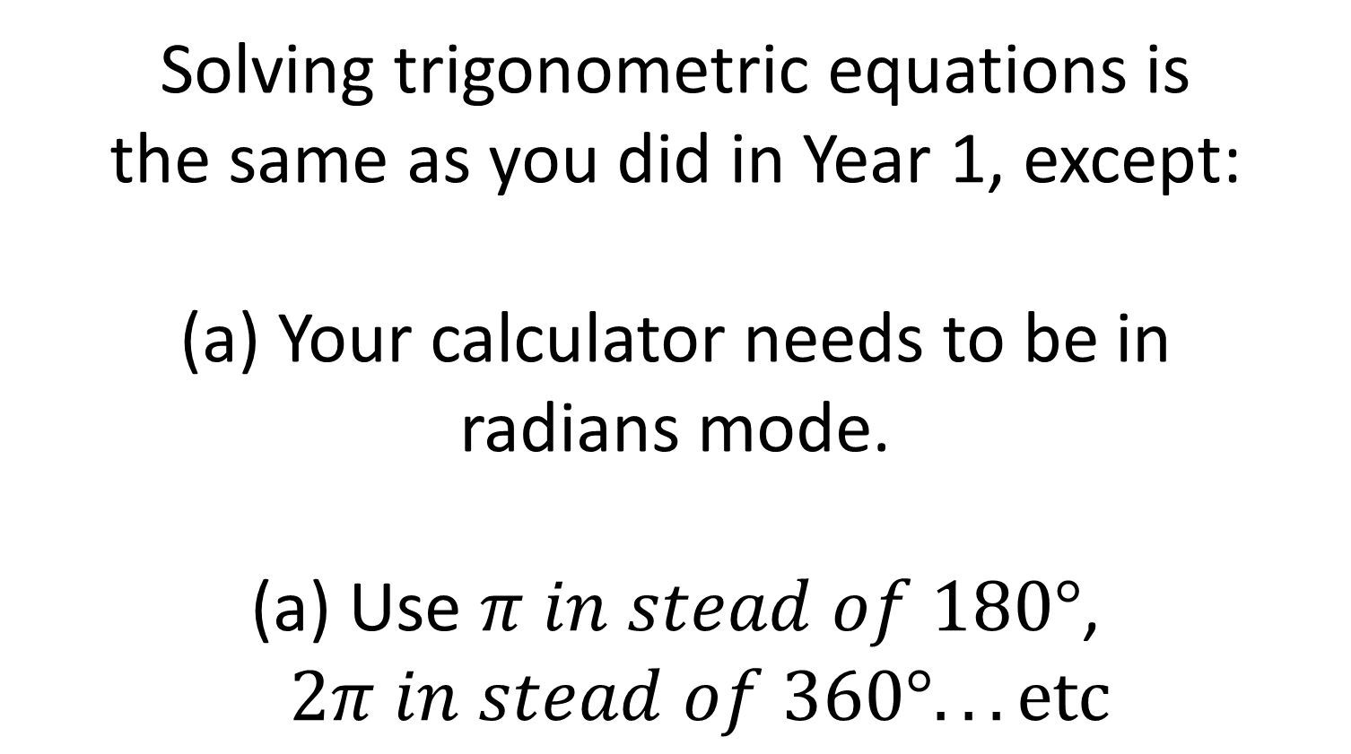
Radians - Solving Trigonometric Equations
Solving trigonometric equations is
the same as you did in Year 1, except:
Your calculator needs to be in
radians mode.
Use $π in stead of 180°$, $2π in stead of 360°...etc$

Slide 3
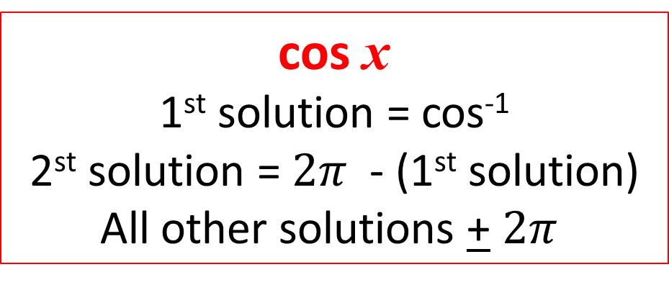
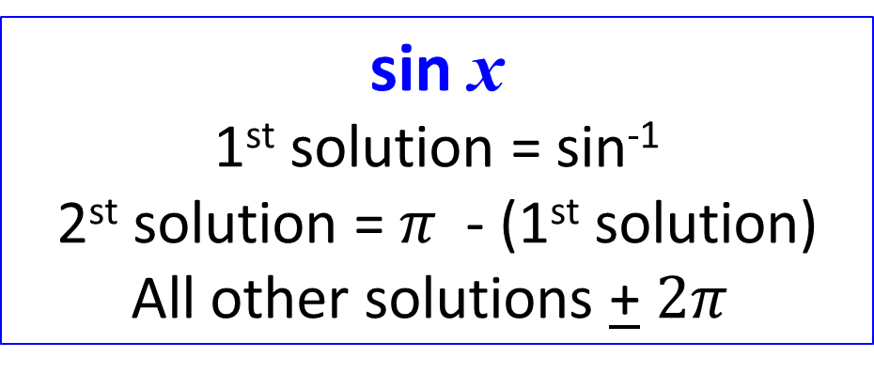
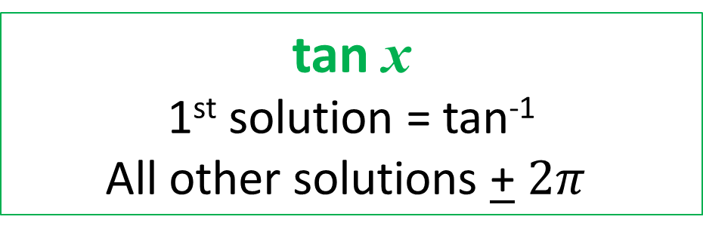
Radians - Solving Trigonometric Equations
sin x
1st solution = sin⁻¹
2st solution = $π$ - (1st solution)
All other solutions + $2π$
cos x
1st solution = cos⁻¹
2st solution = $2π$ - (1st solution)
All other solutions + $2π$
tan x
1st solution = tan⁻¹
All other solutions + $2π$

Slide 4
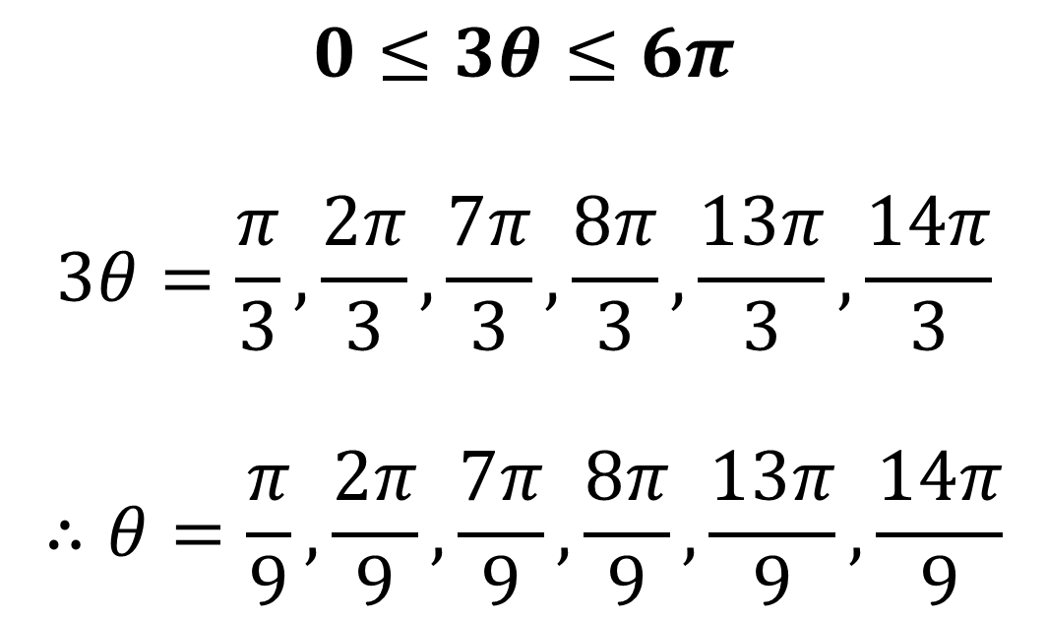
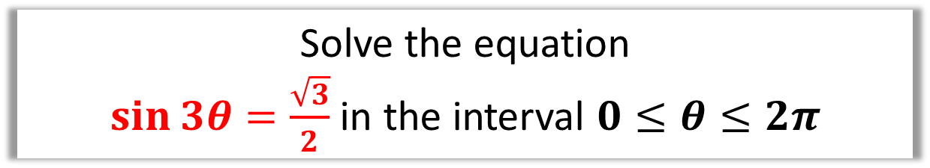
Radian - Solving Trigonometric Equations
Solve the equation
$\sin{3θ}=\frac{\sqrt{3}}{2}$ in the interval $0≤θ≤2π$
$$0≤3θ≤6π$$
$$3θ=\frac{π}{3},\frac{2π}{3},\frac{7π}{3},\frac{8π}{3},\frac{13π}{3},\frac{14π}{3}$$
$$∴θ=\frac{π}{9},\frac{2π}{9},\frac{7π}{9},\frac{8π}{9},\frac{13π}{9},\frac{14π}{9}$$

Slide 5
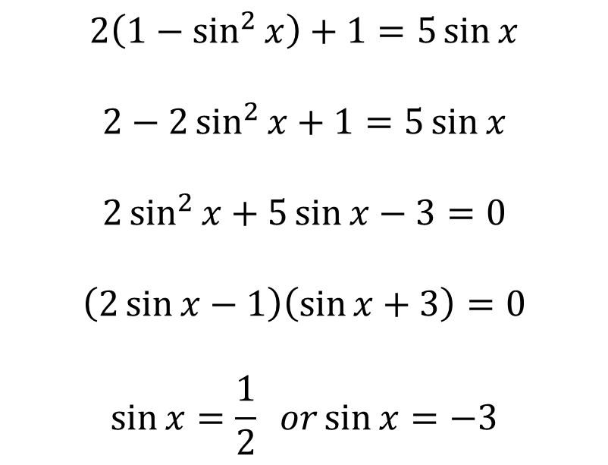

Radians - Solving Trigonometric Equations
Find all the solutions, in the interval 0 ≤ x < 2π, of the equation
2 cos² x + 1 = 5 sin x,
giving each solution in terms of π. (6)
$$2\left(1−\sin^{2}{x}\right)+1=5\sin{x}$$
$$2−2\sin^{2}{x}+1=5\sin{x}$$
$$2\sin^{2}{x}+5\sin{x}−3=0$$
$$\left(2\sin{x}−1\right)\left(\sin{x}+3\right)=0$$
$$\sin{x}=\frac{1}{2} or\sin{x}=−3$$
$$x=\frac{π}{6}$$
$$or$$
$$x=π−\frac{π}{6}=\frac{5π}{6}$$

Slide 6
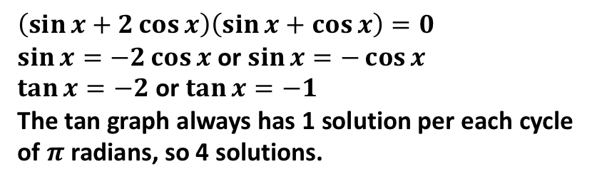
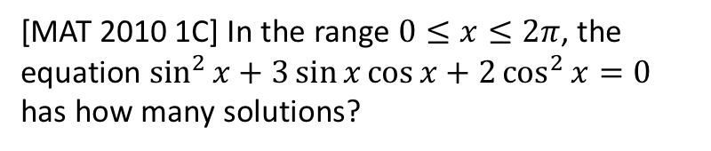
Exercises 5E
Pearson Pure Mathematics Year 2/AS
Pages 131-132
Complete before the lesson Q1-3
In Class:
Green Q4-6
Amber Q7-8
Red Q9-15
Extension
[MAT 2010 1C] In the range $0≤x≤2π$, the equation $\sin^{2}{x}+3\sin{x}\cos{x}+2\cos^{2}{x}=0$ has how many solutions?
?
$$\left(\sin{x}+2\cos{x}\right)\left(\sin{x}+\cos{x}\right)=0$$
$\sin{x=−2\cos{x}}$ or $\sin{x}=−\cos{x}$
$\tan{x}=−2$ or $\tan{x}=−1$
The tan graph always has 1 solution per each cycle of $π$ radians, so 4 solutions.

