Slide 1
Year 2 Pure Mathematics
Trig Functions
- Graphs
Chapter 6
(Part 4 of 4)

Slide 2
Year 2 Pure Mathematics
Trig Functions
- Graphs
Chapter 6
(Part 4 of 5)

Slide 3
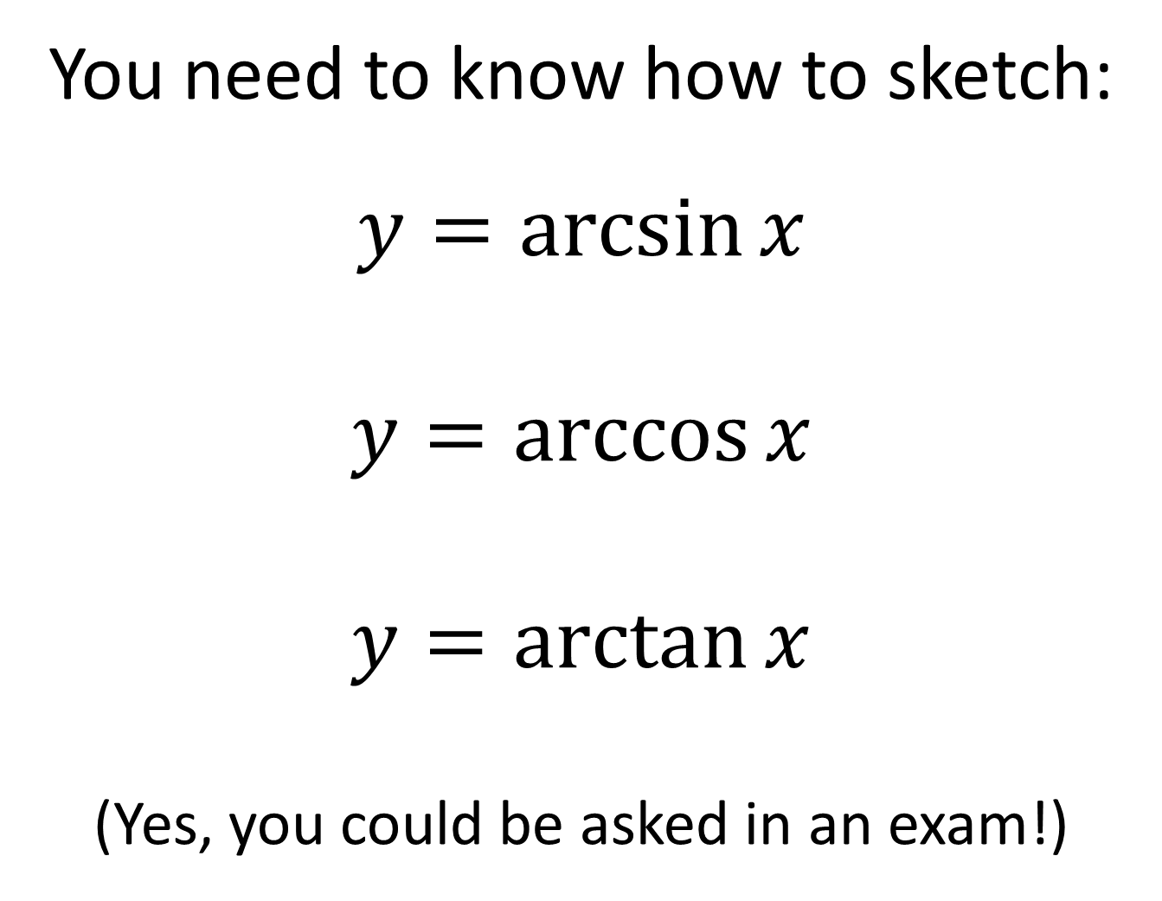
Inverse Trig Functions
You need to know how to sketch:
$$y=\arcsin{x}$$
$y=\arccos{x}$
$y=\arctan{x}$
(Yes, you could be asked in an exam!)

Slide 4





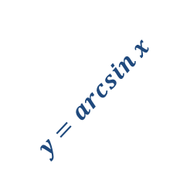




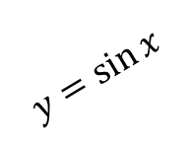


Inverse Trig Functions
You need to know how to sketch $y=\arcsin{x}, y=\arccos{x}$, $y=\arctan{x}$.
(Yes, you could be asked in an exam!)
$$y$$
We have to restrict the domain of $\sin{x}$ to $−\frac{π}{2}≤x<\frac{π}{2}$ before we can find the inverse. Why?
Because only one-to-one functions have an inverse. By restricting the domain it is now one-to-one.
$$\frac{π}{2}$$
?
$$1$$
$$y=arcsin x$$
$$x$$
$$−\frac{π}{2}$$
$$−1$$
$$1$$
$$\frac{π}{2}$$
$$y=\sin{x}$$
$$−1$$
$$−\frac{π}{2}$$

Slide 5

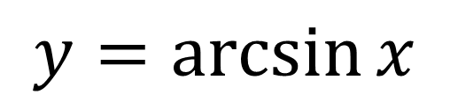


Inverse Trig Functions
We have to restrict the domain of $\sin{x}$ to $−\frac{π}{2}≤x<\frac{π}{2}$ before we can find the inverse. Why?
Because only one-to-one functions have an inverse. By restricting the domain it is now one-to-one.
$$y=\arcsin{x}$$
$$y$$
$$\frac{π}{2}$$
$$y=arcsin x$$
$$x$$
$$−1$$
$$1$$
$$−\frac{π}{2}$$

Slide 6
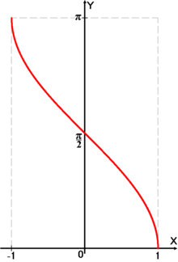
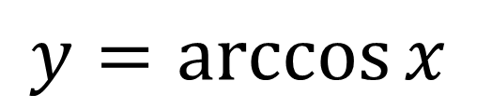
Inverse Trig Functions
$$y=\arccos{x}$$

Slide 7
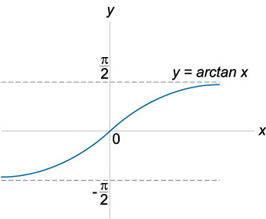
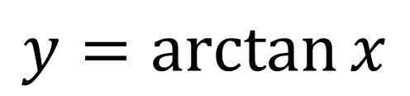
Inverse Trig Functions
$$y=\arctan{x}$$
Note that this graph has asymptotes.

Slide 8
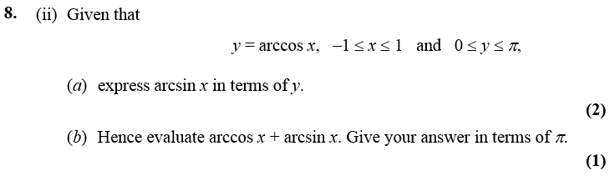

One Final Problem…
Edexcel C3 Jan 2007
?
Fewer than 10% of candidates got this part right.
$$y=\arccos{x} \\ x=\cos{y}=sin\left(\frac{π}{2}−y\right) \\ \arcsin{x=\frac{π}{2}−y}$$
$$\arccos{x+\arcsin{x}} \\ =y+\frac{π}{2}−y=\frac{π}{2}$$

Slide 9




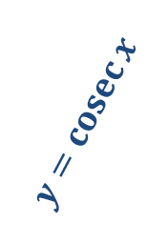



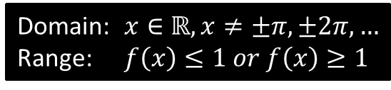

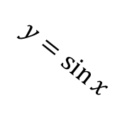


Sketches
To draw a graph of $y=cosec x$, start with a graph of $y=\sin{x}$, then consider what happens when we reciprocate each $y$ value.
It touches here because the reciprocal of 1 is 1.
$$y$$
$$y=\operatorname{cosec}{x}$$
$cosec$ isn’t defined for multiples of $π$ because we can’t divide by 0. We get an asymptote.
Click to Frosketch $y=cosec x$
$$1$$
$$y=\sin{x}$$
$$x$$
$$\frac{1}{2}π$$
$$π$$
$$\frac{3}{2}π$$
$$2π$$
$$−1$$
Domain: $x∈ℝ, x≠±π,±2π,…$
Range: $f\left(x\right)≤1 or f\left(x\right)≥1$
?
?
Reciprocating preserves sign. When we divide by a small positive number, we get a very large positive number.

Slide 10
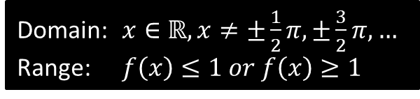
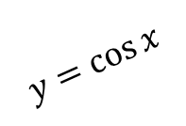
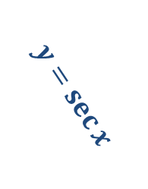

Sketches
$$y$$
$$y=\sec{x}$$
Click to Frosketch $y=sec x$
$$1$$
$$y=\cos{x}$$
$$x$$
$$\frac{1}{2}π$$
$$π$$
$$\frac{3}{2}π$$
$$2π$$
$$−1$$
Domain: $x∈ℝ, x≠±\frac{1}{2}π,±\frac{3}{2}π,…$
Range: $f\left(x\right)≤1 or f\left(x\right)≥1$
?
?

Slide 11

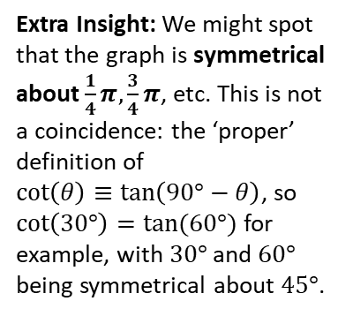
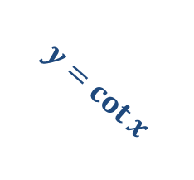
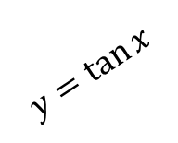
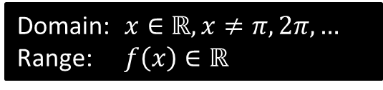
Sketches
Click to Brosketch $y=cot x$
$$y$$
?
Domain: $x∈ℝ, x≠π,2π,…$
Range: $f\left(x\right)∈ℝ$
?
$$y=\tan{x}$$
$$y=\cot{x}$$
$$x$$
$$\frac{1}{2}π$$
$$π$$
$$\frac{3}{2}π$$
$$2π$$
Extra Insight: We might spot that the graph is symmetrical about $\frac{1}{4}π,\frac{3}{4}π$, etc. This is not a coincidence: the ‘proper’ definition of
$\cot\left(θ\right)≡\tan\left(90°−θ\right)$, so $\cot\left(30°\right)=tan⁡(60°)$ for example, with $30°$ and $60°$ being symmetrical about $45°$.

Slide 12




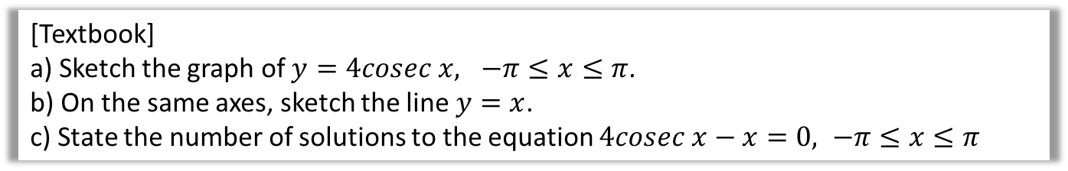





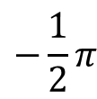
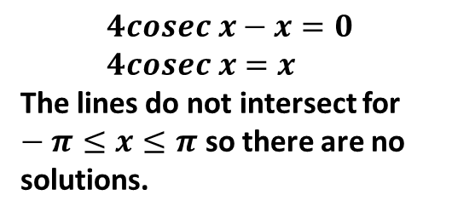
Example
[Textbook]
a) Sketch the graph of $y=4cosec x, −π≤x≤π$.
b) On the same axes, sketch the line $y=x$.
c) State the number of solutions to the equation $4cosec x−x=0, −π≤x≤π$
?
$$y$$
$$y=\operatorname{cosec}{x}$$
$$y=x$$
$$4$$
$$x$$
$$−π$$
$$−\frac{1}{2}π$$
$$\frac{1}{2}π$$
$$π$$
$$4cosec x−x=0 \\ 4cosec x=x$$
The lines do not intersect for $−π≤x≤π$ so there are no solutions.
$$−4$$

Slide 13






















Test Your Understanding
Sketch $y=−1+\sec{2x}$ in the interval $0≤x<360°$.
?
$$y$$
$$y$$
$$y=\sec{x}$$
$$y=\sec{2x}$$
$$1$$
$$1$$
$$x$$
$$x$$
$$90°$$
$$180°$$
$$270°$$
$$360°$$
$$90°$$
$$180°$$
$$270°$$
$$360°$$
$$−1$$
$$−1$$
$$y$$
$$y=−1+\sec{2x}$$
$$x$$
Draw the transformations stage by stage, unless you feel comfortable doing multiple transformations at once.
$$90°$$
$$180°$$
$$270°$$
$$360°$$
$$−2$$

Slide 14
Exercises 6B
Pearson Pure Mathematics Year 2/AS
Page 148-149
Complete before the lesson Q1-2
In Class:
Green Q3-6
Amber Q7-8
Red Q9-10

