Slide 1

P1 Chapter 9 :: Trigonometric Ratios
jfrost@tiffin.kingston.sch.uk
www.drfrostmaths.com
@DrFrostMaths
Last modified: 23rd July 2018

Slide 2
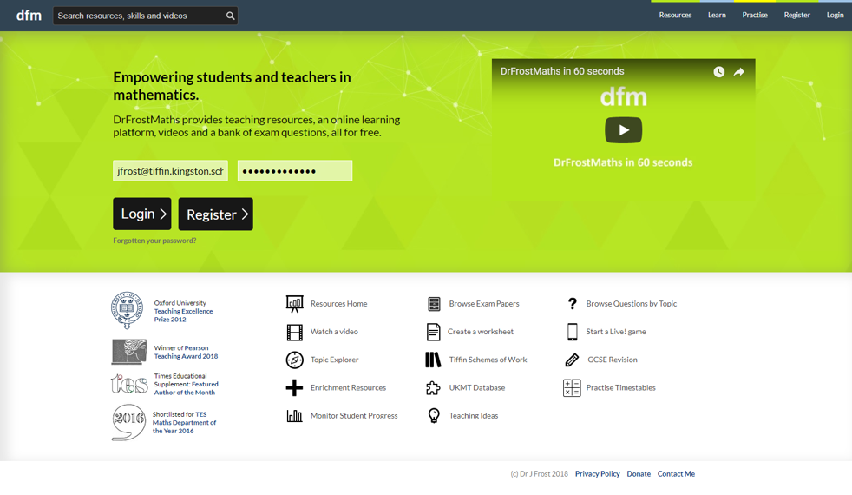







www.drfrostmaths.com
Everything is completely free.
Why not register?
Register now to interactively practise questions on this topic, including past paper questions and extension questions (including MAT + UKMT).
Teachers: you can create student accounts (or students can register themselves), to set work, monitor progress and even create worksheets.
With questions by:
Dashboard with points, trophies, notifications and student progress.
Questions organised by topic, difficulty and past paper.
Teaching videos with topic tests to check understanding.

Slide 3

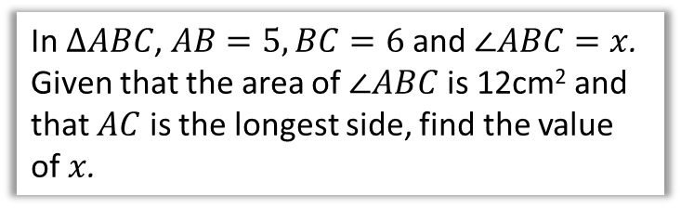





Chapter Overview
There is technically no new content in this chapter since GCSE.
However, the problems might be more involved than at GCSE level.
1:: Sine/Cosine Rule
2:: Areas of Triangles
$$x$$
$$5$$
In $ΔABC$, $AB=5, BC=6$ and $∠ABC=x$. Given that the area of $∠ABC$ is 12cm² and that $AC$ is the longest side, find the value of $x$.
Determine $x$.
$$60°$$
$$x+2$$
3:: Graphs of Sine/Cosine/Tangent
Sketch $y=\sin\left(2x\right)$ for $0≤x≤360°$

Slide 4
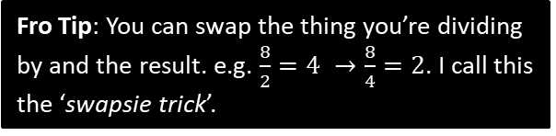

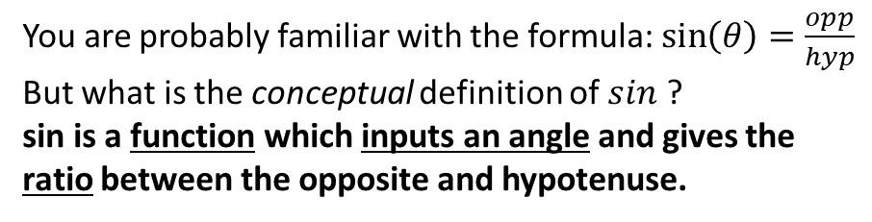









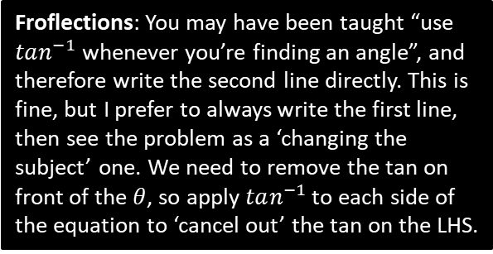
RECAP :: Right-Angled Trigonometry
You are probably familiar with the formula: $\sin\left(θ\right)=\frac{opp}{hyp}$
But what is the conceptual definition of $sin$ ?
sin is a function which inputs an angle and gives the ratio between the opposite and hypotenuse.
hyp
opp
?
$$θ$$
adj
Remember that a ratio just means the ‘relative size’ between quantities (in this case lengths). For this reason, sin/cos/tan are known as “trigonometric ratios”.
Find $x$.
Fro Tip: You can swap the thing you’re dividing by and the result. e.g. $\frac{8}{2}=4 →\frac{8}{4}=2$. I call this the ‘swapsie trick’.
4
?
$$\cos\left(20\right)=\frac{4}{x} \\ x=\frac{4}{\cos\left(20\right)}=11.7 (3sf)$$
$$20°$$
$$x$$
Froflections: You may have been taught “use $tan^{−1}$ whenever you’re finding an angle”, and therefore write the second line directly. This is fine, but I prefer to always write the first line, then see the problem as a ‘changing the subject’ one. We need to remove the tan on front of the $θ$, so apply $tan^{−1}$ to each side of the equation to ‘cancel out’ the tan on the LHS.
$$5$$
Find $θ$.
$$\tan\left(θ\right)=\frac{5}{3} \\ θ=\tan^{−1}\left(\frac{5}{3}\right)=59.0°$$
$$3$$
?
$$θ$$

Slide 5
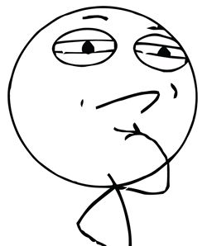









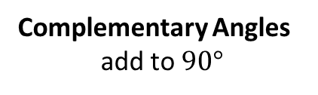

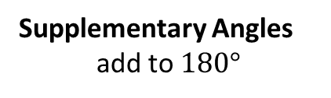





Just for your interest…
Have you ever wondered why “cosine” contains the word “sine”?
$$a$$
$$a$$
$$b$$
$$b$$
$$a$$
$$b$$
Supplementary Angles
add to $180°$
Complementary Angles
add to $90°$
Therefore these angles are complementary.
i.e. The cosine of an angle is the sine of the complementary angle.
Hence cosine = COMPLEMENTARY SINE
?
$$\cos\left(50\right)=\frac{x}{z}$$
$$z$$
$$50°$$
$$x$$
?
$$\sin\left(40\right)=\frac{x}{z}$$
$$40°$$
ME-WOW!
$$y$$
$$∴\cos\left(50\right)=\sin\left(40\right)$$

Slide 6
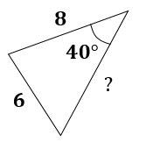
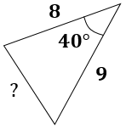
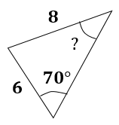
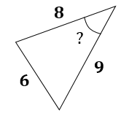
OVERVIEW: Finding missing sides and angles
When triangles are not right-angled, we can no longer use simple trigonometric ratios, and must use the cosine and sine rules.
You have | You want | Use
#1: Two angle-side opposite pairs | Missing angle or side in one pair | Sine rule
#2 Two sides known and a missing side opposite a known angle | Remaining side | Cosine rule
#3 All three sides | An angle | Cosine rule
#4 Two sides known and a missing side not opposite known angle | Remaining side | Sine rule twice
?
?
?
?

Slide 7




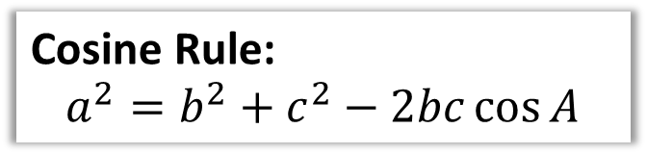





Cosine Rule
We use the cosine rule whenever we have three sides (and an angle) involved.
Proof at end of PowerPoint.
$$b$$
Cosine Rule:
$$a^{2}=b^{2}+c^{2}−2bc\cos{A}$$
$$15$$
$$A$$
The only angle in formula is $A$, so label angle in diagram $A$, label opposite side $a$, and so on ($b$ and $c$ can go either way).
$$x^{2}={15}^{2}+{12}^{2}−\left(2×15×12×\cos{115}\right) \\ x^{2}=521.14257… \\ x=22.83$$
$$115°$$
How are sides labelled ?
$$a$$
$$c$$
$$x$$
$$12$$
Calculation?

Slide 8
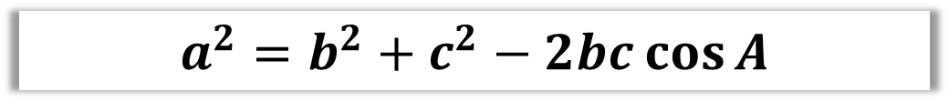




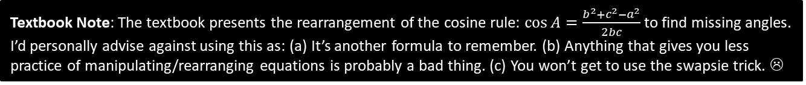

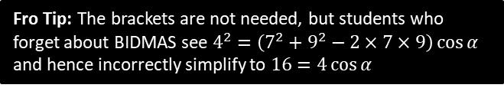
Dealing with Missing Angles
You have | You want | Use
All three sides | An angle | Cosine rule
$$a^{2}=b^{2}+c^{2}−2bc\cos{A}$$
$$7$$
Fro Tip: The brackets are not needed, but students who forget about BIDMAS see $4^{2}=\left(7^{2}+9^{2}−2×7×9\right)\cos{α}$ and hence incorrectly simplify to $16=4\cos{α}$
$$α$$
$$4$$
?
Label sides then substitute into formula.
$$9$$
$$4^{2}=7^{2}+9^{2}−\left(2×7×9×\cos{α}\right) \\ 16=130−126\cos{α} \\ 126\cos{α}=130−16 \\ \cos{α}=\frac{114}{126} \\ α=\cos^{−1}\left(\frac{114}{126}\right)=25.2°$$
?
Simplify each bit of formula.
?
Rearrange (I use ‘subtraction swapsie trick’ to swap thing you’re subtracting and result)
?
Textbook Note: The textbook presents the rearrangement of the cosine rule: $\cos{A}=\frac{b^{2}+c^{2}−a^{2}}{2bc}$ to find missing angles. I’d personally advise against using this as: (a) It’s another formula to remember. (b) Anything that gives you less practice of manipulating/rearranging equations is probably a bad thing. (c) You won’t get to use the swapsie trick. ☹

Slide 9


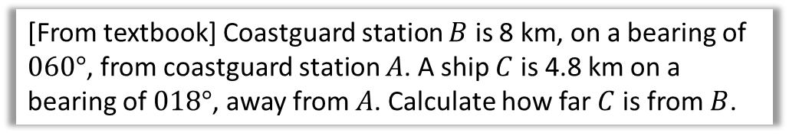



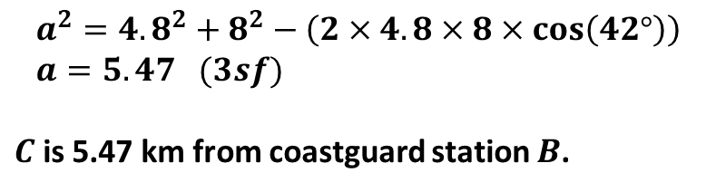










Harder Ones
Determine the value of $x$.
?
$${\left(2x−1\right)}^{2}=x^{2}+{\left(x+8\right)}^{2}−2x\left(x+8\right)\cos{60°} \\ 4x^{2}−4x+1=x^{2}+x^{2}+16x+64−x^{2}−8x \\ 3x^{2}−12x−63=0 \\ x^{2}−4x−21=0 \\ \left(x+3\right)\left(x−7\right)=0 \\ ∴x=7$$
$$x$$
$$2x−1$$
$$60°$$
$$x+8$$
[From textbook] Coastguard station $B$ is 8 km, on a bearing of $060°$, from coastguard station $A$. A ship $C$ is 4.8 km on a bearing of $018°$, away from $A$. Calculate how far $C$ is from $B$.
?
$$N$$
$$C$$
$$a km$$
$$B$$
$$a^{2}={4.8}^{2}+8^{2}−\left(2×4.8×8×\cos\left(42°\right)\right) \\ a=5.47 (3sf)$$
$C$ is 5.47 km from coastguard station $B$.
$$4.8km$$
$$18°$$
$$60°$$
$$8 km$$
$$A$$

Slide 10















Test Your Understanding
1
$$x$$
3
$$2x−3$$
$$5$$
$$70°$$
$$2x−2$$
$$6$$
$$3$$
2
$$60°$$
$$x$$
$$x=6.36°$$
?
$$θ$$
$$8$$
?
$$10$$
$$x=5$$
$$θ=124.2°$$
?
Fro Note: You will get an obtuse angle whenever you inverse cos a negative value.

Slide 11
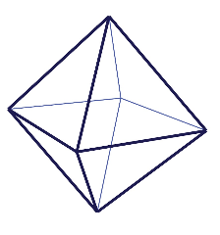
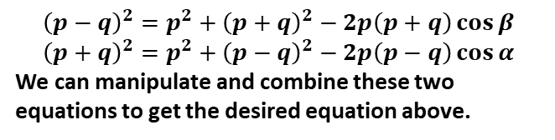


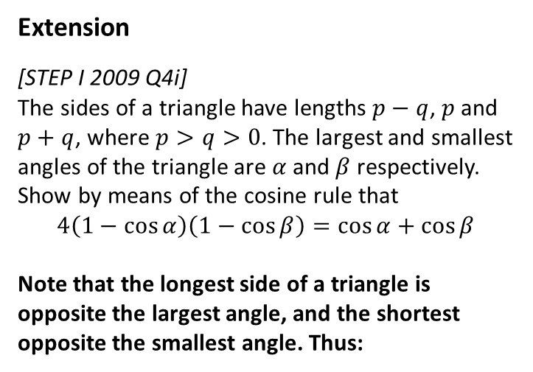



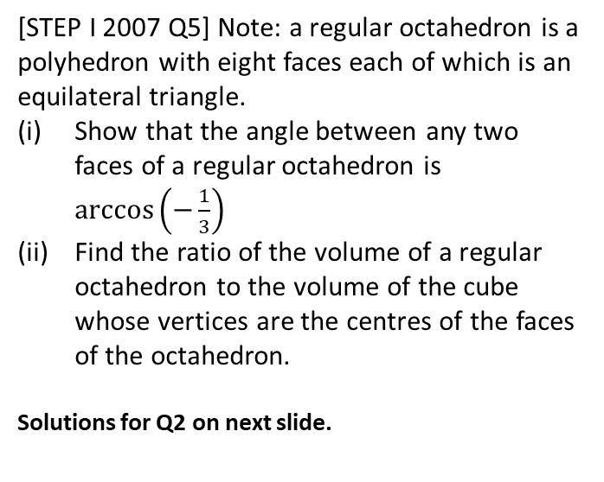
Exercise 9A
Complete before the lesson Q1-2
Green Q3-6
Amber Q7-13
Red Q14-17
Pearson Pure Mathematics
Pages 177-179
Extension
[STEP I 2009 Q4i]
The sides of a triangle have lengths $p−q$, $p$ and $p+q$, where $p>q>0$. The largest and smallest angles of the triangle are $α$ and $β$ respectively. Show by means of the cosine rule that
$$4\left(1−\cos{α}\right)\left(1−\cos{β}\right)=\cos{α+\cos{β}}$$
Note that the longest side of a triangle is opposite the largest angle, and the shortest opposite the smallest angle. Thus:
2
[STEP I 2007 Q5] Note: a regular octahedron is a polyhedron with eight faces each of which is an equilateral triangle.
Show that the angle between any two faces of a regular octahedron is $\arccos\left(−\frac{1}{3}\right)$
Find the ratio of the volume of a regular octahedron to the volume of the cube whose vertices are the centres of the faces of the octahedron.
Solutions for Q2 on next slide.
1
?
$$p$$
$$p−q$$
$$α$$
$$β$$
$$p+q$$
$${\left(p−q\right)}^{2}=p^{2}+{\left(p+q\right)}^{2}−2p\left(p+q\right)\cos{β} \\ {\left(p+q\right)}^{2}=p^{2}+{\left(p−q\right)}^{2}−2p\left(p−q\right)\cos{α}$$
We can manipulate and combine these two equations to get the desired equation above.

Slide 12
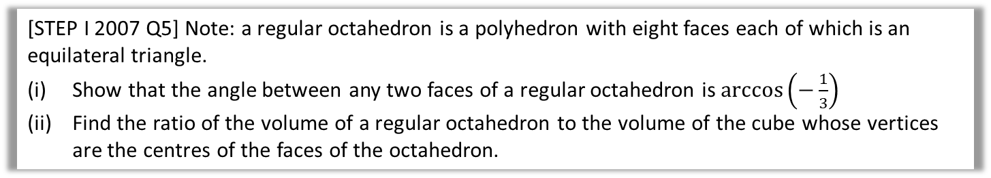

Solutions to Extension Question 2
[STEP I 2007 Q5] Note: a regular octahedron is a polyhedron with eight faces each of which is an equilateral triangle.
Show that the angle between any two faces of a regular octahedron is $\arccos\left(−\frac{1}{3}\right)$
Find the ratio of the volume of a regular octahedron to the volume of the cube whose vertices are the centres of the faces of the octahedron.
(Official solutions) Big, clear diagram essential!
Let the side length of the octahedron be $2k$. Then sloping “height” of a triangular face is $k\sqrt{3}$.
Also, the vertical height of the whole octahedron is $2k\sqrt{2}$.
Therefore, by the cosine rule, $8k^{2}=3k^{2}+3k^{2}−2\left(k\sqrt{3}\right)\left(k\sqrt{3}\right)\cos{A}$
Hence $A=arcos\left(−\frac{2k^{2}}{6k^{2}}\right)=\arccos\left(−\frac{1}{3}\right)$
The centre of each face is on any median of the equilateral triangle that is the face, and the centre is two-thirds of the way along the median from any vertex.
This is a quotable fact, but can be worked out from a diagram, using the fact that the centre of an equilateral triangle is equidistant from the three vertices: the centre divides the median in the ratio $1:\cos{60°}$.
The feet of the two medians from the apex of the octahedron in two adjacent triangles are $k\sqrt{2}$ apart. Therefore, by similarity, adjacent centres of the triangular faces are $\frac{2}{3}×k\sqrt{2}$ apart. Therefore, the volume of the cube (whose vertices are the centres of the faces) is
${\left(\frac{2}{3}×k\sqrt{2}\right)}^{3}=\frac{16k^{3}\sqrt{2}}{27}$
and the volume of the octahedron is $2×\frac{4k^{2}×k\sqrt{2}}{3}=\frac{8k^{3}\sqrt{2}}{3}$.
Hence the ratio of the volume of the octahedron to the volume of the cube is $9:2$.
?
?

Slide 13
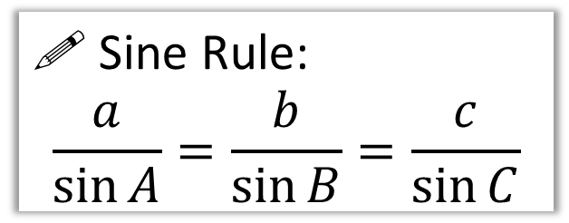
The Sine Rule
b
For this triangle, try calculating each side divided by the sin of its opposite angle. What do you notice in all three cases?
65°
c
5.02
A
10
85°
! Sine Rule:
$$\frac{a}{\sin{A}}=\frac{b}{\sin{B}}=\frac{c}{\sin{C}}$$
?
C
B
30°
9.10
a
You have | You want | Use
#1: Two angle-side opposite pairs | Missing angle or side in one pair | Sine rule

Slide 14
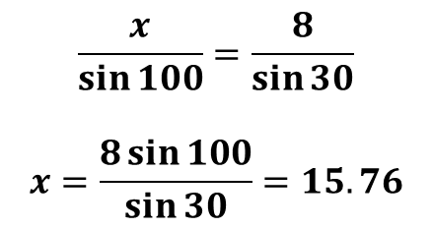
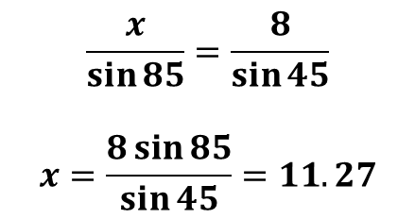
Examples
8
Q2
Q1
8
50°
85°
100°
15.76
45°
?
30°
11.27
?
$$\frac{x}{\sin{85}}=\frac{8}{\sin{45}}$$
$$x=\frac{8\sin{85}}{\sin{45}}=11.27$$
$$\frac{x}{\sin{100}}=\frac{8}{\sin{30}}$$
$$x=\frac{8\sin{100}}{\sin{30}}=15.76$$
You have | You want | Use
#1: Two angle-side opposite pairs | Missing angle or side in one pair | Sine rule

Slide 15
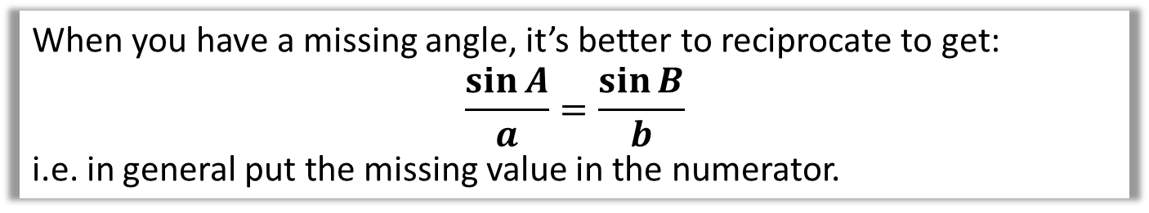
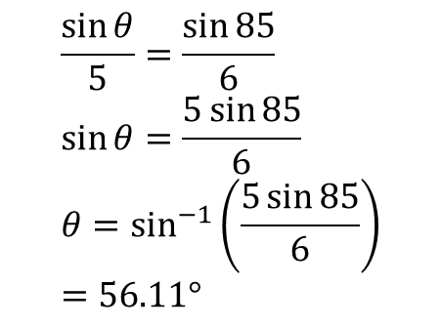
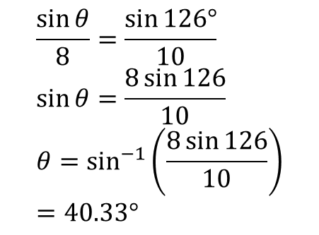
Examples
When you have a missing angle, it’s better to reciprocate to get:
$$\frac{\sin{A}}{a}=\frac{\sin{B}}{b}$$
i.e. in general put the missing value in the numerator.
5
Q3
Q4
8
126°
85°
40.33°
?
56.11°
6
10
?
$$\frac{\sin{θ}}{5}=\frac{\sin{85}}{6} \\ \sin{θ}=\frac{5\sin{85}}{6} \\ θ=\sin^{−1}\left(\frac{5\sin{85}}{6}\right) \\ =56.11°$$
$$\frac{\sin{θ}}{8}=\frac{\sin{126°}}{10} \\ \sin{θ}=\frac{8\sin{126}}{10} \\ θ=\sin^{−1}\left(\frac{8\sin{126}}{10}\right) \\ =40.33°$$

Slide 16
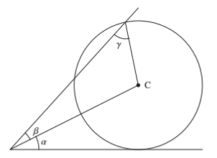
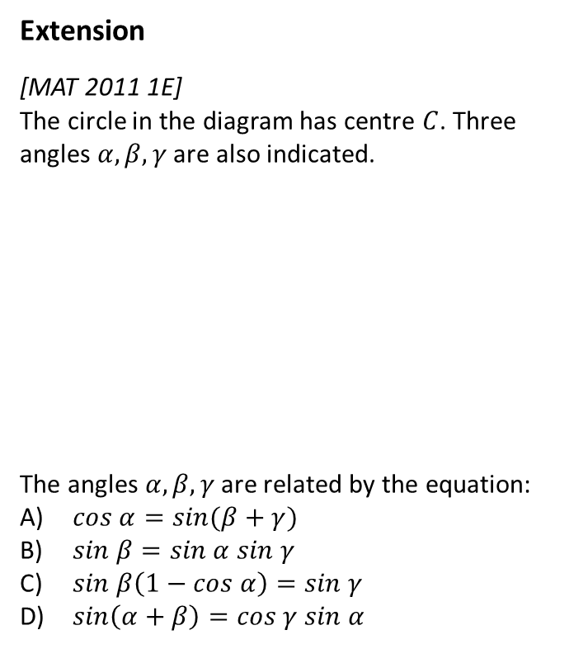


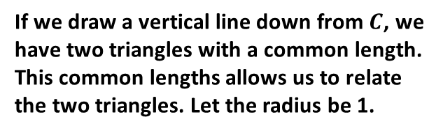
Exercise 9B
Complete before the lesson Q3-4
Green Q5-7
Amber Q8-9
Red Q10-12
Pearson Pure Mathematics
Pages 181-183
Extension
[MAT 2011 1E]
The circle in the diagram has centre $C$. Three angles $α, β, γ$ are also indicated.
The angles $α, β, γ$ are related by the equation:
$cos α=sin(β+γ)$
$sin β=sin α sin γ$
$sin β\left(1−cos α\right)=sin γ$
$sin\left(α+β\right)=cos γ sin α$
?
If we draw a vertical line down from $C$, we have two triangles with a common length. This common lengths allows us to relate the two triangles. Let the radius be 1.
1
1
$$x$$
1
Using bottom triangle:
$$1=x\sin{α → x=\frac{1}{\sin{α}}}$$
Using sine rule on top:
$$\frac{x}{\sin{γ}}=\frac{1}{\sin{β}}$$
Substituting in $x$ from the first equation, and rearranging, we obtain (B).

Slide 17
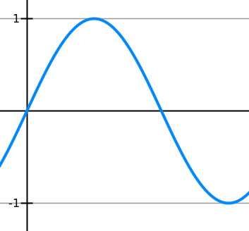
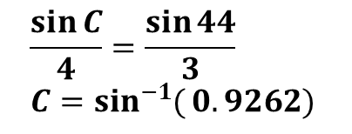

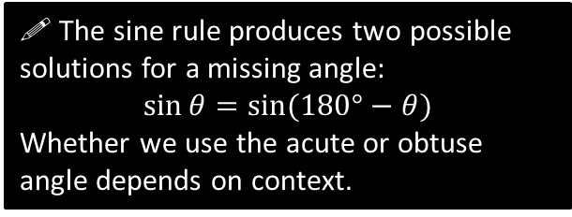

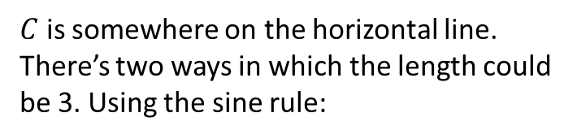




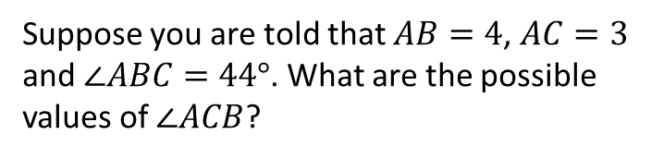
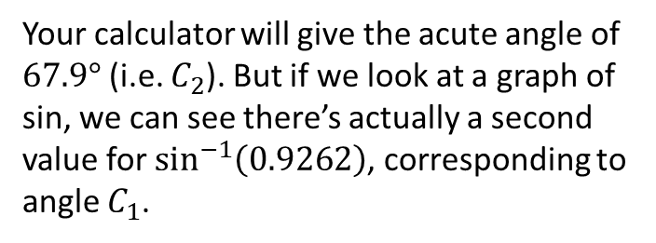





The ‘Ambiguous Case’
$$A$$
Suppose you are told that $AB=4$, $AC=3$ and $∠ABC=44°$. What are the possible values of $∠ACB$?
$C$ is somewhere on the horizontal line. There’s two ways in which the length could be 3. Using the sine rule:
$$4$$
$$3$$
$$3$$
$$\frac{\sin{C}}{4}=\frac{\sin{44}}{3} \\ C=\sin^{−1}{(}0.9262)$$
$$44°$$
Your calculator will give the acute angle of $67.9°$ (i.e. $C_{2}$). But if we look at a graph of sin, we can see there’s actually a second value for $\sin^{−1}\left(0.9262\right)$, corresponding to angle $C_{1}$.
$$B$$
$$C_{1}$$
$$C_{2}$$
0.9262
! The sine rule produces two possible solutions for a missing angle:
$$\sin{θ}=sin⁡(180°−θ)$$
Whether we use the acute or obtuse angle depends on context.
$$67.9°$$
$$112.1°$$
$$180°$$

Slide 18



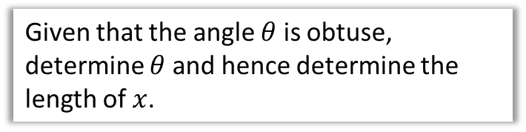

Test Your Understanding
Given that the angle $θ$ is obtuse, determine $θ$ and hence determine the length of $x$.
10
$$θ$$
5
?
$$20°$$
$$\frac{\sin{θ}}{10}=\frac{\sin{20°}}{5} \\ \sin^{−1}\left(\frac{10\sin{20°}}{5}\right)=43.1602° \\ ∴θ=180°−43.1602°=136.8398°$$
The other angle is:
$$180°−136.8398°−20°=23.1602°$$
Using sine rule again:
$$\frac{x}{\sin{23.1602°}}=\frac{5}{\sin{20°}}$$
$$x=5.75 (3sf)$$
$$x$$

Slide 19
Exercise 9C
Pearson Pure Mathematics Year 1/AS
Pages 184-185
Complete before the lesson Q1-2
Green Q3-4
Amber Q5-6

Slide 20
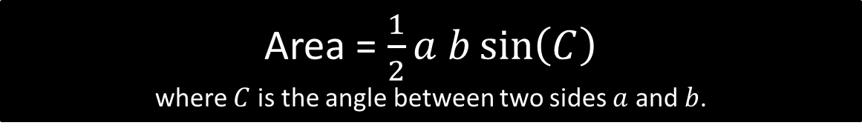
Area of Non Right-Angled Triangles
3cm
Area = 0.5 x 3 x 7 x sin(59)
= 9.00cm²
?
59°
7cm
!
Area = $\frac{1}{2}a b\sin\left(C\right)$
where $C$ is the angle between two sides $a$ and $b$.
Fro Tip: You shouldn’t have to label sides/angles before using the formula. Just remember that the angle is between the two sides.

Slide 21


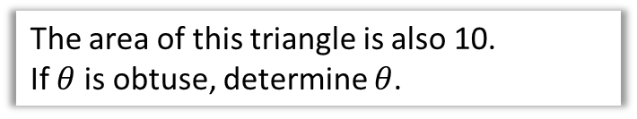







Test Your Understanding
The area of this triangle is 10.
Determine $x$.
$$x$$
?
$$\frac{1}{2}x\left(x+3\right)\sin\left(30°\right)=10 \\ \frac{1}{4}x\left(x+3\right)=10 \\ x\left(x+3\right)=40 \\ x^{2}+3x−40=0 \\ \left(x+8\right)\left(x−5\right)=0$$
As $x>0, x=5$
$$30°$$
$$x+3$$
$$5$$
The area of this triangle is also 10.
If $θ$ is obtuse, determine $θ$.
$$6$$
$$θ$$
?
$$\frac{1}{2}×5×6×\sin\left(θ\right)=10 \\ \sin\left(θ\right)=\frac{10}{15} \\ θ=180°−41.8°=138.2°$$

Slide 22
Exercise 9D
Pearson Pure Mathematics Year 1/AS
Pages 186-187
Complete before the lesson Q1-2
Green Q3-4
Amber Q5-6

Slide 23
















Sin or cosine rule?
Recall that whenever we have two “side-angle pairs” involved, use sine rule. If there’s 3 sides involved, we can use cosine rule. Sine rule is generally easier to use than cosine rule.
Sine
Cosine
$$3$$
$$3$$
$$100°$$
$$x$$
$$40°$$
$$a$$
$$5$$
$$5$$
Sine
Cosine
$$3$$
$$3$$
$$x$$
$$40°$$
$$2$$
$$45°$$
$$a$$
$$5$$
Sine
Cosine
Sine
Cosine

Slide 24






Using sine rule twice
You have | You want | Use
#4 Two sides known and a missing side not opposite known angle | Remaining side | Sine rule twice
Given there is just one angle involved, you might attempt to use the cosine rule:
$$3^{2}=x^{2}+4^{2}−\left(2×x×4×\cos{32}\right)$$
$$9=x^{2}+16−8x\cos{32}$$
$$4$$
?
$$3$$
$$32°$$
$$x$$
This is a quadratic equation!
It’s possible to solve this using the quadratic formula (using $a=1, b=−8\cos{32} ,$
$c=7$). However, this is a bit fiddly and not the primary method expected in the exam…

Slide 25







Using sine rule twice
You have | You want | Use
#4 Two sides known and a missing side not opposite known angle | Remaining side | Sine rule twice
!
2: Which means we would then know this angle.
$$4$$
?
$$180−32−44.9556=103.0444$$
1: We could use the sine rule to find this angle.
$$32°$$
$$3$$
3: Using the sine rule a second time allows us to find $x$
?
$$\frac{\sin{A}}{4}=\frac{\sin{32}}{3}$$
$$A=44.9556°$$
$$x$$
$$\frac{x}{\sin{103.0444}}=\frac{3}{\sin{32}} \\ x=5.52 to 3sf$$
?

Slide 26









Test Your Understanding
$$9$$
?
$$y=6.97$$
$$y$$
$$61°$$
$$10$$
$$4$$
$$3$$
$$53°$$
?
$$Area=6.00$$

Slide 27











Problem Solving With Sine/Cosine Rule
[From Textbook] The diagram shows the locations of four mobile phone masts in a field, $BC=75 m$.
$CD=80m$, angle $BCD=55°$ and angle $ADC=140°$.
In order that the masts do not interfere with each other, they must be at least 70m apart.
Given that $A$ is the minimum distance from $D$, find:
The distance $A$ is from $B$
The angle $BAD$
The area enclosed by the four masts.
Using triangle $BCD$:
$BD^{2}={75}^{2}+{80}^{2}−2×75×80×\cos{55°}$
$$BD=71.708…$$
Then use sine rule to find $∠BDC$:
$\frac{\sin\left(∠BDC\right)}{75}=\frac{\sin\left(55\right)}{71.708} → ∠BDC=58.954$
$$∴∠BDA=81.045…$$
We can then use cosine rule on $ΔABD$:
$$AB^{2}={70}^{2}+{71.708}^{2}−2×70×71.708×cos\left(81.045\right)$$
$$AB=92.1 m \left(3sf\right)$$
Using sine rule on $ΔABD, ∠BAD=50.3° (3sf)$
By adding areas of $ΔABD$ and $ΔBDC$:
$$Area ABCD=4940 m^{2} (3sf)$$
$$B$$
a
?
$$75 m$$
$$55°$$
$$A$$
$$C$$
$$70 m$$
$$140°$$
$$80 m$$
$$D$$
b
?
c
?

Slide 28


Exercise 9E
Pearson Pure Mathematics Year 1/AS
Pages 189-191
1
[AEA 2009 Q5a] The sides of the triangle $ABC$ have lengths $BC=a, AC=b$ and $AB=c$, where $a<b<c$. The sizes of the angles $A, B$ and $C$ form an arithmetic sequence.
Show that the area of triangle $ABC$ is $ac\frac{\sqrt{3}}{4}$.
Given that $a=2$ and $\sin{A}=\frac{\sqrt{15}}{5}$, find
(ii) the value of $b$,
(iii) the value of $c$.
2
[STEP I 2006 Q8] Note that the volume of a tetrahedron is equal to
$$\frac{1}{3}×area of base×height$$
The points $O, A, B, C$ have coordinates $\left(0,0,0\right),\left(a,0,0\right), \left(0,b,0\right)$ and $(0,0,c)$ respectively, where $a,b,c$ are positive.
Find, in terms of $a,b,c$ the volume of the tetrahedron $OABC$.
Let angle $ACB=θ$. Show that
$\cos{θ=\frac{c^{2}}{\sqrt{\left(a^{2}+c^{2}\right)\left(b^{2}+c^{2}\right)}}}$
and find, in terms of $a,b$ and $c$, the area of triangle $ABC$.
Hence show that $d$, the perpendicular distance of the origin from the triangle $ABC$, satisfies $\frac{1}{d^{2}}=\frac{1}{a^{2}}+\frac{1}{b^{2}}+\frac{1}{c^{2}}$
Complete before the lesson Q1
Green Q3-5
Amber Q6-9
Red Q10-15
Solutions to extension problems on next slides.

Slide 29


Solution to Extension Problem 1
[AEA 2009 Q5a] The sides of the triangle $ABC$ have lengths $BC=a, AC=b$ and $AB=c$, where $a<b<c$. The sizes of the angles $A, B$ and $C$ form an arithmetic sequence.
Show that the area of triangle $ABC$ is $ac\frac{\sqrt{3}}{4}$.
Given that $a=2$ and $\sin{A}=\frac{\sqrt{15}}{5}$, find
(ii) the value of $b$,
(iii) the value of $c$.

Slide 30


Solution to Extension Problem 2
[STEP I 2006 Q8] Note that the volume of a tetrahedron is equal to $\frac{1}{3}×area of base×height$
The points $O, A, B, C$ have coordinates $\left(0,0,0\right),\left(a,0,0\right), \left(0,b,0\right)$ and $(0,0,c)$ respectively, where $a,b,c$ are positive.
Find, in terms of $a,b,c$ the volume of the tetrahedron $OABC$.
Let angle $ACB=θ$. Show that
$\cos{θ=\frac{c^{2}}{\sqrt{\left(a^{2}+c^{2}\right)\left(b^{2}+c^{2}\right)}}}$
and find, in terms of $a,b$ and $c$, the area of triangle $ABC$.
Hence show that $d$, the perpendicular distance of the origin from the triangle $ABC$, satisfies $\frac{1}{d^{2}}=\frac{1}{a^{2}}+\frac{1}{b^{2}}+\frac{1}{c^{2}}$
This is FM content, but see a few lines below.

Slide 31


Sin Graph
What does it look like?
?
Key Features:
Repeats every $360°$.
Range: $−1<\sin\left(x\right)<1$
-360
-270
-180
-90
90
180
270
360

Slide 32
Sin Graph
What do the following graphs look like?
-360
-270
-180
-90
90
180
270
360
Suppose we know that sin(30) = 0.5. By thinking about symmetry in the graph, how could we work out:
sin(150) = 0.5
?
sin(-30) = -0.5
?
sin(210) = -0.5
?

Slide 33


Cos Graph
What do the following graphs look like?
?
Key Features:
Repeats every $360°$.
Range: $−1<\sin\left(x\right)<1$
-360
-270
-180
-90
90
180
270
360

Slide 34
Cos Graph
What does it look like?
-360
-270
-180
-90
90
180
270
360
Suppose we know that cos(60) = 0.5. By thinking about symmetry in the graph, how could we work out:
cos(120) = -0.5
?
cos(-60) = 0.5
cos(240) = -0.5
?
?

Slide 35


Tan Graph
What does it look like?
?
-360
-270
-180
-90
90
180
270
360
Key Features:
Repeats every $180°$.
Roots: $0,180°,−180°, …$
Range: $\tan\left(x\right)∈ℝ$ (i.e. no min/max value!)
Asymptotes: $x=±90°, ±270°,…$

Slide 36



Tan Graph
What does it look like?
-360
-270
-180
-90
90
180
270
360
Suppose we know that $\tan\left(30°\right)=\frac{1}{\sqrt{3}}$. By thinking about symmetry in the graph, how could we work out:
$$\tan\left(−30°\right)=−\frac{1}{\sqrt{3}}$$
?
$$\tan\left(150°\right)=−\frac{1}{\sqrt{3}}$$
?

Slide 37

















Transforming Trigonometric Graphs
There is no new theory here: just use your knowledge of transforming graphs, i.e. whether the transformation occurs ‘inside’ the function (i.e. input modified) or ‘outside’ the function (i.e. output modified).
Sketch $y=4\sin{x}$, $0≤x≤360°$
Sketch $y=\cos\left(x+45°\right)$, $0≤x≤360°$
?
?
$$y$$
$$y$$
$$×4$$
$$45°$$
$$4$$
$$1$$
$$x$$
$$x$$
$$90°$$
$$180°$$
$$270°$$
$$360°$$
$$−90°$$
$$90°$$
$$180°$$
$$270°$$
$$360°$$
$$−4$$
$$−1$$

Slide 38












Transforming Trigonometric Graphs
Sketch $y=−\tan{x}$, $0≤x≤360°$
Sketch $y=\sin\left(\frac{x}{2}\right)$, $0≤x≤360°$
?
?
$$×(−1)$$
$$y$$
$$×2$$
$$y$$
$$1$$
$$x$$
$$90°$$
$$180°$$
$$270°$$
$$360°$$
$$x$$
$$90°$$
$$180°$$
$$270°$$
$$360°$$
$$−1$$

Slide 39





Exercise 9F/9G
Complete before the lesson Ex9F
Green Ex9G Q1-3
Amber Ex9G Q4-5
Red Ex9G Q6-9
Pearson Pure Mathematics
Pages 194, 197-198
Extension
1
[MAT 2013 1B] The graph of $y=\sin{x}$ is reflected first in the line $x=π$ and then in the line $y=2$. The resulting graph has equation:
$y=\cos{x}$
$y=2+\sin{x}$
$y=4+\sin{x}$
$y=2−\cos{x}$
Solution: C
3
[MAT 2007 1G] On which of the axes is a sketch of the graph
$$y=2^{−x}\sin^{2}\left(x^{2}\right)$$
?
2
[MAT 2011 1D] What fraction of the interval
$0≤x≤360°$ is one (or both) of the inequalities:
$$\sin{x}≥\frac{1}{2}, \sin{2x}≥\frac{1}{2}$$
true?
Solution: $\frac{13}{24}$ (this is clear if you draw the graphs $y=\sin{x}$ and $y=\sin{2x}$ on the same axes)
$2^{−x}$ and $s{in}^{2}$ are always positive eliminating (b). When $x=0, y=0$ eliminating (d). Multiplying by $2^{−x}$ causes the amplitude of the peaks to go down as $x$ increases. The $x^{2}$ increases more rapidly as $x$ increases, hence reducing the wavelength (i.e. distance between peaks). The answer is therefore (a).
?
?

Slide 40








APPENDIX :: Proof of Cosine Rule
We want to use Pythagoras, so split $c$ into two so that we get two right-angled triangles.
$$b$$
$$a$$
$$h$$
$$A$$
$$c−x$$
$$x$$
By Pythagoras: $h^{2}+x^{2}=b^{2}$ and $h^{2}+{\left(c−x\right)}^{2}=a^{2}$
Subtracting to eliminate $h$:
$$x^{2}−{\left(c−x\right)}^{2}=b^{2}−a^{2} \\ a^{2}=b^{2}+c^{2}−2cx$$
But $x=b\cos{A}∴$
$$a^{2}=b^{2}+c^{2}−2bc\cos{A}$$

Slide 41










APPENDIX :: Proof of Sine Rule
$$C$$
The idea is that we can use the common length of $ΔACX$ and $∠XBC$, i.e. $h$, to connect the two triangles, and therefore connect their angles/length.
$$b$$
$$a$$
$$h$$
$$A$$
$$B$$
$$X$$
$$c$$
Using basic trigonometry:
$h=a\sin{B}$ and $h=b\sin{A}$
$$∴a\sin{B}=b\sin{A} \\ ∴\frac{a}{\sin{A}}=\frac{b}{\sin{B}}$$

