Slide 1
Year 2 Applied Mathematics
Regression Correlation and Hypothesis Testing
- Measuring Correlation
Chapter 1
(Part 2 of 3)

Slide 2
Measuring Correlation
You have used qualitative terms such as
“strong positive correlation”,
“ weak negative correlation”
and “no correlation”
to describe the type and strength of correlation.
The Product Moment Correlation Coefficient
is one way to quantify this.

Slide 3
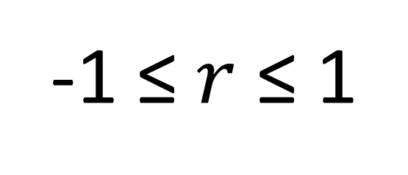

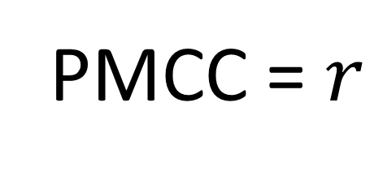




Measuring Correlation
The Product Moment Correlation Coefficient
PMCC = $r$
-1 ≤ $r$ ≤ 1
$$−1$$
$−0.7$
$$0$$
$0.7$
$$1$$
Perfect
Negative
Correlation
Strong
Negative
No
Negative
Strong
Positive
Perfect
Positive
Correlation
(Note: PMCC is only applicable for a linear correlation)

Slide 4


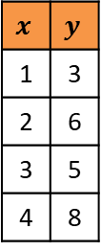
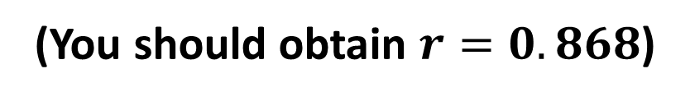



Measuring Correlation - Calculating $r$
Instructions for Casio ClassWiz:
6: Statistics
Press MODE then select ‘Statistics’.
$$y=a+bx$$
We want to measure linear correlation,
so select $y=a+bx$
$$x$$ | $$y$$
1 | 3
2 | 6
3 | 5
4 | 8
Data Entry
PMCC
Press OPTN then choose “Regression Calc”
to obtain $r$.
(You should obtain $r=0.868$)
You should obtain $r=0.868$

Slide 5
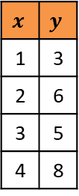
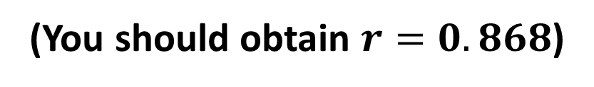
Measuring Correlation - Calculating $r$
Instructions for Casio Graphical Calculator:
2: Statistics
Press MODE then select ‘Statistics’.
$$x$$ | $$y$$
1 | 3
2 | 6
3 | 5
4 | 8
Data Entry
Calc
REG
Press REG. Can be found on the bottom of the screen.
X
Press X. Can be found on the bottom of the screen.
ax + b
Press ax + b. Can be found on the bottom of the screen.
(You should obtain $r=0.868$)

Slide 6
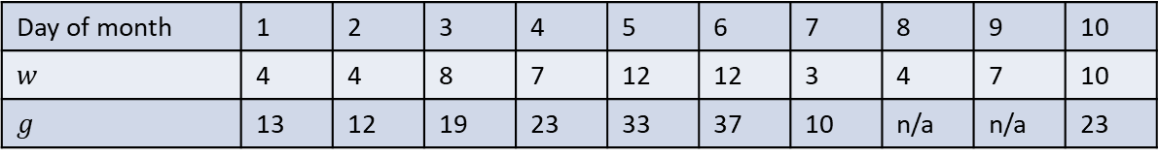
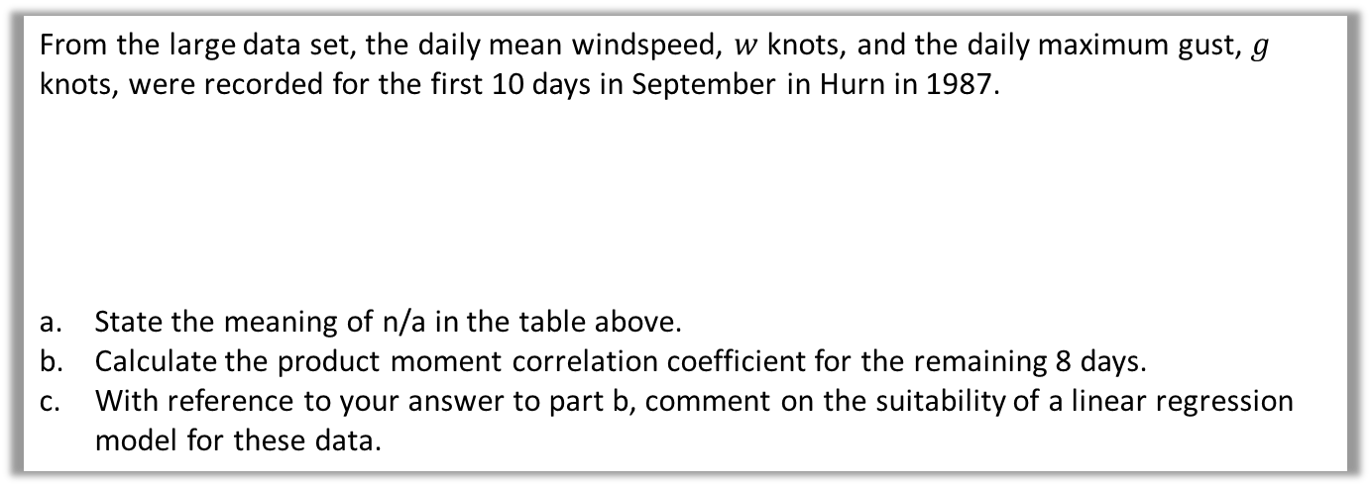
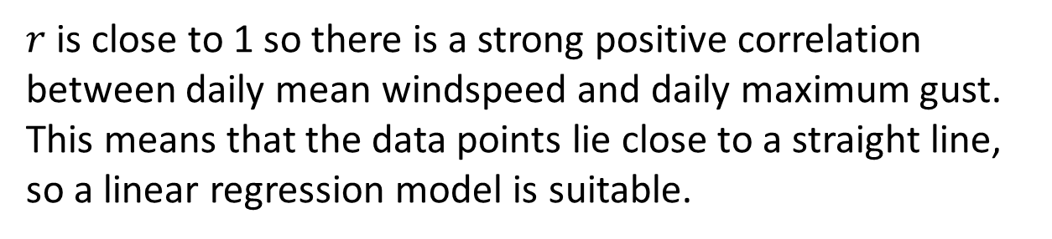

Measuring Correlation - Example
From the large data set, the daily mean windspeed, $w$ knots, and the daily maximum gust, $g$ knots, were recorded for the first 10 days in September in Hurn in 1987.
State the meaning of n/a in the table above.
Calculate the product moment correlation coefficient for the remaining 8 days.
With reference to your answer to part b, comment on the suitability of a linear regression model for these data.
Day of month | 1 | 2 | 3 | 4 | 5 | 6 | 7 | 8 | 9 | 10
$$w$$ | 4 | 4 | 8 | 7 | 12 | 12 | 3 | 4 | 7 | 10
$$g$$ | 13 | 12 | 19 | 23 | 33 | 37 | 10 | n/a | n/a | 23
Data on daily maximum gust is not available for these days.
a
b
$$r=0.9533$$
$r$ is close to 1 so there is a strong positive correlation between daily mean windspeed and daily maximum gust. This means that the data points lie close to a straight line, so a linear regression model is suitable.
c

Slide 7
Exercise 1B
Pearson Pure Mathematics Year 1/AS
Pages 6-8
Complete before the lesson Q1-3
In Class:
Green Q6
Amber Q4&5
Red Q7 & Challenge

