Slide 1
Year 1 Applied Mathematics
Variable Acceleration
- Using Integration
Chapter 11
(Part 4 of 4)

Slide 2
Variable Acceleration - Using Calculus
Displacement (s)
differentiate
integration
Velocity (v)
differentiate
integration
Acceleration (a)

Slide 3
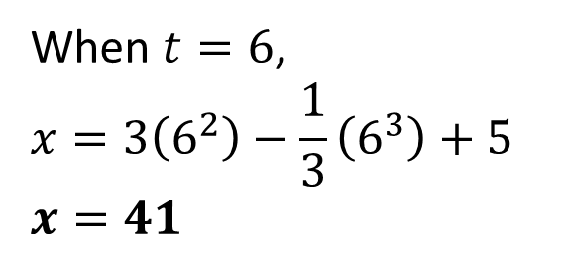
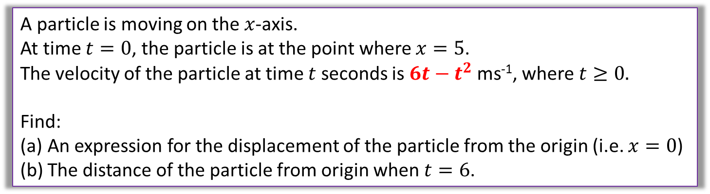
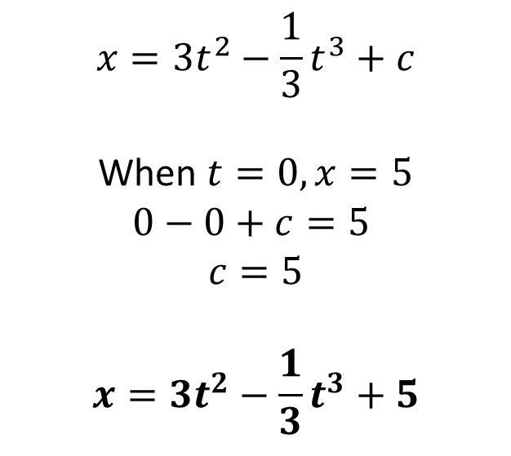
Variable Acceleration - Using integration
A particle is moving on the $x$-axis.
At time $t=0$, the particle is at the point where $x=5$.
The velocity of the particle at time $t$ seconds is $6t−t^{2}$ ms⁻¹, where $t≥0.$
Find:
An expression for the displacement of the particle from the origin (i.e. $x=0$)
The distance of the particle from origin when $t=6$.
$$x=3t^{2}−\frac{1}{3}t^{3}+c$$
When $t=0, x=5$
$$0−0+c=5$$
$$c=5$$
$$x=3t^{2}−\frac{1}{3}t^{3}+5$$
a
b
When $t=6$,
$$x=3\left(6^{2}\right)−\frac{1}{3}\left(6^{3}\right)+5$$
$$x=41$$

Slide 4
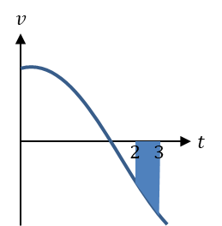
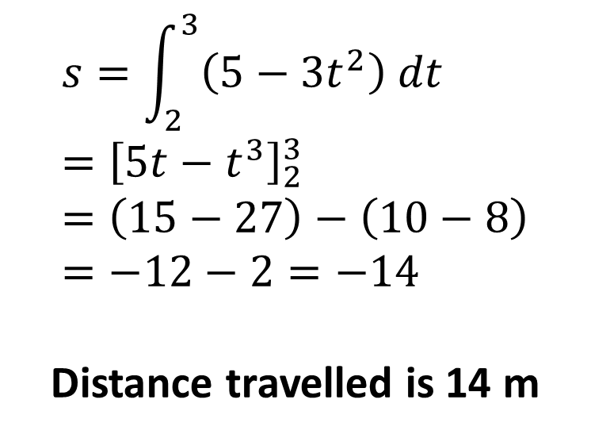
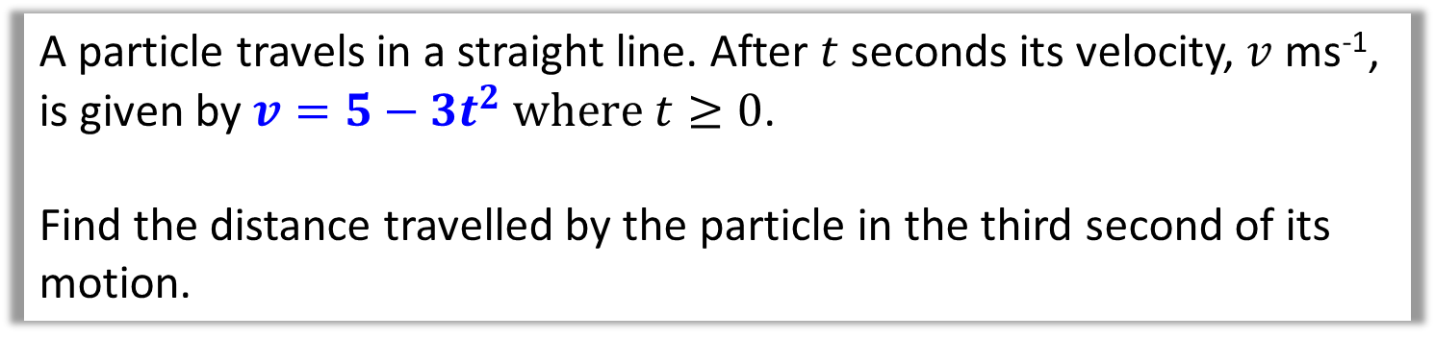
Variable Acceleration - Using integration
A particle travels in a straight line. After $t$ seconds its velocity, $v$ ms⁻¹,
is given by $v=5−3t^{2} where$ $t≥0$.
Find the distance travelled by the particle in the third second of its motion.
$$s=\int_{2}^{3}{\left(5−3t^{2}\right) dt} \\ ={\left[5t−t^{3}\right]}_{2}^{3}=\left(15−27\right)−\left(10−8\right) \\ =−12−2=−14$$
Distance travelled is 14 m

Slide 5
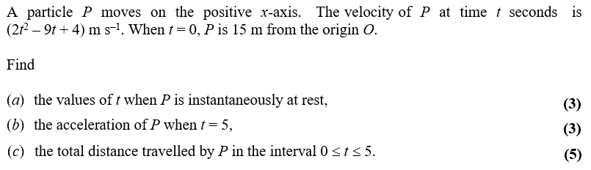
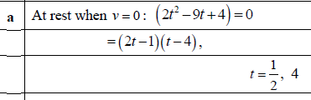
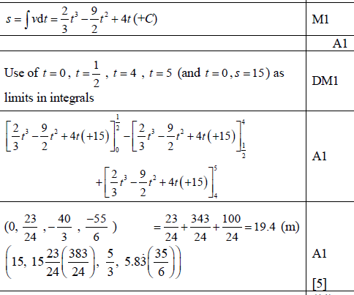
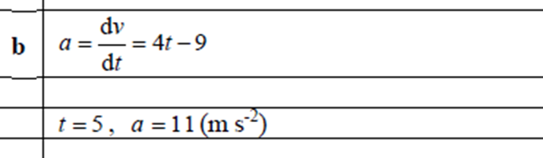
Variable Acceleration – Exam Question

Slide 6
Exercise 11D
Pearson Stats/Mechanics Year 1
Page 189-191
Complete before the lesson Q1
In Class:
Green Q2-4
Amber Q5-8
Red Q9-12 & Challenge

Slide 7
Exercise 11E
Pearson Stats/Mechanics Year 1
Pages 192-193
Complete before the lesson Q1
In Class:
Amber Q2-3
Red Q4-6

