Slide 1
Year 2 Applied Mathematics
Correlation and Regression
- Correlation
Chapter 5
(Part 1 of 2)

Slide 2
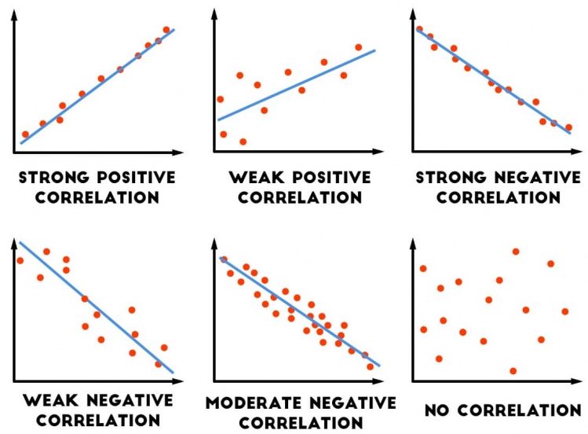
Correlation
Correlation gives the strength and type
of the relationship between two variables.

Slide 3
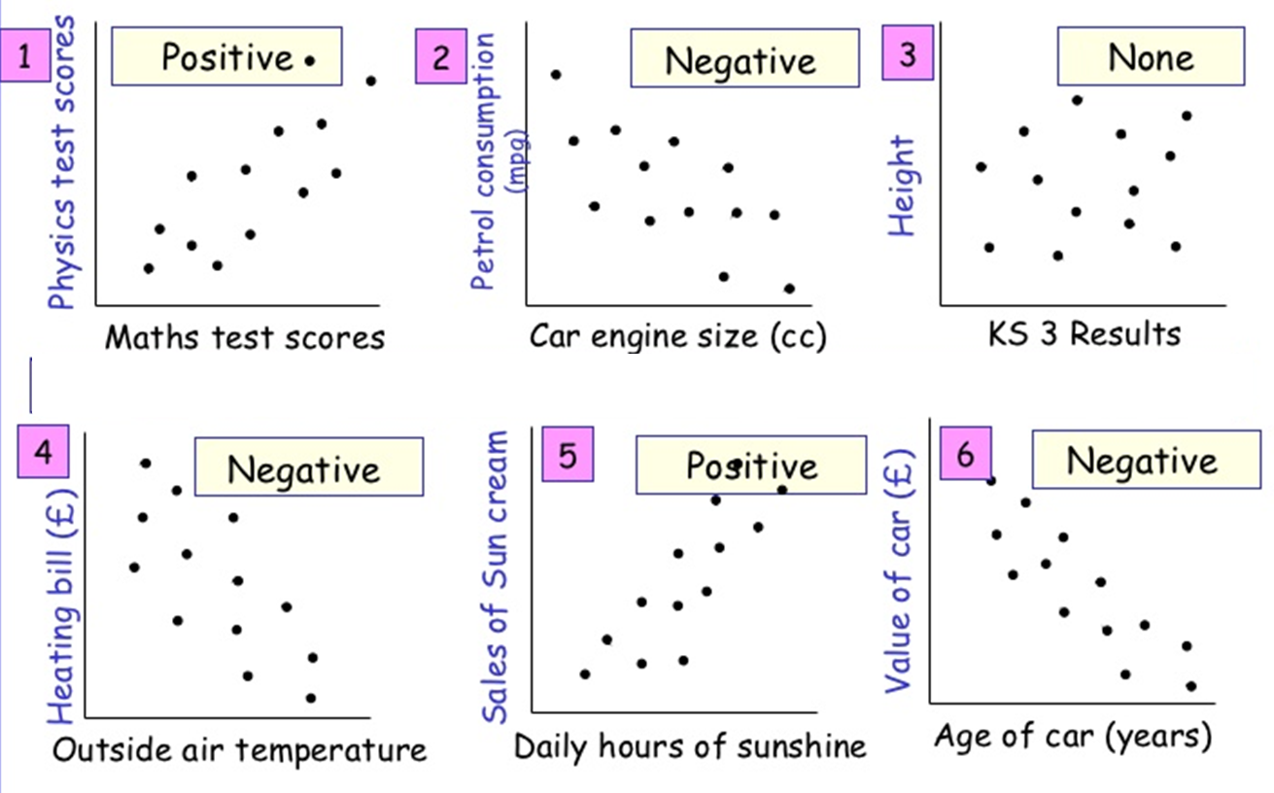
Correlation
The vertical-axis variable usually depends
on the horizontal-axis value.

Slide 4
Correlation
Note the difference between being asked for
the correlation and to describe the relationship.
State the correlation: positive, negative
or no correlation. Also state the strength.
To describe (or interpret) is to give a worded description in the context of the problem.

Slide 5
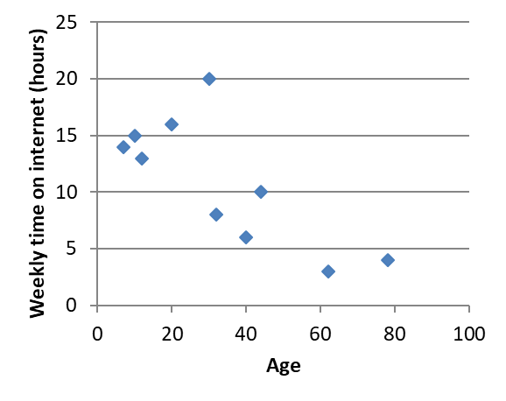
Correlation
Correlation: Weak Negative
Describe: As you increase with age you spend less time on the internet

Slide 6
Exercise 4A
Pearson Statistics/Mechanics Year 1/AS
Pages 61-62
Complete before the lesson Q1
In Class:
Green Q2-3
Amber Q4-5

