Slide 1
Year 1 Pure Mathematics
Vectors
- Introduction
Chapter 11
(Part 1 of 2)

Slide 2
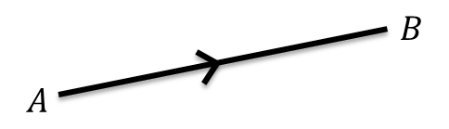
Vector - Properties
A vector gets you from A to B!
A vector has 2 properties:
Direction
Magnitude (i.e. length)

Slide 3
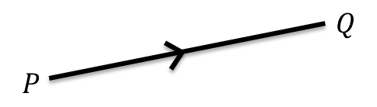
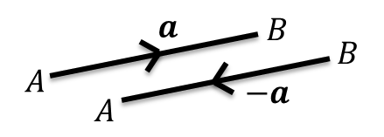
Vector - Properties
If $P$ and $Q$ are points then $\vec{PQ}$ is the vector between them.
Opposite directions – the label becomes a negative

Slide 4



Vector - Scalar
A scalar is a normal number,
which can be used to ‘scale’ a vector.
The direction will be the same.
But the magnitude will be different
unless the scalar is 1).
$$a$$
$$2a$$
$$−\frac{1}{2}a$$
If scalar is negative, opposite direction.

Slide 5


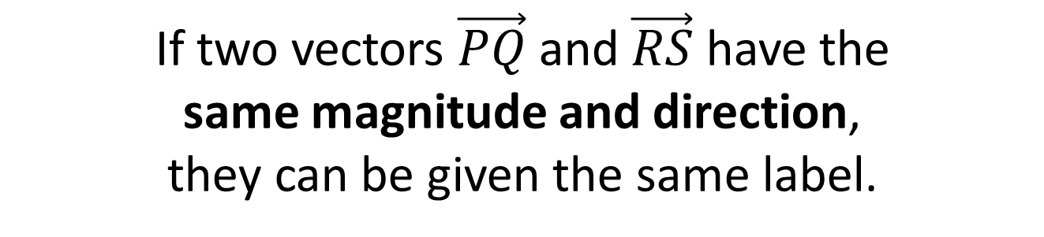



Vector - Lables
If two vectors $\vec{PQ}$ and $\vec{RS}$ have the
same magnitude and direction,
they can be given the same label.
a
$$Q$$
$$P$$
$$S$$
$$R$$
$PQ$ = a and RS = a

Slide 6












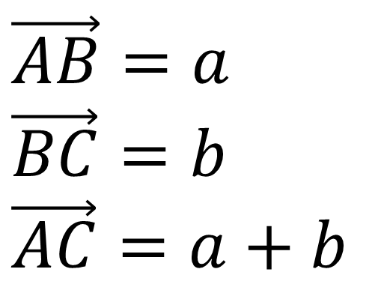
Vector - Adding
Adding Vectors
$$\vec{AB}+\vec{BC}=\vec{AC}$$
$$B$$
$$B$$
$$b$$
$$\vec{AB}=a$$
$$\vec{BC}=b$$
$$\vec{AC}=a+b$$
$$b$$
$$a$$
$$a$$
$$C$$
$$C$$
$$A$$
$$a+b$$
$$A$$

Slide 7
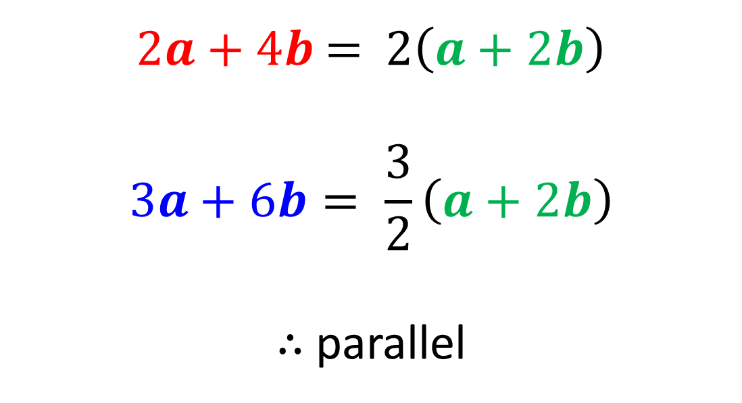

Vector - Parallel
Vectors are parallel if one is a multiple of the other.
Show $2a+4b$ and $3a+6b$ are parallel
$2a+4b$ = $2\left(a+2b\right)$
$$3a+6b= \frac{3}{2}\left(a+2b\right)$$
$∴$parallel

Slide 8


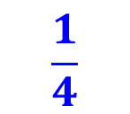
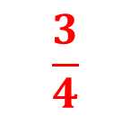

Vector - Ratios
AC:CB
is in the ratio
3:1
$$A$$
$$\frac{3}{4}$$
$$C$$
$$\frac{1}{4}$$
$$B$$

Slide 9
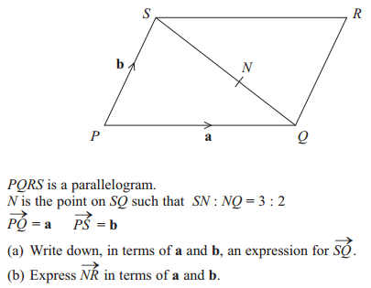

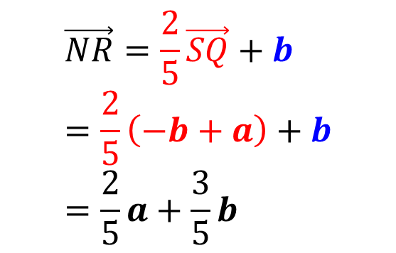
Vector – Exam Questions and Answers
3 : 2
$$\vec{NR}=\frac{2}{5}\vec{SQ}+b \\ =\frac{2}{5}\left(−b+a\right)+b \\ =\frac{2}{5}a+\frac{3}{5}b$$
a
$$\vec{SQ}=−b+a$$
b

Slide 10
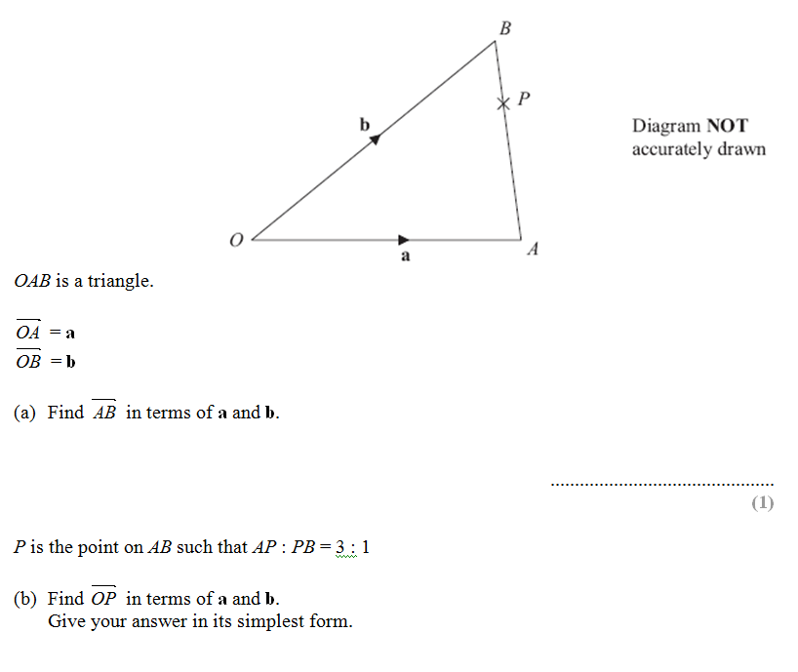
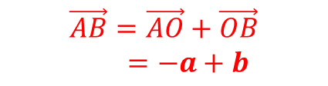

Vector – Exam Questions and Answers
$$\vec{AB}=\vec{AO}+\vec{OB}$$
$=−a+b$
$$\vec{OP}=a+\frac{3}{4}\vec{AB}$$
$=a+\frac{3}{4}\left(−a+b\right)$
$=\frac{1}{4}a+\frac{3}{4}b$

Slide 11
Exercise 11A
Pearson Pure Mathematics Year 1/AS
Pages 234-235
Complete before the lesson Q1-4
Green Q5-7
Amber Q8-11

Slide 12
Exercise 11B
Pearson Pure Mathematics Year 1/AS
Pages 237-238
Complete before the lesson Q1-3
Green Q4-7
Amber Q8-10

