Slide 1

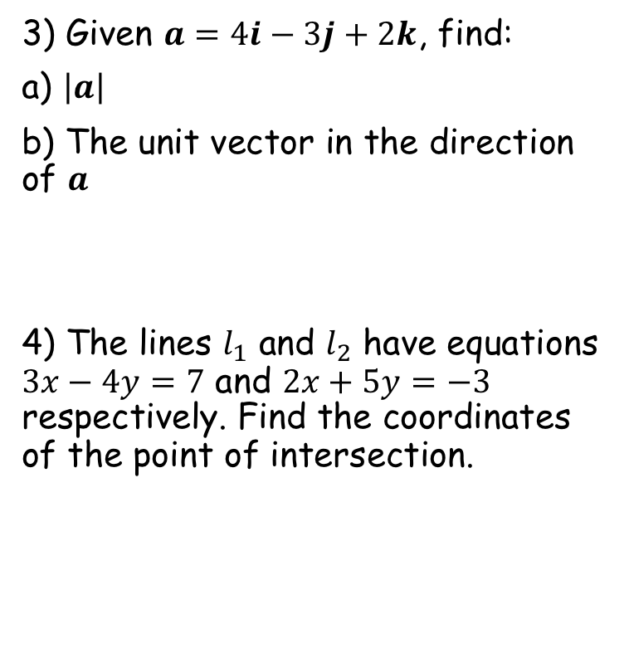

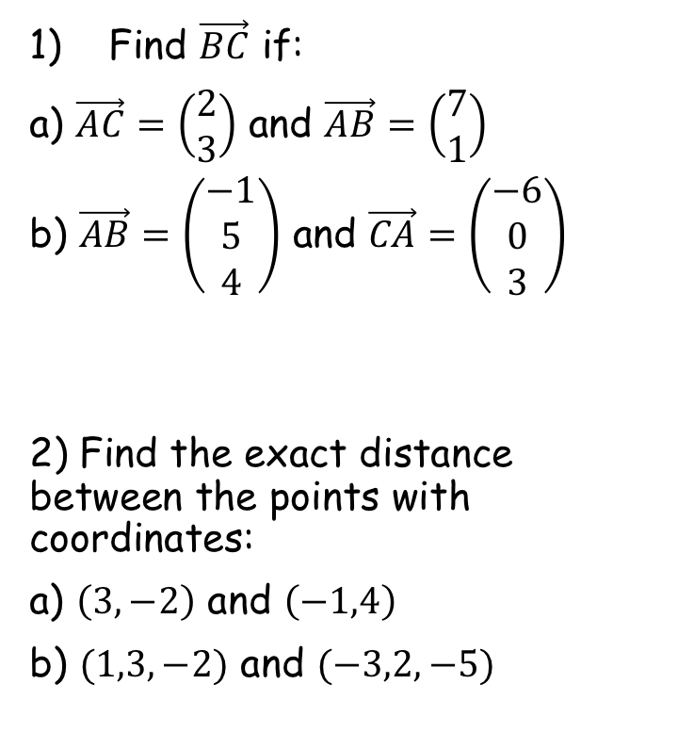

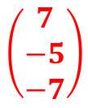


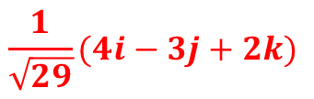
Prior Knowledge Check
Find $\vec{BC}$ if:
a) $\vec{AC}=\left(\begin{matrix}2 \\ 3\end{matrix}\right)$ and $\vec{AB}=\left(\begin{matrix}7 \\ 1\end{matrix}\right)$
b) $\vec{AB}=\left(\begin{matrix}−1 \\ 5 \\ 4\end{matrix}\right)$ and $\vec{CA}=\left(\begin{matrix}−6 \\ 0 \\ 3\end{matrix}\right)$
2) Find the exact distance between the points with coordinates:
a) $\left(3,−2\right)$ and $\left(−1,4\right)$
b) $(1,3,−2)$ and $(−3,2,−5)$
3) Given $a=4i−3j+2k$, find:
a) $\left|a\right|$
b) The unit vector in the direction of $a$
4) The lines $l_{1}$ and $l_{2}$ have equations $3x−4y=7$ and $2x+5y=−3$ respectively. Find the coordinates of the point of intersection.
$$\left(\begin{matrix}−5 \\ 2\end{matrix}\right)$$
$$\sqrt{29}$$
$$\frac{1}{\sqrt{29}}(4i−3j+2k)$$
$$\left(\begin{matrix}7 \\ −5 \\ −7\end{matrix}\right)$$
$$2\sqrt{13}$$
$$(1,−1)$$
$$\sqrt{26}$$

Slide 2
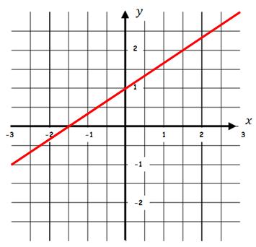
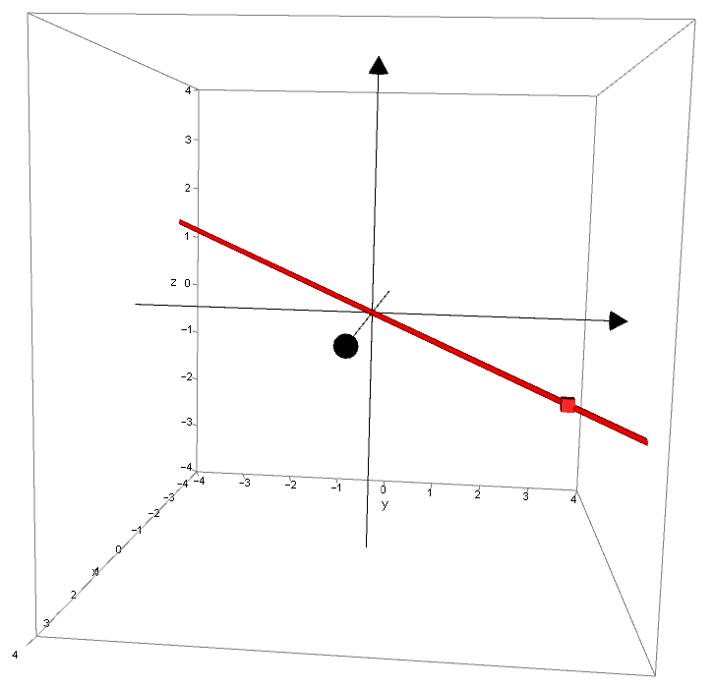






Vectors
You need to be able to write the equation of a straight line in three dimensions in vector form
Direction vector
In 2 dimensions:
Position vector
In 3 dimensions:
$$y=mx+c$$
$$r=a+λb$$
→ The $c$ represents a point on the line
→ The $a$ represents a point on the line (in 3 dimensions)
→ The $m$ represents the direction of the line
→ The $b$ represents the direction of the line
CLICK
9A

Slide 3
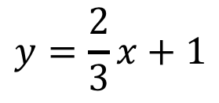
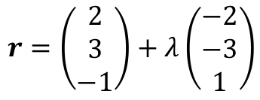
Vectors
You need to be able to write the equation of a straight line in three dimensions in vector form
In 2 dimensions:
In 3 dimensions:
$$y=\frac{2}{3}x+1$$
$$r=\left(\begin{matrix}2 \\ 3 \\ −1\end{matrix}\right)+λ\left(\begin{matrix}−2 \\ −3 \\ 1\end{matrix}\right)$$
9A

Slide 4
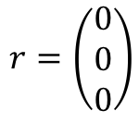
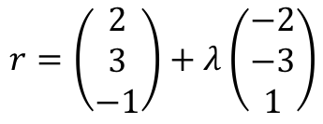
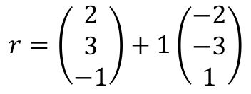

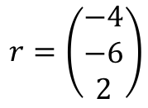
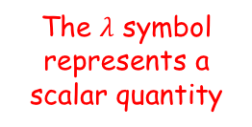
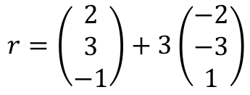
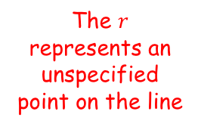

Vectors
You need to be able to write the equation of a straight line in three dimensions in vector form
$$r=\left(\begin{matrix}2 \\ 3 \\ −1\end{matrix}\right)+λ\left(\begin{matrix}−2 \\ −3 \\ 1\end{matrix}\right)$$
The direction vector represents the direction the line is moving
Overall, this tells us that any point on the line is equal to the position vector, plus a multiple of the direction vector…
The $r$ represents an unspecified point on the line
For example, if $λ=3$
For example, if $λ=1$
The $λ$ symbol represents a scalar quantity
This position vector represents a specific point on the line
$$r=\left(\begin{matrix}2 \\ 3 \\ −1\end{matrix}\right)+3\left(\begin{matrix}−2 \\ −3 \\ 1\end{matrix}\right)$$
$$r=\left(\begin{matrix}2 \\ 3 \\ −1\end{matrix}\right)+1\left(\begin{matrix}−2 \\ −3 \\ 1\end{matrix}\right)$$
$$r=\left(\begin{matrix}−4 \\ −6 \\ 2\end{matrix}\right)$$
$$r=\left(\begin{matrix}0 \\ 0 \\ 0\end{matrix}\right)$$
9A

Slide 5
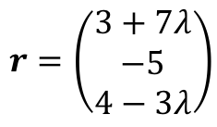

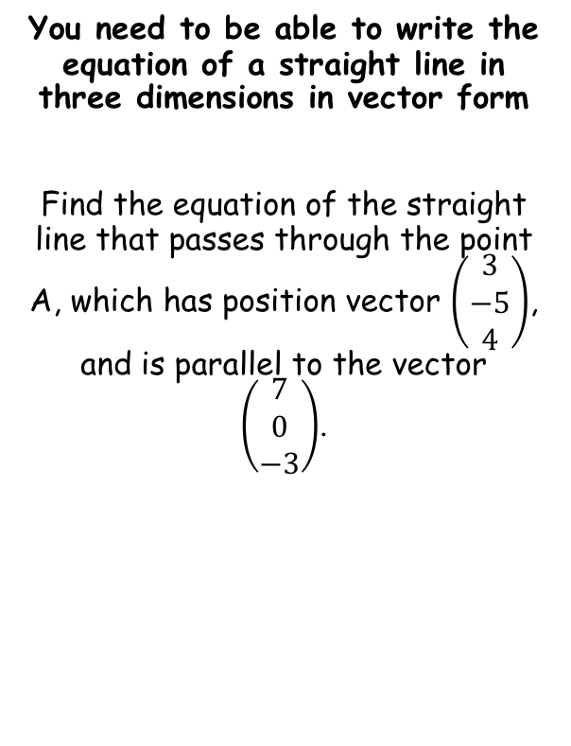

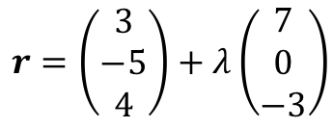

Vectors
$$r=a+λb$$
You need to be able to write the equation of a straight line in three dimensions in vector form
Find the equation of the straight line that passes through the point A, which has position vector $\left(\begin{matrix}3 \\ −5 \\ 4\end{matrix}\right)$, and is parallel to the vector $\left(\begin{matrix}7 \\ 0 \\ −3\end{matrix}\right)$.
$$r=a+λb$$
Replace the position vector and the direction vector
$$r=\left(\begin{matrix}3 \\ −5 \\ 4\end{matrix}\right)+λ\left(\begin{matrix}7 \\ 0 \\ −3\end{matrix}\right)$$
Alternative forms
→ You can also write the vector in these ways…
$$r=(3i−5j+4k)+λ\left(7i−3k\right)$$
$$r=\left(3+7λ\right)i+\left(−5\right)j+\left(4−3λ\right)k$$
$$r=\left(\begin{matrix}3+7λ \\ −5 \\ 4−3λ\end{matrix}\right)$$
9A

Slide 6

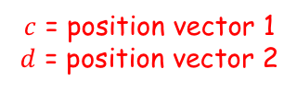
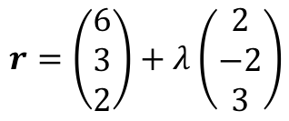
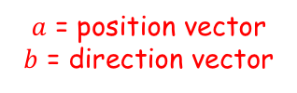
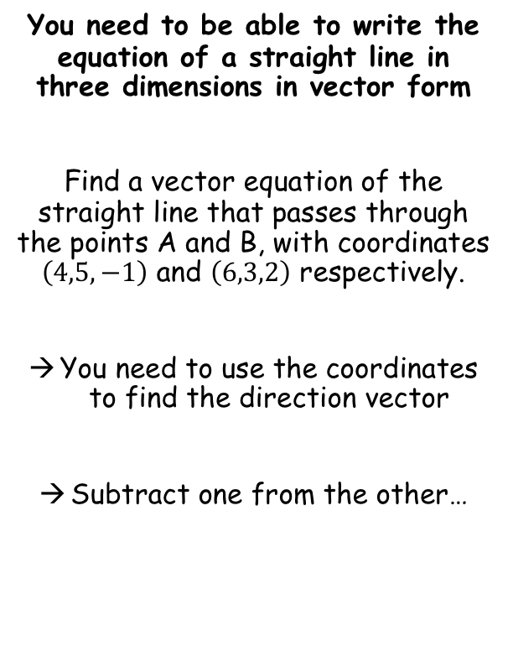

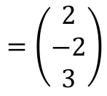

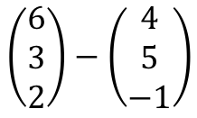
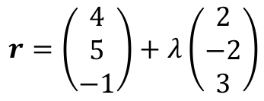
Vectors
$$r=a+λb$$
$$r=c+λ(d−c)$$
$a$ = position vector
$b$ = direction vector
$c$ = position vector 1
$d$ = position vector 2
You need to be able to write the equation of a straight line in three dimensions in vector form
Find a vector equation of the straight line that passes through the points A and B, with coordinates $\left(4,5,−1\right)$ and $\left(6,3,2\right)$ respectively.
You need to use the coordinates to find the direction vector
Subtract one from the other…
$$\left(\begin{matrix}6 \\ 3 \\ 2\end{matrix}\right)−\left(\begin{matrix}4 \\ 5 \\ −1\end{matrix}\right)$$
Calculate
$$=\left(\begin{matrix}2 \\ −2 \\ 3\end{matrix}\right)$$
→ Now we have the direction vector, we can use either of the position vectors to form the equation…
$$r=a+λb$$
$$r=a+λb$$
$$r=\left(\begin{matrix}6 \\ 3 \\ 2\end{matrix}\right)+λ\left(\begin{matrix}2 \\ −2 \\ 3\end{matrix}\right)$$
$$r=\left(\begin{matrix}4 \\ 5 \\ −1\end{matrix}\right)+λ\left(\begin{matrix}2 \\ −2 \\ 3\end{matrix}\right)$$
→ These will both give the same line, but with a different value of $λ$ for each point!
9A

Slide 7
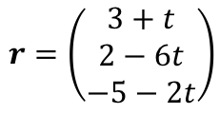


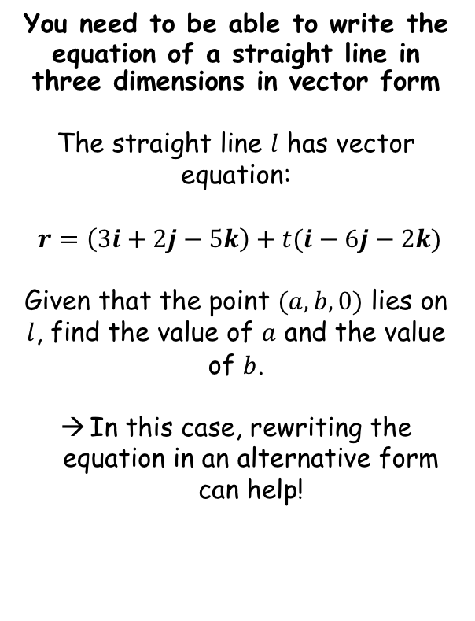






Vectors
$$r=a+λb$$
$$r=c+λ(d−c)$$
$a$ = position vector
$b$ = direction vector
$c$ = position vector 1
$d$ = position vector 2
You need to be able to write the equation of a straight line in three dimensions in vector form
The straight line $l$ has vector equation:
$r=\left(3i+2j−5k\right)+t(i−6j−2k)$
Given that the point $(a,b,0)$ lies on $l$, find the value of $a$ and the value of $b$.
In this case, rewriting the equation in an alternative form can help!
$$r=\left(3i+2j−5k\right)+t(i−6j−2k)$$
$$r=\left(\begin{matrix}3+t \\ 2−6t \\ −5−2t\end{matrix}\right)$$
We know from the question that the final coordinate is 0…
$$−5−2t=0$$
Add 2t
$$−5=2t$$
Divide by 2
$$−2.5=t$$
We can use this to find the values of $a$ and $b$
$$3+t=a$$
$$2−6t=b$$
$$0.5=a$$
$$17=b$$
9A

Slide 8
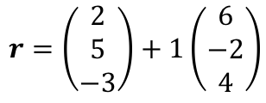
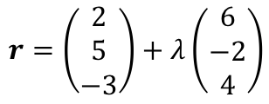
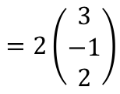
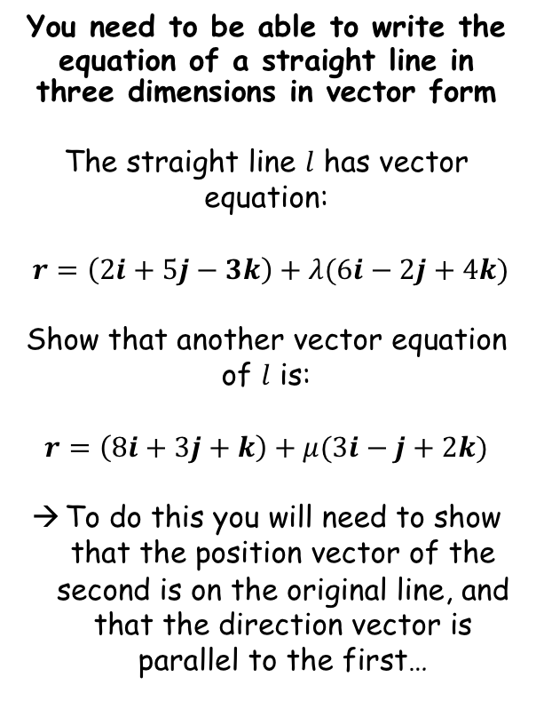


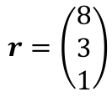
Vectors
$$r=a+λb$$
$$r=c+λ(d−c)$$
$a$ = position vector
$b$ = direction vector
$c$ = position vector 1
$d$ = position vector 2
You need to be able to write the equation of a straight line in three dimensions in vector form
The straight line $l$ has vector equation:
$r=\left(2i+5j−3k\right)+λ(6i−2j+4k)$
Show that another vector equation of $l$ is:
$$r=\left(8i+3j+k\right)+μ(3i−j+2k)$$
To do this you will need to show that the position vector of the second is on the original line, and that the direction vector is parallel to the first…
$$r=\left(\begin{matrix}2 \\ 5 \\ −3\end{matrix}\right)+λ\left(\begin{matrix}6 \\ −2 \\ 4\end{matrix}\right)$$
Check position vector is on the line
Let $λ=1$
$$r=\left(\begin{matrix}2 \\ 5 \\ −3\end{matrix}\right)+1\left(\begin{matrix}6 \\ −2 \\ 4\end{matrix}\right)$$
Calculate
$$r=\left(\begin{matrix}8 \\ 3 \\ 1\end{matrix}\right)$$
So this position vector is on the line!
$$\left(\begin{matrix}6 \\ −2 \\ 4\end{matrix}\right)$$
$$=2\left(\begin{matrix}3 \\ −1 \\ 2\end{matrix}\right)$$
Check direction vector is parallel
As one is a multiple of the other, they are parallel!
9A

Slide 9






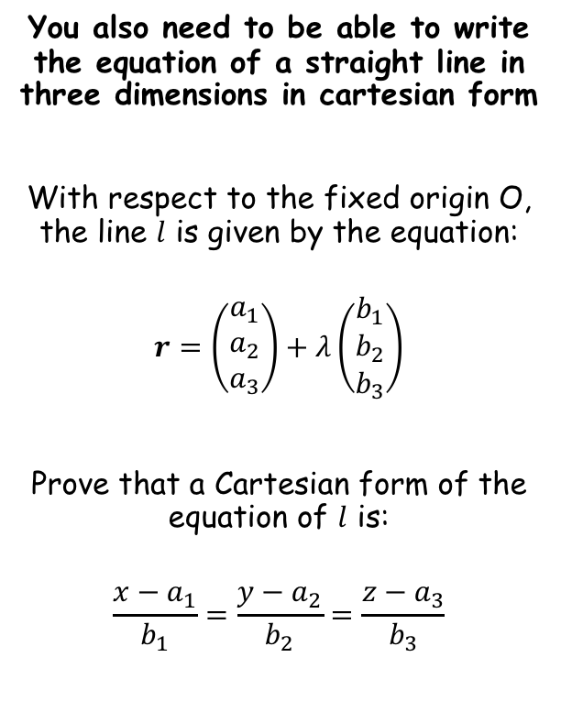









Vectors
$$r=a+λb$$
$$r=\left(\begin{matrix}a_{1} \\ a_{2} \\ a_{3}\end{matrix}\right)+λ\left(\begin{matrix}b_{1} \\ b_{2} \\ b_{3}\end{matrix}\right)$$
$$r=c+λ(d−c)$$
$a$ = position vector
$b$ = direction vector
$c$ = position vector 1
$d$ = position vector 2
$$\frac{x−a_{1}}{b_{1}}=\frac{y−a_{2}}{b_{2}}=\frac{z−a_{3}}{b_{3}}$$
You also need to be able to write the equation of a straight line in three dimensions in cartesian form
With respect to the fixed origin O, the line $l$ is given by the equation:
$$r=\left(\begin{matrix}a_{1} \\ a_{2} \\ a_{3}\end{matrix}\right)+λ\left(\begin{matrix}b_{1} \\ b_{2} \\ b_{3}\end{matrix}\right)$$
Prove that a Cartesian form of the equation of $l$ is:
$$\frac{x−a_{1}}{b_{1}}=\frac{y−a_{2}}{b_{2}}=\frac{z−a_{3}}{b_{3}}$$
The general point on the line can be written algebraically from the equation given in vector form
$$a_{1}+λb_{1}$$
$$\left(\begin{matrix}x \\ y \\ z\end{matrix}\right)$$
$$=\left(\begin{matrix} & & \\ & & \\ & & \end{matrix}\right)$$
$$a_{2}+λb_{2}$$
$$a_{3}+λb_{3}$$
From this, you can form and rearrange equations to give $λ$
$$x=a_{1}+λb_{1}$$
$$y=a_{2}+λb_{2}$$
$$z=a_{3}+λb_{3}$$
$$\frac{x−a_{1}}{b_{1}}=λ$$
$$\frac{y−a_{2}}{b_{2}}=λ$$
$$\frac{z−a_{3}}{b_{3}}=λ$$
Since the 3 rearranged expressions all equal $λ$, they must be equal to each other…
$$\frac{x−a_{1}}{b_{1}}=\frac{y−a_{2}}{b_{2}}=\frac{z−a_{3}}{b_{3}}$$
This is the equation of a straight line in 3 dimensions, but given in Cartesian form!
9A

Slide 10
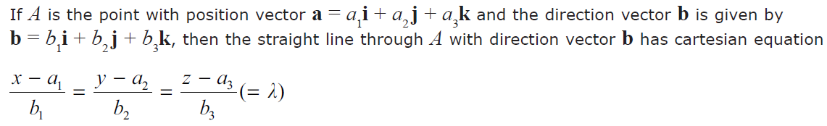
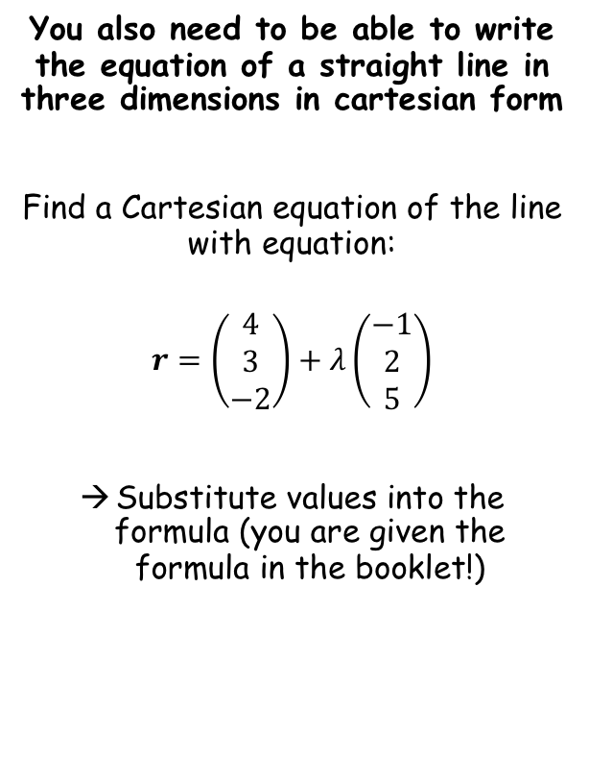


Vectors
$$r=a+λb$$
$$r=\left(\begin{matrix}a_{1} \\ a_{2} \\ a_{3}\end{matrix}\right)+λ\left(\begin{matrix}b_{1} \\ b_{2} \\ b_{3}\end{matrix}\right)$$
$$r=c+λ(d−c)$$
$a$ = position vector
$b$ = direction vector
$c$ = position vector 1
$d$ = position vector 2
$$\frac{x−a_{1}}{b_{1}}=\frac{y−a_{2}}{b_{2}}=\frac{z−a_{3}}{b_{3}}$$
You also need to be able to write the equation of a straight line in three dimensions in cartesian form
Find a Cartesian equation of the line with equation:
$$r=\left(\begin{matrix}4 \\ 3 \\ −2\end{matrix}\right)+λ\left(\begin{matrix}−1 \\ 2 \\ 5\end{matrix}\right)$$
Substitute values into the formula (you are given the formula in the booklet!)
$$\frac{x−a_{1}}{b_{1}}=\frac{y−a_{2}}{b_{2}}=\frac{z−a_{3}}{b_{3}}$$
Sub in values
$$\frac{x−4}{−1}=\frac{y−3}{2}=\frac{z+2}{5}$$
9A

Slide 11


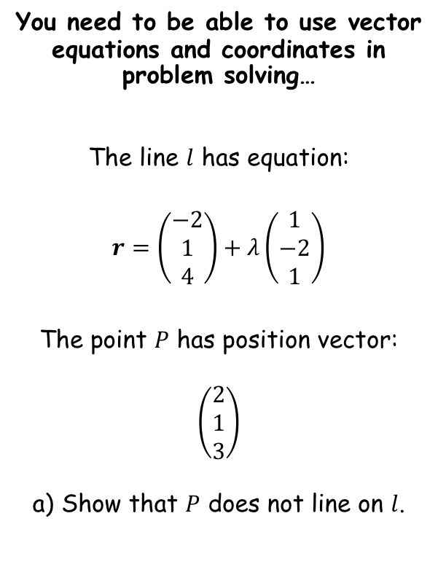
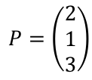

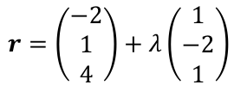
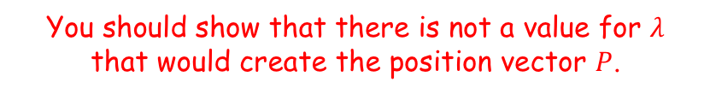

Vectors
$$r=a+λb$$
$$r=\left(\begin{matrix}a_{1} \\ a_{2} \\ a_{3}\end{matrix}\right)+λ\left(\begin{matrix}b_{1} \\ b_{2} \\ b_{3}\end{matrix}\right)$$
$$r=c+λ(d−c)$$
$a$ = position vector
$b$ = direction vector
$c$ = position vector 1
$d$ = position vector 2
$$\frac{x−a_{1}}{b_{1}}=\frac{y−a_{2}}{b_{2}}=\frac{z−a_{3}}{b_{3}}$$
You need to be able to use vector equations and coordinates in problem solving…
The line $l$ has equation:
$$r=\left(\begin{matrix}−2 \\ 1 \\ 4\end{matrix}\right)+λ\left(\begin{matrix}1 \\ −2 \\ 1\end{matrix}\right)$$
The point $P$ has position vector:
$$\left(\begin{matrix}2 \\ 1 \\ 3\end{matrix}\right)$$
a) Show that $P$ does not line on $l$.
You should show that there is not a value for $λ$ that would create the position vector $P$.
$$r=\left(\begin{matrix}−2 \\ 1 \\ 4\end{matrix}\right)+λ\left(\begin{matrix}1 \\ −2 \\ 1\end{matrix}\right)$$
$$P=\left(\begin{matrix}2 \\ 1 \\ 3\end{matrix}\right)$$
Form equations for $λ$ using the information
$$−2+λ=2$$
$$1−2λ=1$$
Solve
Solve
$$λ=4$$
$$λ=0$$
As the values of $λ$ are different, $P$ cannot be on the line $l$.
9A

Slide 12



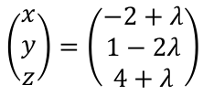
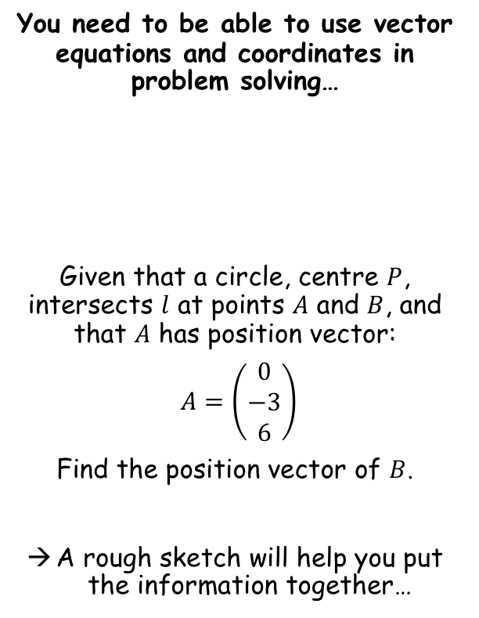



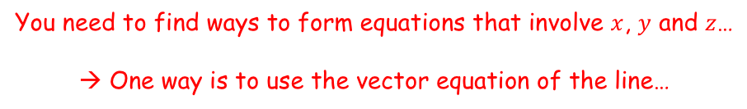
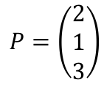

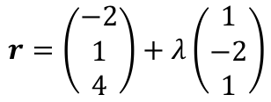

Vectors
$$r=a+λb$$
$$r=\left(\begin{matrix}a_{1} \\ a_{2} \\ a_{3}\end{matrix}\right)+λ\left(\begin{matrix}b_{1} \\ b_{2} \\ b_{3}\end{matrix}\right)$$
$$r=c+λ(d−c)$$
$a$ = position vector
$b$ = direction vector
$c$ = position vector 1
$d$ = position vector 2
$$\frac{x−a_{1}}{b_{1}}=\frac{y−a_{2}}{b_{2}}=\frac{z−a_{3}}{b_{3}}$$
You need to be able to use vector equations and coordinates in problem solving…
Given that a circle, centre $P$, intersects $l$ at points $A$ and $B$, and that $A$ has position vector:
$A=\left(\begin{matrix}0 \\ −3 \\ 6\end{matrix}\right)$
Find the position vector of $B$.
A rough sketch will help you put the information together…
A 2D sketch is fine – you do not need to try and draw the information in 3D!
$$A(0,−3,6)$$
$$B(x,y,z)$$
$$r=\left(\begin{matrix}−2 \\ 1 \\ 4\end{matrix}\right)+λ\left(\begin{matrix}1 \\ −2 \\ 1\end{matrix}\right)$$
$$P=\left(\begin{matrix}2 \\ 1 \\ 3\end{matrix}\right)$$
$$l$$
$$P(2,1,3)$$
You need to find ways to form equations that involve $x$, $y$ and $z$…
→ One way is to use the vector equation of the line…
$$\left(\begin{matrix}x \\ y \\ z\end{matrix}\right)=\left(\begin{matrix}−2 \\ 1 \\ 4\end{matrix}\right)+λ\left(\begin{matrix}1 \\ −2 \\ 1\end{matrix}\right)$$
Rewrite
$$\left(\begin{matrix}x \\ y \\ z\end{matrix}\right)=\left(\begin{matrix}−2+λ \\ 1−2λ \\ 4+λ\end{matrix}\right)$$
$$x=−2+λ$$
$$y=1−2λ$$
$$z=4+λ$$
9A

Slide 13
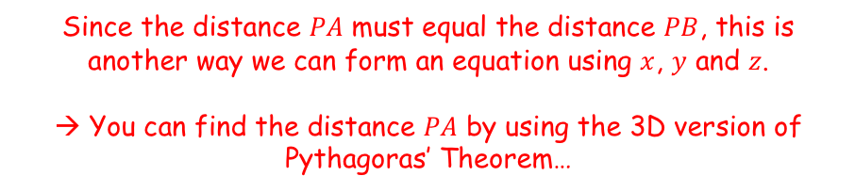


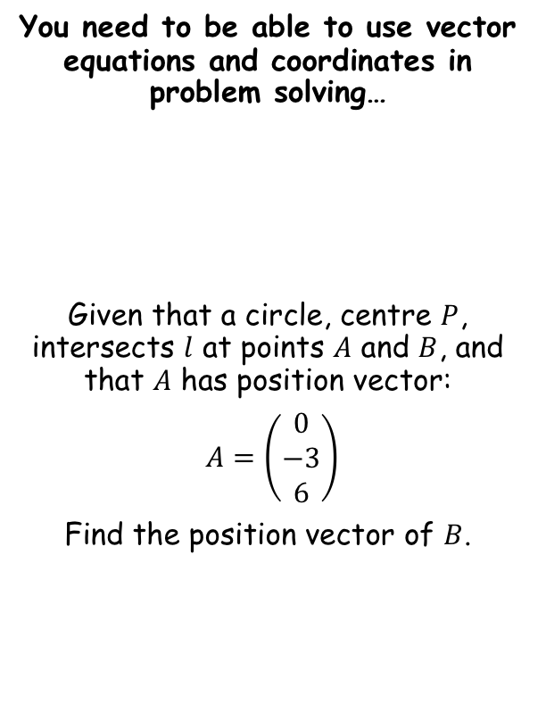


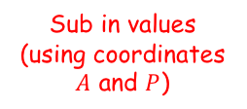




Vectors
$$r=a+λb$$
$$r=\left(\begin{matrix}a_{1} \\ a_{2} \\ a_{3}\end{matrix}\right)+λ\left(\begin{matrix}b_{1} \\ b_{2} \\ b_{3}\end{matrix}\right)$$
$$r=c+λ(d−c)$$
$a$ = position vector
$b$ = direction vector
$c$ = position vector 1
$d$ = position vector 2
$$\frac{x−a_{1}}{b_{1}}=\frac{y−a_{2}}{b_{2}}=\frac{z−a_{3}}{b_{3}}$$
You need to be able to use vector equations and coordinates in problem solving…
Given that a circle, centre $P$, intersects $l$ at points $A$ and $B$, and that $A$ has position vector:
$A=\left(\begin{matrix}0 \\ −3 \\ 6\end{matrix}\right)$
Find the position vector of $B$.
A 2D sketch is fine – you do not need to try and draw the information in 3D!
$$A(0,−3,6)$$
$$B(x,y,z)$$
$$r=\left(\begin{matrix}−2 \\ 1 \\ 4\end{matrix}\right)+λ\left(\begin{matrix}1 \\ −2 \\ 1\end{matrix}\right)$$
$$P=\left(\begin{matrix}2 \\ 1 \\ 3\end{matrix}\right)$$
$$\sqrt{29}$$
$$l$$
$$\sqrt{29}$$
$$P(2,1,3)$$
Since the distance $PA$ must equal the distance $PB$, this is another way we can form an equation using $x$, $y$ and $z$.
→ You can find the distance $PA$ by using the 3D version of Pythagoras’ Theorem…
$$x=−2+λ$$
$$y=1−2λ$$
$$z=4+λ$$
$$\sqrt{a^{2}+b^{2}+c^{2}}=d$$
Sub in values (using coordinates $A$ and $P$)
$$\sqrt{{(0−2)}^{2}+{(−3−1)}^{2}+{(6−3)}^{2}}=d$$
Calculate
$$\sqrt{29}=d$$
9A

Slide 14

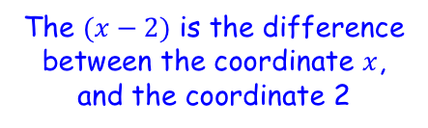



Vectors
$$r=a+λb$$
$$r=\left(\begin{matrix}a_{1} \\ a_{2} \\ a_{3}\end{matrix}\right)+λ\left(\begin{matrix}b_{1} \\ b_{2} \\ b_{3}\end{matrix}\right)$$
$$r=c+λ(d−c)$$
$a$ = position vector
$b$ = direction vector
$c$ = position vector 1
$d$ = position vector 2
$$\frac{x−a_{1}}{b_{1}}=\frac{y−a_{2}}{b_{2}}=\frac{z−a_{3}}{b_{3}}$$
You need to be able to use vector equations and coordinates in problem solving…
Given that a circle, centre $P$, intersects $l$ at points $A$ and $B$, and that $A$ has position vector:
$A=\left(\begin{matrix}0 \\ −3 \\ 6\end{matrix}\right)$
Find the position vector of $B$.
A 2D sketch is fine – you do not need to try and draw the information in 3D!
$$A(0,−3,6)$$
$$B(x,y,z)$$
$$r=\left(\begin{matrix}−2 \\ 1 \\ 4\end{matrix}\right)+λ\left(\begin{matrix}1 \\ −2 \\ 1\end{matrix}\right)$$
$$P=\left(\begin{matrix}2 \\ 1 \\ 3\end{matrix}\right)$$
$$\sqrt{29}$$
$$l$$
$$\sqrt{29}$$
$$P(2,1,3)$$
→ We can form an equation for the distance $PB$ using the information given, knowing that it must equal $\sqrt{29}$.
$$\sqrt{a^{2}+b^{2}+c^{2}}=d$$
$$x=−2+λ$$
$$y=1−2λ$$
$$z=4+λ$$
Sub in values
$$\sqrt{{(x−2)}^{2}+{(y−1)}^{2}+{(z−3)}^{2}} =\sqrt{29}$$
Square both sides
The $(x−2)$ is the difference between the coordinate $x$, and the coordinate 2
$${(x−2)}^{2}+{(y−1)}^{2}+{(z−3)}^{2} =29$$
We can replace x, y and z!
$${(−2+λ−2)}^{2}+{(1−2λ−1)}^{2}+{(4+λ−3)}^{2} =29$$
9A

Slide 15





Vectors
$$r=a+λb$$
$$r=\left(\begin{matrix}a_{1} \\ a_{2} \\ a_{3}\end{matrix}\right)+λ\left(\begin{matrix}b_{1} \\ b_{2} \\ b_{3}\end{matrix}\right)$$
$$r=c+λ(d−c)$$
$a$ = position vector
$b$ = direction vector
$c$ = position vector 1
$d$ = position vector 2
$$\frac{x−a_{1}}{b_{1}}=\frac{y−a_{2}}{b_{2}}=\frac{z−a_{3}}{b_{3}}$$
You need to be able to use vector equations and coordinates in problem solving…
Given that a circle, centre $P$, intersects $l$ at points $A$ and $B$, and that $A$ has position vector:
$A=\left(\begin{matrix}0 \\ −3 \\ 6\end{matrix}\right)$
Find the position vector of $B$.
A 2D sketch is fine – you do not need to try and draw the information in 3D!
$$A(0,−3,6)$$
$$B(x,y,z)$$
$$r=\left(\begin{matrix}−2 \\ 1 \\ 4\end{matrix}\right)+λ\left(\begin{matrix}1 \\ −2 \\ 1\end{matrix}\right)$$
$$P=\left(\begin{matrix}2 \\ 1 \\ 3\end{matrix}\right)$$
$$\sqrt{29}$$
$$l$$
$$\sqrt{29}$$
$$P(2,1,3)$$
$${(−2+λ−2)}^{2}+{(1−2λ−1)}^{2}+{(4+λ−3)}^{2} =29$$
Simplify
$${(λ−4)}^{2}+{(2λ)}^{2}+{(1+λ)}^{2} =29$$
Expand and rearrange
$$x=−2+λ$$
$$y=1−2λ$$
$$z=4+λ$$
$${6λ}^{2}−6λ−12=0$$
Divide by 6
$$λ^{2}−λ−2=0$$
Factorise
$$\left(λ−2\right)\left(λ+1\right)=0$$
Solve
$$λ=2 or −1$$
9A

Slide 16







Vectors
$$r=a+λb$$
$$r=\left(\begin{matrix}a_{1} \\ a_{2} \\ a_{3}\end{matrix}\right)+λ\left(\begin{matrix}b_{1} \\ b_{2} \\ b_{3}\end{matrix}\right)$$
$$r=c+λ(d−c)$$
$a$ = position vector
$b$ = direction vector
$c$ = position vector 1
$d$ = position vector 2
$$\frac{x−a_{1}}{b_{1}}=\frac{y−a_{2}}{b_{2}}=\frac{z−a_{3}}{b_{3}}$$
You need to be able to use vector equations and coordinates in problem solving…
Given that a circle, centre $P$, intersects $l$ at points $A$ and $B$, and that $A$ has position vector:
$A=\left(\begin{matrix}0 \\ −3 \\ 6\end{matrix}\right)$
Find the position vector of $B$.
A 2D sketch is fine – you do not need to try and draw the information in 3D!
$$A(0,−3,6)$$
$$B(x,y,z)$$
$$r=\left(\begin{matrix}−2 \\ 1 \\ 4\end{matrix}\right)+λ\left(\begin{matrix}1 \\ −2 \\ 1\end{matrix}\right)$$
$$P=\left(\begin{matrix}2 \\ 1 \\ 3\end{matrix}\right)$$
$$\sqrt{29}$$
$$l$$
$$\sqrt{29}$$
$$P(2,1,3)$$
$$r=\left(\begin{matrix}−2 \\ 1 \\ 4\end{matrix}\right)+λ\left(\begin{matrix}1 \\ −2 \\ 1\end{matrix}\right)$$
Sub in $λ=−1$ (using $λ=2$ will give you point A)
A way to make this slightly easier is to change the original vector equation so it uses point A as the position vector (this way one solution will be $λ=0$)
$$x=−2+λ$$
$$y=1−2λ$$
$$z=4+λ$$
$$r=\left(\begin{matrix}−2 \\ 1 \\ 4\end{matrix}\right)−1\left(\begin{matrix}1 \\ −2 \\ 1\end{matrix}\right)$$
$$λ=2 or −1$$
Calculate
$$r=\left(\begin{matrix}−3 \\ 3 \\ 3\end{matrix}\right)$$
$$B=\left(\begin{matrix}−3 \\ 3 \\ 3\end{matrix}\right)$$
9A

Slide 17
Exercise 9A
Pearson Pure Mathematics Year 1/AS
Pages 3-5
Complete before the lesson Q1-4
In Class:
Green Q5-7
Amber Q8-11
Red Q12-17

