Slide 1
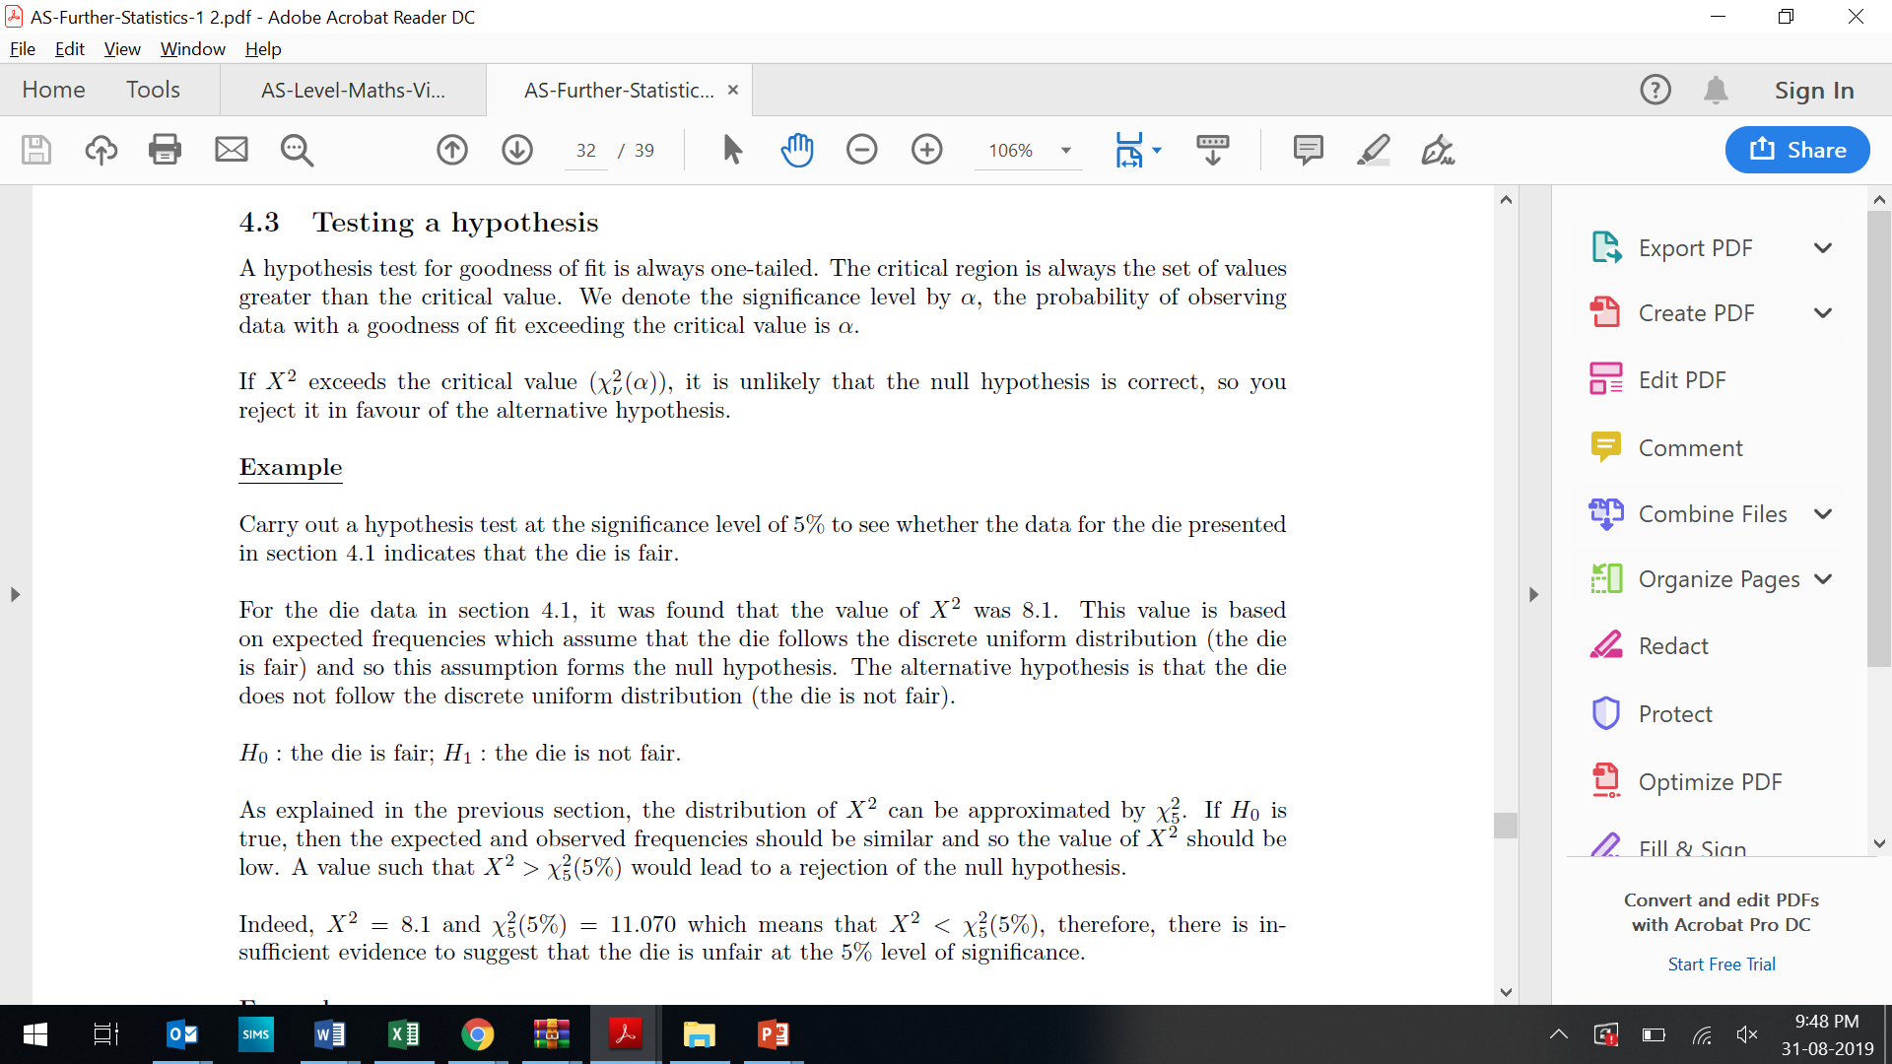

Slide 3
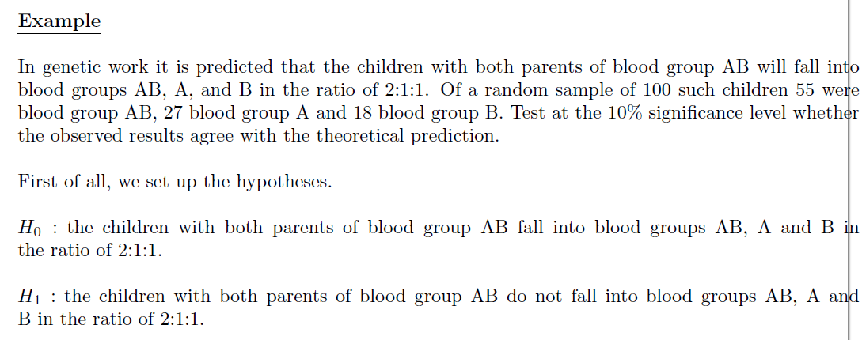

Slide 4
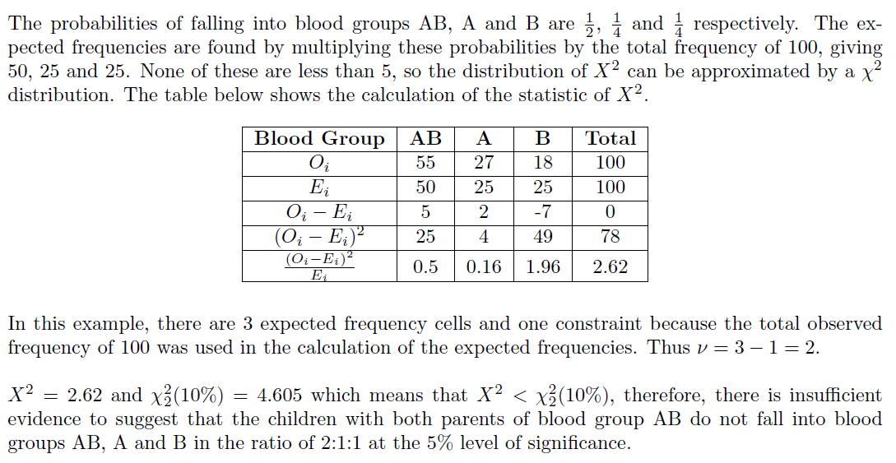

Slide 5
Exercise 6C
Pearson Further Statistics 1
Pages 102-103
Complete before the lesson Q1
In Class:
Green Q2-3
Amber Q4-5

