Slide 1

P1 Chapter 12 :: Differentiation
jfrost@tiffin.kingston.sch.uk
www.drfrostmaths.com
@DrFrostMaths
Last modified: 9th September 2017

Slide 2

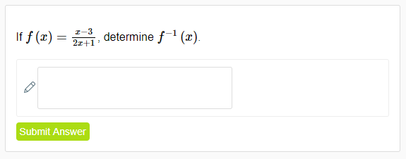
Use of DrFrostMaths for practice
Register for free at:
www.drfrostmaths.com/homework
Practise questions by chapter, including past paper Edexcel questions and extension questions (e.g. MAT).
Teachers: you can create student accounts (or students can register themselves).

Slide 3

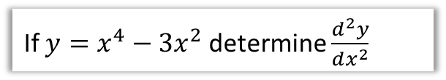
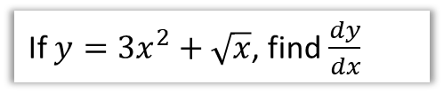
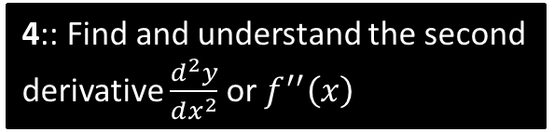
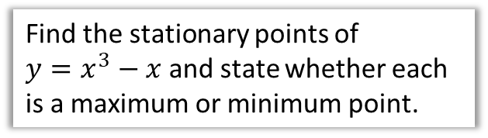
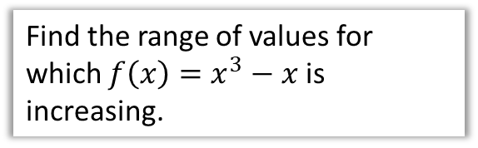
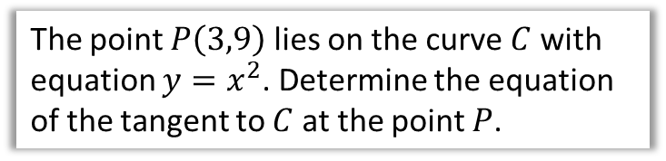
Chapter Overview
Those who have done either IGCSE Mathematics, IGCSE Further Mathematics or Additional Mathematics would have encountered this content. Otherwise it will be completely new!
1:: Find the derivative of polynomials.
2:: Find equations of tangents and normal to curves.
If $y=3x^{2}+\sqrt{x}$, find $\frac{dy}{dx}$
The point $P\left(3,9\right)$ lies on the curve $C$ with equation $y=x^{2}$. Determine the equation of the tangent to $C$ at the point $P$.
3:: Identify increasing and decreasing functions.
4:: Find and understand the second derivative $\frac{d^{2}y}{dx^{2}}$ or $f^{′′}\left(x\right)$
Find the range of values for which $f\left(x\right)=x^{3}−x$ is increasing.
If $y=x^{4}−3x^{2}$ determine $\frac{d^{2}y}{dx^{2}}$
5:: Find stationary points and determine their nature.
6:: Sketch a gradient function.
Draw $y=x^{3}$ and its gradient function on the same axes.
Find the stationary points of
$y=x^{3}−x$ and state whether each is a maximum or minimum point.
7:: Model real-life problems.

Slide 4
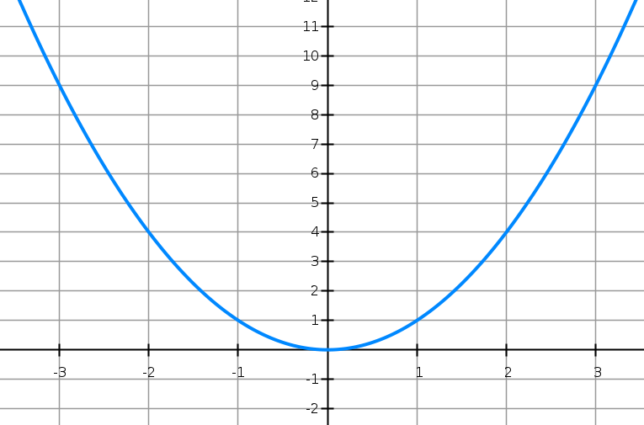





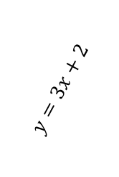
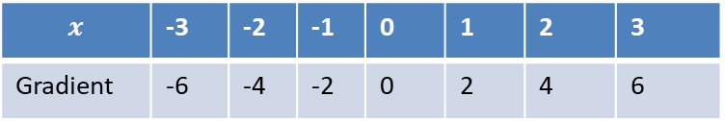

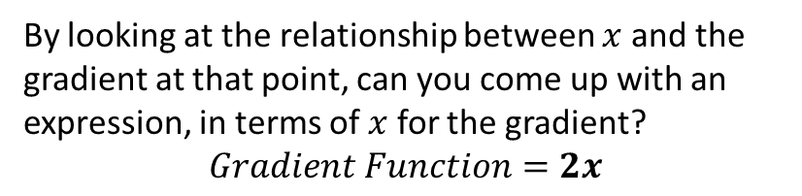

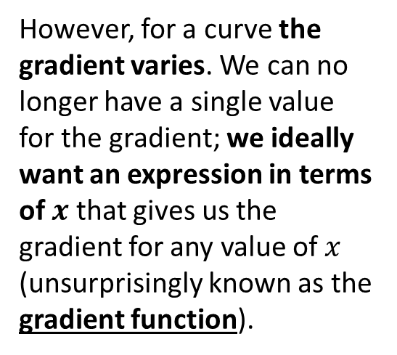


Gradient Function
For a straight line, the gradient is constant:
At GCSE, you found the gradient of a curve at a particular point by drawing a tangent.
$$m=6$$
$$m=−6$$
$$y=x^{2}$$
$$y=3x+2$$
$$m=3$$
$$m=−4$$
$$m=4$$
$$m=−2$$
$$m=2$$
$$m=0$$
However, for a curve the gradient varies. We can no longer have a single value for the gradient; we ideally want an expression in terms of $x$ that gives us the gradient for any value of $x$ (unsurprisingly known as the gradient function).
$$x$$ | -3 | -2 | -1 | 0 | 1 | 2 | 3
Gradient | -6 | -4 | -2 | 0 | 2 | 4 | 6
?
?
?
?
?
?
?
By looking at the relationship between $x$ and the gradient at that point, can you come up with an expression, in terms of $x$ for the gradient?
$$Gradient Function=2x$$
?

Slide 5
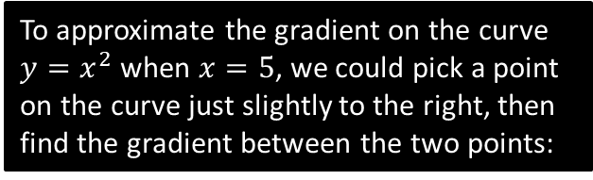
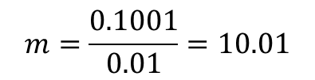

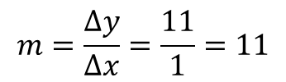








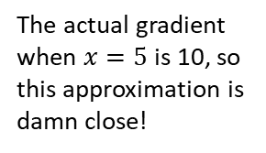
Finding the Gradient Function
The question is then: Is there a method to work out the gradient function without having to draw lots of tangents and hoping that we can spot the rule?
To approximate the gradient on the curve $y=x^{2}$ when $x=5$, we could pick a point on the curve just slightly to the right, then find the gradient between the two points:
As the second point gets closer and closer, the gradient becomes a better approximation of the true gradient:
$$y=x^{2}$$
?
$$\left(6,36\right)$$
?
$$11$$
$$\left(5.01,25.1001\right)$$
$$1$$
$$0.01$$
$$0.1001$$
$$\left(5,25\right)$$
$$\left(5,25\right)$$
?
?
?
$$m=\frac{Δy}{Δx}=\frac{11}{1}=11$$
$$m=\frac{0.1001}{0.01}=10.01$$
The actual gradient when $x=5$ is 10, so this approximation is damn close!

Slide 6




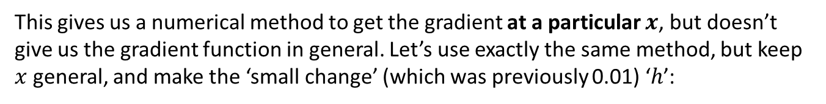
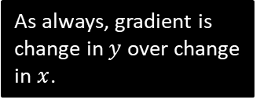
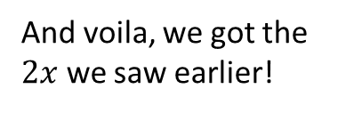

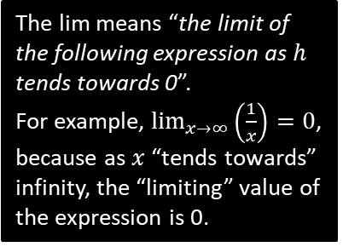


Finding the Gradient Function
This gives us a numerical method to get the gradient at a particular $x$, but doesn’t give us the gradient function in general. Let’s use exactly the same method, but keep $x$ general, and make the ‘small change’ (which was previously 0.01) ‘$h$’:
$$y=x^{2}$$
?
?
As always, gradient is change in $y$ over change in $x$.
$$\left(x+h,{\left(x+h\right)}^{2}\right)$$
$$gradient=\lim_{h→0}{\frac{{\left(x+h\right)}^{2}−x^{2}}{h}} \\ =\lim_{h→0}{\frac{2xh+h^{2}}{h}} \\ =\lim_{h→0}\left(2x+h\right) \\ =2x$$
?
$$?$$
$$\left(x,x^{2}\right)$$
?
$$?$$
?
The lim means “the limit of the following expression as $h$ tends towards 0”.
For example, $\lim_{x→∞}\left(\frac{1}{x}\right)=0$, because as $x$ “tends towards” infinity, the “limiting” value of the expression is 0.
?
The $h$ disappears as $h$ tends towards 0, i.e. we can effectively treat it as 0 at this point.
And voila, we got the $2x$ we saw earlier!

Slide 7
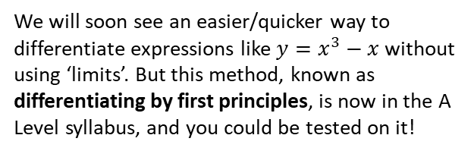

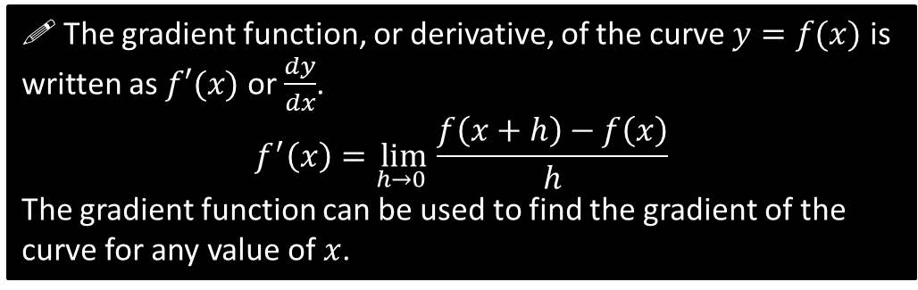
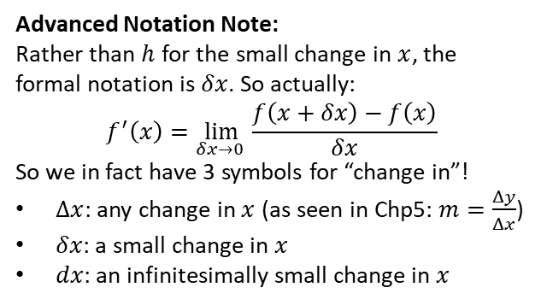
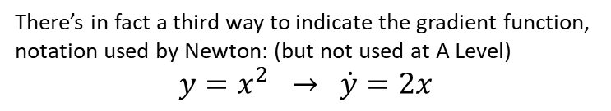
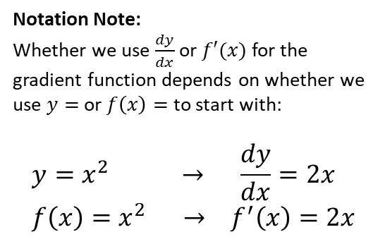
Finding the Gradient Function
! The gradient function, or derivative, of the curve $y=f(x)$ is written as $f′(x)$ or $\frac{dy}{dx}$.
$$f^{′}\left(x\right)=\lim_{h→0 }{\frac{f\left(x+h\right)−f\left(x\right)}{h}}$$
The gradient function can be used to find the gradient of the curve for any value of $x$.
Notation Note:
Whether we use $\frac{dy}{dx}$ or $f′(x)$ for the gradient function depends on whether we use $y=$ or $f\left(x\right)=$ to start with:
$$y=x^{2} → \frac{dy}{dx}=2x \\ f\left(x\right)=x^{2} → f^{′}\left(x\right)=2x$$
We will soon see an easier/quicker way to differentiate expressions like $y=x^{3}−x$ without using ‘limits’. But this method, known as differentiating by first principles, is now in the A Level syllabus, and you could be tested on it!
“Leibniz’s notation”
“Lagrange’s notation”
Advanced Notation Note:
Rather than $h$ for the small change in $x$, the formal notation is $δx$. So actually:
$$f^{′}\left(x\right)=\lim_{δx→0 }{\frac{f\left(x+δx\right)−f\left(x\right)}{δx}}$$
So we in fact have 3 symbols for “change in”!
$Δx$: any change in $x$ (as seen in Chp5: $m=\frac{Δy}{Δx}$)
$δx$: a small change in $x$
$dx$: an infinitesimally small change in $x$
There’s in fact a third way to indicate the gradient function, notation used by Newton: (but not used at A Level)
$$y=x^{2} → \dot{y}=2x$$
So the estimated gradient using some point close by was $\frac{δy}{δx}$, but in the ‘limit’ as $δx→0$, $\frac{δy}{δx}→\frac{dy}{dx}$

Slide 8

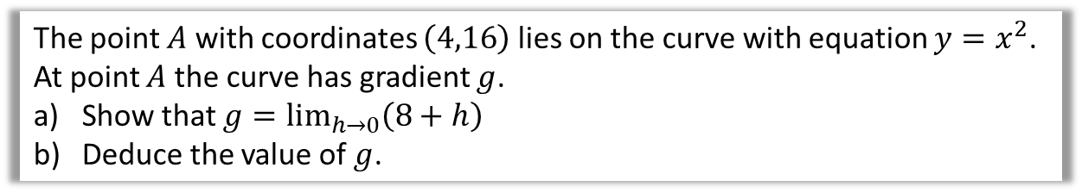

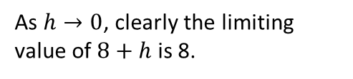
Example
!
The point $A$ with coordinates $\left(4,16\right)$ lies on the curve with equation $y=x^{2}$.
At point $A$ the curve has gradient $g$.
Show that $g=\lim_{h→0}\left(8+h\right)$
Deduce the value of $g$.
a
?
$$g=\lim_{h→0}{\frac{f\left(4+h\right)−f\left(4\right)}{h}} \\ =\lim_{h→0}{\frac{{\left(4+h\right)}^{2}−4^{2}}{h}} \\ =\lim_{h→0}{\frac{16+8h+h^{2}−16}{h}} \\ =\lim_{h→0}{\frac{8h+h^{2}}{h}} \\ =\lim_{h→0}\left(8+h\right)$$
$$g=8$$
Use the “differentiation by first principles” formula.
Function is $f\left(x\right)=x^{2}$
As $h→0$, clearly the limiting value of $8+h$ is 8.
b
?

Slide 9


Test Your Understanding
Prove from first principles that the derivative of $x^{4}$ is $4x^{3}$.
?
Helping Hand:
“Row 4” of Pascal’s Triangle is:
1 4 6 4 1
You’re welcome.
$$f^{′}\left(x\right)=\lim_{h→0}{\frac{f\left(x+h\right)−f\left(x\right)}{h}} \\ =\lim_{h→0}{\frac{{\left(x+h\right)}^{4}−x^{4}}{h}} \\ =\lim_{h→0}{\frac{x^{4}+4x^{3}h+6x^{2}h^{2}+4xh^{3}+h^{4}−x^{4}}{h}} \\ =\lim_{h→0}{\frac{4x^{3}h+6x^{2}h^{2}+4xh^{3}+h^{4}}{h}} \\ =\lim_{h→0}{4x^{3}+6x^{2}h+4xh^{2}+h^{3}} \\ =4x^{3}$$
As $h→0$, any term involving a multiplication by $h$ will become 0.

Slide 10
Exercise 12B
Pearson Pure Mathematics Year 1/AS
Pages 261-262
(Note that Exercise 12A was skipped in these slides)
Don’t forget the ‘Challenge’ question on Page 262!
Complete before the lesson Q1
Green Q2
Amber Q3
Red

Slide 11


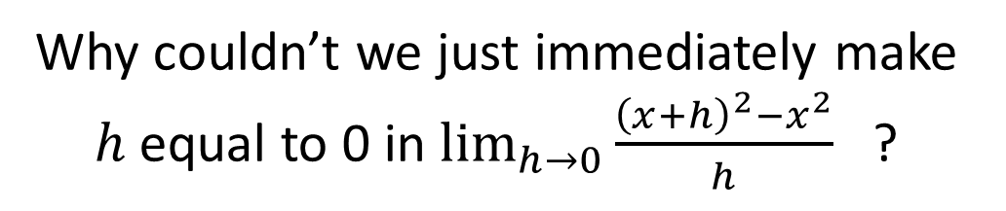
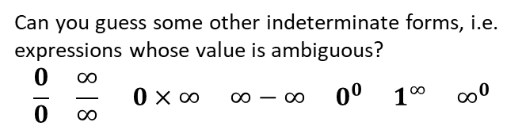
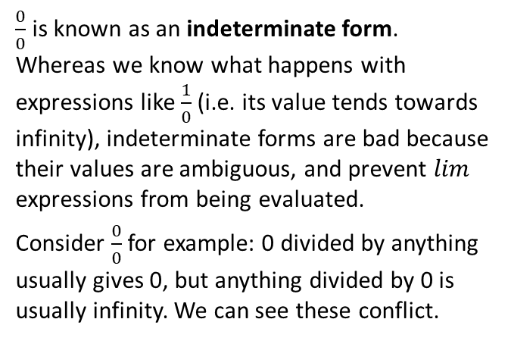
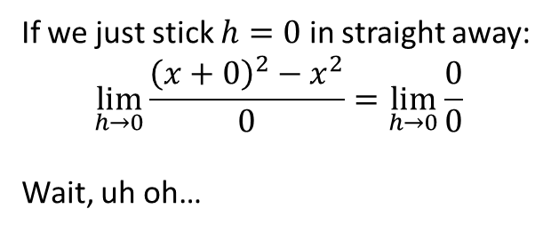
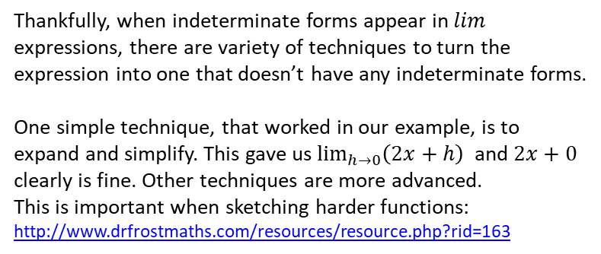
Just for your interest…
Why couldn’t we just immediately make $h$ equal to 0 in $\lim_{h→0}{\frac{{\left(x+h\right)}^{2}−x^{2}}{h}}$ ?
God, not another one of these…
$\frac{0}{0}$ is known as an indeterminate form. Whereas we know what happens with expressions like $\frac{1}{0}$ (i.e. its value tends towards infinity), indeterminate forms are bad because their values are ambiguous, and prevent $lim$ expressions from being evaluated.
Consider $\frac{0}{0}$ for example: 0 divided by anything usually gives 0, but anything divided by 0 is usually infinity. We can see these conflict.
If we just stick $h=0$ in straight away:
$$\lim_{h→0}{\frac{{\left(x+0\right)}^{2}−x^{2}}{0}}=\lim_{h→0}{\frac{0}{0}}$$
Wait, uh oh…
Thankfully, when indeterminate forms appear in $lim$ expressions, there are variety of techniques to turn the expression into one that doesn’t have any indeterminate forms.
One simple technique, that worked in our example, is to expand and simplify. This gave us $\lim_{h→0}\left(2x+h\right)$ and $2x+0$ clearly is fine. Other techniques are more advanced.
This is important when sketching harder functions: http://www.drfrostmaths.com/resources/resource.php?rid=163
Can you guess some other indeterminate forms, i.e. expressions whose value is ambiguous?
$$\frac{0}{0} \frac{∞}{∞} 0×∞ ∞−∞ 0^{0} 1^{∞} ∞^{0}$$
?
ME-WOW!

Slide 12
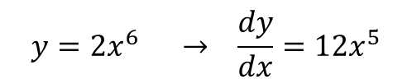
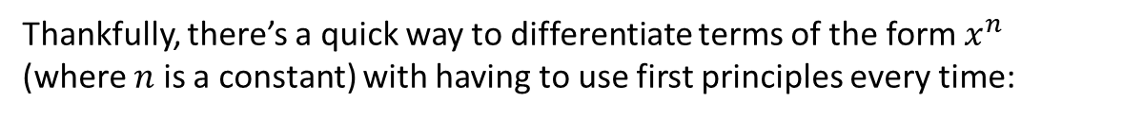
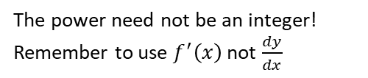
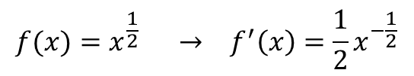
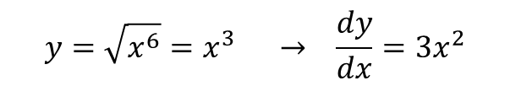
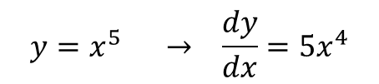

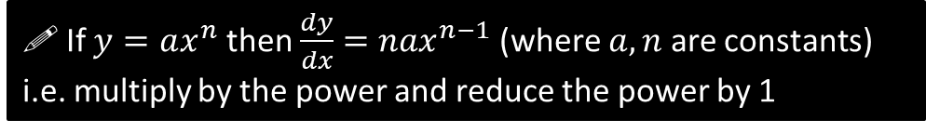

Differentiating $x^{n}$
Thankfully, there’s a quick way to differentiate terms of the form $x^{n}$ (where $n$ is a constant) with having to use first principles every time:
If $y=ax^{n}$ then $\frac{dy}{dx}=nax^{n−1}$ (where $a,n$ are constants)
i.e. multiply by the power and reduce the power by 1
Examples:
?
$$y=x^{5} → \frac{dy}{dx}=5x^{4}$$
Power is 5, so multiply by 5 then reduce power by 5.
$$f(x)=x^{\frac{1}{2}} → f^{′}\left(x\right)=\frac{1}{2}x^{−\frac{1}{2}}$$
The power need not be an integer!
Remember to use $f^{′}\left(x\right)$ not $\frac{dy}{dx}$
?
Why would it be incorrect to say that $y=2^{x}$ differentiates to $\frac{dy}{dx}=x 2^{x−1}$?
The rule only works when the base is $x$ and the power is a constant. Neither is true here! Note that $x^{n}$ is “a power of $x$” whereas $2^{x}$ is an exponential term (which you will encounter more in Chp14), and therefore differentiate differently. You will learn how to differentiate exponential terms in Year 2.
$$y={2x}^{6} → \frac{dy}{dx}=12x^{5}$$
?
?
?
?
$$f\left(x\right)=\frac{x}{x^{4}}=x^{−3} → f^{′}\left(x\right)=−3x^{−4}$$
$$y=\sqrt{x^{6}}=x^{3} → \frac{dy}{dx}=3x^{2}$$
?
?

Slide 13
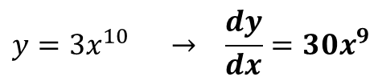
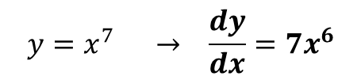
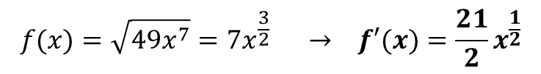
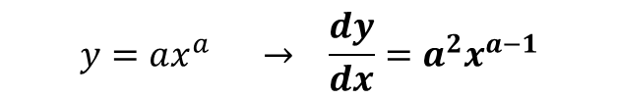
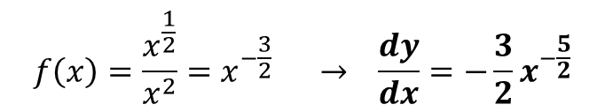
Test Your Understanding
?
$$y=x^{7} → \frac{dy}{dx}=7x^{6}$$
1
$$y=3x^{10} → \frac{dy}{dx}=30x^{9}$$
?
2
$$f\left(x\right)=\frac{x^{\frac{1}{2}}}{x^{2}}=x^{−\frac{3}{2}} → \frac{dy}{dx}=−\frac{3}{2}x^{−\frac{5}{2}}$$
?
?
3
$$y=ax^{a} → \frac{dy}{dx}=a^{2}x^{a−1}$$
?
4
?
?
$$f(x)=\sqrt{49x^{7}}=7x^{\frac{3}{2}} → f′(x)=\frac{21}{2}x^{\frac{1}{2}}$$
5

Slide 14
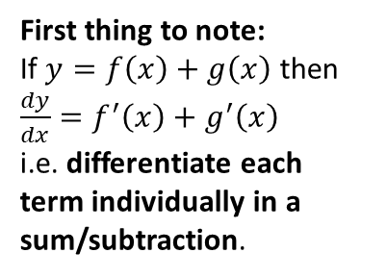




Differentiating Multiple Terms
Differentiate $y=x^{2}+4x+3$
First thing to note:
If $y=f\left(x\right)+g\left(x\right)$ then $\frac{dy}{dx}=f^{′}\left(x\right)+g^{′}\left(x\right)$
i.e. differentiate each term individually in a sum/subtraction.
$$\frac{dy}{dx}=2x+4$$
?
?
?
$$y=4x=4x^{1}$$
Therefore applying the usual rule:
$$\frac{dy}{dx}=4x^{0}=4$$
Alternatively, if you compare $y=4x$ to $y=mx+c$, it’s clear that the gradient is fixed and $m=4$.
$$y=3=3x^{0}$$
Therefore applying the usual rule:
$$\frac{dy}{dx}=0x^{−1}=0$$
Alternatively, if you sketch $y=4$, the line is horizontal, so the gradient is 0.

Slide 15







Quickfire Questions
?
$$y=2x^{2}−3x → \frac{dy}{dx}=4x−3$$
1
?
2
$$y=4−9x^{3} → \frac{dy}{dx}=−27x^{2}$$
?
$$y=5x+1 → \frac{dy}{dx}=5$$
3
?
$$y=ax → \frac{dy}{dx}=a$$
4
(where $a$ is a constant)
?
$$y=6x−3+px^{2} → \frac{dy}{dx}=6+2px$$
5
(where $p$ is a constant)

Slide 16







Harder Example
Let $f\left(x\right)=4x^{2}−8x+3$
Find the gradient of $y=f\left(x\right)$ at the point $\left(\frac{1}{2},0\right)$
Find the coordinates of the point on the graph of $y=f\left(x\right)$ where the gradient is 8.
Find the gradient of $y=f\left(x\right)$ at the points where the curve meets the line $y=4x−5$.
$$f^{′}\left(x\right)=8x−8$$
When $f^{′}\left(\frac{1}{2}\right)=8\left(\frac{1}{2}\right)−8=4$
a
?
Remember that the ‘gradient function’ allows you to find the gradient for a particular value of $x$.
b
$$8=8x−8 \\ x=2 \\ y=4{\left(2\right)}^{2}−8\left(2\right)+3=3$$
Point is $\left(2,3\right)$
This example is important!
Previously you used a value of $x$ to get the gradient $f^{′}\left(x\right)$. This time we’re doing the opposite: using a known gradient $f^{′}\left(x\right)$ to get the value of $x$. We therefore substitute $f^{′}\left(x\right)$ for 8.
?
Once you have your $x$, you need to work out $y$.
Ensure you use the correct equation!
c
First find point of intersection:
$$4x^{2}−8x+3=4x−5$$
Solving, we obtain: $x=1$ or $x=2$
When $x=1, f^{′}\left(1\right)=0$
When $x=2, f^{′}\left(2\right)=8$
?

Slide 17




Test Your Understanding
Let $f\left(x\right)=x^{2}−4x+2$
Find the gradient of $y=f\left(x\right)$ at the point $\left(1,−1\right)$
Find the coordinates of the point on the graph of $y=f\left(x\right)$ where the gradient is 5.
Find the gradient of $y=f\left(x\right)$ at the points where the curve meets the line $y=2−x$.
a
$$f^{′}\left(x\right)=2x−4$$
When $f^{′}\left(1\right)=2\left(1\right)−4=−2$
?
$$5=2x−4 \\ x=\frac{9}{2} \\ y={\left(\frac{9}{2}\right)}^{2}−4\left(\frac{9}{2}\right)+2=\frac{17}{4}$$
Point is $\left(\frac{9}{2},\frac{17}{4}\right)$
b
?
$$x^{2}−4x+2=2−x$$
Solving: $x=0$ or $x=3$
When $x=0, f^{′}\left(0\right)=−4$
When $x=3, f^{′}\left(3\right)=2$
c
?

Slide 18
Exercise 12D
Pearson Pure Mathematics Year 1/AS
Pages 265-266
(Note that Exercise 12C was skipped in these slides)
Complete before the lesson Q1
Green Q2
Amber Q3
Red

Slide 19






Differentiating Harder Expressions
If your expression isn’t a sum of $x^{n}$ terms, simply manipulate it until it is!
$$y=\sqrt{x}=x^{\frac{1}{2}} → \frac{dy}{dx}=\frac{1}{2}x^{−\frac{1}{2}}$$
1. Turn roots into powers:
?
?
?
?
$$y=\frac{1}{\sqrt[3]{x}}=x^{−\frac{1}{3}} → \frac{dy}{dx}=−\frac{1}{3}x^{−\frac{4}{3}}$$
2. Split up fractions.
?
$$y=\frac{x^{2}+3}{\sqrt{x}}=\frac{x^{2}+3}{x^{\frac{1}{2}}}=x^{\frac{3}{2}}+3x^{−\frac{1}{2}} \\ → \frac{dy}{dx}=\frac{3}{2}x^{\frac{1}{2}}−\frac{3}{2}x^{−\frac{3}{2}}$$
?
?
3. Expand out brackets.
$$y=x^{2}\left(x−3\right)=x^{3}−3x^{2} \\ → \frac{dy}{dx}=3x^{2}−6x$$
?
NOT $3x^{−1}$!!!
4. Beware of numbers in denominators!
?
?
$$y=\frac{1}{3x}=\frac{1}{3}x^{−1} → \frac{dy}{dx}=−\frac{1}{3}x^{−2}$$

Slide 20



Test Your Understanding
Differentiate the following.
?
$$y=\frac{1}{\sqrt{x}}=x^{−\frac{1}{2}} → \frac{dy}{dx}=−\frac{1}{2}x^{−\frac{3}{2}}$$
?
$$y=\frac{2+x^{3}}{x^{2}}=2x^{−2}+x → \frac{dy}{dx}=−4x^{−3}+1$$
?
$$y=\frac{1+2x}{3x\sqrt{x}}=\frac{1+2x}{3x^{\frac{3}{2}}}=\frac{1}{3}x^{−\frac{3}{2}}+\frac{2}{3}x^{−\frac{1}{2}} → \frac{dy}{dx}=−\frac{1}{2}x^{−\frac{5}{2}}−\frac{1}{3}x^{−\frac{3}{2}}$$

Slide 21

Exercise 12E
Complete before the lesson Q1
Green Q2
Amber Q3
Red
Pearson Pure Mathematics
Pages 267-268
Extension
[MAT 2013 1E]
The expression $\frac{d^{2}}{dx^{2}}\left[{\left(2x−1\right)}^{4}{\left(1−x\right)}^{5}\right]+\frac{d}{dx}\left[{\left(2x+1\right)}^{4}{\left(3x^{2}−2\right)}^{2}\right]$
is a polynomial of degree:
9
8
7
less than 7
Full expansion is not needed. The highest power term in the first polynomial is $16x^{4}×{\left(−x\right)}^{5}=−16x^{9}$, differentiating twice to give ${\left(−16×9×8\right)}^{9}x^{7}$.
The highest power term in the second polynomial is $16x^{4}×9x^{2}=\left(16×9\right)x^{8}$, differentiating once to give $\left(16×9×8\right)x^{7}$. These terms cancel leaving a polynomial of order (at most) 6. The answer is (D).
This just means “differentiate twice”. We’ll be looking at the ‘second derivative’ later in this chapter.
?

Slide 22



Finding equations of tangents
Find the equation of the tangent to the curve $y=x^{2}$ when $x=3$.
We want to use $y−y_{1}=m\left(x−x_{1}\right)$ for the tangent (as it is a straight line!). Therefore we need:
A point $\left(x_{1},y_{1}\right)$
The gradient $m$.
Gradient function: $\frac{dy}{dx}=2x$
Gradient when $x=3$: $m=6$
$y$-value when $x=3$: $y=9$
So equation of tangent:
$$y−9=6\left(x−3\right)$$
?
?
?
tangent
$$(3,?)$$
?

Slide 23


Finding equations of normals
Find the equation of the normal to the curve $y=x^{2}$ when $x=3$.
The normal to a curve is the line perpendicular to the tangent.
Equation of tangent (from earlier):
$$y−9=6(x−3)$$
Therefore equation of normal:
$$y−9=−\frac{1}{6}\left(x−3\right)$$
normal
tangent
?
$$(3,9)$$
Fro Exam Tip: A very common error is for students to accidentally forget whether the question is asking for the tangent or for the normal.

Slide 24


Test Your Understanding
Find the equation of the normal to the curve $y=x+3\sqrt{x}$ when $x=9$.
? y
When $x=9$, $y=9+3\sqrt{9}=18$
$$y=x+3x^{\frac{1}{2}}$$
$$∴\frac{dy}{dx}=1+\frac{3}{2}x^{−\frac{1}{2}}$$
$$m_{T}=1+\frac{3}{2}\left(9^{−\frac{1}{2}}\right)=\frac{3}{2} \\ ∴m_{N}=−\frac{2}{3}$$
Equation of normal: $y−18=−\frac{2}{3}\left(x−9\right)$
? gradient
Fro Tip: I like to use $m_{T}$ and $m_{N}$ to make clear to the examiner (and myself) what gradient I’ve found.
? Final equation

Slide 25



Exercise 12F
Complete before the lesson Q1
Green Q2
Amber Q3
Red
Pearson Pure Mathematics
Pages 269-270
Extension
The ‘difference of two cubes’:
$a^{3}−b^{3}=\left(a−b\right)\left(a^{2}+ab+b^{2}\right)$
will help for both of these.
2
[STEP I 2012 Q4]
The curve $C$ has equation $xy=\frac{1}{2}$.
The tangents to $C$ at the distinct points $P\left(p,\frac{1}{2p}\right)$ and $Q\left(q,\frac{1}{2q}\right)$, where $p$ and $q$ are positive, intersect at $T$ and the normal to $C$ at these points intersect at $N$. Show that $T$ is the point
$$\left(\frac{2pq}{p+q},\frac{1}{p+q}\right)$$
In the case $pq=\frac{1}{2}$, find the coordinates of $N$. Show (in this case) that $T$ and $N$ lie on the line $y=x$ and are such that the product of their distances from the origin is constant.
1
[STEP I 2005 Q2]
The point $P$ has coordinates $\left(p^{2},2p\right)$ and the point $Q$ has coordinates $\left(q^{2},2q\right)$, where $p$ and $q$ are non-zero and $p≠q$. The curve $C$ is given by $y^{2}=4x$. The point $R$ is the intersection of the tangent to $C$ at $P$ and the tangent to $C$ at $Q$. Show that $R$ has coordinates $\left(pq,p+q\right)$.
The point $S$ is the intersection of the normal to $C$ at $P$ and the normal to $C$ at $Q$. If $p$ and $q$ are such that $\left(1,0\right)$ lies on the line $PQ$, show that $S$ has coordinates $\left(p^{2}+q^{2}+1,p+q\right)$, and that the quadrilateral $PSQR$ is a rectangle.
Solutions on next slide.

Slide 26


Solutions to Extension Question 1
This is using something called ‘implicit differentiation’ (Year 2), but you could easily do:
$$y^{2}=4x →y=2x^{\frac{1}{2}} \\ \frac{dy}{dx}=x^{−\frac{1}{2}}=\frac{1}{\sqrt{x}}=\frac{2}{y}$$

Slide 27








Increasing and Decreasing Functions
A function can also be increasing and decreasing in certain intervals.
$$\left(2,3\right)$$
What do you think it means for a function to be an ‘increasing function’?
$$\left(4,−1\right)$$
Increasing for $x≤2$
?
?
?
! An increasing function is one whose gradient is always at least 0.
$f^{′}\left(x\right)≥0$ for all $x$.
Decreasing for
$$2≤x≤4$$
Increasing for $x≥4$
We could also write “$f\left(x\right)$ is decreasing in the interval $[2,4]$”
$[a,b]$ represents all the real numbers between $a$ and $b$ inclusive, i.e:
$$\left[a,b\right]=\left\{x :a≤x≤b\right\}$$
It would be ‘strictly increasing’ if $f\left(x\right)>0$ for all $x$, i.e. is not allowed to go horizontal.

Slide 28




Examples
Show that the function
$f\left(x\right)=x^{3}+6x^{2}+21x+2$ is increasing for all real values of $x$.
Find the interval on which the function $f\left(x\right)=x^{3}+3x^{2}−9x$ is decreasing.
?
?
$$f\left(x\right)=x^{3}+3x^{2}−9x \\ f^{′}\left(x\right)=3x^{2}+6x−9$$
$$f^{′}\left(x\right)≤0 \\ 3x^{2}+6x−9≤0 \\ x^{2}+2x−3≤0 \\ \left(x+3\right)\left(x−1\right)≤0 \\ −3≤x≤1$$
So $f(x)$ is decreasing in the interval $[−3,1]$
$$f^{′}\left(x\right)=3x^{2}+12x+21$$
$$f^{′}\left(x\right)=3\left(x^{2}+4x+7\right) \\ =3{\left(x+2\right)}^{2}+9$$
${\left(x+2\right)}^{2}≥0$ for all real $x$,
$∴3{\left(x+2\right)}^{2}+9≥0$ for all real $x$
$∴f(x)$ is an increasing function for all $x$.
Fro Tip: To show a quadratic is always positive, complete the square, then indicate the squared term is always at least 0.

Slide 29




Test Your Understanding
Show that the function
$f\left(x\right)=x^{3}+16x−2$ is increasing for all real values of $x$.
Find the interval on which the function $f\left(x\right)=x^{3}+6x^{2}−135x$ is decreasing.
?
?
$$f^{′}\left(x\right)=3x^{2}+16$$
$x^{2}≥0$ for all real $x$
$∴3x^{2}+16≥0$ for all real $x$.
Therefore $f(x)$ is an increasing function for all real $x$.
$$f^{′}\left(x\right)=3x^{2}+12x−135 \\ f^{′}\left(x\right)≤0 \\ ∴3x^{2}+12x−135≤0 \\ x^{2}+4x−45≤0 \\ \left(x+9\right)\left(x−5\right)≤0 \\ −9≤x≤5$$
So $f(x)$ is decreasing in the interval $[−9,5]$

Slide 30
Exercise 12G
Pearson Pure Mathematics Year 1/AS
Page 271
Complete before the lesson Q1
Green Q2
Amber Q3
Red

Slide 31











Second Order Derivatives
When you differentiate once, the expression you get is known as the first derivative.
Unsurprisingly, when we differentiate a second time, the resulting expression is known as the second derivative. And so on…
Original Function
First Derivative
Second Derivative
$$\frac{dy}{dx}=4x^{3}$$
$$\frac{d^{2}y}{dx^{2}}=12x^{2}$$
Leibniz’s
$$y=x^{4}$$
$$y′=4x^{3}$$
$$y′′=12x^{2}$$
Newton’s
$$\dot{y}=4x^{3}$$
$$\ddot{y}=12x^{2}$$
Lagrange’s
$$f\left(x\right)=x^{4}$$
$$f′\left(x\right)=4x^{3}$$
$$f′′\left(x\right)=12x^{2}$$
You can similarly have the third derivative ($\frac{d^{3}y}{dx^{3}}$), although this is no longer in the A Level syllabus. We’ll see why might use the second derivative soon…

Slide 32




Just for your interest…
How does the notation $\frac{d^{2}y}{dx^{2}}$ work?
Why are the squareds where they are?
Suppose that $y=x^{3}+1$.
Then when we write $\frac{dy}{dx}$, we’re effectively doing $\frac{d\left(x^{3}+1\right)}{dx}$ (by substitution), although this would typically be written:
$$\frac{d}{dx}\left(x^{3}+1\right)$$
The $\frac{d}{dx}(…)$ notation is quite handy, because it behaves as a function and allows us to write the original expression and the derivative within a single equation:
$$\frac{d}{dx}\left(x^{3}+1\right)=3x^{2}$$
Therefore, if we wanted to differentiate $y$ twice, we’d do:
$$\frac{d}{dx}\left(\frac{d}{dx}\left(y\right)\right) \\ =\frac{d^{2}}{dx^{2}}\left(y\right) \\ =\frac{d^{2}y}{dx^{2}}$$
ME-WOW!

Slide 33




Examples
If $y=3x^{5}+\frac{4}{x^{2}}$, find $\frac{d^{2}y}{dx^{2}}$.
If $f\left(x\right)=3\sqrt{x}+\frac{1}{2\sqrt{x}}$, find $f′′(x)$.
?
?
$$y=3x^{5}+4x^{−2} \\ \frac{dy}{dx}=15x^{4}−8x^{−3} \\ \frac{d^{2}y}{dx^{2}}=60x^{3}+24x^{−4}$$
This could also be written as:
$$60x^{3}+\frac{24}{x^{4}}$$
$$f\left(x\right)=3x^{\frac{1}{2}}+\frac{1}{2}x^{−\frac{1}{2}} \\ f^{′}\left(x\right)=\frac{3}{2}x^{−\frac{1}{2}}−\frac{1}{4}x^{−\frac{3}{2}} \\ f^{′′}\left(x\right)=−\frac{3}{4}x^{−\frac{3}{2}}+\frac{3}{8}x^{−\frac{5}{2}}$$

Slide 34



Test Your Understanding
If $y=5x^{3}−\frac{x}{3\sqrt{x}}$, find $\frac{d^{2}y}{dx^{2}}$.
?
$$y=5x^{3}−\frac{1}{3}x^{\frac{1}{2}} \\ \frac{dy}{dx}=15x^{2}−\frac{1}{6}x^{−\frac{1}{2}} \\ \frac{d^{2}y}{dx^{2}}=30x+\frac{1}{12}x^{−\frac{3}{2}}$$
(Note: For time reasons, I’m skipping Exercise 12H on Page 272)
Also note an error on this page: “When you differentiate with respect to $x$, you treat any other letters as constants.”
This is emphatically not true – it depends on whether the letter is a variable or a constant.
The statement however is true of ‘partial differentiation’ (which is not in the A Level syllabus). In fact in Year 2, you will learn that $xy$, when differentiated with respect to $x$, gives $x\frac{dy}{dx}+y$, not to just $y$. What the textbook means is “When you differentiate with respect to $x$, you treat any letters, defined to be constants, as numbers.” So $ax$ would differentiate to $a$, just as $3x$ differentiates to $3$, but ONLY if you were told that $a$ is a constant! If $a$ was in fact a variable, we need to use something called the product rule (Year 2 content).

Slide 35



Stationary/Turning Points
A stationary point is where the gradient is 0, i.e. $f^{′}\left(x\right)=0$.
Local maximum
$$f^{′}\left(x\right)=0$$
Fro Note: It’s called a ‘local’ maximum because it’s the function’s largest output within the vicinity. Functions may also have a ‘global’ maximum, i.e. the maximum output across the entire function. This particular function doesn’t have a global maximum because the output keeps increasing up to infinity. It similarly has no global minimum, as with all cubics.
Local minimum
$$f^{′}\left(x\right)=0$$
Find the coordinates of the turning points of $y=x^{3}+6x^{2}−135x$
?
$$\frac{dy}{dx}=3x^{2}+12x−135=0 \\ x^{2}+4x−45=0 \\ \left(x+9\right)\left(x−5\right)=0 \\ x=−9 or x=5$$
When $x=5, y=5^{3}+6\left(5^{2}\right)−135\left(5\right)=−400 → \left(5,−400\right)$
When $x=−9, y={\left(−9\right)}^{3}+6{\left(−9\right)}^{2}−135\left(−9\right)=972 → (−9,972)$

Slide 36





More Examples
Find the least value of
$$f\left(x\right)=x^{2}−4x+9$$
Find the turning point of
$$y=\sqrt{x}−x$$
?
Method 1: Differentiation
?
Method 1: Differentiation
$$f^{′}\left(x\right)=2x−4=0 \\ x=2 \\ f\left(2\right)=2^{2}−4\left(2\right)+9=5$$
So 5 is the minimum value.
$$y=x^{\frac{1}{2}}−x \\ \frac{dy}{dx}=\frac{1}{2}x^{−\frac{1}{2}}−1=0 \\ \frac{1}{2}x^{−\frac{1}{2}}=1 \\ x^{−\frac{1}{2}}=2 → \frac{1}{\sqrt{x}}=2 \\ \sqrt{x}=\frac{1}{2} → x=\frac{1}{4}$$
When $x=\frac{1}{4}$,
$$y=\sqrt{\frac{1}{4}}−\frac{1}{4}=\frac{1}{4}$$
So turning point is $\left(\frac{1}{4},\frac{1}{4}\right)$
?
Method 2:
Completing the Square
Method 2: Completing the square
$$f\left(x\right)={\left(x−2\right)}^{2}+5$$
Therefore the minimum value of $f(x)$ is 5, and this occurs when
$x=2$.
Fro Note: Method 2 is only applicable for quadratic functions. For others, differentiation must be used.

Slide 37


Points of Inflection
There’s a third type of stationary point (that we’ve encountered previously):
A point of inflection is where the curve changes from convex concave (or vice versa).
$$f^{′}\left(x\right)=0$$
concave
convex
(the same terms used in optics!)
Technically we could label these either way round depending on where we view the curve from. What’s important is that the concavity changes.
i.e. the line curves in one direction before the point of inflection, then curves in the other direction after.
Fro Side Note: Not all points of inflection are stationary points, as can be seen in the example on the right.
A point of inflection which is a stationary point is known as a saddle point.
$$f^{′}\left(x\right)≠0$$

Slide 38
How do we tell what type of stationary point?
Method 1: Look at gradient just before and just after point.
Local Maximum
Gradient just before | Gradient at maximum | Gradient just after
+ve | 0 | +ve
?
?
?
Point of Inflection
Gradient just before | Gradient at p.o.i | Gradient just after
+ve | 0 | +ve
Local Minimum
Gradient just before | Gradient at minimum | Gradient just after
-ve | 0 | +ve
?
?
?
?
?
?

Slide 39



How do we tell what type of stationary point?
Method 1: Look at gradient just before and just after point.
Find the stationary point on the curve with equation
$y=x^{4}−32x$, and determine whether it is a local maximum, a local minimum or a point of inflection.
? Turning Point
$$\frac{dy}{dx}=4x^{3}−32=0 \\ x=2 ∴ y=−48$$
Stationary point is $\left(2,−48\right)$
?
Strategy: Find the gradient for values just before and after $x=2$. Let’s try $x=1.9$ and $x=2.1$.
? Determine point type
 | $$x=1.9$$ | $$x=2$$ | $$x=2.1$$
Gradient | $$−4.56$$ | $$0$$ | $$5.04$$
Shape
Looking at the shape, we can see that $\left(2,−48\right)$ is a minimum.

Slide 40



Method 2: Using the second derivative
The method of substituting values of $x$ just before and after is a bit cumbersome.
It also has the potential for problems: what if two different types of stationary points are really close together?
0
gradient
Recall the gradient gives a measure of the rate of change of $y$, i.e. how much the $y$ value changes as $x$ changes.
Thus by differentiating the gradient function, the second derivative tells us the rate at what the gradient is changing.
Thus if the second derivative is positive, the gradient is increasing.
If the second derivative is negative, the gradient is decreasing.
+ve
gradient
-ve
gradient
At a maximum point, we can see that as $x$ increases, the gradient is decreasing from a positive value to a negative value.
$$∴\frac{d^{2}y}{{dx}^{2}}<0$$

Slide 41





Method 2: Using the second derivative
! At a stationary point $x=a$:
If $f^{′′}\left(a\right)>0$ the point is a local minimum.
If $f^{′′}\left(a\right)<0$ the point is a local maximum.
If $f^{′′}\left(a\right)=0$ it could be any type of point, so resort to Method 1.
I will eventually do a ‘Just for your Interest…’ thingy on why we can’t classify the point when $f^{′′}\left(x\right)=0$, and how we could use the third derivative!
The stationary point of $y=x^{4}−32x$ is $\left(2,−48\right)$. Use the second derivative to classify this stationary point.
?
$$\frac{dy}{dx}=4x^{3}−32 \\ \frac{d^{2}y}{dx^{2}}=12x^{2}$$
When $x=2,\frac{d^{2}y}{dx^{2}}=12{\left(2\right)}^{2}>0$
Therefore the stationary point is a minimum point.
Find $\frac{d^{2}y}{dx^{2}}$ for the $x$ at the stationary point.

Slide 42


Test Your Understanding
Edexcel C2 May 2013 Q9
?
?

Slide 43









Sketching Graphs
All the way back in Chapter 4, we used features such as intercepts with the axes, and behaviour when $x→∞$ and $x→−∞$ in order to sketch graphs.
Now we can also find stationary/turning points!
[Textbook] By first finding the stationary points, sketch the graph of $y=\frac{1}{x}+27x^{3}$
? Turning Points
$$y$$
$$y=x^{−1}+27x^{3} \\ \frac{dy}{dx}=−x^{−2}+81x^{2}=0 \\ −\frac{1}{x^{2}}+81x^{2}=0 → 81x^{2}=\frac{1}{x^{2}} \\ 81x^{4}=1 → x=\frac{1}{3} or −\frac{1}{3} \\ \left(\frac{1}{3},4\right), \left(−\frac{1}{3},−4\right)$$
As $x→∞, y→∞$
As $x→−∞, y→−∞$
$x$ not defined at 0 (due to $\frac{1}{x}$ term)
? Graph
$$4$$
$$x$$
$$−\frac{1}{3}$$
$$\frac{1}{3}$$
? As $x→∞$, $x→−∞$
$$−4$$
? Vertical Asymptotes

Slide 44




Exercise 12I
Complete before the lesson Q1
Green Q2
Amber Q3
Red
Pearson Pure Mathematics
Page 276
Extension
3
[MAT 2001 1E] The maximum gradient of the curve $y=x^{4}−4x^{3}+4x^{2}+2$ in the range $0≤x≤2\frac{1}{5}$ occurs when:
$x=0$
$x=1−\frac{1}{\sqrt{3}}$
$x=1+\frac{1}{\sqrt{3}}$
$x=2\frac{1}{5}$
[STEP I 2007 Q8] A curve is given by:
$$y=ax^{3}−6ax^{2}+\left(12a+12\right)x−(8a+16)$$
where $a$ is a real number. Show that this curve touches the curve with equation $y=x^{3}$ at $\left(2,8\right)$. Determine the coordinates of any other point of intersection of the two curves.
(i) Sketch on the same axes these two curves when $a=2$.
(ii) … when $a=1$ (iii) when $a=−2$
1
[MAT 2014 1C] The cubic
$$y=kx^{3}−\left(k+1\right)x^{2}+\left(2−k\right)x−k$$
has a turning point, that is a minimum, when $x=1$ precisely for
$k>0$
$0<k<1$
$k>\frac{1}{2}$
$k<3$
all values of $k$
Hint: When two curves touch, their $y$ values must match, but what else must also match?
4
2
[MAT 2004 1B] The smallest value of the function:
$$f\left(x\right)=2x^{3}−9x^{2}+12x+3$$
In the range $0≤x≤2$ is what?

Slide 45





Solutions to Extension Questions
1
[MAT 2014 1C] The cubic
$$y=kx^{3}−\left(k+1\right)x^{2}+\left(2−k\right)x−k$$
has a turning point, that is a minimum, when $x=1$ precisely for
$k>0$
$0<k<1$
$k>\frac{1}{2}$
$k<3$
all values of $k$
$$\frac{dy}{dx}=3kx^{2}−2\left(k+1\right)x+(2−k)$$
When $x=1$, $\frac{dy}{dx}=3k−2k−2+2−k≡0$
Therefore there is a turning point for all values of $k$. However, this must be a minimum.
$$\frac{d^{2}y}{dx^{2}}=6kx−2(k+1)$$
When $x=1$, $\frac{d^{2}y}{dx^{2}}=4k−2$
If minimum: $4k−2>0 → k>\frac{1}{2}$
2
[MAT 2004 1B] The smallest value of the function:
$$f\left(x\right)=2x^{3}−9x^{2}+12x+3$$
In the range $0≤x≤2$ is what?
$$f^{′}\left(x\right)=6x^{2}−18x+12=0 \\ x^{2}−3x+2=0 \\ \left(x−1\right)\left(x−2\right)=0 \\ x=1 → f\left(1\right)=8 \\ x=2 → f\left(2\right)=7$$
At start of range: $f\left(0\right)=3$
$$(1,8)$$
$$(2,7)$$
$$(0,3)$$
Therefore answer is 3.

Slide 46

Solutions to Extension Questions
3
[MAT 2001 1E] The maximum gradient of the curve $y=x^{4}−4x^{3}+4x^{2}+2$ in the range
$0≤x≤2\frac{1}{5}$ occurs when:
$x=0$
$x=1−\frac{1}{\sqrt{3}}$
$x=1+\frac{1}{\sqrt{3}}$
$x=2\frac{1}{5}$
Gradient: $\frac{dy}{dx}=4x^{3}−12x^{2}+8x$
So find max value of $4x^{3}−12x^{2}+8x$
$$\frac{d^{2}y}{dx^{2}}=12x^{2}−24x+8=0 \\ 3x^{2}−6x+2=0 \\ x=1±\frac{1}{\sqrt{3}}$$
Due to the shape of a cubic, we have the a local maximum gradient at $x=1−\frac{1}{\sqrt{3}}$
and a local minimum at $x=1+\frac{1}{\sqrt{3}}$
In range $0≤x≤2\frac{1}{5}$, answer must either be $x=1+\frac{1}{\sqrt{3}}$ or $x=2\frac{1}{5}$. Substituting these into $y$ yields a higher value for the latter, so answer is (D).

Slide 47


Solutions to Extension Questions
4
[STEP I 2007 Q8] A curve is given by:
$$y=ax^{3}−6ax^{2} \\ +\left(12a+12\right)x−(8a+16)$$
where $a$ is a real number. Show that this curve touches the curve with equation $y=x^{3}$ at $\left(2,8\right)$. Determine the coordinates of any other point of intersection of the two curves.
(i) Sketch on the same axes these two curves when $a=2$.
(ii) … when $a=1$
(iii) … when $a=−2$

Slide 48










Sketching Gradient Functions
The new A Level specification specifically mentions being able to sketch $y=f′(x)$.
If you know the function $f′(x)$ explicitly (e.g. because you differentiated $y=f(x)$), you can use your knowledge of sketching straight line/quadratic/cubic graphs.
But in other cases you won’t be given the function explicitly, but just the sketch.
$$y$$
The gradient of $y=f\left(x\right)$ is negative, but increasing.
$$y=f\left(x\right)$$
The gradient at the turning point is 0.
The gradient of $y=f\left(x\right)$ is positive, and increasing.
$$x$$
$$y=f′(x)$$
Click to Sketch $y=f′(x)$
Click to Sketch $y=f′(x)$
Click to Sketch $y=f′(x)$

Slide 49






A Harder One
Gradient is positive: initially increases but then decreases.
Fro Tip: Mentally describe the gradient of each section of the curve, starting your mental sentence with “The gradient is…” and using terms like “positive”, “but increasing”, “but not changing”, etc.
Gradient is negative, but increasing.
$$y$$
Gradient is positive: initially increases but then decreases.
Gradient is 0.
Gradient is 0.
Gradient is 0, but positive before and after.
Gradient is negative. Initially decreases but then tends towards 0.
$$y=f\left(x\right)$$
$$x$$
$$y=f′(x)$$
>
>
>
>
>
>
>
Fro Pro Tip: The gradient is momentarily not changing so the gradient of the gradient is 0. We get a turning point in $y=f^{′}\left(x\right)$ whenever the curve has a point of inflection.
Again, on $y=f(x)$ this is a point of inflection so the gradient function has a turning point. It is also a stationary point, so $f^{′}\left(x\right)=0$. i.e. The $f′(x)$ curve touches the $x$-axis.

Slide 50



Test Your Understanding
$$y$$
Gradient is negative, but increasing.
Gradient is positive; initially increases but then decreases.
$$y=f\left(x\right)$$
Gradient is 0.
$$y=f′(x)$$
$$x$$
Gradient is positive, but tending towards 0.
Solution >

Slide 51



Exercise 12J
Complete before the lesson Q1
Green Q2
Amber Q3
Red
Pearson Pure Mathematics
Page 278
Extension
?
(Official solution)
If $f(x)$ is an even function then $f^{′}\left(x\right)$ will be an odd function, and vice versa. $f(x)$ and $f^{′}\left(x\right)$ will cross the $x$-axis at $\left(−a,0\right)$ and will have one further intersection when $y$ and $x$ are greater than 0.
The answer is (b).
1
[MAT 2015 1B]
$$f\left(x\right)={\left(x+a\right)}^{n}$$
where $a$ is a real number and $n$ is a positive whole number, and $n≥2$. If $y=f(x)$ and $y=f′(x)$ are plotted on the same axes, the number of intersections between $f(x)$ and $f^{′}\left(x\right)$ will:
always be odd
always be even
depend on $a$ but not $n$
depend on $n$ but not $a$
depend on both $a$ and $n$.
Recall that:
Odd function: $f\left(−x\right)=−f\left(x\right)$
Even function: $f\left(−x\right)=f(x)$

Slide 52




Optimisation Problems/Modelling
We have a sheet of A4 paper, which we want to fold into a cuboid. What height should we choose for the cuboid in order to maximise the volume?
$$h$$
These are examples of optimisation problems: we’re trying to maximise/minimise some quantity by choosing an appropriate value of a variable that we can control.
We have 50m of fencing, and want to make a bear pen of the following shape, such that the area is maximised. What should we choose $x$ and $y$ to be?
$$x$$
$$y$$

Slide 53



‘Rate of change’
Up to now we’ve had $y$ in terms of $x$, where $\frac{dy}{dx}$ means “the rate at which $y$ changes with respect to $x$”.
But we can use similar gradient function notation for other physical quantities.
Real Life Maths!
A sewage container fills at a rate of 20 cm³ per second.
How could we use appropriate notation to represent this?
$$\frac{dV}{dt}=20 cm^{3}/s$$
“The rate at which the volume $V$ changes with respect to time $t$.”

Slide 54








Example Optimisation Problem
Optimisation problems in an exam usually follow the following pattern:
There are 2 variables involved (you may have to introduce one yourself), typically lengths.
There are expressions for two different physical quantities:
  One is a constraint, e.g. “the surface area is 20cm²”.
  The other we wish to maximise/minimise, e.g. “we wish to maximise the volume”.
We use the constraint to eliminate one of the variables in the latter equation, so that it is then just in terms of one variable, and we can then use differentiation to find the turning point.
[Textbook] A large tank in the shape of a cuboid is to be made from 54m² of sheet metal. The tank has a horizontal base and no top. The height of the tank is $x$ metres. Two of the opposite vertical faces are squares.
a) Show that the volume, V m³, of the tank is given by
$V=18x−\frac{2}{3}x^{3}$.
$$x$$
$$x$$
$$y$$
$$2x^{2}+3xy=54 \\ V=x^{2}y$$
But we want $V$ just in terms of $x$:
$$y=\frac{54−2x^{2}}{3x} → V=x^{2}\left(\frac{54−2x^{2}}{3x}\right)$$
$$V=\frac{54x^{2}−2x^{4}}{3x}=18x−\frac{2}{3}x^{3}$$
These are the two equations mentioned in the guidance: one for surface area and one volume.
?
We need to introduce a second variable ourselves so that we can find expressions for the surface area and volume.
Once we have the ‘optimal’ value of $x$, we sub it back into $V$ to get the best possible volume.
?
b) Given that $x$ can vary, use differentiation to find the maximum or minimum value of $V$.
$$\frac{dV}{dt}=18−2x^{2}=0 ∴x=3 \\ V=18\left(3\right)−\frac{2}{3}{\left(3\right)}^{3}=36$$

Slide 55




Test Your Understanding
Edexcel C2 May 2011 Q8
? b
? c
? a

Slide 56



Exercise 12K
Complete before the lesson Q1
Green Q2
Amber Q3
Red
Pearson Pure Mathematics
Page 281
Extension
1
[STEP I 2006 Q2] A small goat is tethered by a rope to a point at ground level on a side of a square barn which stands in a large horizontal field of grass. The sides of the barn are of length $2a$ and the rope is of length $4a$. Let $A$ be the area of the grass that the goat can graze.
Prove that $A≤14πa^{2}$ and determine the minimum value of $A$.
?

