Slide 1
Year 2 Pure Mathematics
Numerical Solutions
- Iteration
Chapter 10
(Part 2 of 4)

Slide 2
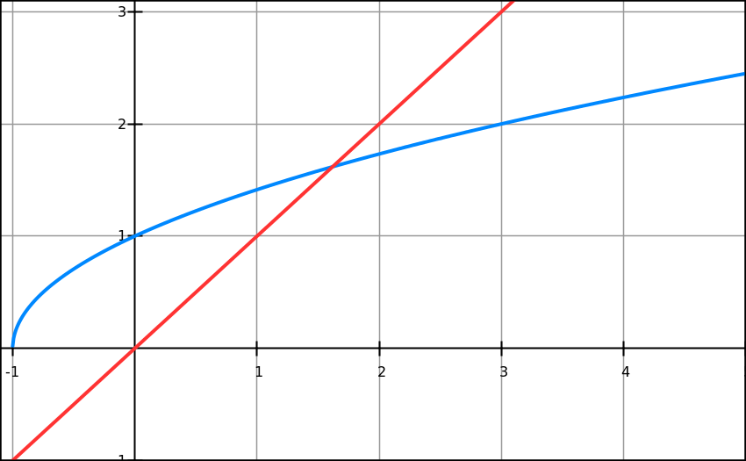
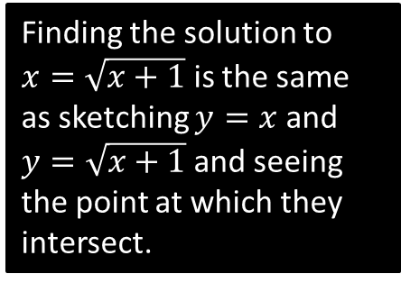
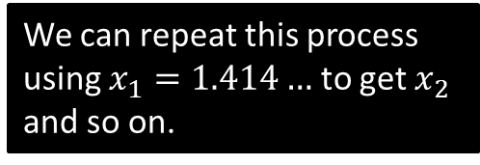


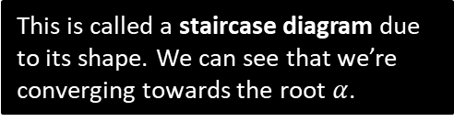


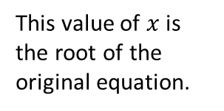

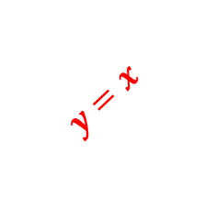
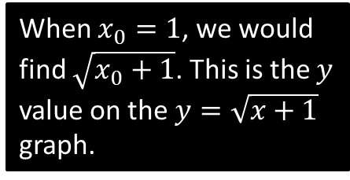

Why does this method work?
Solve $x^{2}−x−1=0$
Recall we put in the form $x=g\left(x\right)$: in this case $x=\sqrt{x+1}$ is one possible rearrangement.
We can then use the recurrence $x_{n+1}=\sqrt{x_{n}+1}$ . Why does this recurrence work?
This is called a staircase diagram due to its shape. We can see that we’re converging towards the root $α$.
$$y=x$$
$$y=\sqrt{x+1}$$
Finding the solution to $x=\sqrt{x+1}$ is the same as sketching $y=x$ and $y=\sqrt{x+1}$ and seeing the point at which they intersect.
This value of $x$ is the root of the original equation.
This gives $x_{1}=1.414…$ This is then fed back into $\sqrt{x_{n}+1}$ for the next iteration, i.e. the $y$ value becomes the new $x$ value! This is equivalent to moving to the line $y=x$.
$$x_{1}$$
$$α$$
$$x_{0}$$
When $x_{0}=1$, we would find $\sqrt{x_{0}+1}$. This is the $y$ value on the $y=\sqrt{x+1}$ graph.
We can repeat this process using $x_{1}=1.414…$ to get $x_{2}$ and so on.

Slide 3
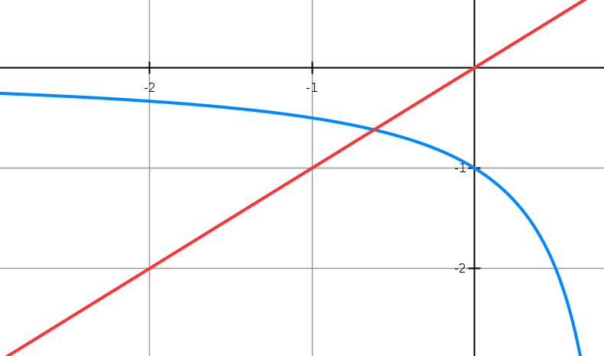





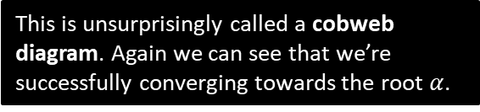
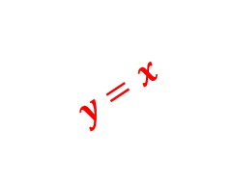

Cobweb Diagrams
Solve $x^{2}−x−1=0$
We could also have rearranged differently to $x=\frac{1}{x−1}$
Therefore we use the recurrence $x_{n+1}=\frac{1}{x_{n}−1}$ . What happens this time?
$$y=x$$
$$x_{2}$$
$$x_{0}$$
$$α$$
$$x_{1}$$
$$x_{3}$$
https://www.youtube.com/watch?v=gojeMEkQqTM
$$y=\frac{1}{x−1}$$
This is unsurprisingly called a cobweb diagram. Again we can see that we’re successfully converging towards the root $α$.

Slide 4
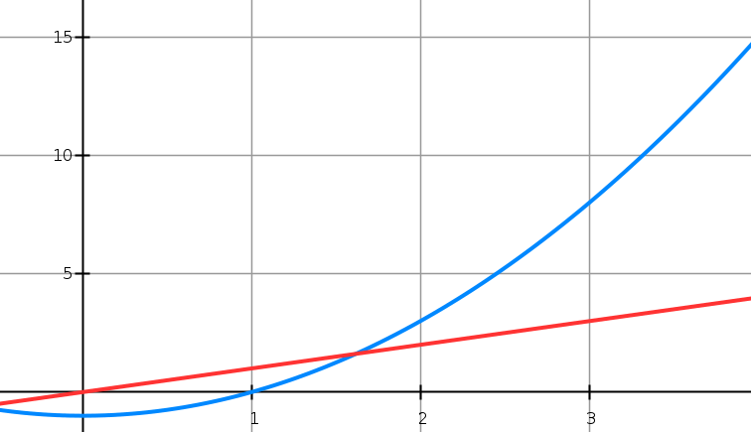
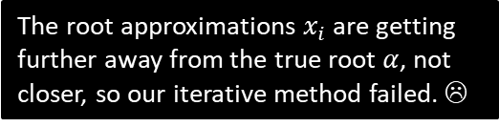


And when iteration fails…
Solve $x^{2}−x−1=0$
But again, we could have rearranged differently! $x=x^{2}−1$
Therefore we use the recurrence $x_{n+1}=x_{n}^{2}−1$ . What happens this time?
The root approximations $x_{i}$ are getting further away from the true root $α$, not closer, so our iterative method failed. ☹
$$α$$
$$x_{0}$$
$$x_{1}$$

Slide 5
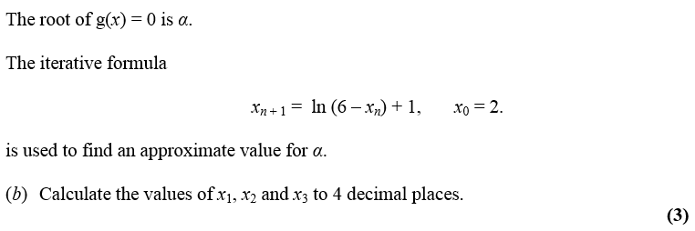
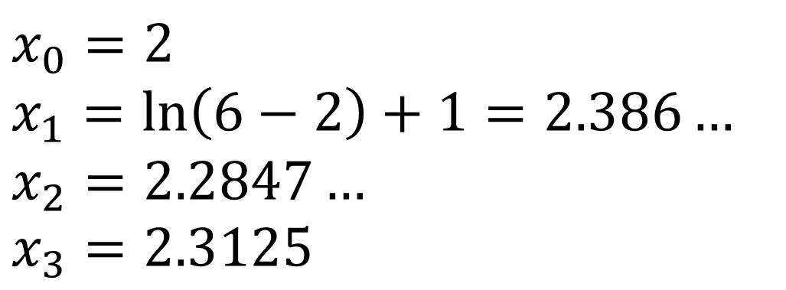
Iteration – Example A
$$x_{0}=2 \\ x_{1}=\ln\left(6−2\right)+1=2.386… \\ x_{2}=2.2847… \\ x_{3}=2.3125$$

Slide 6
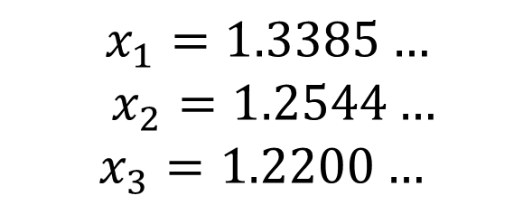
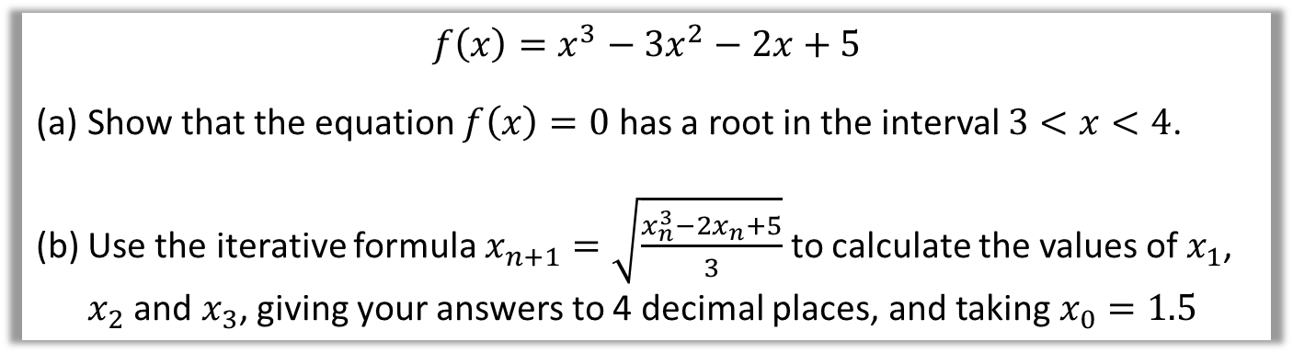
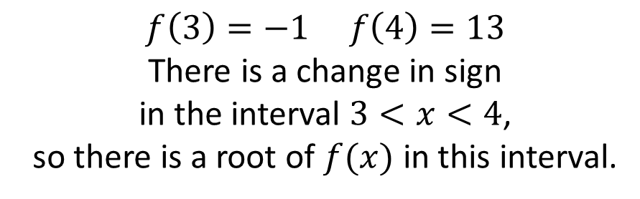
Iteration – Example B
$$f\left(x\right)=x^{3}−3x^{2}−2x+5$$
Show that the equation $f\left(x\right)=0$ has a root in the interval $3<x<4$.
Use the iterative formula $x_{n+1}=\sqrt{\frac{x_{n}^{3}−2x_{n}+5}{3}}$ to calculate the values of $x_{1}$, $x_{2}$ and $x_{3}$, giving your answers to 4 decimal places, and taking $x_{0}=1.5$
$$f\left(3\right)=−1 f\left(4\right)=13$$
There is a change in sign
in the interval $3<x<4$,
so there is a root of $f(x)$ in this interval.
$x_{1}=1.3385…$
$x_{2}=1.2544…$
$$x_{3}=1.2200…$$

Slide 7
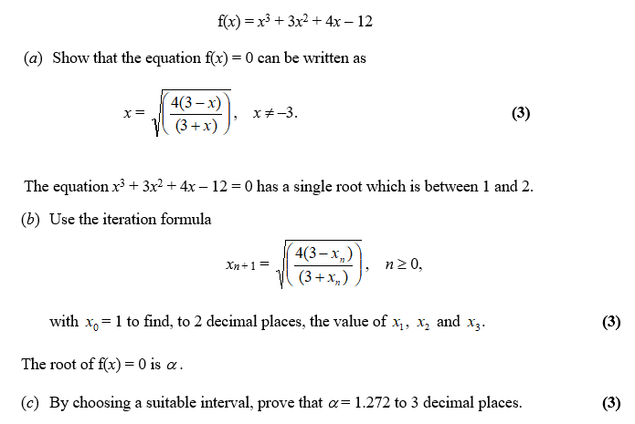
Iteration – Exam Question

Slide 8
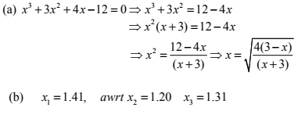
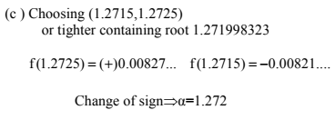
Iteration – Exam Question Answers

Slide 9
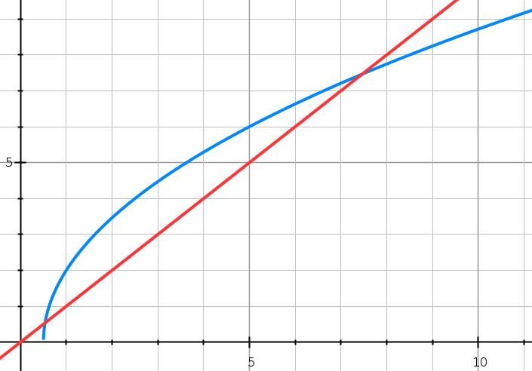


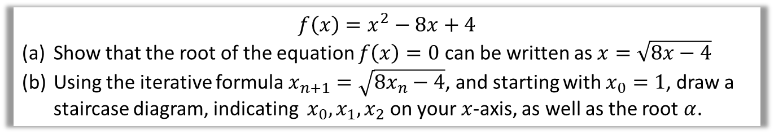


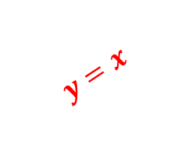

Test Your Understanding
$$f\left(x\right)=x^{2}−8x+4$$
Show that the root of the equation $f\left(x\right)=0$ can be written as $x=\sqrt{8x−4}$
Using the iterative formula $x_{n+1}=\sqrt{8x_{n}−4}$, and starting with $x_{0}=1$, draw a staircase diagram, indicating $x_{0},x_{1}, x_{2}$ on your $x$-axis, as well as the root $α$.
?
$$y=x$$
$$y=\sqrt{8x−4}$$
$$x_{0}$$
$$x_{1}$$
$$x_{2}$$
$$α$$

Slide 10
Exercise 10B
Pearson Pure Mathematics Year 2/AS
Pages 280-282
Complete before the lesson Q1-2
In Class:
Green Q3-5
Amber Q6-8
Red Q9-10

