Slide 1
Year 2 Pure Mathematics
Differentiation
- Parametric Equations
Chapter 9
(Part 7 of 10)

Slide 2

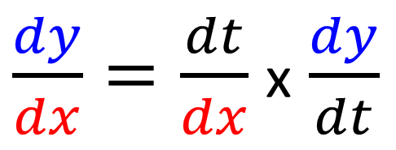
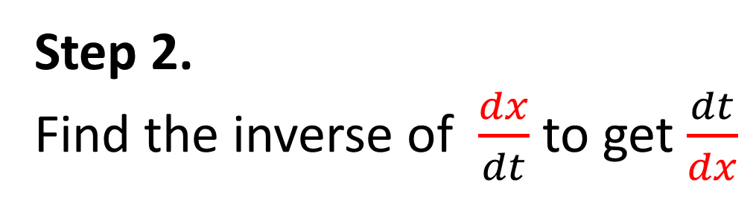
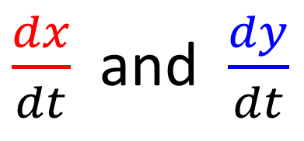
Parametric Differentiation
Finding $\frac{dy}{dt}$ for parametric equations.
Step 1.
Differentiate x and y to get
$\frac{dx}{dt}$ and $\frac{dy}{dt}$
Step 2.
Find the inverse of $\frac{dx}{dt}$ to get $\frac{dt}{dx}$
Step 3.
Use the chain rule
$\frac{dy}{dx}=\frac{dt}{dx}$ x $\frac{dy}{dt}$

Slide 3
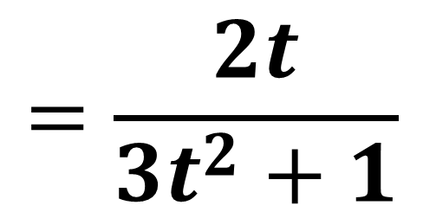
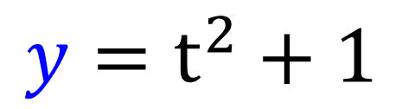
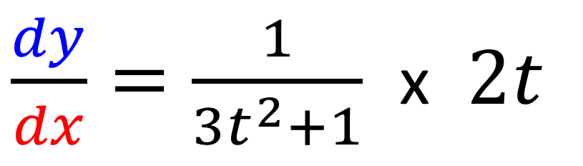
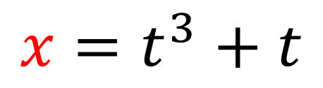
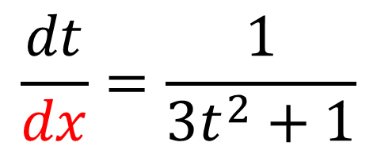
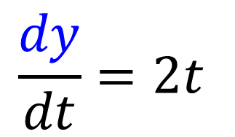
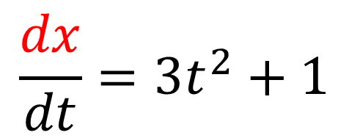
Parametric Differentiation
$$x=t^{3}+t$$
$$y=t^{2}+1$$
$$\frac{dx}{dt}=3t^{2}+1$$
$$\frac{dy}{dt}=2t$$
$$\frac{dt}{dx}=\frac{1}{3t^{2}+1}$$
$\frac{dy}{dx}=\frac{1}{3t^{2}+1}$ x $2t$
$$=\frac{2t}{3t^{2}+1}$$

Slide 4



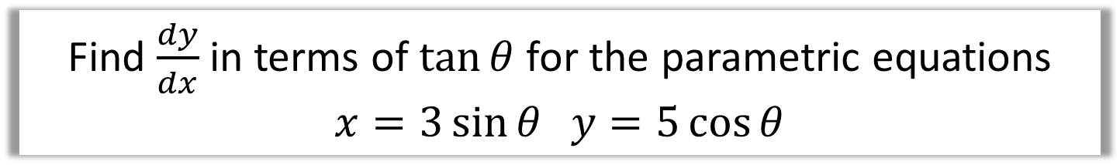
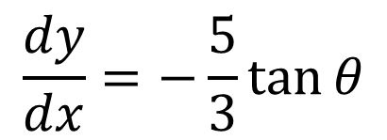
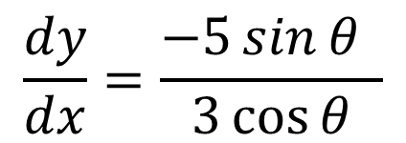
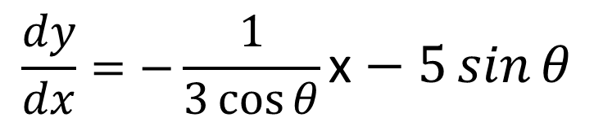
Parametric Differentiation
Find $\frac{dy}{dx}$ in terms of $\tan{θ}$ for the parametric equations
$$x=3\sin{θ} y=5\cos{θ}$$
$$3\sin{θ}$$ | $$5\cos{θ}$$
$$3\cos{θ}$$
$$−5\sin{θ}$$
$$\frac{dy}{dx}=−\frac{1}{3\cos{θ}}\text{x}−5\sin{θ}$$
$$\frac{dy}{dx}=\frac{−5\sin{θ} }{3\cos{θ}}$$
$$\frac{dy}{dx}=−\frac{5}{3}\tan{θ}$$

Slide 5
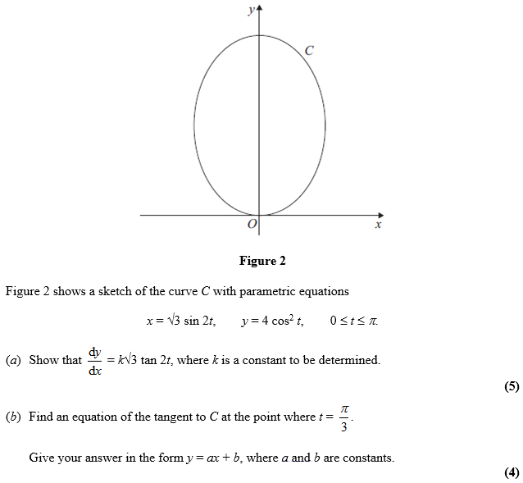
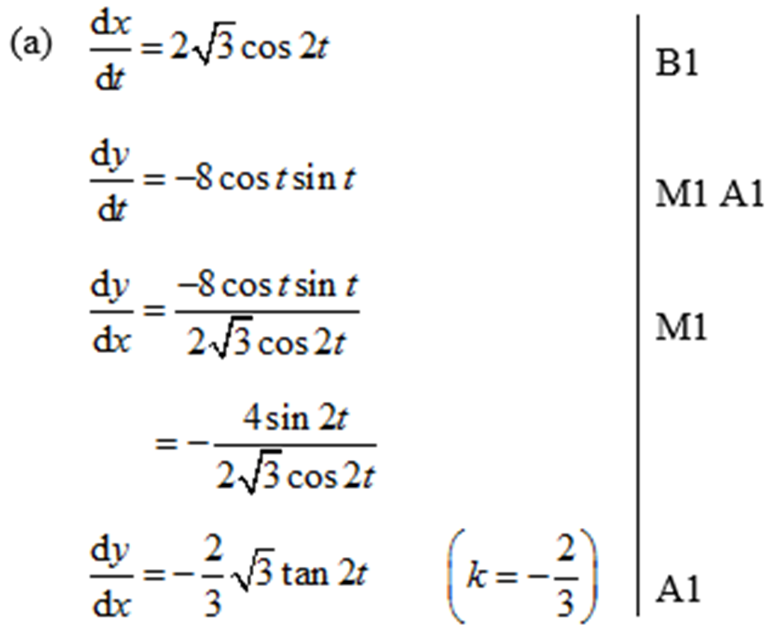
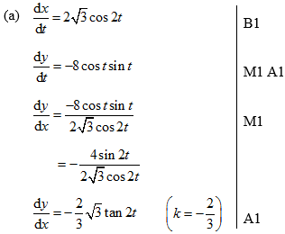

Parametric Differentiation – Exam Question

Slide 6
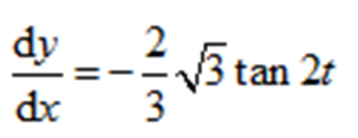
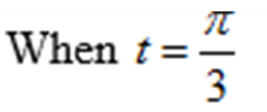
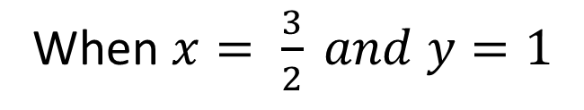

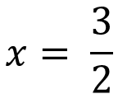
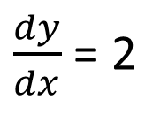


Parametric Differentiation – Exam Question
$\frac{dy}{dx}$ = 2
When $x= \frac{3}{2} and y=1$
$y=2x+c$
$$x= \frac{3}{2}$$
$$y=1$$
$y=2x−2$

Slide 7
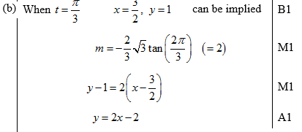
Test Your Understanding
C4 June 2012 Q6
?
?

Slide 8
Exercise 9G
Pearson Pure Mathematics Year 2/AS
Pages 252-254
Complete before the lesson Q1 (any 5) also Q2 &3
In Class:
Green Q4-5
Amber Q6-9
Red Q10-11

