Slide 1
Year 2 Applied Mathematics
Probability
- Sample Space
Chapter 5 (Part 1)

Slide 2

Probability
An experiment is a repeatable process
that gives a number of outcomes.
An event is a set of one or more of these outcomes.
A sample space is the set of all possible outcomes.
A sample space could be the following formats:
Venn Diagram
Sample Space Diagram
A simple list
Frequency Tables

Slide 3


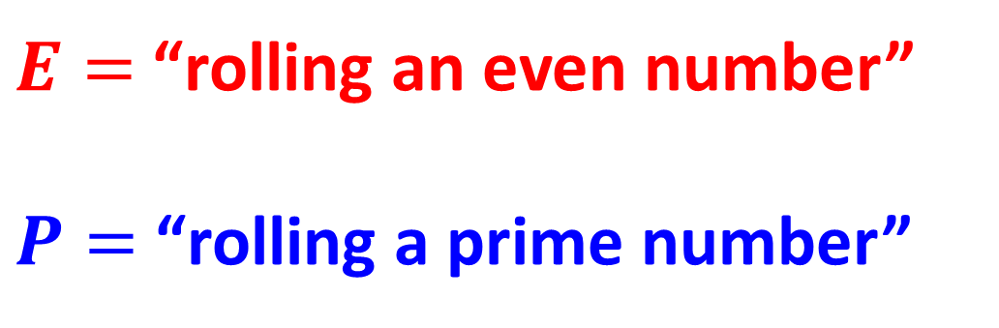
Probability – Venn Diagrams
$E=$“rolling an even number”
$P=$“rolling a prime number”
$$P$$
1
3
5
$$E$$
2
6
4

Slide 4
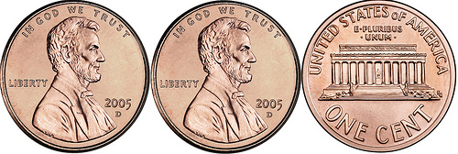
Probability – Lists
Three coins are flipped.
List all the possible outcomes.
HHH
HHT
HTH
THH
HTT
THT
TTH
TTT

Slide 5
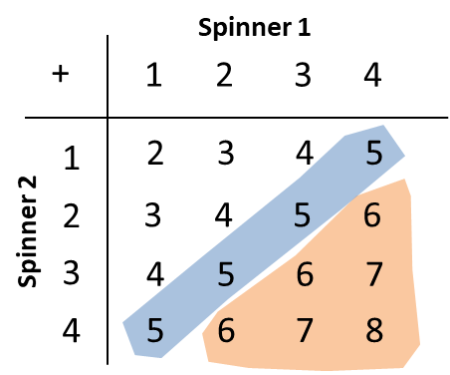
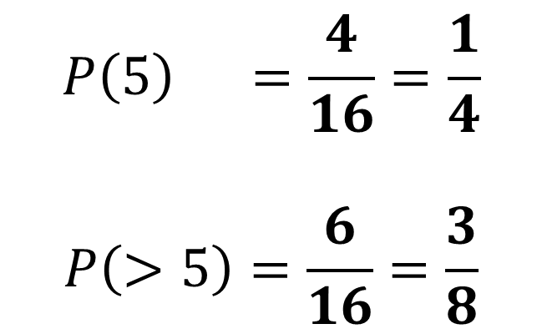
Probability – Sample Space Diagram
Two fair spinners each have four sectors numbered 1 to 4.
The two spinners are spun together and the sum of the numbers indicated on each spinner is recorded.
Find the probability of the spinners indicating a sum of
(a) exactly 5 (b) more than 5
$$P\left(5\right) =\frac{4}{16}=\frac{1}{4}$$
$$P\left(>5\right)=\frac{6}{16}=\frac{3}{8}$$

Slide 6
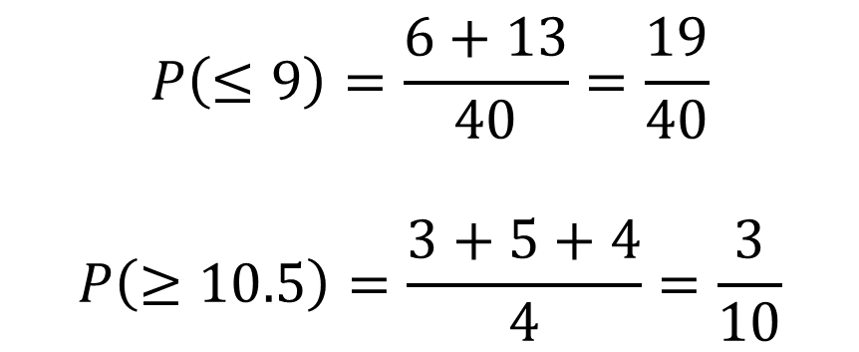
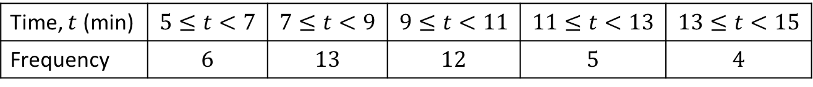
Probability – Frequency Tables
The table shows the times taken, in minutes, for a group of students to complete a number puzzle.
A student is chosen at random. Find the probability for a group of students to complete a number puzzle
(a) In under 9 minutes (b) in over 10.5 minutes.
Time, $t$ (min) | $$5≤t<7$$ | $$7≤t<9$$ | $$9≤t<11$$ | $$11≤t<13$$ | $$13≤t<15$$
Frequency | $$6$$ | $$13$$ | $$12$$ | $$5$$ | $$4$$
$$P\left(≤9\right)=\frac{6+13}{40}=\frac{19}{40}$$
$$P\left(≥10.5\right)=\frac{3+5+4}{4}=\frac{3}{10}$$

Slide 7
Exercise 5A
Pearson Pure Mathematics Year 1/AS
Pages 71-72
Complete before the lesson Q1-2
In Class:
Green Q3-4
Amber
Red Q5 & Challenge

