Slide 1
Year 1 Applied Mathematics
Constant Acceleration
- SUVAT Vertical
Chapter 9
(Part 4 of 4)

Slide 2
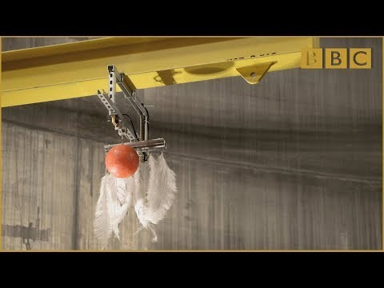
Vertical Motion - Under Gravity
If there is no air resistance, then the acceleration of
objects under gravity, regardless of mass, is constant.

Slide 3
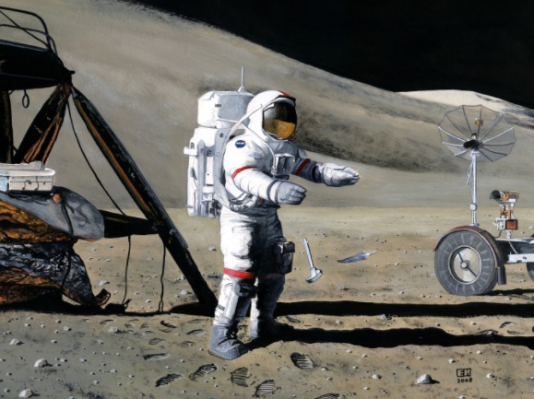
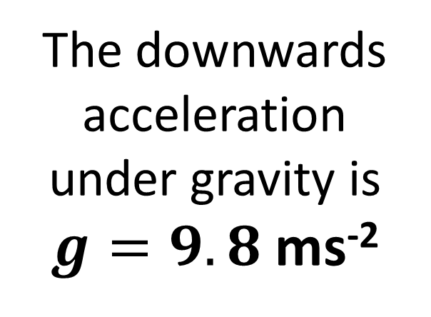
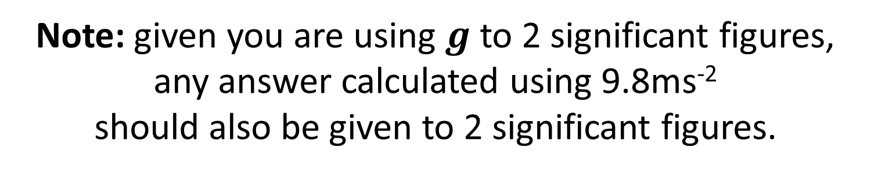
Vertical Motion - Under Gravity
The downwards
acceleration
under gravity is
$g=9.8$ms⁻²
Note: given you are using $g$ to 2 significant figures,
any answer calculated using 9.8ms⁻²
should also be given to 2 significant figures.

Slide 4
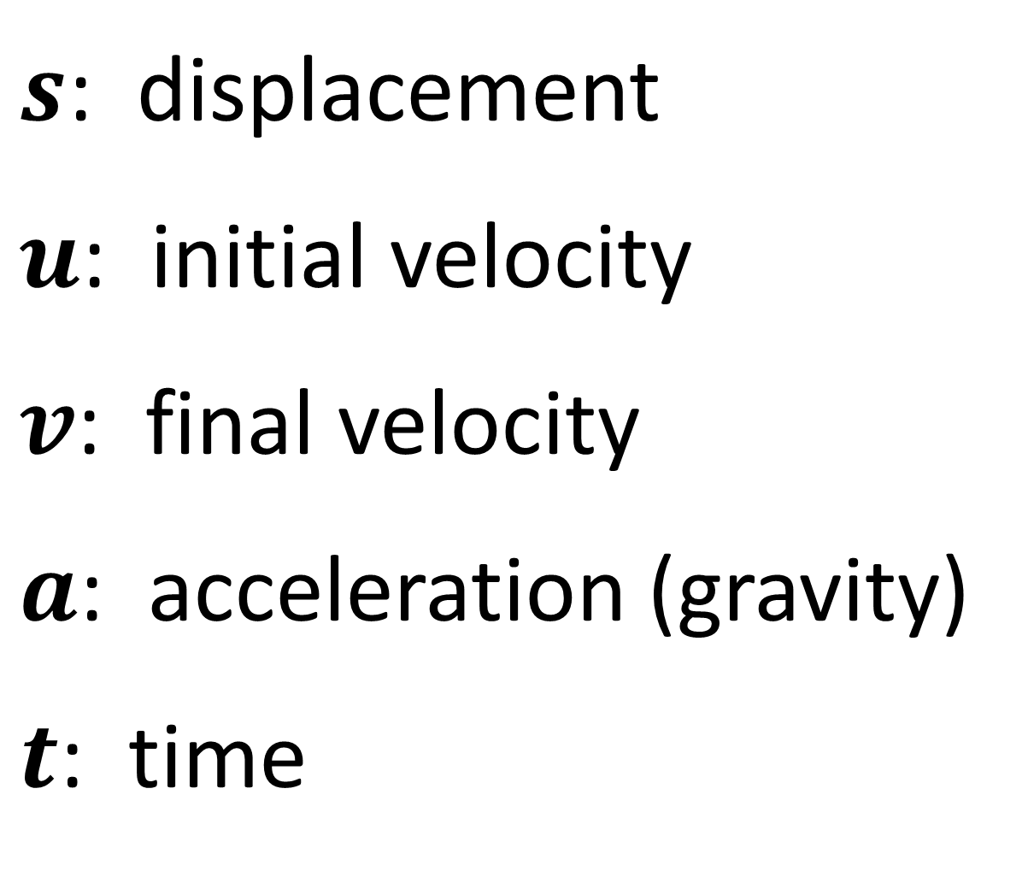
Constant Acceleration - SUVAT Equations
$s$: displacement
$u$: initial velocity
$v$: final velocity
$a$: acceleration (gravity)
$t$: time

Slide 5

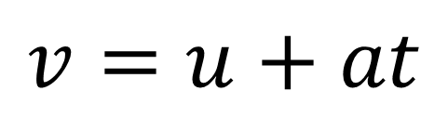

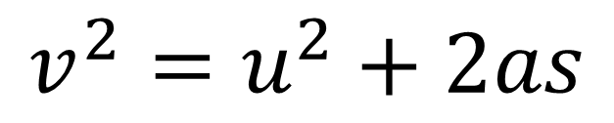
Constant Acceleration - SUVAT Equations
SUVAT equations are to be used when you have constant acceleration.
$$v=u+at$$
$$v^{2}=u^{2}+2as$$
$$s=\left(\frac{u+v}{2}\right)t$$
$$s=ut+\frac{1}{2}at^{2}$$

Slide 6
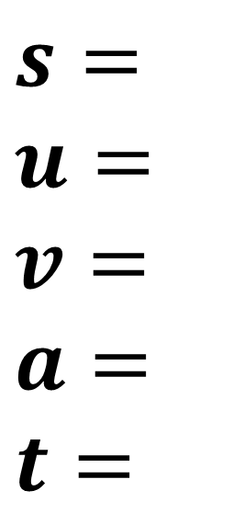
Constant Acceleration – SUVAT Equations
For each question write out SUVAT
and identify the information you know.
$s=$
$$u=$$
$$v=$$
$$a=$$
$$t=$$
Then identify which SUVAT equation you can use
that only gives you one unknown to find.

Slide 7

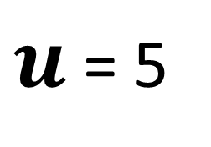
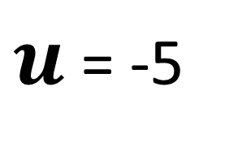
Vertical Motion – Velocity
5 ms⁻¹
-5 ms⁻¹
$u$ = 5
$u$ = -5
Upward motion
is positive
Downward motion
is negative

Slide 8
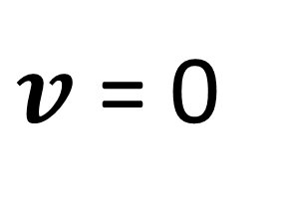
Vertical Motion – Maximum Height
What is the speed of the particle when is at its maximum height?
0 ms⁻¹
0 ms⁻¹
0 ms⁻¹
$v$ = 0
When the particle has reached it’s maximum height the velocity will be zero.

Slide 9


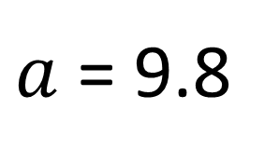
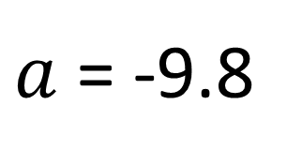
Vertical Motion – Acceleration
9.8 ms⁻¹
9.8 ms⁻¹
$a$ = 9.8
$a$ = -9.8
Upward motion
is positive
Downward motion
is negative

Slide 10
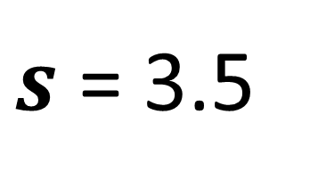
Vertical Motion – Displacement
What is the displacement of the particle?
Maximum Height
1.5m
Finish
5m
$s$ = 3.5
Start
Displacement is the distance from
you starting point to your current position.

Slide 11
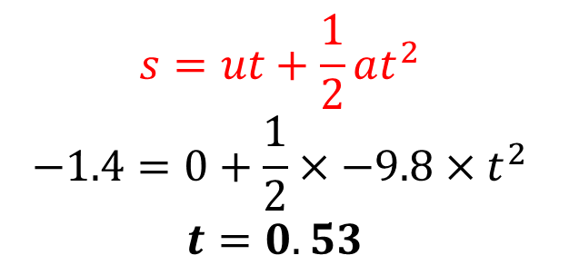
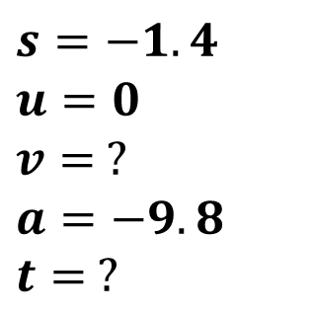
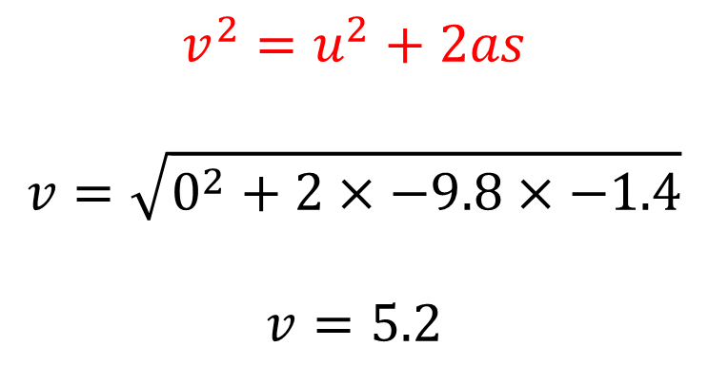
Vertical Motion - Under Gravity
A book falls off the top shelf of a bookcase.
The shelf is 1.4 m above a wooden floor.
Find:
the time the book takes to reach the floor,
the speed with which the book strikes the floor.
$$s=−1.4$$
$$u=0$$
$$v= ?$$
$$a=−9.8$$
$$t= ?$$
a
$$v^{2}=u^{2}+2as$$
$$v=\sqrt{0^{2}+2×−9.8×−1.4}$$
$$v=5.2$$
b
$$s=ut+\frac{1}{2}at^{2} \\ −1.4=0+\frac{1}{2}×−9.8×t^{2} \\ t=0.53$$

Slide 12
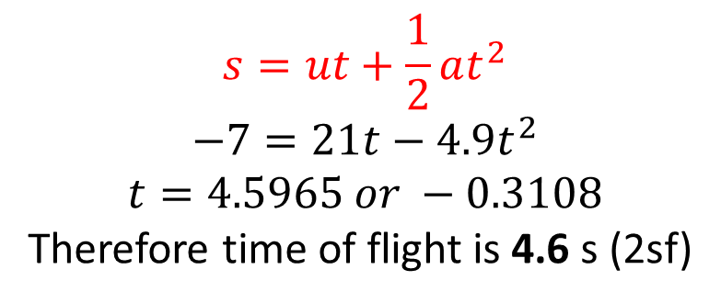
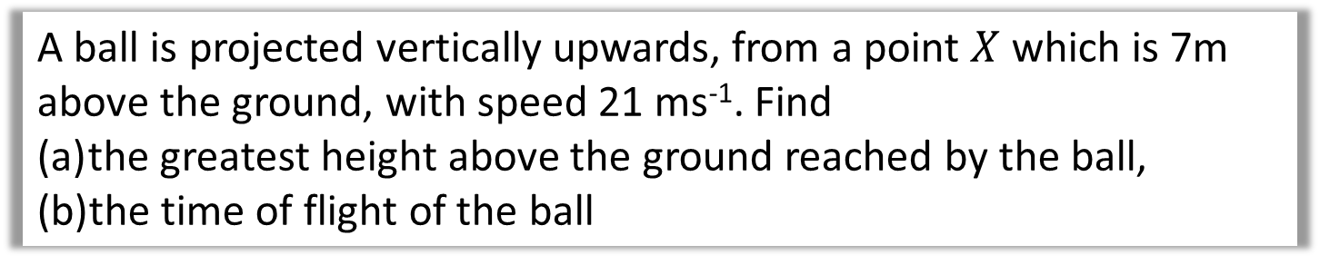

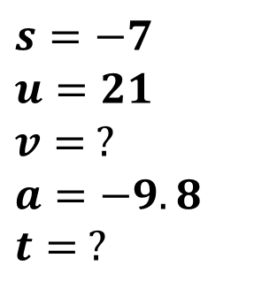

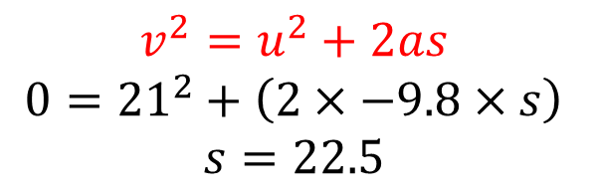
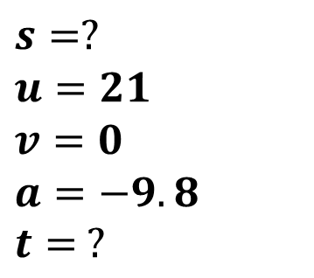
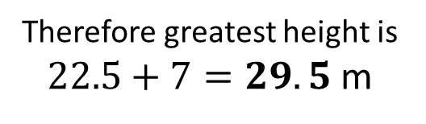
Vertical Motion - Under Gravity
A ball is projected vertically upwards, from a point $X$ which is 7m above the ground, with speed 21 ms⁻¹. Find
the greatest height above the ground reached by the ball,
the time of flight of the ball
$$s=?$$
$$u=21$$
$$v=0$$
$$a=−9.8$$
$$t= ?$$
$$v^{2}=u^{2}+2as \\ 0={21}^{2}+\left(2×−9.8×s\right) \\ s=22.5$$
a
$$s$$
$$7$$
Therefore greatest height is
$22.5+7=29.5$ m
b
$$s=−7$$
$$u=21$$
$$v= ?$$
$$a=−9.8$$
$$t= ?$$
$$s=ut+\frac{1}{2}at^{2} \\ −7=21t−4.9t^{2} \\ t=4.5965 or −0.3108$$
Therefore time of flight is 4.6 s (2sf)

Slide 13
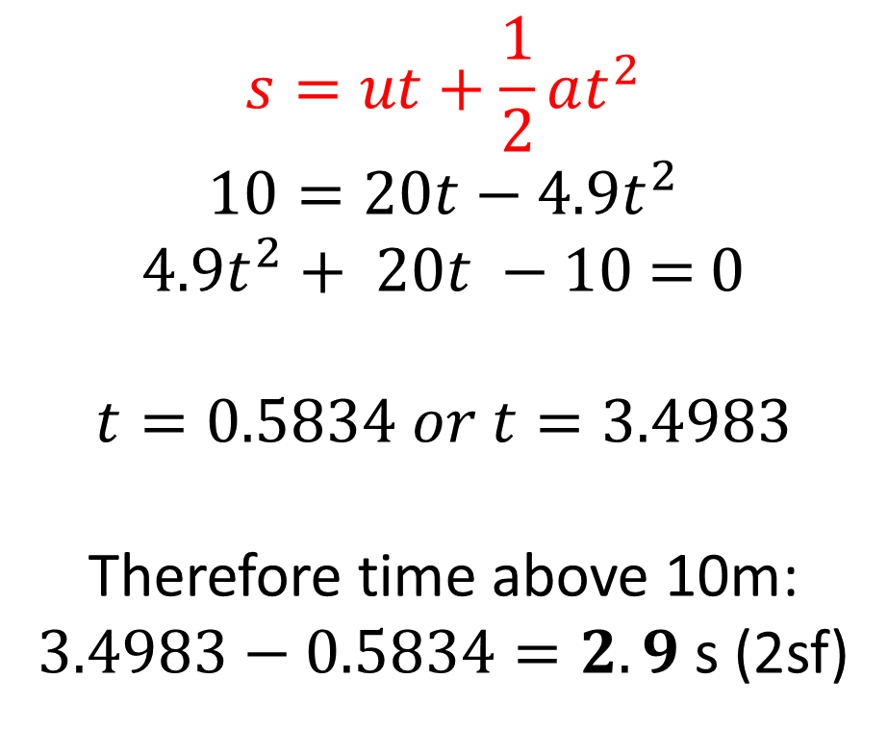
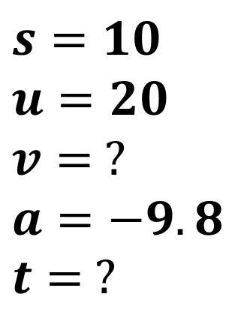
Vertical Motion - Under Gravity
A ball is projected vertically upwards from ground level at a speed of 20 ms⁻¹. Determine the amount of time the ball is at least 10m
above ground level.
$$s=10$$
$$u=20$$
$$v= ?$$
$$a=−9.8$$
$$t= ?$$
a
$$s=ut+\frac{1}{2}at^{2} \\ 10=20t−4.9t^{2}$$
$4.9t^{2}+ 20t −10$ = 0
$$t=0.5834 or t=3.4983$$
Therefore time above 10m:
$3.4983−0.5834=2.9$ s (2sf)
10m

Slide 14
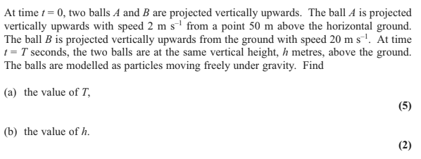
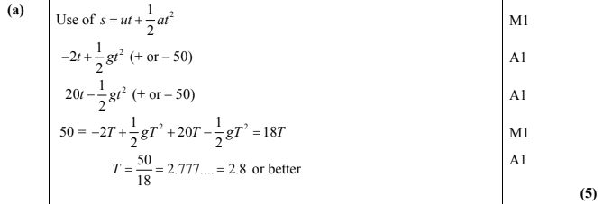

Vertical Motion - Under Gravity

Slide 15
Exercise 9E
Pearson Stats/Mechanics Year 1
Pages 151-152
Complete before the lesson Q1-3
In Class:
Green Q4-6
Amber Q7-9
Red Q10-13 & Challenge

