Slide 1





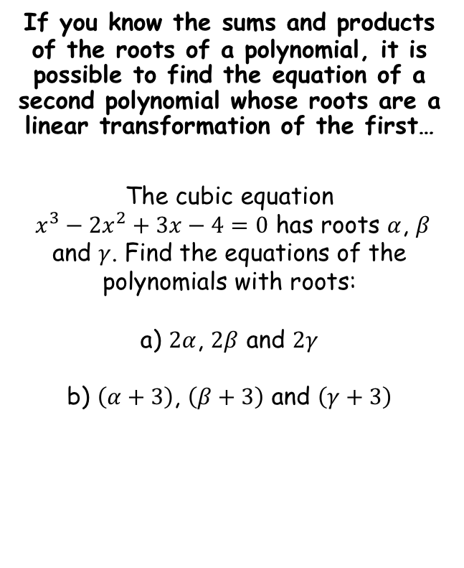






Roots of Polynomials
If you know the sums and products of the roots of a polynomial, it is possible to find the equation of a second polynomial whose roots are a linear transformation of the first…
The cubic equation
$x^{3}−2x^{2}+3x−4=0$ has roots $α$, $β$ and $γ$. Find the equations of the polynomials with roots:
a) $2α$, $2β$ and $2γ$
b) $\left(α+3\right)$, $\left(β+3\right)$ and $\left(γ+3\right)$
Method 1 – Using the roots
Calculate each value from the original equation
$$α+β+γ=−\frac{b}{a}$$
$$αβ+βγ+γα=\frac{c}{a}$$
$$αβγ=−\frac{d}{a}$$
$$α+β+γ=2$$
$$αβ+βγ+γα=3$$
$$αβγ=4$$
We can use these to find the new relationships between the roots…
$$2α+2β+2γ$$
Factorise
$$=2(α+β+γ)$$
Sub in value from above
$$=2(2)$$
Calculate
$$2α+2β+2γ=4$$
$$=4$$
4E

Slide 2




Roots of Polynomials
If you know the sums and products of the roots of a polynomial, it is possible to find the equation of a second polynomial whose roots are a linear transformation of the first…
The cubic equation
$x^{3}−2x^{2}+3x−4=0$ has roots $α$, $β$ and $γ$. Find the equations of the polynomials with roots:
a) $2α$, $2β$ and $2γ$
b) $\left(α+3\right)$, $\left(β+3\right)$ and $\left(γ+3\right)$
Method 1 – Using the roots
Calculate each value from the original equation
$$α+β+γ=−\frac{b}{a}$$
$$αβ+βγ+γα=\frac{c}{a}$$
$$αβγ=−\frac{d}{a}$$
$$α+β+γ=2$$
$$αβ+βγ+γα=3$$
$$αβγ=4$$
We can use these to find the new relationships between the roots…
$$(2α)(2β)+(2β)(2γ)+(2γ)(2α)$$
Multiply out and then factorise
$$=4(αβ+βγ+γα)$$
Sub in value from above
$$=4(3)$$
Calculate
$$2α+2β+2γ=4$$
$$=12$$
$$(2α)(2β)+(2β)(2γ)+(2γ)(2α)=12$$
4E

Slide 3





Roots of Polynomials
If you know the sums and products of the roots of a polynomial, it is possible to find the equation of a second polynomial whose roots are a linear transformation of the first…
The cubic equation
$x^{3}−2x^{2}+3x−4=0$ has roots $α$, $β$ and $γ$. Find the equations of the polynomials with roots:
a) $2α$, $2β$ and $2γ$
b) $\left(α+3\right)$, $\left(β+3\right)$ and $\left(γ+3\right)$
Method 1 – Using the roots
Calculate each value from the original equation
$$α+β+γ=−\frac{b}{a}$$
$$αβ+βγ+γα=\frac{c}{a}$$
$$αβγ=−\frac{d}{a}$$
$$α+β+γ=2$$
$$αβ+βγ+γα=3$$
$$αβγ=4$$
We can use these to find the new relationships between the roots…
$$(2α)(2β)(2γ)$$
Multiply out and then factorise
$$=8(αβγ)$$
Sub in value from above
$$=8(4)$$
Calculate
$$2α+2β+2γ=4$$
$$=32$$
$$(2α)(2β)+(2β)(2γ)+(2γ)(2α)=12$$
$$\left(2α\right)\left(2β\right)\left(2γ\right)=32$$
4E

Slide 4







Roots of Polynomials
If you know the sums and products of the roots of a polynomial, it is possible to find the equation of a second polynomial whose roots are a linear transformation of the first…
The cubic equation
$x^{3}−2x^{2}+3x−4=0$ has roots $α$, $β$ and $γ$. Find the equations of the polynomials with roots:
a) $2α$, $2β$ and $2γ$
b) $\left(α+3\right)$, $\left(β+3\right)$ and $\left(γ+3\right)$
Method 1 – Using the roots
$${ax}^{3}+{bx}^{2}+cx+d=0$$
Divide by a
$$x^{3}+{\frac{b}{a}x}^{2}+\frac{c}{a}x+\frac{d}{a}=0$$
Replace coefficients
$$x^{3}−4x^{2}+12x−32=0$$
A new letter is usually used to represent the new equation
$$w^{3}−4w^{2}+12w−32=0$$
This is $−\frac{b}{a}$
$$2α+2β+2γ=4$$
This is $\frac{c}{a}$
$$(2α)(2β)+(2β)(2γ)+(2γ)(2α)=12$$
$$\left(2α\right)\left(2β\right)\left(2γ\right)=32$$
This is $−\frac{d}{a}$
4E

Slide 5
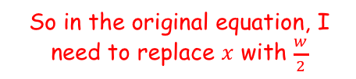



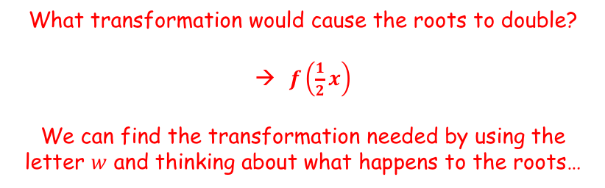


Roots of Polynomials
Method 2 – Using a substitution
If you know the sums and products of the roots of a polynomial, it is possible to find the equation of a second polynomial whose roots are a linear transformation of the first…
The cubic equation
$x^{3}−2x^{2}+3x−4=0$ has roots $α$, $β$ and $γ$. Find the equations of the polynomials with roots:
a) $2α$, $2β$ and $2γ$
b) $\left(α+3\right)$, $\left(β+3\right)$ and $\left(γ+3\right)$
Imagine we knew what the roots were…
$$y=f\left(\frac{1}{2}x\right)$$
$$y=f(x)$$
-1
3
-2
6
What transformation would cause the roots to double?
$f\left(\frac{1}{2}x\right)$
We can find the transformation needed by using the letter $w$ and thinking about what happens to the roots…
$$w^{3}−4w^{2}+12w−32=0$$
$$w=2x$$
So in the original equation, I need to replace $x$ with $\frac{w}{2}$
Divide by 2
$$\frac{w}{2}=x$$
4E

Slide 6
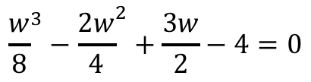






Roots of Polynomials
Method 2 – Using a substitution
If you know the sums and products of the roots of a polynomial, it is possible to find the equation of a second polynomial whose roots are a linear transformation of the first…
The cubic equation
$x^{3}−2x^{2}+3x−4=0$ has roots $α$, $β$ and $γ$. Find the equations of the polynomials with roots:
a) $2α$, $2β$ and $2γ$
b) $\left(α+3\right)$, $\left(β+3\right)$ and $\left(γ+3\right)$
Start by considering how the roots should change. In this case, the roots need to be doubled
$$w=2x$$
Divide by 2
$$\frac{w}{2}=x$$
We can now substitute this into the original equation
$$x^{3}−2x^{2}+3x−4=0$$
$$w^{3}−4w^{2}+12w−32=0$$
Sub in $\frac{w}{2}$
$${\left(\frac{w}{2}\right)}^{3}−2{\left(\frac{w}{2}\right)}^{2}+3\left(\frac{w}{2}\right)−4=0$$
Multiply brackets
$${\frac{w}{8}}^{3}−{\frac{2w}{4}}^{2}+\frac{3w}{2}−4=0$$
You will usually find that the substitution method is easier!
Multiply all by 8
$$w^{3}−{4w}^{2}+12w−32=0$$
4E

Slide 7





Roots of Polynomials
Method 2 – Using a substitution
If you know the sums and products of the roots of a polynomial, it is possible to find the equation of a second polynomial whose roots are a linear transformation of the first…
The cubic equation
$x^{3}−2x^{2}+3x−4=0$ has roots $α$, $β$ and $γ$. Find the equations of the polynomials with roots:
a) $2α$, $2β$ and $2γ$
b) $\left(α+3\right)$, $\left(β+3\right)$ and $\left(γ+3\right)$
Start by considering how the roots should change. In this case, the roots need to increase by 3
$$w=x+3$$
Subtract 3
$$w−3=x$$
We can now substitute this into the original equation
$$w^{3}−4w^{2}+12w−32=0$$
$$x^{3}−2x^{2}+3x−4=0$$
Sub in $w−3$
$${\left(w−3\right)}^{3}−2{\left(w−3\right)}^{2}+3\left(w−3\right)−4=0$$
Multiply brackets
$$w^{3}−{9w}^{2}+27w−27−2\left(w^{2}−6w+9\right)+3w−9−4=0$$
Simplify
$$w^{3}−{11w}^{2}+42w−58=0$$
4E

Slide 8


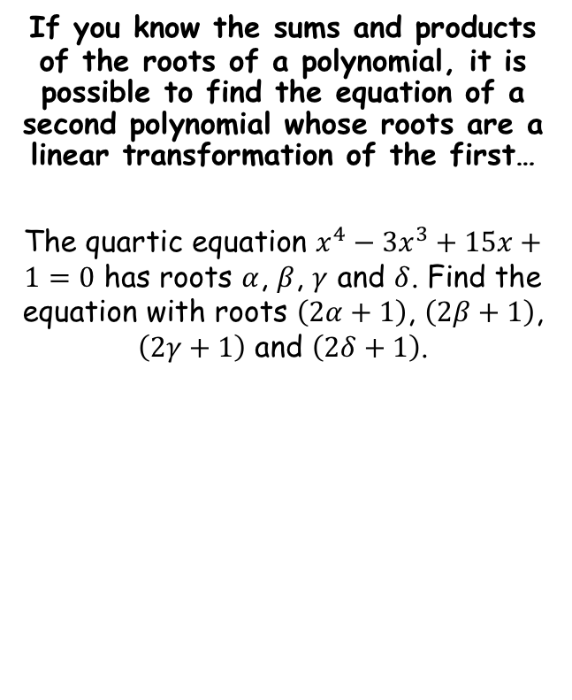


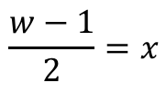
Roots of Polynomials
Using a substitution
If you know the sums and products of the roots of a polynomial, it is possible to find the equation of a second polynomial whose roots are a linear transformation of the first…
The quartic equation $x^{4}−3x^{3}+15x+1=0$ has roots $α$, $β$, $γ$ and $δ$. Find the equation with roots $\left(2α+1\right)$, $\left(2β+1\right)$, $\left(2γ+1\right)$ and $\left(2δ+1\right)$.
Start by considering how the roots should change. In this case, the roots need to double and then increase by 1
$$w=2x+1$$
Subtract 1, divide by 2
$$\frac{w−1}{2}=x$$
We can now substitute this into the original equation
$$x^{4}−3x^{3}+15x+1=0$$
Substitute using the relationship above
$${\left(\frac{w−1}{2}\right)}^{4}−3{\left(\frac{w−1}{2}\right)}^{3}+15\left(\frac{w−1}{2}\right)+1=0$$
Rewrite the denominators
$$\frac{{\left(w−1\right)}^{4}}{16}−3{\frac{\left(w−1\right)}{8}}^{3}+15\frac{w−1}{2}+1=0$$
Multiply all by 16
$${\left(w−1\right)}^{4}−6{\left(w−1\right)}^{3}+120(w−1)+16=0$$
Expand and group like terms
$$w^{4}−10w^{3}+24w^{2}+98w−97=0$$
4E

Slide 9
Exercise 4E
Pearson Further Core Mathematics Year 1/AS
Complete before the lesson Q1-2
In Class:
Green Q3-4
Amber Q5-6
Red Q7-8 & challenge

