Slide 1
Year 1 Pure Mathematics
Trigonometric Identities
and Equations
- Trigonometric Equations
Chapter 10
(Part 2 of 4)

Slide 2
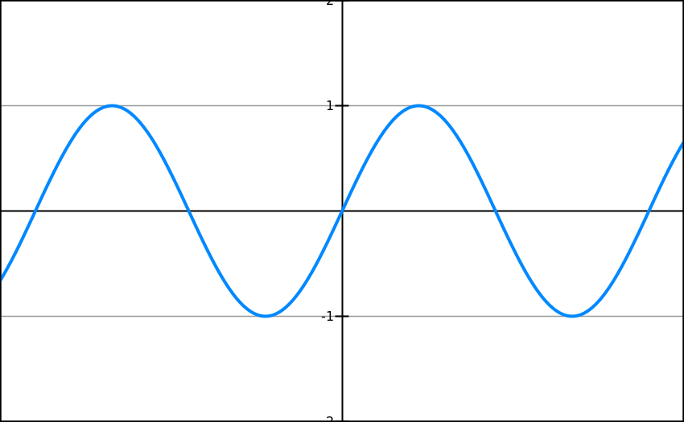
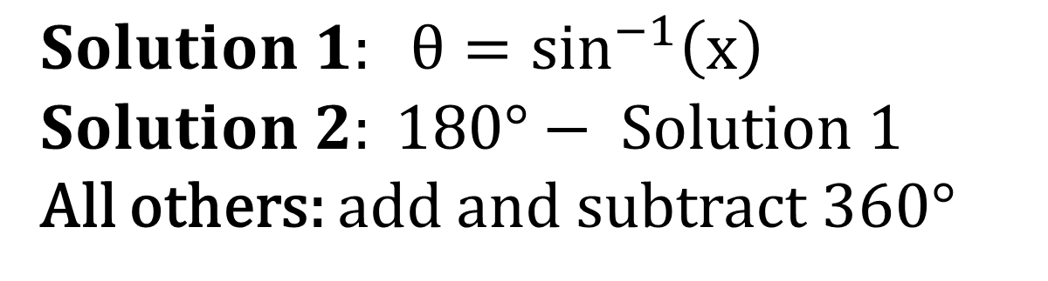
Solving Trigonometric Equations
Calculating solutions for sin equations
Solution 1
Solution 2
1 cycle
$$Solution 1: θ=\sin^{−1}\left(x\right)$$
$$Solution 2: 180°− Solution 1$$
All others: add and subtract 360$°$

Slide 3
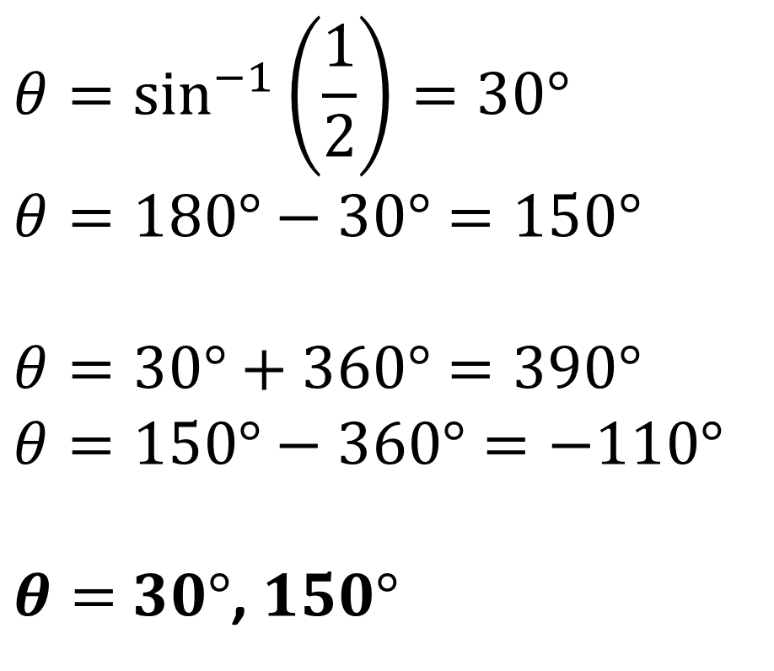
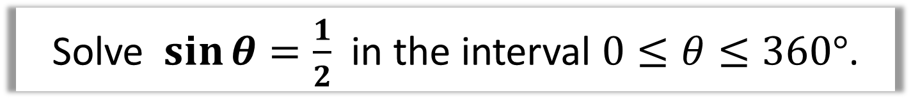
Solving Trigonometric Equations
Solve $\sin{θ}=\frac{1}{2}$ in the interval $0≤θ≤360°$.
$$θ=\sin^{−1}\left(\frac{1}{2}\right)=30°$$
$$θ=180°−30°=150°$$
$$θ=30°+360°=390°$$
$$θ=150°−360°=−110°$$
$θ=$ $30°$, $150°$
Solution 1
Solution 2

Slide 4
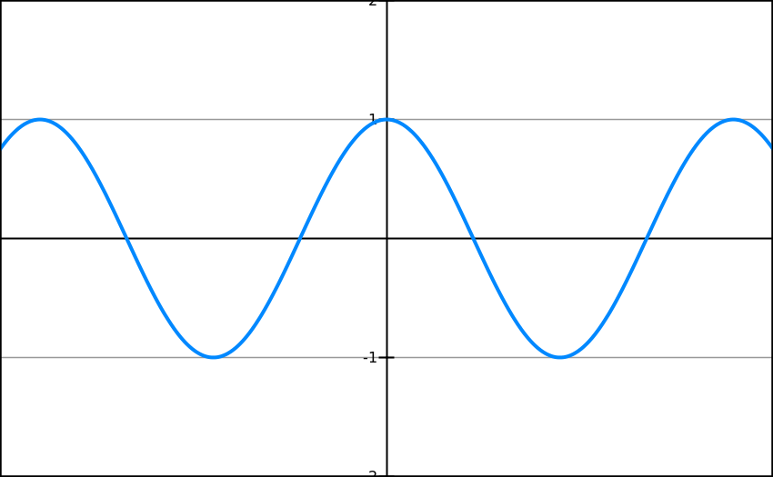
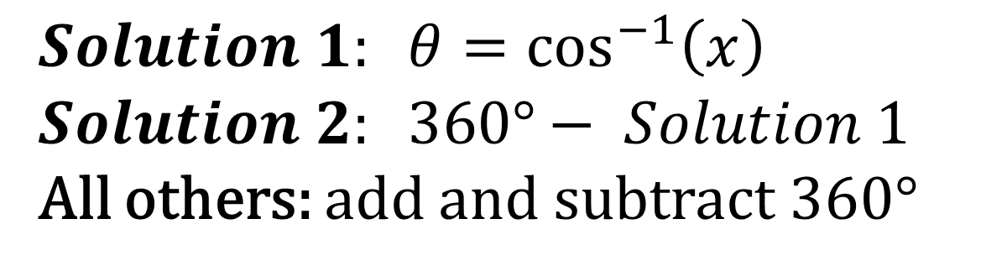
Solving Trigonometric Equations
Calculating solutions for cos equations
Solution 1
Solution 2
1 cycle
$$Solution 1: θ=\cos^{−1}\left(x\right)$$
$$Solution 2: 360°− Solution 1$$
All others: add and subtract 360$°$

Slide 5

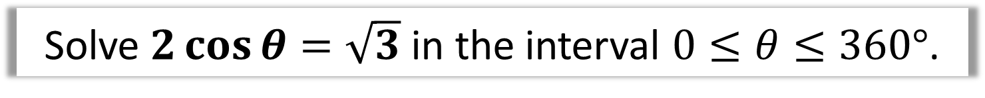
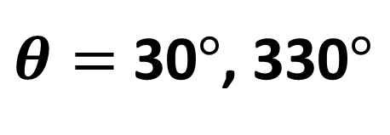
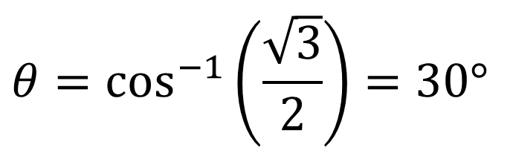
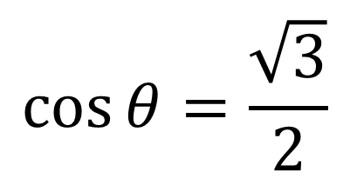
Solving Trigonometric Equations
Solve $2\cos{θ}=\sqrt{3}$ in the interval $0≤θ≤360°$.
$$\cos{θ=\frac{\sqrt{3}}{2}}$$
$$θ=\cos^{−1}\left(\frac{\sqrt{3}}{2}\right)=30°$$
$$θ=360°−30°=330°$$
$θ=$ 30$°$, 330$°$

Slide 6
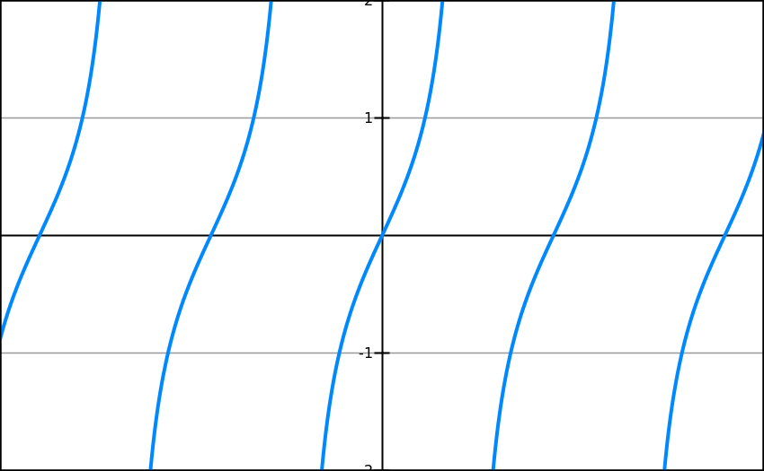
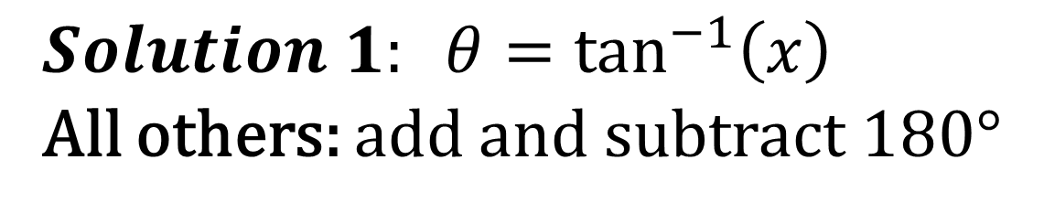
Solving Trigonometric Equations
Calculating solutions for tan equations
Solution 1
1 cycle
$$Solution 1: θ=\tan^{−1}\left(x\right)$$
All others: add and subtract 180$°$

Slide 7
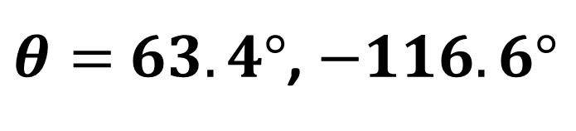
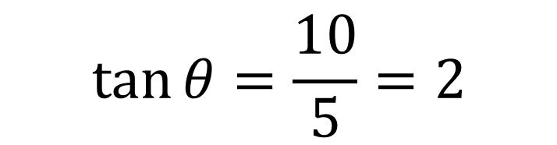
Solving Trigonometric Equations
Solve $5\tan{θ}=10$ in the interval $−180°≤θ<180°$
$$\tan{θ}=\frac{10}{5}=2$$
$$θ=\tan^{−1}{(2})=63.4° (1dp)$$
Solution 1
$$θ=63.4°−180°=−116.6° \left(1dp\right)$$
$θ=$ $63.4°$, $−116.6°$

Slide 8
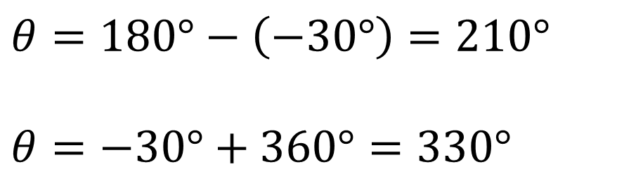
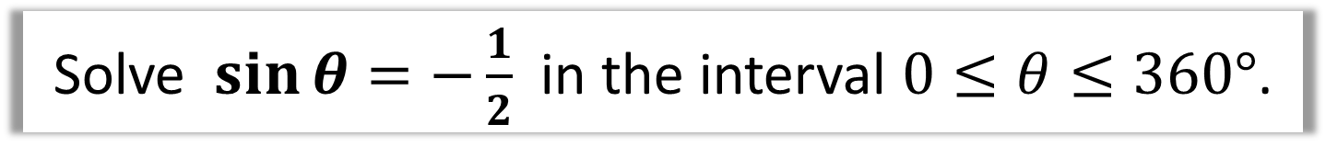
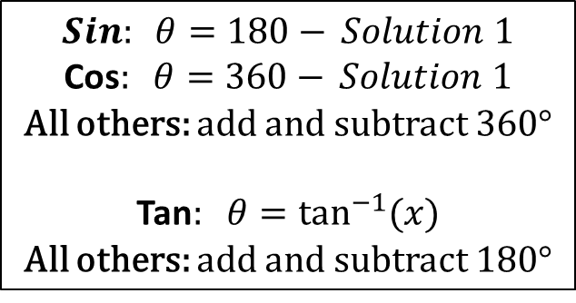
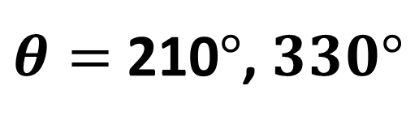
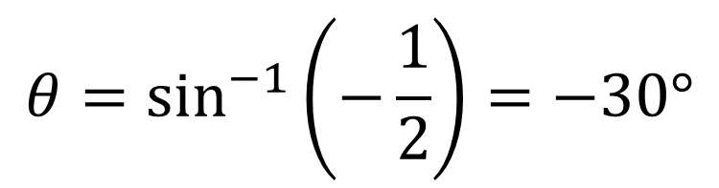
Solving Trigonometric Equations
Solve $\sin{θ}=−\frac{1}{2}$ in the interval $0≤θ≤360°$.
$$θ=\sin^{−1}\left(−\frac{1}{2}\right)=−30°$$
$$θ=180°−\left(−30°\right)=210°$$
$$θ=−30°+360°=330°$$
$$Sin: θ=180−{ Solution 1}$$
Cos$: θ=360−{ Solution 1}$
All others: add and subtract 360$°$
Tan$: θ=\tan^{−1}{(x)}$
All others: add and subtract 180$°$
$θ=$ 210$°$, $330°$

Slide 9
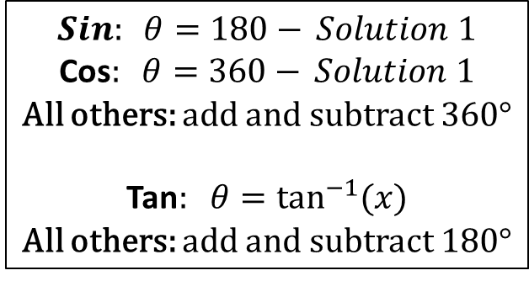

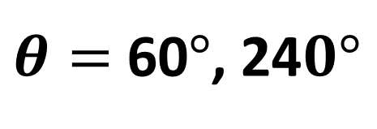
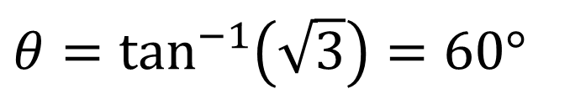
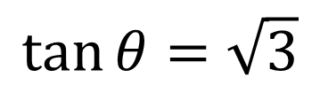
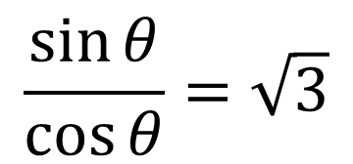
Solving Trigonometric Equations
Solve $\sin{θ}=\sqrt{3}\cos{θ}$ in the interval $0≤θ≤360°$.
$$\frac{\sin{θ}}{\cos{θ}}=\sqrt{3}$$
Hint: The problem here is that we have two different trig functions. Change into one trig function by using trig identities
$$\tan{θ}=\sqrt{3}$$
$$θ=\tan^{−1}\left(\sqrt{3}\right)=60°$$
$$θ=60°+180°=240°$$
$$Sin: θ=180−{ Solution 1}$$
Cos$: θ=360−{ Solution 1}$
All others: add and subtract 360$°$
Tan$: θ=\tan^{−1}{(x)}$
All others: add and subtract 180$°$
$θ=$ 60$°$, 24$0°$

Slide 10
Exercise 10D
Pearson Pure Mathematics Year 1/AS
Page 215-216
Complete before the lesson Q1-3
Green Q4-8
Amber Q9-11

