Slide 1
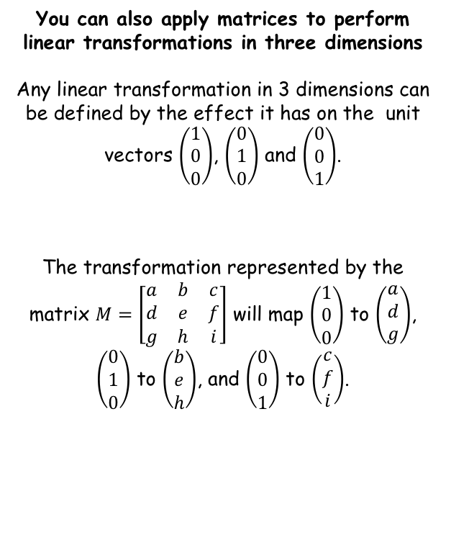
Linear Transformations
You can also apply matrices to perform linear transformations in three dimensions
Any linear transformation in 3 dimensions can be defined by the effect it has on the unit vectors $\left(\begin{matrix}1 \\ 0 \\ 0\end{matrix}\right)$, $\left(\begin{matrix}0 \\ 1 \\ 0\end{matrix}\right)$ and $\left(\begin{matrix}0 \\ 0 \\ 1\end{matrix}\right)$.
The transformation represented by the matrix $M=\left[\begin{matrix}a & b & c \\ d & e & f \\ g & h & i\end{matrix}\right]$ will map $\left(\begin{matrix}1 \\ 0 \\ 0\end{matrix}\right)$ to $\left(\begin{matrix}a \\ d \\ g\end{matrix}\right)$, $\left(\begin{matrix}0 \\ 1 \\ 0\end{matrix}\right)$ to $\left(\begin{matrix}b \\ e \\ h\end{matrix}\right)$, and $\left(\begin{matrix}0 \\ 0 \\ 1\end{matrix}\right)$ to $\left(\begin{matrix}c \\ f \\ i\end{matrix}\right)$.
7E

Slide 2














Linear Transformations
$$z$$
The plane $xz$
You can also apply matrices to perform linear transformations in three dimensions
$$y=0$$
$$y$$
The plane $zy$
$$z$$
$$x=0$$
$$y$$
$$x$$
$$z$$
$$x$$
$$y$$
The plane $xy$
$$x$$
$$z=0$$
7E

Slide 3
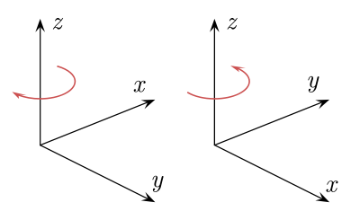
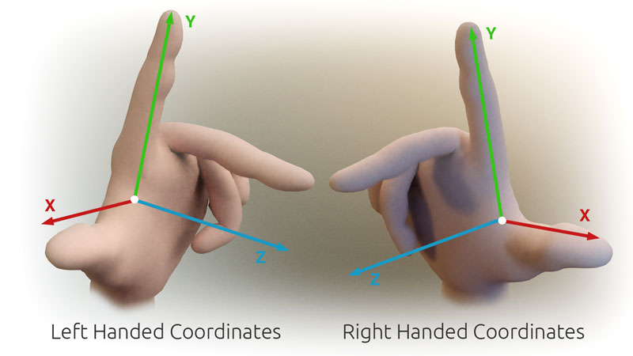
Linear Transformations
Please note that when operating in 3D, sometimes axes are labelled in different ways…
Sometimes referred to as left handed or right handed!
7E

Slide 4

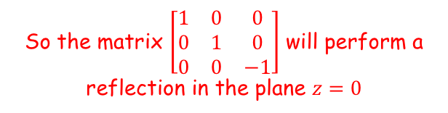


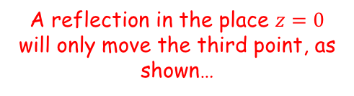
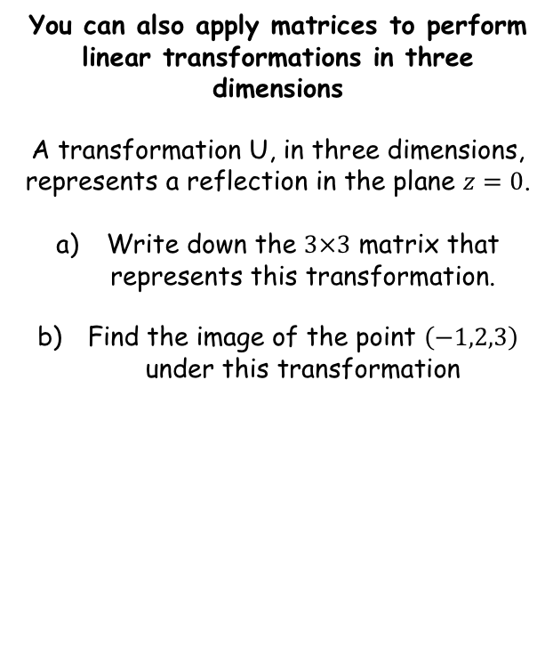

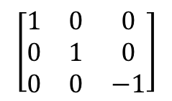

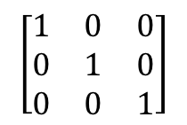


Linear Transformations
$$z$$
The plane $xy$
You can also apply matrices to perform linear transformations in three dimensions
A transformation U, in three dimensions, represents a reflection in the plane $z=0$.
Write down the $3×3$ matrix that represents this transformation.
Find the image of the point $\left(−1,2,3\right)$ under this transformation
$$z=0$$
(0,0,1)
$$y$$
(0,1,0)
(0,0,-1)
(1,0,0)
$$x$$
Original coordinates
New coordinates
A reflection in the place $z=0$ will only move the third point, as shown…
$$\left[\begin{matrix}1 & 0 & 0 \\ 0 & 1 & 0 \\ 0 & 0 & −1\end{matrix}\right]$$
$$\left[\begin{matrix}1 & 0 & 0 \\ 0 & 1 & 0 \\ 0 & 0 & 1\end{matrix}\right]$$
$$\left[\begin{matrix}1 & 0 & 0 \\ 0 & 1 & 0 \\ 0 & 0 & −1\end{matrix}\right]$$
$$\left[\begin{matrix}1 & 0 & 0 \\ 0 & 1 & 0 \\ 0 & 0 & 1\end{matrix}\right]$$
So the matrix $\left[\begin{matrix}1 & 0 & 0 \\ 0 & 1 & 0 \\ 0 & 0 & −1\end{matrix}\right]$ will perform a reflection in the plane $z=0$
7E

Slide 5
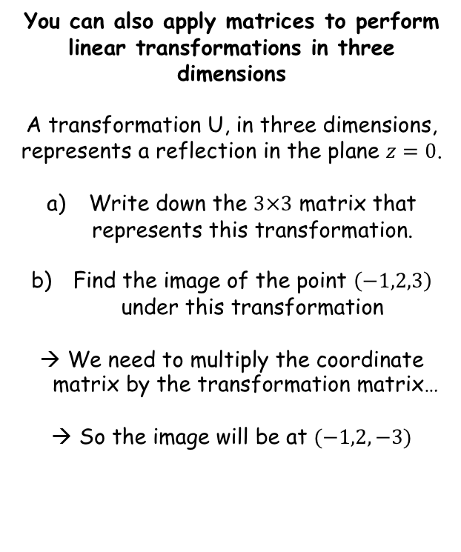
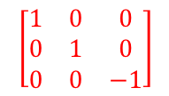
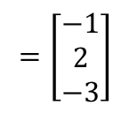
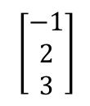
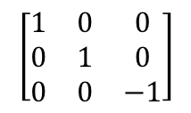
Linear Transformations
$$z$$
The plane $xy$
You can also apply matrices to perform linear transformations in three dimensions
A transformation U, in three dimensions, represents a reflection in the plane $z=0$.
Write down the $3×3$ matrix that represents this transformation.
Find the image of the point $\left(−1,2,3\right)$ under this transformation
We need to multiply the coordinate matrix by the transformation matrix…
So the image will be at $(−1,2,−3)$
$$z=0$$
$$y$$
(0,1,0)
$$\left[\begin{matrix}1 & 0 & 0 \\ 0 & 1 & 0 \\ 0 & 0 & −1\end{matrix}\right]$$
(0,0,-1)
(1,0,0)
$$x$$
$$\left[\begin{matrix}1 & 0 & 0 \\ 0 & 1 & 0 \\ 0 & 0 & −1\end{matrix}\right]$$
$$\left[\begin{matrix}−1 \\ 2 \\ 3\end{matrix}\right]$$
Calculate
$$=\left[\begin{matrix}−1 \\ 2 \\ −3\end{matrix}\right]$$
7E

Slide 6
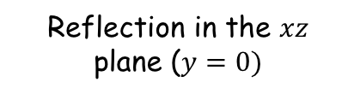
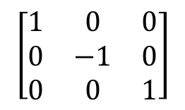
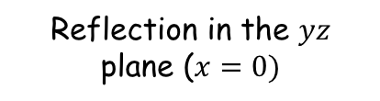
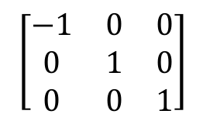
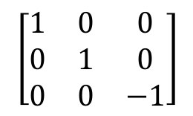
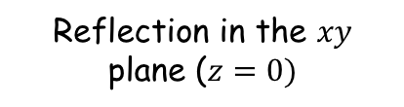
Linear Transformations
You can also apply matrices to perform linear transformations in three dimensions
The reflection matrices you need to know are as follows.
Reflection in the $yz$ plane ($x=0)$
Reflection in the $xz$ plane ($y=0)$
Reflection in the $xy$ plane ($z=0)$
$$\left[\begin{matrix}−1 & 0 & 0 \\ 0 & 1 & 0 \\ 0 & 0 & 1\end{matrix}\right]$$
$$\left[\begin{matrix}1 & 0 & 0 \\ 0 & −1 & 0 \\ 0 & 0 & 1\end{matrix}\right]$$
$$\left[\begin{matrix}1 & 0 & 0 \\ 0 & 1 & 0 \\ 0 & 0 & −1\end{matrix}\right]$$
7E

Slide 7




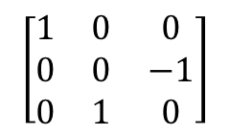




Linear Transformations
$$z$$
You can also apply matrices to perform linear transformations in three dimensions
A transformation U, in three dimensions, represents a 90˚ anticlockwise rotation around the x-axis
Write down the $3×3$ matrix that represents this transformation.
Find the image of the point $\left(−1,2,3\right)$ under this transformation
(0,0,1)
$$y$$
(0,1,0)
(1,0,0)
$$x$$
$$z$$
$$y$$
Original coordinates
New coordinates
(0,0,1)
$$\left[\begin{matrix}1 & 0 & 0 \\ 0 & 0 & −1 \\ 0 & 1 & 0\end{matrix}\right]$$
(0,-1,0)
$$\left[\begin{matrix}1 & 0 & 0 \\ 0 & 1 & 0 \\ 0 & 0 & 1\end{matrix}\right]$$
$$\left[\begin{matrix}1 & 0 & 0 \\ 0 & 0 & −1 \\ 0 & 1 & 0\end{matrix}\right]$$
$$\left[\begin{matrix}1 & 0 & 0 \\ 0 & 1 & 0 \\ 0 & 0 & 1\end{matrix}\right]$$
(1,0,0)
$$x$$
7E

Slide 8
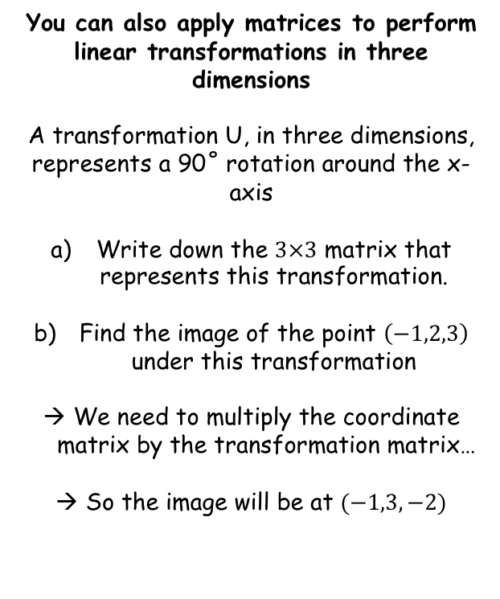
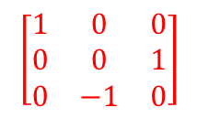
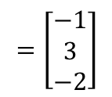
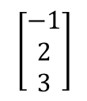
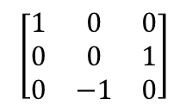
Linear Transformations
You can also apply matrices to perform linear transformations in three dimensions
A transformation U, in three dimensions, represents a 90˚ rotation around the x-axis
Write down the $3×3$ matrix that represents this transformation.
Find the image of the point $\left(−1,2,3\right)$ under this transformation
We need to multiply the coordinate matrix by the transformation matrix…
So the image will be at $(−1,3,−2)$
$$\left[\begin{matrix}1 & 0 & 0 \\ 0 & 0 & 1 \\ 0 & −1 & 0\end{matrix}\right]$$
$$\left[\begin{matrix}−1 \\ 2 \\ 3\end{matrix}\right]$$
Calculate
$$=\left[\begin{matrix}−1 \\ 3 \\ −2\end{matrix}\right]$$
$$\left[\begin{matrix}1 & 0 & 0 \\ 0 & 0 & 1 \\ 0 & −1 & 0\end{matrix}\right]$$
7E

Slide 9
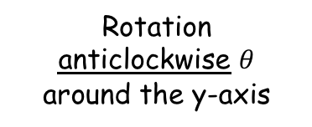
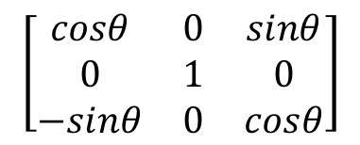
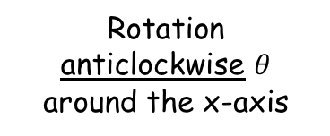
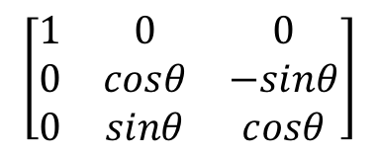
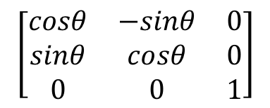
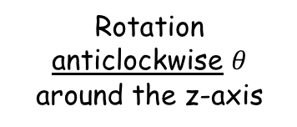
Linear Transformations
You can also apply matrices to perform linear transformations in three dimensions
The rotation matrices you need to know are as follows.
Rotation anticlockwise $θ$ around the x-axis
Rotation anticlockwise $θ$ around the y-axis
Rotation anticlockwise $θ$ around the z-axis
$$\left[\begin{matrix}1 & 0 & 0 \\ 0 & cosθ & −sinθ \\ 0 & sinθ & cosθ\end{matrix}\right]$$
$$\left[\begin{matrix}cosθ & 0 & sinθ \\ 0 & 1 & 0 \\ −sinθ & 0 & cosθ\end{matrix}\right]$$
$$\left[\begin{matrix}cosθ & −sinθ & 0 \\ sinθ & cosθ & 0 \\ 0 & 0 & 1\end{matrix}\right]$$
You do not get given any of these (or any of the reflections either!)
7E

Slide 10





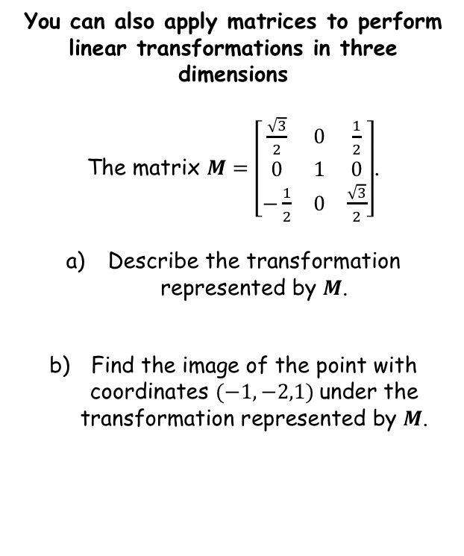





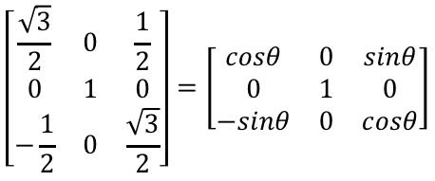

Linear Transformations
$$\left[\begin{matrix}−1 & 0 & 0 \\ 0 & 1 & 0 \\ 0 & 0 & 1\end{matrix}\right]$$
$$\left[\begin{matrix}1 & 0 & 0 \\ 0 & −1 & 0 \\ 0 & 0 & 1\end{matrix}\right]$$
$$\left[\begin{matrix}1 & 0 & 0 \\ 0 & 1 & 0 \\ 0 & 0 & −1\end{matrix}\right]$$
$$\left[\begin{matrix}1 & 0 & 0 \\ 0 & cosθ & −sinθ \\ 0 & sinθ & cosθ\end{matrix}\right]$$
$$\left[\begin{matrix}cosθ & 0 & sinθ \\ 0 & 1 & 0 \\ −sinθ & 0 & cosθ\end{matrix}\right]$$
$$\left[\begin{matrix}cosθ & −sinθ & 0 \\ sinθ & cosθ & 0 \\ 0 & 0 & 1\end{matrix}\right]$$
You can also apply matrices to perform linear transformations in three dimensions
The matrix $M=\left[\begin{matrix}\frac{\sqrt{3}}{2} & 0 & \frac{1}{2} \\ 0 & 1 & 0 \\ −\frac{1}{2} & 0 & \frac{\sqrt{3}}{2}\end{matrix}\right]$.
Describe the transformation represented by $M$.
Find the image of the point with coordinates $(−1,−2,1)$under the transformation represented by $M$.
This is the pattern that is in the question…
→ Rotation anti-clockwise about the y-axis
$$\left[\begin{matrix}\frac{\sqrt{3}}{2} & 0 & \frac{1}{2} \\ 0 & 1 & 0 \\ −\frac{1}{2} & 0 & \frac{\sqrt{3}}{2}\end{matrix}\right]=\left[\begin{matrix}cosθ & 0 & sinθ \\ 0 & 1 & 0 \\ −sinθ & 0 & cosθ\end{matrix}\right]$$
Compare sides and form equations. Remember there can sometimes be multiple answers!
$$cosθ=\frac{\sqrt{3}}{2}$$
$$sinθ=\frac{1}{2}$$
$θ={30}^{°}$ or ${330}^{°}$
$θ={30}^{°}$ or ${150}^{°}$
$$θ={30}^{°}$$
7E

Slide 11
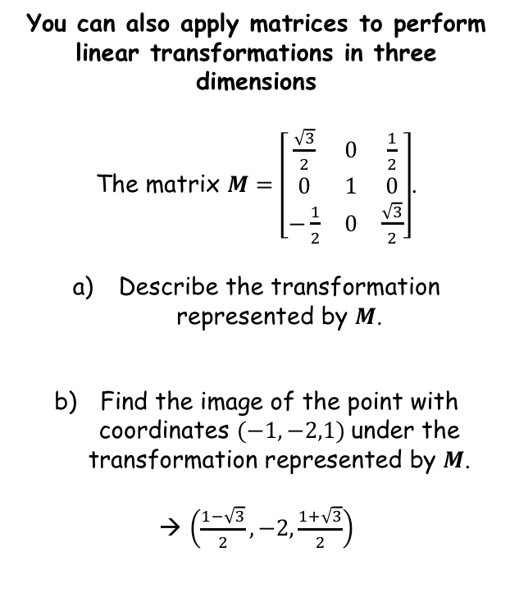
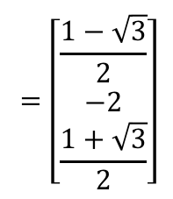

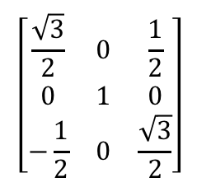
Linear Transformations
$$\left[\begin{matrix}−1 & 0 & 0 \\ 0 & 1 & 0 \\ 0 & 0 & 1\end{matrix}\right]$$
$$\left[\begin{matrix}1 & 0 & 0 \\ 0 & −1 & 0 \\ 0 & 0 & 1\end{matrix}\right]$$
$$\left[\begin{matrix}1 & 0 & 0 \\ 0 & 1 & 0 \\ 0 & 0 & −1\end{matrix}\right]$$
$$\left[\begin{matrix}1 & 0 & 0 \\ 0 & cosθ & −sinθ \\ 0 & sinθ & cosθ\end{matrix}\right]$$
$$\left[\begin{matrix}cosθ & 0 & sinθ \\ 0 & 1 & 0 \\ −sinθ & 0 & cosθ\end{matrix}\right]$$
$$\left[\begin{matrix}cosθ & −sinθ & 0 \\ sinθ & cosθ & 0 \\ 0 & 0 & 1\end{matrix}\right]$$
$$\left[\begin{matrix}\frac{\sqrt{3}}{2} & 0 & \frac{1}{2} \\ 0 & 1 & 0 \\ −\frac{1}{2} & 0 & \frac{\sqrt{3}}{2}\end{matrix}\right]$$
You can also apply matrices to perform linear transformations in three dimensions
The matrix $M=\left[\begin{matrix}\frac{\sqrt{3}}{2} & 0 & \frac{1}{2} \\ 0 & 1 & 0 \\ −\frac{1}{2} & 0 & \frac{\sqrt{3}}{2}\end{matrix}\right]$.
Describe the transformation represented by $M$.
Find the image of the point with coordinates $(−1,−2,1)$under the transformation represented by $M$.
→ $\left(\frac{1−\sqrt{3}}{2},−2,\frac{1+\sqrt{3}}{2}\right)$
$$\left[\begin{matrix}−1 \\ −2 \\ 1\end{matrix}\right]$$
Calculate
$$=\left[\begin{matrix}\frac{1−\sqrt{3}}{2} \\ −2 \\ \frac{1+\sqrt{3}}{2}\end{matrix}\right]$$
Rotation 30˚ anticlockwise about the y-axis
7E

Slide 12
Exercise 7E
Pearson Pure Mathematics Year 1/AS
Pages 3-5
Complete before the lesson Q1-2
In Class:
Green Q3-4
Amber Q5-6
Red Q7 & challenge

