Slide 1
Year 2 Pure Mathematics
Differentiation
- Quotient Rule
Chapter 9
(Part 5 of 10)

Slide 2
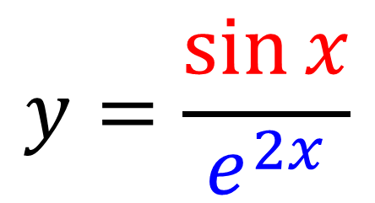
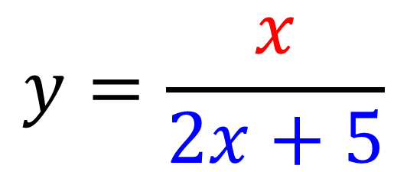
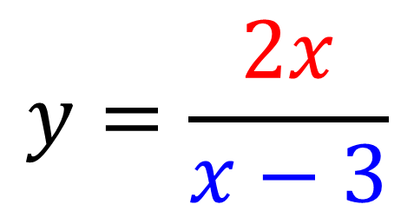
The Quotient Rule
The quotient rule is used when
you have a division of two functions.
$$y=\frac{x}{2x+5}$$
$$y=\frac{\sin{x}}{e^{2x}}$$
$$y=\frac{2x}{x−3}$$

Slide 3
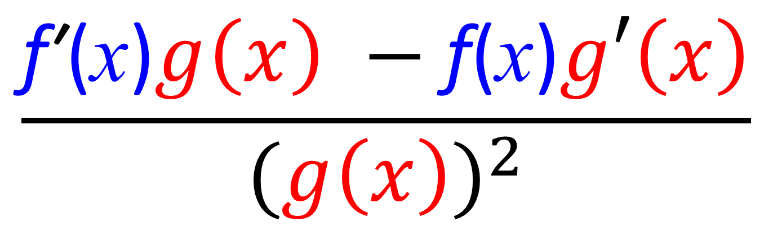

The Quotient Rule
The Quotient Rule:
If $y=\frac{\text{f}\text{ (}\text{x}\text{)}}{g\left(x\right)}$ then
$$\frac{\text{f}\text{′}\text{(}\text{x}\text{)}g\left(x\right) −\text{f}\text{(}\text{x}\text{)}g′\left(x\right)}{{(g\left(x\right))}^{2}}$$
This is given in the formula booklet!

Slide 4
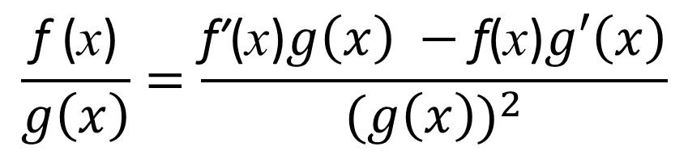

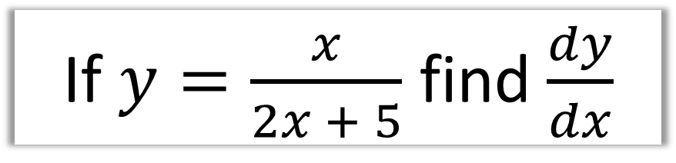
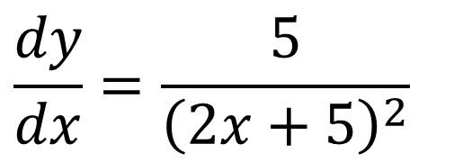
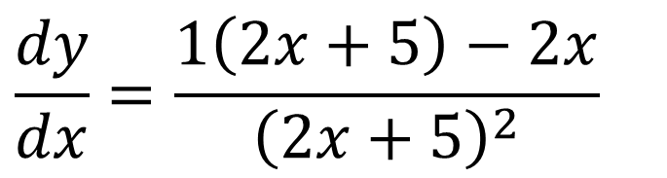
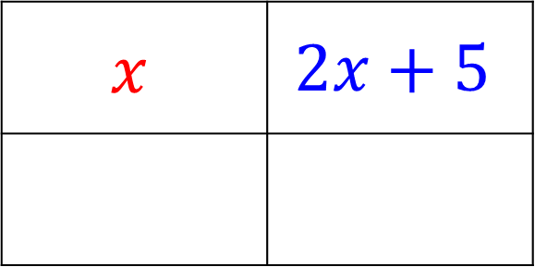
The Quotient Rule
If $y=\frac{x}{2x + 5}$ find $\frac{dy}{dx}$
$$\frac{\text{f} \text{(}\text{x}\text{)}}{g\left(x\right)}=\frac{\text{f}\text{′}\text{(}\text{x}\text{)}g\left(x\right) −\text{f}\text{(}\text{x}\text{)}g′\left(x\right)}{{(g\left(x\right))}^{2}}$$
$$x$$ | $$2x+5$$
$$\frac{dy}{dx}=\frac{1\left(2x+5\right)−2x}{{\left(2x+5\right)}^{2}}$$
$$1$$
2
$$\frac{dy}{dx}=\frac{5}{{\left(2x+5\right)}^{2}}$$

Slide 5
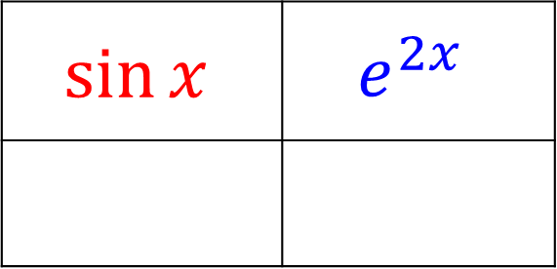

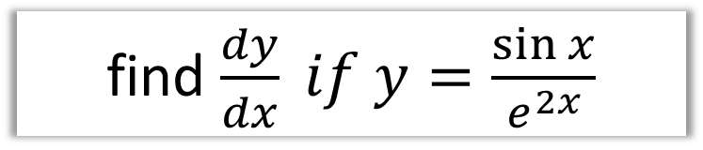

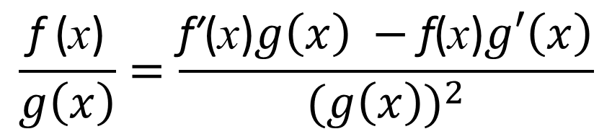
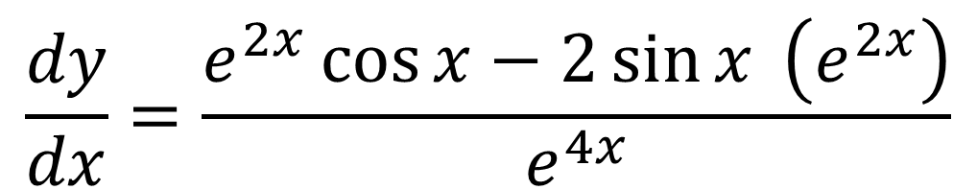
The Quotient Rule
find $\frac{dy}{dx} if y=\frac{\sin{x}}{e^{2x}}$
$$\frac{\text{f} \text{(}\text{x}\text{)}}{g\left(x\right)}=\frac{\text{f}\text{′}\text{(}\text{x}\text{)}g\left(x\right) −\text{f}\text{(}\text{x}\text{)}g′\left(x\right)}{{(g\left(x\right))}^{2}}$$
$$\sin{x}$$ | $$e^{2x}$$
$$\cos{x}$$
$$2e^{2x}$$
$$\frac{dy}{dx}=\frac{e^{2x}\cos{x}−2\sin{x} \left(e^{2x}\right)}{e^{4x}}$$

Slide 6


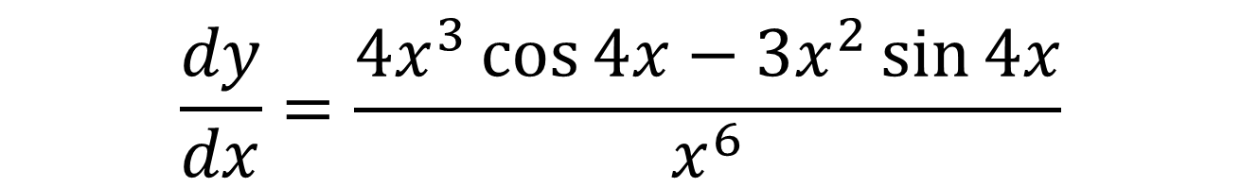
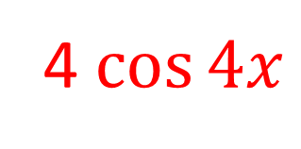
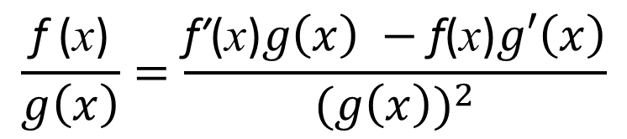
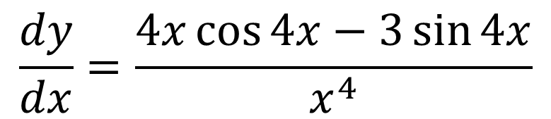
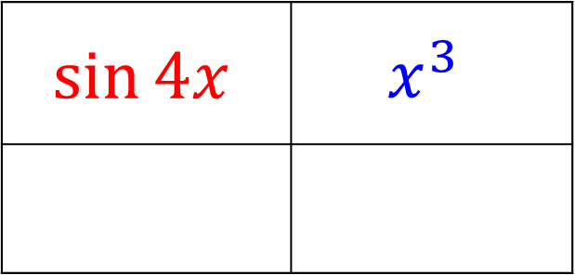
The Quotient Rule
$$\sin{4x}$$ | $$x^{3}$$
$$\frac{\text{f} \text{(}\text{x}\text{)}}{g\left(x\right)}=\frac{\text{f}\text{′}\text{(}\text{x}\text{)}g\left(x\right) −\text{f}\text{(}\text{x}\text{)}g′\left(x\right)}{{(g\left(x\right))}^{2}}$$
4 $\cos{4x}$
$$3x^{2}$$
$$\frac{dy}{dx}=\frac{4x^{3}\cos{4x}−3x^{2}\sin{4x}}{x^{6}}$$
$$\frac{dy}{dx}=\frac{4x\cos{4x}−3\sin{4x}}{x^{4}}$$

Slide 7
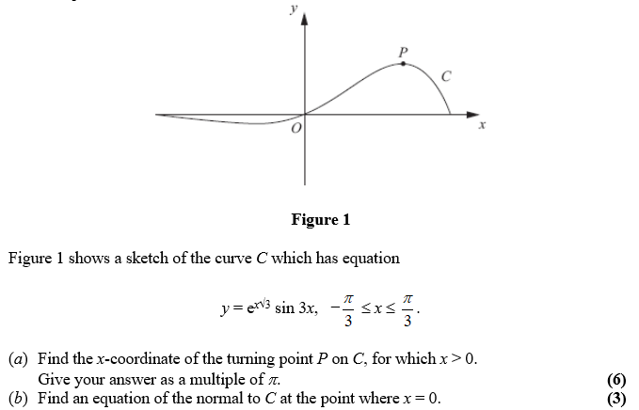
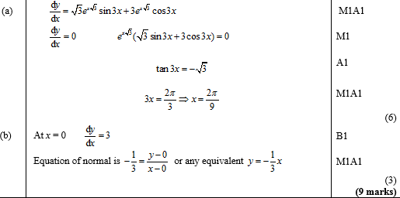
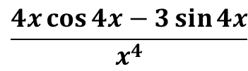
Test Your Understanding
Edexcel C3 Jan 2012 Q1a
?
$$\frac{4x\cos{4x}−3\sin{4x}}{x^{4}}$$
Edexcel C3 June 2012 Q3
?

Slide 8
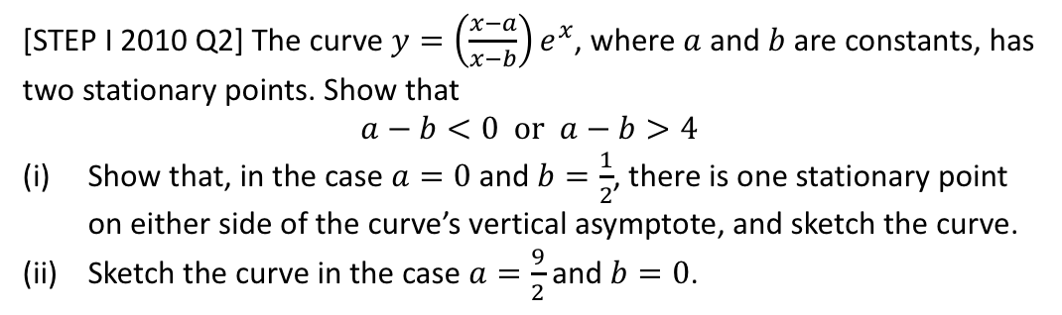
Exercise 9E
Pearson Pure Mathematics Year 2/AS
Pages 244-245
Complete before the lesson Q1-3
In Class:
Green Q4-6
Amber Q7-10
Red Q11-12 & Ext
Extension
[STEP I 2010 Q2] The curve $y=\left(\frac{x−a}{x−b}\right)e^{x}$, where $a$ and $b$ are constants, has two stationary points. Show that
$$a−b<0 or a−b>4$$
Show that, in the case $a=0$ and $b=\frac{1}{2}$, there is one stationary point on either side of the curve’s vertical asymptote, and sketch the curve.
Sketch the curve in the case $a=\frac{9}{2}$ and $b=0$.

