Slide 1
Year 2 Pure Mathematics
Numerical Methods
- Introduction
Chapter 10
(Part 1 of 4)

Slide 2
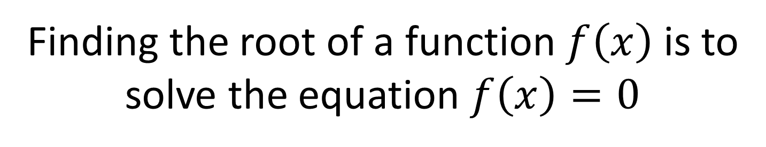
Numerical Methods
Finding the root of a function $f\left(x\right)$ is to
solve the equation $f\left(x\right)=0$
However, for some functions,
the ‘exact’ root is either
complicated and difficult to calculate.

Slide 3
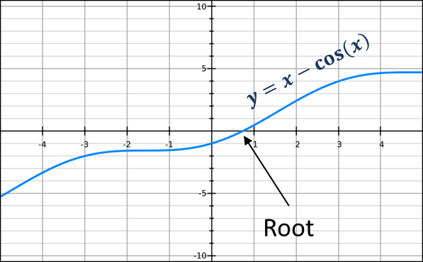
Numerical Methods
The root is between 0 and 1

Slide 4
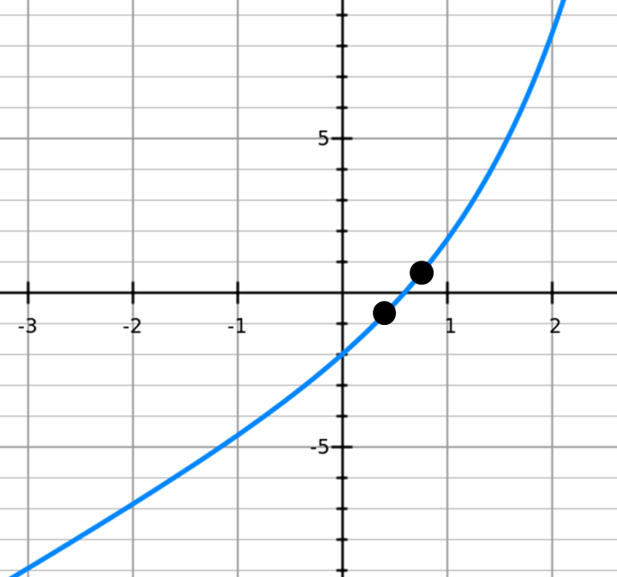
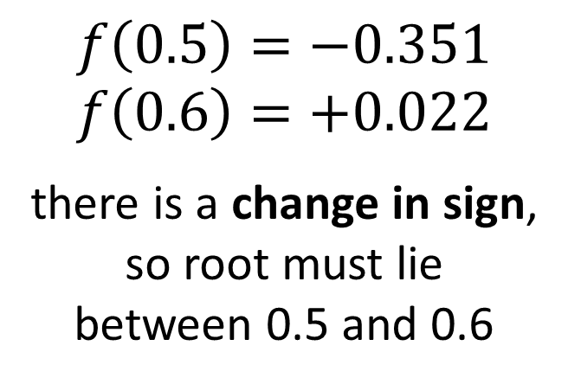
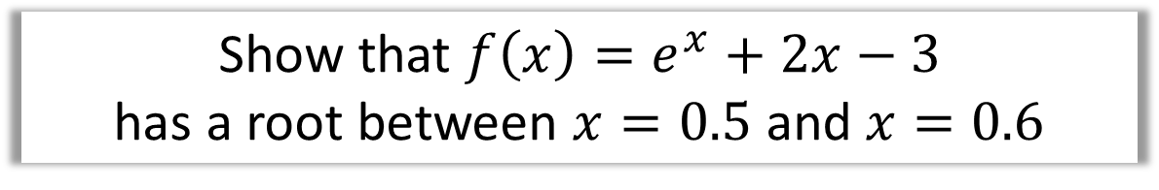
Numerical Methods
Show that ${f\left(x\right)=e}^{x}+2x−3$
has a root between $x=0.5$ and $x=0.6$
$$f\left(0.5\right)=−0.351 \\ f\left(0.6\right)=+0.022$$
there is a change in sign,
so root must lie
between 0.5 and 0.6

Slide 5
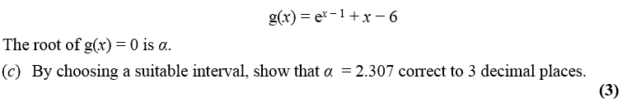
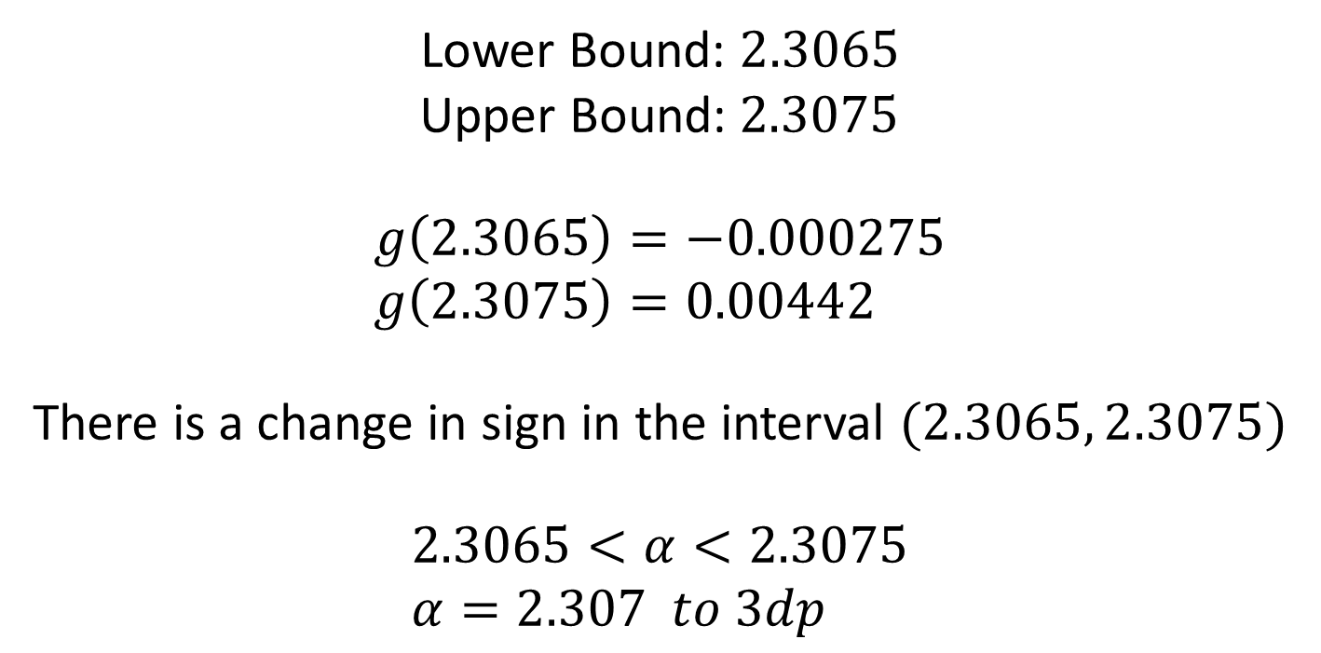
Numerical Methods
Lower Bound: $2.3065$
Upper Bound:$2.3075$
$$g\left(2.3065\right)=−0.000275 \\ g\left(2.3075\right)=0.00442$$
There is a change in sign in the interval $(2.3065, 2.3075)$
$$2.3065<α<2.3075 \\ α=2.307 to 3dp$$

Slide 6


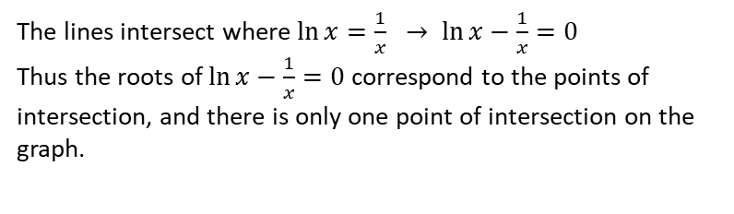
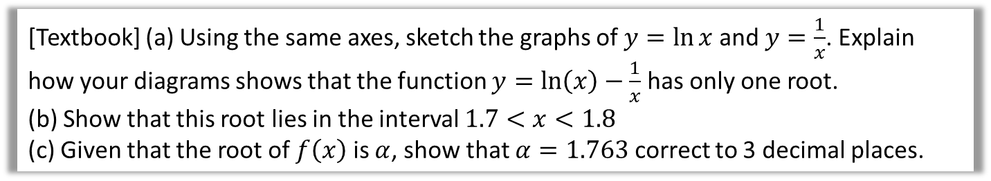



Example
[Textbook] (a) Using the same axes, sketch the graphs of $y=\ln{x}$ and $y=\frac{1}{x}$. Explain how your diagrams shows that the function $y=\ln\left(x\right)−\frac{1}{x}$ has only one root.
(b) Show that this root lies in the interval $1.7<x<1.8$
(c) Given that the root of $f\left(x\right)$ is $α$, show that $α=1.763$ correct to 3 decimal places.
a
$$y$$
?
b
$$f\left(x\right)=\ln{x}−\frac{1}{x} \\ f\left(1.7\right)=−0.0576… \\ f\left(1.8\right)=0.0322…$$
There is a change of sign between 1.7 and 1.8, so there is a root in the interval $1.7<x<1.8$
$$f\left(1.17625\right)=−0.00064<0 \\ f\left(1.7635\right)=0.00024>0$$
There is a change of sign in the interval $(1.7625, 1.7635)$ so $1.7625<α<1.7635$, so $α=1.763$ correct to 3dp.
$$y=\frac{1}{x}$$
?
$$y=\ln{x}$$
$$x$$
c
?
The lines intersect where $\ln{x}=\frac{1}{x} → \ln{x}−\frac{1}{x}=0$
Thus the roots of $\ln{x}−\frac{1}{x}=0$ correspond to the points of intersection, and there is only one point of intersection on the graph.

Slide 7
Exercise 10A
Pearson Pure Mathematics Year 2/AS
Pages 276-277
Complete before the lesson Q1-2
In Class:
Green Q7-9
Amber Q10-12

