Slide 1
Year 2 Pure Mathematics
Integration
- Partial Fractions
Chapter 11
(Part 7 of 11)

Slide 2
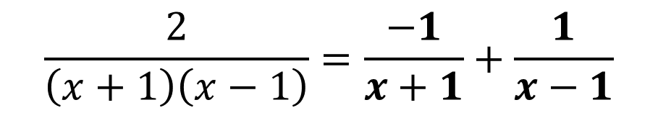
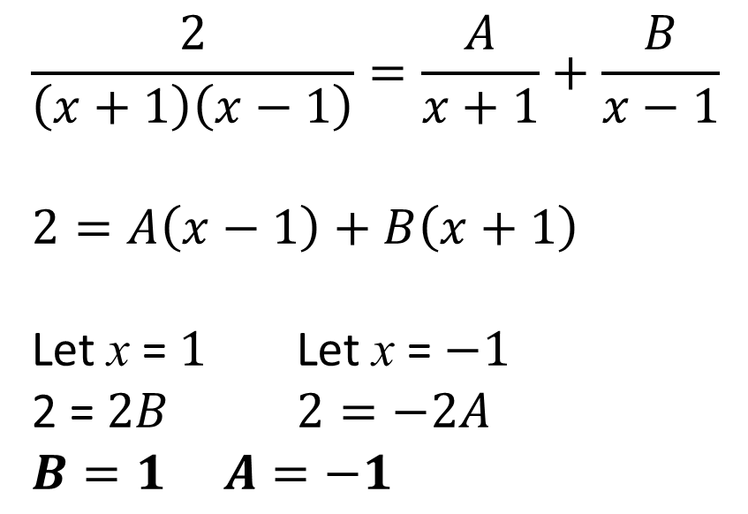
Using Partial Fractions
Splitting some expressions into partial fractions
can make it easier to integrate.
$$\frac{2}{\left(x+1\right)\left(x−1\right)}=\frac{A}{x+1}+\frac{B}{x−1}$$
$$2=A\left(x−1\right)+B\left(x+1\right)$$
Let x = $1$ Let x = $−1$
2 = $2B$ $2=−2A$
$$B=1 A=−1$$
$$\frac{2}{\left(x+1\right)\left(x−1\right)}=\frac{−1}{x+1}+\frac{1}{x−1}$$

Slide 3
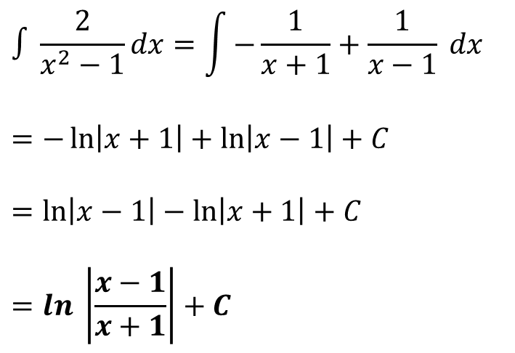
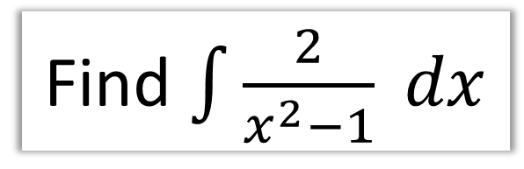
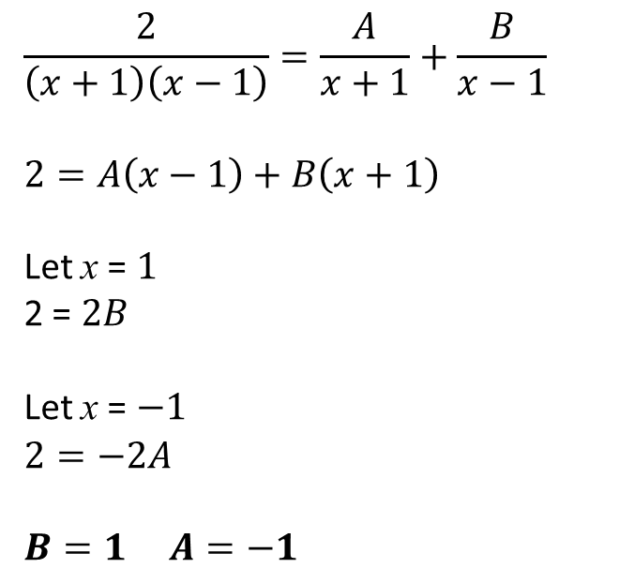
Using Partial Fractions
Find $\int{\frac{2}{x^{2}−1} dx}$
Partial Fractions:
Integration:
$$\frac{2}{\left(x+1\right)\left(x−1\right)}=\frac{A}{x+1}+\frac{B}{x−1}$$
$$2=A\left(x−1\right)+B\left(x+1\right)$$
Let x = $1$
2 = $2B$
Let x = $−1$
$$2=−2A$$
$$B=1 A=−1$$
$$∫\frac{2}{x^{2}−1}dx=\int{−\frac{1}{x+1}+\frac{1}{x−1} dx}$$
$$=−\ln\left|x+1\right|+\ln\left|x−1\right|+C$$
$$=\ln\left|x−1\right|−\ln\left|x+1\right|+C$$
$$=ln \left|\frac{x−1}{x+1}\right|+C$$

Slide 4
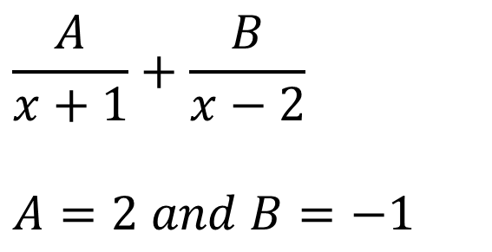
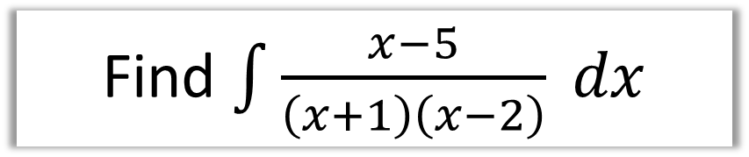
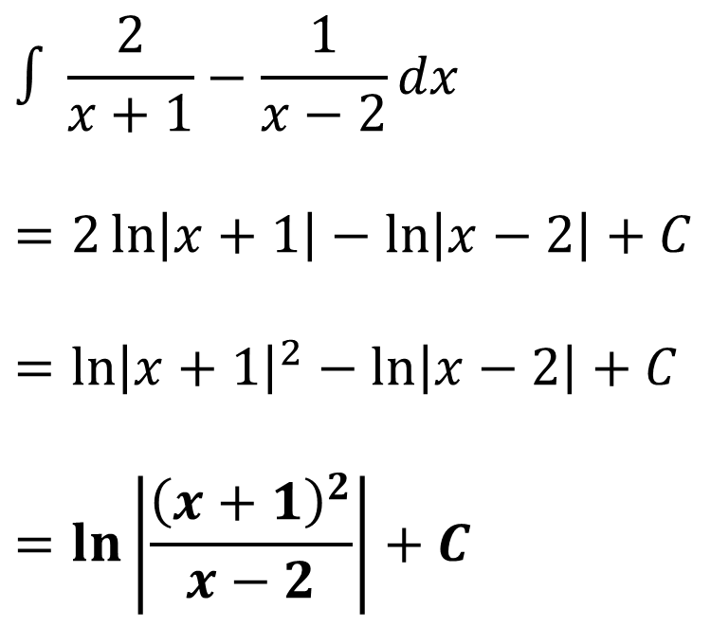
Using Partial Fractions
Find $\int{\frac{x−5}{\left(x+1\right)\left(x−2\right)} dx}$
Partial Fractions:
Integration:
$$\frac{A}{x+1}+\frac{B}{x−2}$$
$$A=2 and B=−1$$
$$∫\frac{2}{x+1}−\frac{1}{x−2}dx$$
$$=2\ln\left|x+1\right|−\ln\left|x−2\right|+C$$
$$={\ln\left|x+1\right|}^{2}−\ln\left|x−2\right|+C$$
$$=\ln\left|\frac{{\left(x+1\right)}^{2}}{x−2}\right|+C$$

Slide 5
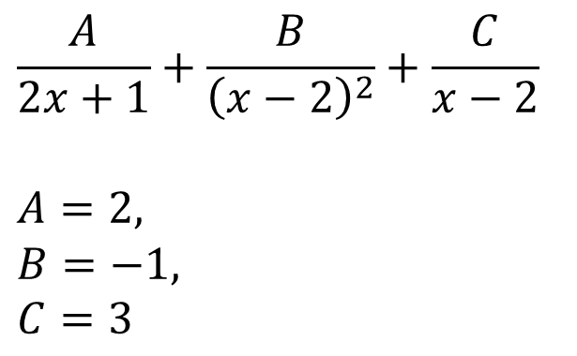
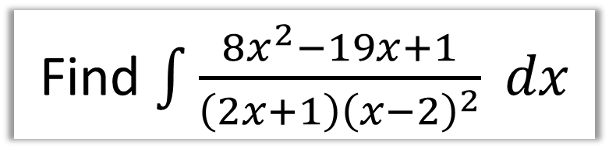
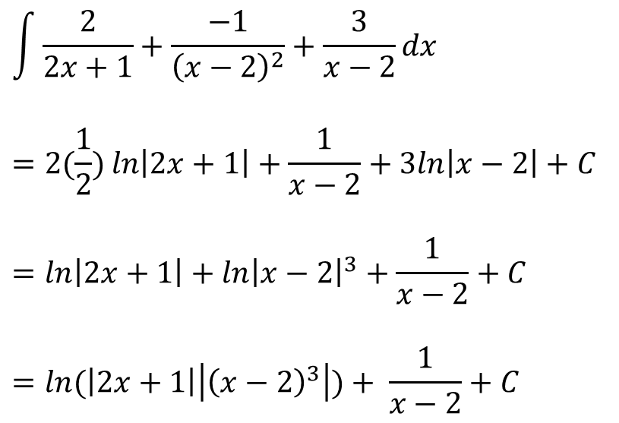
Using Partial Fractions
Find $\int{\frac{8x^{2}−19x+1}{\left(2x+1\right){\left(x−2\right)}^{2}} dx}$
Partial Fractions:
Integration:
$$\frac{A}{2x+1}+\frac{B}{{\left(x−2\right)}^{2}}+\frac{C}{x−2}$$
$$A=2,$$
$$B=−1,$$
$$C=3$$
$$\int{\frac{2}{2x+1}+\frac{−1}{{\left(x−2\right)}^{2}}+\frac{3}{x−2}dx}$$
$$=2(\frac{1}{2})\ln\left|2x+1\right|+\frac{1}{x−2}+3ln\left|x−2\right|+C$$
$$=\ln\left|2x+1\right|+{\ln\left|x−2\right|}^{3}+\frac{1}{x−2}+C$$
$$=\ln{(\left|2x+1\right|}\left|{\left(x−2\right)}^{3}\right|)+ \frac{1}{x−2}+C$$

Slide 6
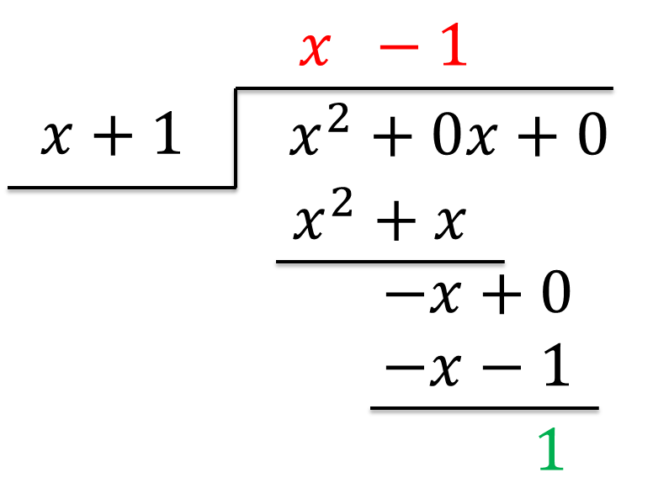
Integrating top-heavy algebraic fractions
$$\int{\frac{x^{2}}{x+1} dx}$$
To be able to integrate
you will need to rewrite as
a mixed algebraic fraction.
$$\int{\frac{x^{2}}{x+1} dx}=\int{x−1+\frac{1}{x+1}}dx$$

Slide 7
Integrating top-heavy algebraic fractions
$$\int{\frac{x^{2}}{x+1} dx}$$
$$=\int{x−1+\frac{1}{x+1}}dx$$
$=\frac{1}{2}x^{2}−x+\ln\left|x+1\right|$ $+C$

Slide 8
Integrating top-heavy algebraic fractions
$$\int{\frac{x}{x−1} dx}$$
$$=\int{1+\frac{1}{x−1}dx}$$
$$=x+\ln\left|x−1\right|+C$$

Slide 9
Integrating top-heavy algebraic fractions
$$\int{\frac{x^{3}+2}{x+1} dx}$$
$$=\int{x^{2}−x−1+\frac{1}{x+1}}dx$$
$$=\frac{1}{3}x^{3}−\frac{1}{2}x^{2}+x+\ln\left|x+1\right|+C$$

Slide 10
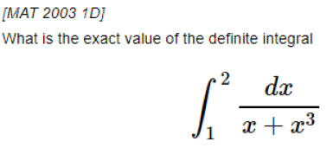

Exercise 11G
Pearson Pure Mathematics Year 2/AS
Page 312-313
Complete before the lesson Q1-2
In Class:
Amber Q3-5
Red Q6-7
Extension:
?
Solution: $\frac{1}{2}\ln\left(\frac{8}{5}\right)$

