Slide 1
Year 2 Applied Mathematics
Normal Distribution
– Missing Mean and Standard Deviation
Chapter 3 (Part 5)

Slide 2
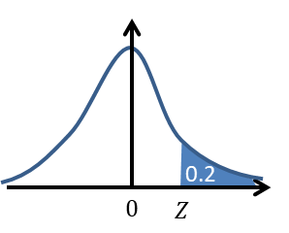


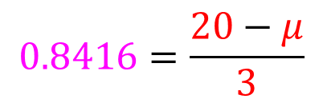
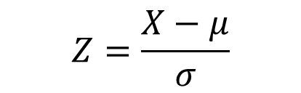

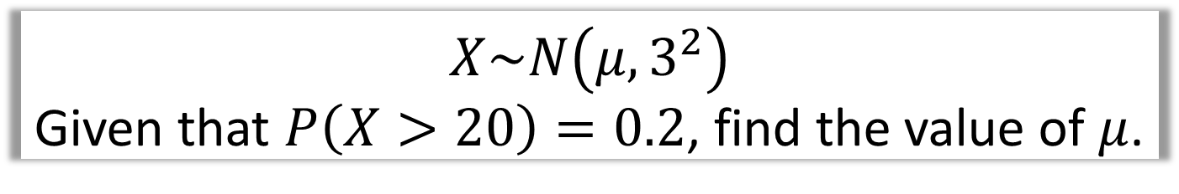
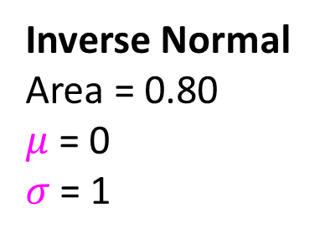


Missing $μ$
$X\sim N\left(μ,3^{2}\right)$
Given that $P\left(X>20\right)=0.2$, find the value of $μ$.
Standard
$μ=0$
$$σ=1$$
Normal
$μ= ?$
$$σ=3$$
Inverse Normal
Area = 0.80
$μ$ = 0
$σ$ = 1
$$Z=\frac{X−μ}{σ}$$
$$0.8416=\frac{20−μ}{3}$$
$$Z=0.8416$$
$$μ=17.5 (3sf)$$

Slide 3
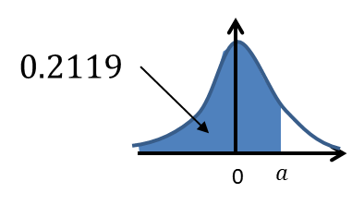

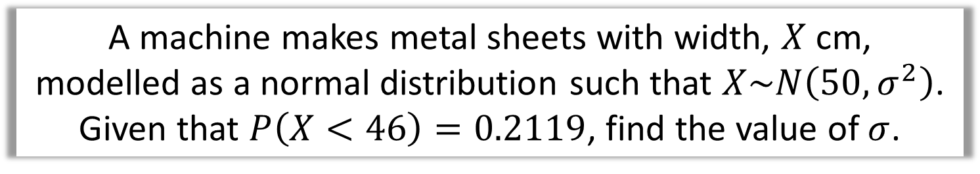

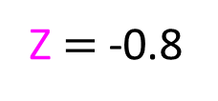
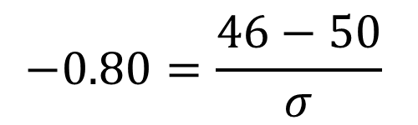
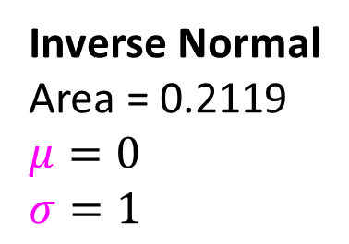

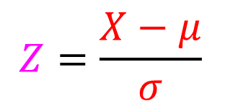

Missing $σ$
A machine makes metal sheets with width, $X$ cm,
modelled as a normal distribution such that $X\sim N\left(50,σ^{2}\right)$.
Given that $P\left(X<46\right)=0.2119$, find the value of $σ$.
Standard
$μ=0$
$$σ=1$$
Normal
$μ= ?$
$$σ=3$$
Z
Inverse Normal
Area = 0.2119
$μ=0$
$$σ=1$$
$$Z=\frac{X−μ}{σ}$$
$$−0.80=\frac{46−50}{σ}$$
Z $=$ -0.8
$$σ=5$$

Slide 4
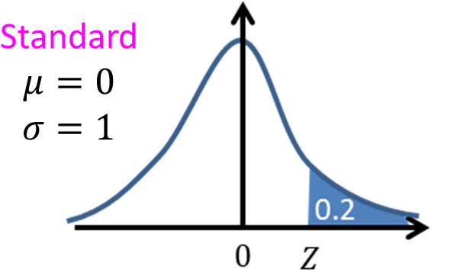
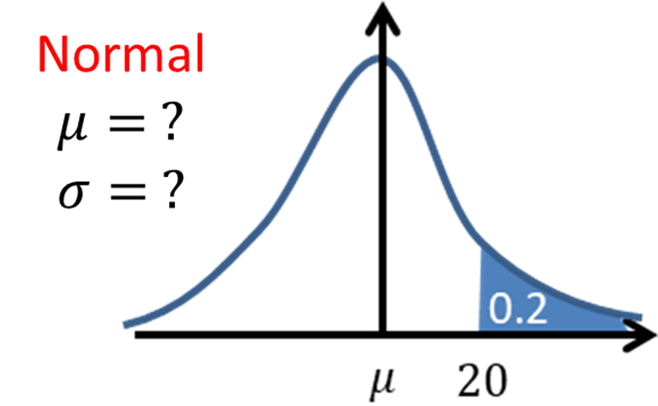
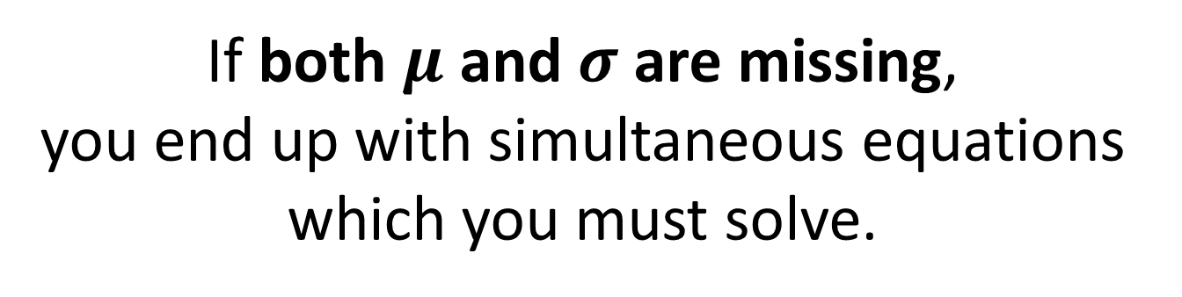
When $μ$ and $σ$ are both missing
If both $μ$ and $σ$ are missing,
you end up with simultaneous equations
which you must solve.

Slide 5
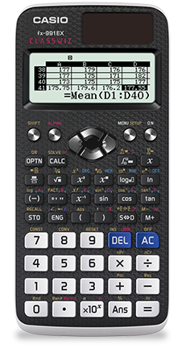
When $μ$ and $σ$ are both missing
Your Classwiz solves simultaneous equations.
Look under the EQUATIONS mode.
Menu
Scroll and select A: Equation/Func
1: Simul Equation
2 (unknowns)
Enter in both equations
Press = to find solutions

Slide 6
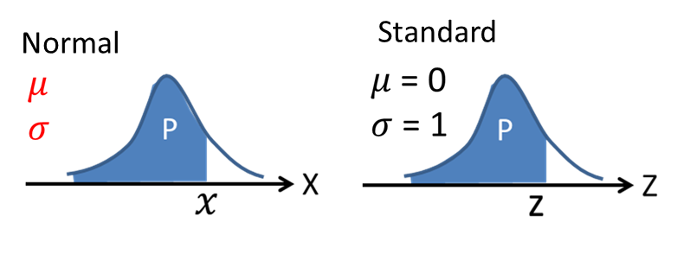
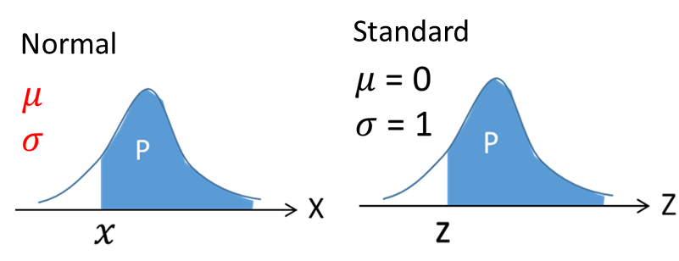
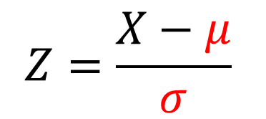
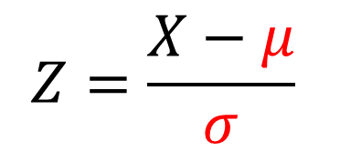
When $μ$ and $σ$ are both missing
Set up two equations using the Z number equation.
You will need to know two different probabilities.
$$Z=\frac{X−μ}{σ}$$
$$Z=\frac{X−μ}{σ}$$

Slide 7
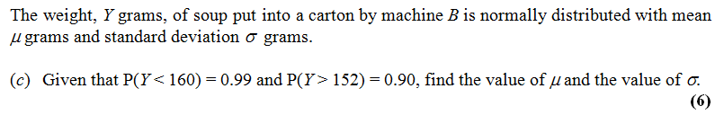


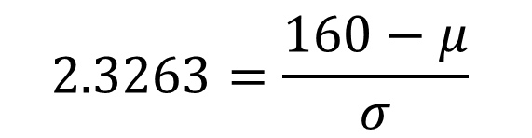


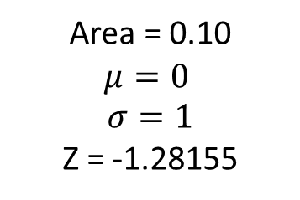
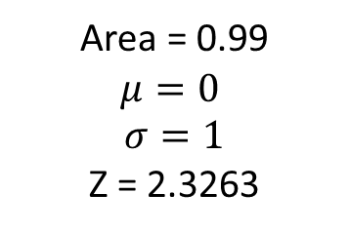





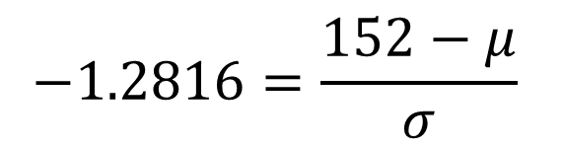



When both $μ$ and $σ$ are both missing
Normal
Standard
Area = 0.99
$$μ=0$$
$$σ=1$$
Z = 2.3263
$$0.99$$
$$0.99$$
$$160$$
$$μ$$
$$z$$
$$0$$
Normal
Standard
Area = 0.10
$$μ=0$$
$$σ=1$$
Z = -1.28155
$$0.90$$
$$0.90$$
$$152$$
$$μ$$
$$z$$
$$0$$
$$2.3263=\frac{160−μ}{σ}$$
$$−1.2816=\frac{152−μ}{σ}$$

Slide 8

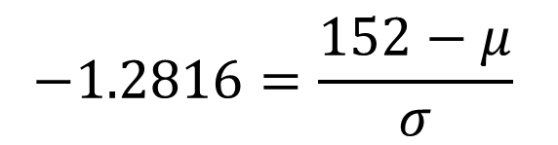

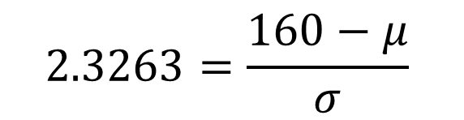




When both $μ$ and $σ$ are both missing
$$2.3263=\frac{160−μ}{σ}$$
$$−1.2816=\frac{152−μ}{σ}$$
$2.3263σ=$ $160−μ$
$$−1.2816σ=152−μ$$
$2.3263σ=$ $160−μ$
$$−1.2816σ=152−μ$$
$$σ=2.21$$
$$μ=154.84$$

Slide 9
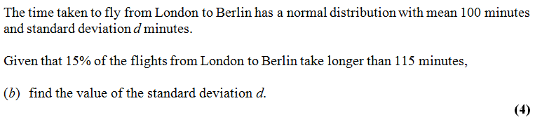

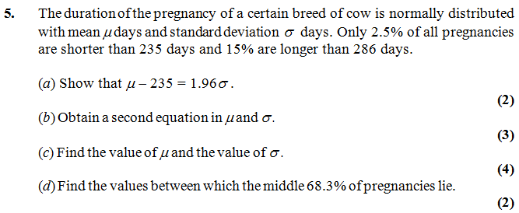
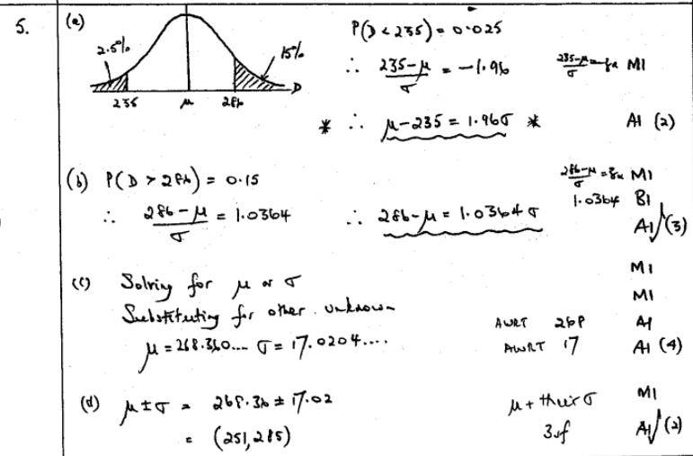
Test Your Understanding
Edexcel S1 May 2013 (R)
?
Edexcel S1 Jan 2002
?
?
?
?

Slide 10
Exercise 3E
Pearson Stats/Mechanics Year 2
Pages 51-53
Complete before the lesson Q1&4
In Class:
Green Q5-6
Amber Q7-10
Red Q11-14 & Challenge

