Slide 1
Year 2 Pure Mathematics
Vectors
- Magnitude
Chapter 12
(Part 2 of 6)

Slide 2
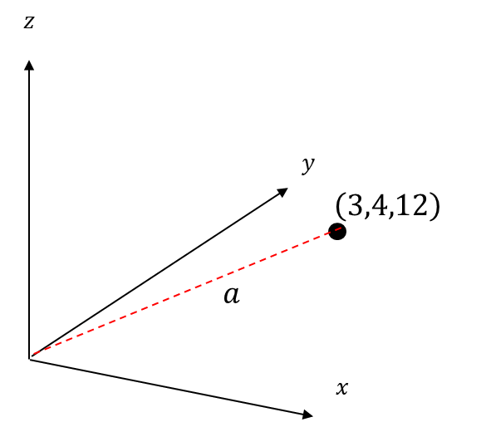
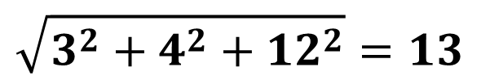
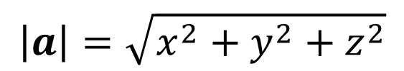
Vectors - Magnitude of a vector (from the origin)
3 Dimensions:
What is the distance to the origin?
$$\sqrt{3^{2}+4^{2}+12^{2}}=13$$
$$\left|a\right|=\sqrt{x^{2}+y^{2}+z^{2}}$$

Slide 3
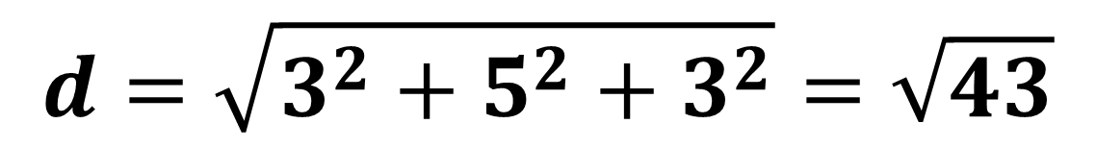
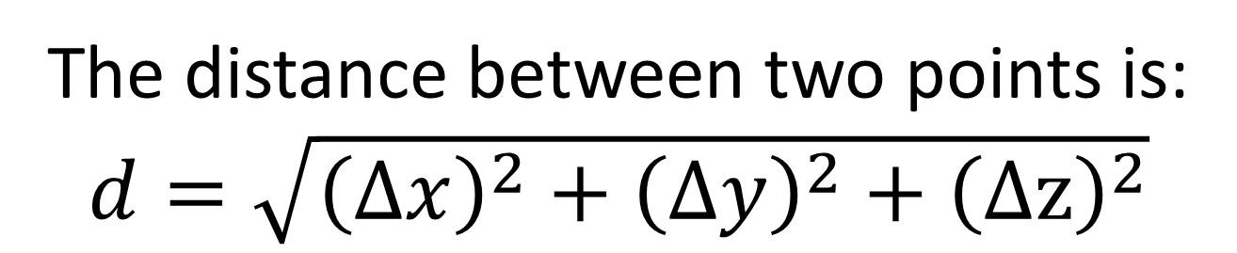
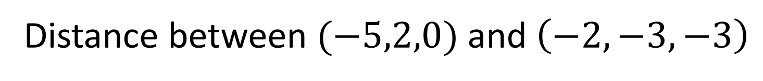
Vectors - Distance between two 3D points
The distance between two points is:
$d=\sqrt{{\left(Δx\right)}^{2}+{\left(Δy\right)}^{2}+{\left(Δz\right)}^{2}}$
Distance between $(−5,2,0)$ and $\left(−2,−3,−3\right)$
$$d=\sqrt{3^{2}+5^{2}+3^{2}}=\sqrt{43}$$

Slide 4
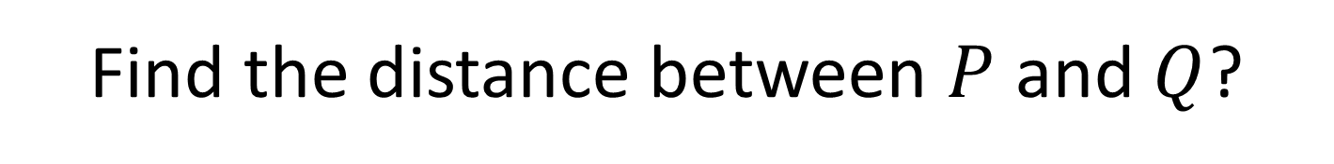

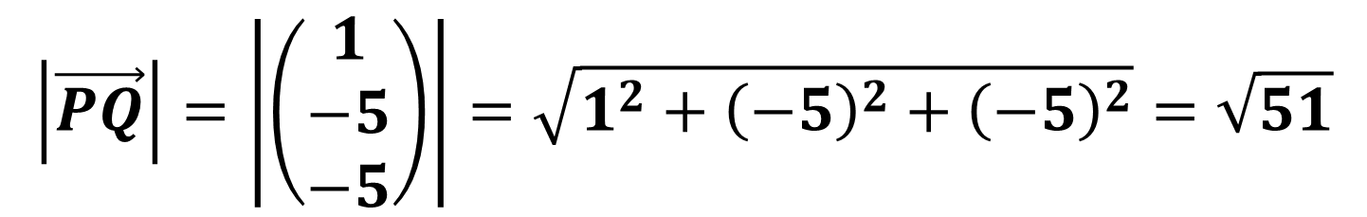




Vectors - Distance between two 3D points
Find the distance between $P$ and $Q$?
$$z$$
$$y$$
$$P\left(3,4,12\right)$$
$$x$$
$$Q\left(4,−1,7\right)$$
$$\left|\vec{PQ}\right|=\left|\left(\begin{matrix}1 \\ −5 \\ −5\end{matrix}\right)\right|=\sqrt{1^{2}+{\left(−5\right)}^{2}+{\left(−5\right)}^{2}}=\sqrt{51}$$

Slide 5
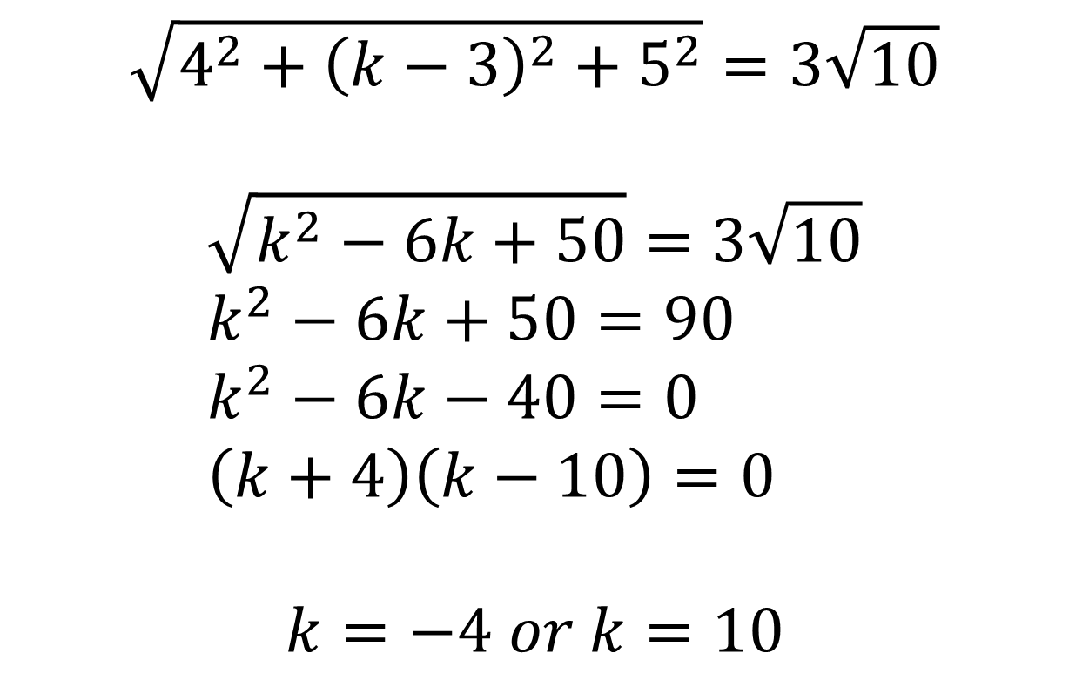
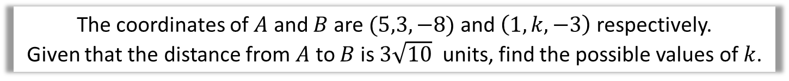
Vectors – Exam Question
The coordinates of $A$ and $B$ are $(5,3,−8)$ and $\left(1,k,−3\right)$ respectively.
Given that the distance from $A$ to $B$ is $3\sqrt{10}$ units, find the possible values of $k$.
$$\sqrt{4^{2}+{\left(k−3\right)}^{2}+5^{2}}=3\sqrt{10}$$
$$\sqrt{k^{2}−6k+50}=3\sqrt{10} \\ k^{2}−6k+50=90 \\ k^{2}−6k−40=0 \\ \left(k+4\right)\left(k−10\right)=0$$
$$k=−4 or k=10$$

Slide 6
Exercise 12A
Pearson Pure Mathematics Year 2/AS
Pages 338-340
Complete before the lesson Q1-3
In Class:
Green Q4
Amber Q5
Red Challenge

