Slide 1
Year 2 Applied Mathematics
Normal Distribution
- Inverse Normal Distribution
Chapter 3 (Part 3)

Slide 2
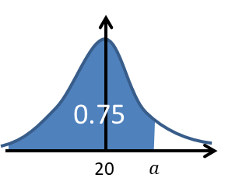
Inverse Normal Distribution
Given the probability (area)
find the boundary value.
Find a

Slide 3

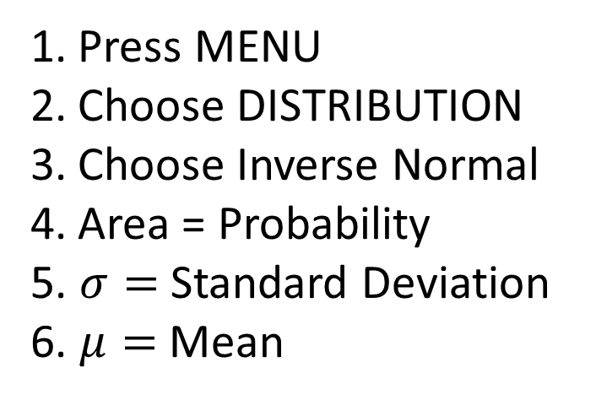
Inverse Normal Distribution
Press MENU
Choose DISTRIBUTION
Choose Inverse Normal
Area = Probability
5. $σ=$ Standard Deviation
6. $μ=$ Mean

Slide 4
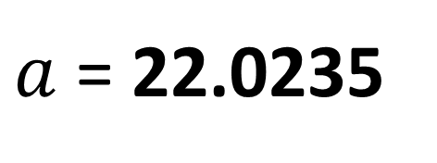
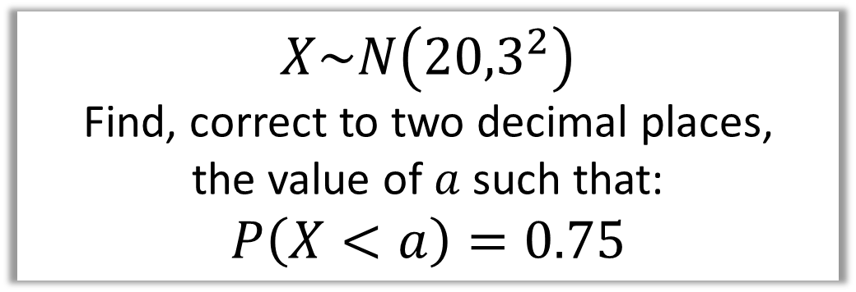
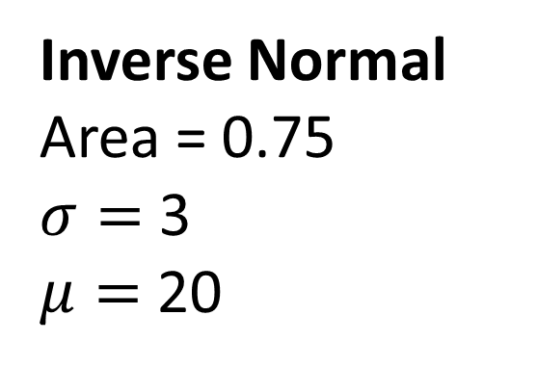
Inverse Normal Distribution
$$X\sim N\left({20,3}^{2}\right)$$
Find, correct to two decimal places,
the value of $a$ such that:
$$P\left(X<a\right)=0.75$$
Inverse Normal
Area = 0.75
$σ=$ 3
$μ=$ 20
$a$ = 22.0235

Slide 5
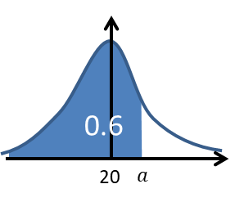
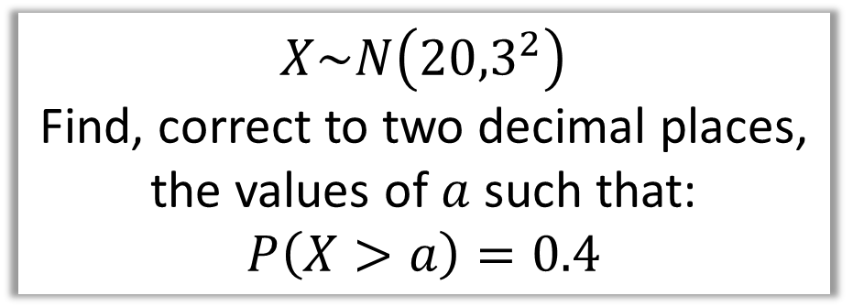
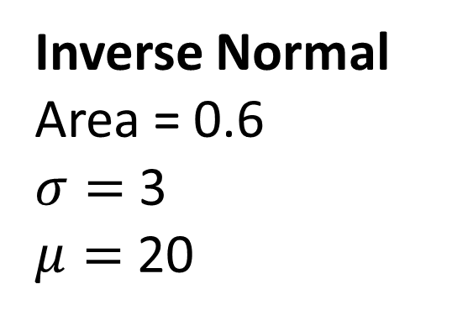
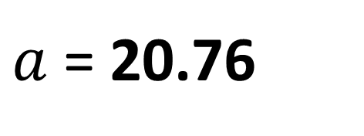
Inverse Normal Distribution
$$X\sim N\left({20,3}^{2}\right)$$
Find, correct to two decimal places,
the values of $a$ such that:
$$P\left(X>a\right)=0.4$$
Inverse Normal
Area = 0.6
$σ=$ 3
$μ=$ 20
$a$ = 20.76

Slide 6

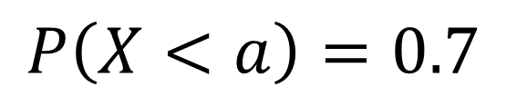
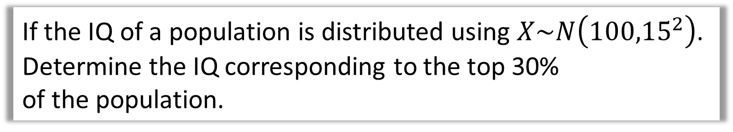
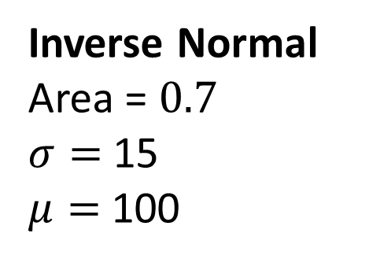
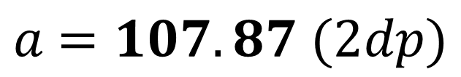
Inverse Normal Distribution
If the IQ of a population is distributed using $X\sim N\left({100,15}^{2}\right)$.
Determine the IQ corresponding to the top 30%
of the population.
$$P\left(X<a\right)=0.7$$
Inverse Normal
Area = $0.7$
$σ=$ 15
$μ=$ 100
$a$ $=107.87 (2dp)$

Slide 7
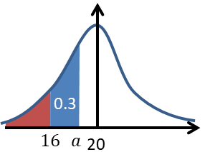

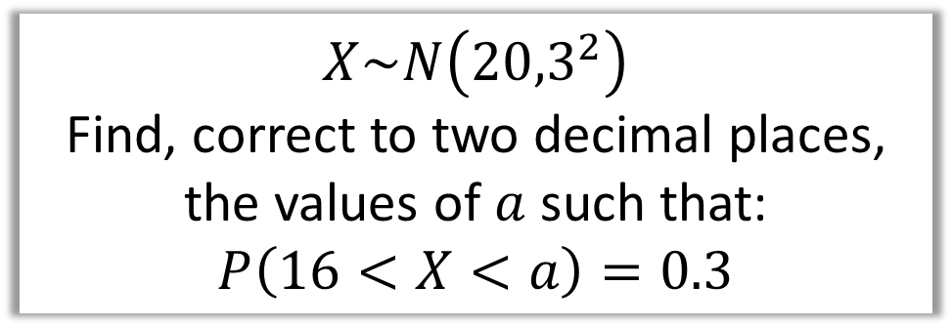
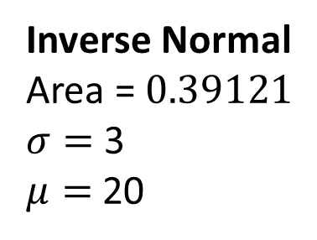
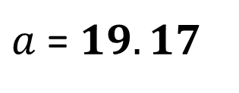
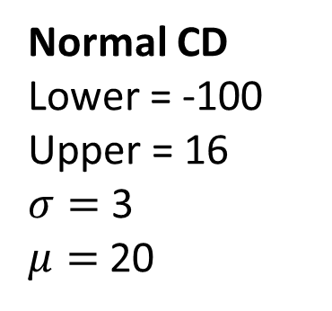
Inverse Normal Distribution
$$X\sim N\left({20,3}^{2}\right)$$
Find, correct to two decimal places,
the values of $a$ such that:
$$P\left(16<X<a\right)=0.3$$
Normal CD
Lower = -100
Upper = 16
$σ=$ 3
$μ=$ 20
Inverse Normal
Area = $0.39121$
$σ=$ 3
$μ=$ 20
$a$ = $19.17$
$$P\left(X<16\right)=0.09121$$

Slide 8
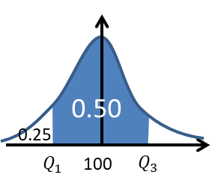
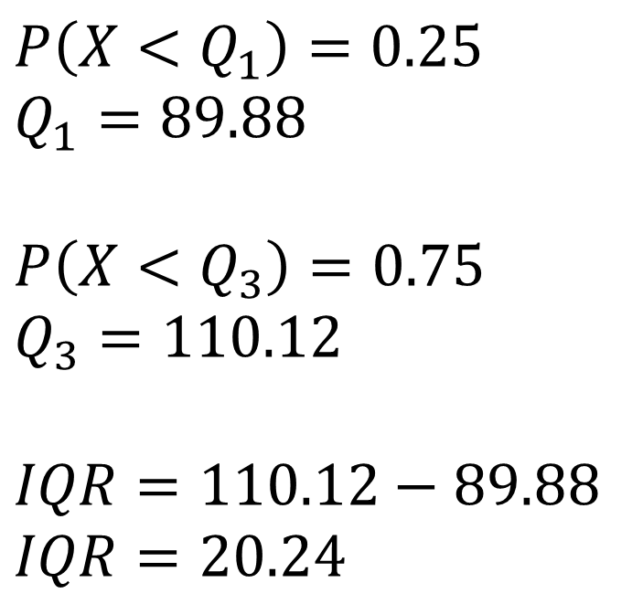
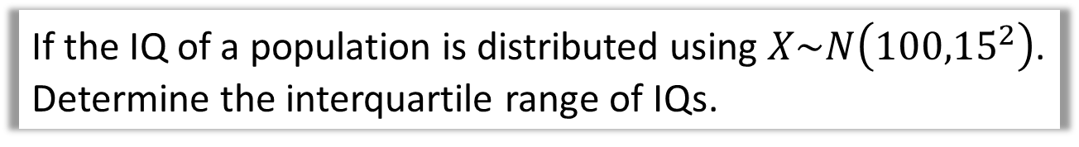
Inverse Normal Distribution
If the IQ of a population is distributed using $X\sim N\left({100,15}^{2}\right)$.
Determine the interquartile range of IQs.
$$P\left(X<Q_{1}\right)=0.25 \\ Q_{1}=89.88$$
$$P\left(X<Q_{3}\right)=0.75 \\ Q_{3}=110.12$$
$$IQR=110.12−89.88$$
$$IQR=20.24$$

Slide 9




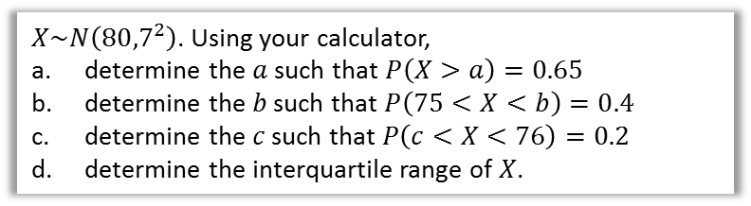



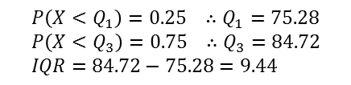


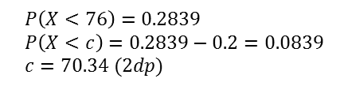
Test Your Understanding
$X\sim N\left({80,7}^{2}\right)$. Using your calculator,
determine the $a$ such that $P\left(X>a\right)=0.65$
determine the $b$ such that $P\left(75<X<b\right)=0.4$
determine the $c$ such that $P\left(c<X<76\right)=0.2$
determine the interquartile range of $X$.
a
?
c
?
$$P\left(X>a\right)=0.65 \\ ∴P\left(X<a\right)=0.35 \\ a=77.303 (3dp)$$
0.2839
$$P\left(X<76\right)=0.2839 \\ P\left(X<c\right)=0.2839−0.2=0.0839 \\ c=70.34 (2dp)$$
0.75
0.2
$$76$$
80
80
$$a$$
$$c$$
b
?
d
?
$$P\left(X<75\right)=0.2375 \\ ∴P\left(X<b\right)=0.2375+0.4=0.6375$$
$$b=82.463$$
$$P\left(X<Q_{1}\right)=0.25 ∴Q_{1}=75.28 \\ P\left(X<Q_{3}\right)=0.75 ∴Q_{3}=84.72 \\ IQR=84.72−75.28=9.44$$
0.4
0.50
0.2375
0.25
$$75$$
80
$$b$$
$$Q_{1}$$
80
$$Q_{3}$$

Slide 10
Exercise 3C
Pearson Stats/Mechanics Year 2
Pages 46-47
Complete before the lesson Q1-3
In Class:
Green Q4-5
Amber Q6-7
Red Q8-9

