Slide 1

P1 Chapter 1 :: Algebraic Expressions
jfrost@tiffin.kingston.sch.uk
www.drfrostmaths.com
@DrFrostMaths
Last modified: 23rd July 2018

Slide 2








www.drfrostmaths.com
Everything is completely free.
Why not register?
Register now to interactively practise questions on this topic, including past paper questions and extension questions (including MAT + UKMT).
Teachers: you can create student accounts (or students can register themselves), to set work, monitor progress and even create worksheets.
With questions by:
Dashboard with points, trophies, notifications and student progress.
Questions organised by topic, difficulty and past paper.
Teaching videos with topic tests to check understanding.

Slide 3
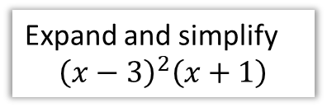
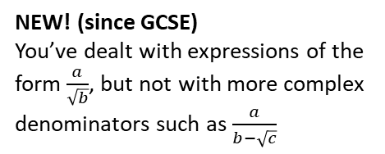
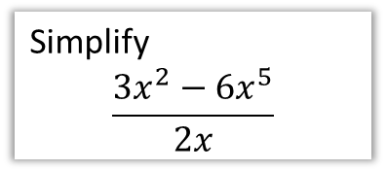
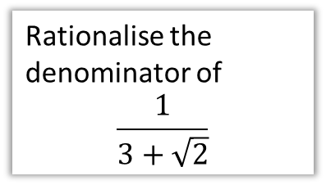
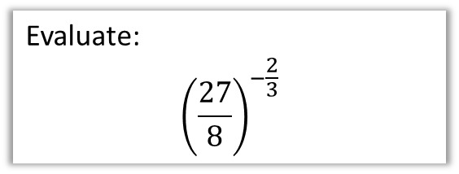
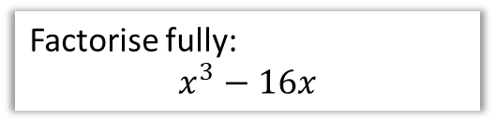
Chapter Overview
As a relatively gentle introduction to Pure, most of this chapter is a recap of core GCSE algebraic skills.
1:: Basic Index Laws
2:: Expand brackets
Simplify
$$\frac{3x^{2}−6x^{5}}{2x}$$
Expand and simplify
$${\left(x−3\right)}^{2}\left(x+1\right)$$
4:: Fractional/Negative Powers
3:: Factorise quadratics/cubics
Evaluate:
$${\left(\frac{27}{8}\right)}^{−\frac{2}{3}}$$
Factorise fully:
$$x^{3}−16x$$
NEW! (since GCSE)
You may have to combine factorisation techniques to factorise cubics.
5:: Surds
Rationalise the denominator of
$$\frac{1}{3+\sqrt{2}}$$
NEW! (since GCSE)
You’ve dealt with expressions of the form $\frac{a}{\sqrt{b}}$, but not with more complex denominators such as $\frac{a}{b−\sqrt{c}}$

Slide 4


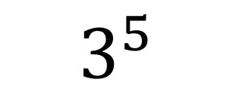


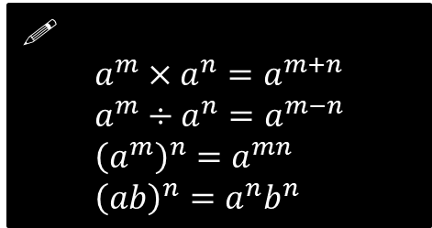



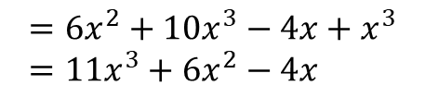
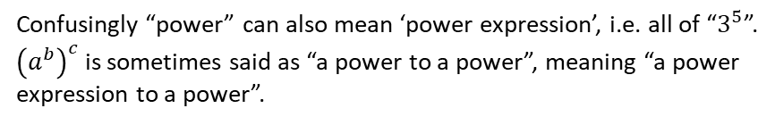

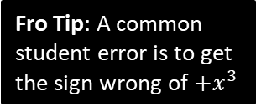
1 :: Index Laws
exponent or power or index (plural: indices)
base
!
$$a^{m}×a^{n}=a^{m+n} \\ a^{m}÷a^{n}=a^{m−n} \\ {\left(a^{m}\right)}^{n}=a^{mn} \\ {\left(ab\right)}^{n}=a^{n}b^{n}$$
$$3^{5}$$
Confusingly “power” can also mean ‘power expression’, i.e. all of “$3^{5}$”.
${\left(a^{b}\right)}^{c}$ is sometimes said as “a power to a power”, meaning “a power expression to a power”.
Simplify ${\left(a^{3}\right)}^{2}×2a^{2}$
Simplify ${\left(4x^{3}y\right)}^{3}$
?
?
$$=a^{6}×2a^{2}=2a^{8}$$
$$=64x^{9}y^{3}$$
Simplify $2x^{2}\left(3+5x\right)−x\left(4−x^{2}\right)$
Simplify $\frac{x^{3}−2x}{3x^{2}}$
?
?
$$=6x^{2}+10x^{3}−4x+x^{3} \\ =11x^{3}+6x^{2}−4x$$
$$=\frac{x^{3}}{{3x}^{2}}−\frac{2x}{3x^{2}} \\ =\frac{1}{3}x−\frac{2}{3x}$$
Fro Tip: A common student error is to get the sign wrong of $+x^{3}$
Fro Tip: While $\frac{a+b}{c}$ can be split into $\frac{a}{c}+\frac{b}{c}$, a common student error is to think that $\frac{a}{b+c}=\frac{a}{b}+\frac{a}{c}$

Slide 5

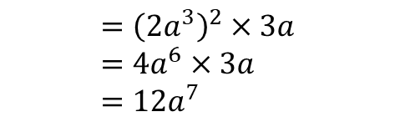




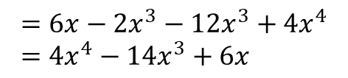

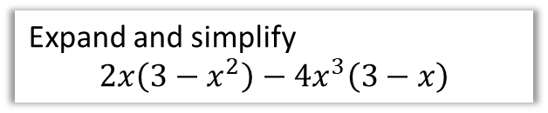
Test Your Understanding
1
Simplify ${\left(\frac{2a^{5}}{a^{2}}\right)}^{2}×3a$
2
Simplify $\frac{2x+x^{5}}{4x^{3}}$
?
?
$$={\left(2a^{3}\right)}^{2}×3a \\ =4a^{6}×3a \\ =12a^{7}$$
$$=\frac{1}{2}x^{−2}+\frac{1}{4}x^{2}$$
or $\frac{1}{2x^{2}}+\frac{x^{2}}{4}$
3
Expand and simplify
$$2x\left(3−x^{2}\right)−4x^{3}\left(3−x\right)$$
4
Simplify $2^{x}×3^{x}$
?
$$=6^{x}$$
Fro Note: This is using ${\left(ab\right)}^{n}=a^{n}b^{n}$ law backwards.
?
$$=6x−2x^{3}−12x^{3}+4x^{4} \\ =4x^{4}−14x^{3}+6x$$

Slide 6
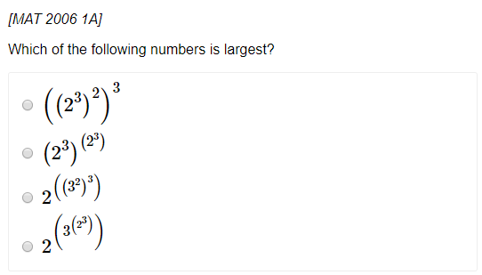
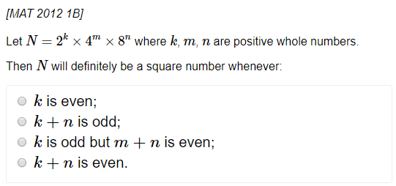
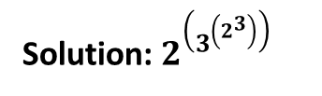
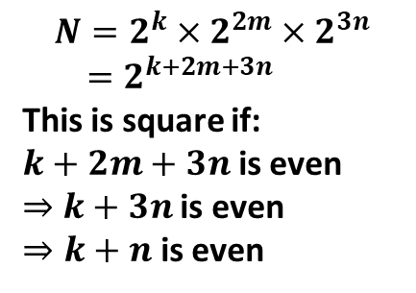
Exercise 1A – See slide for Ex1D
Pearson Pure Mathematics Year 1/AS
Page 3
Extension (Full Database: http://www.drfrostmaths.com/resources/resource.php?rid=268 )
1
2
?
$$N=2^{k}×2^{2m}×2^{3n} \\ =2^{k+2m+3n}$$
This is square if:
$k+2m+3n$ is even
$⇒$ $k+3n$ is even
$⇒k+n$ is even
?
Solution: $2^{\left(3^{\left(2^{3}\right)}\right)}$

Slide 7






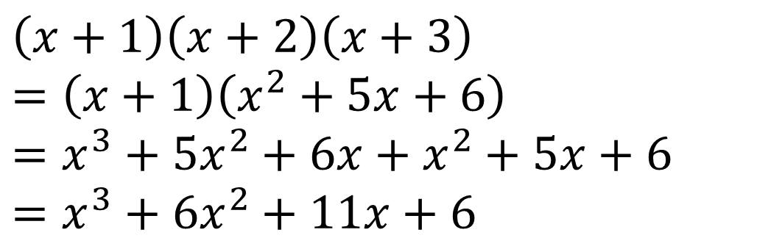


2 :: Expanding Brackets
If you have ever been taught ‘FOIL’ to multiply brackets please purge it from your mind now – instead:
Multiply each term in the first bracket by each term in the second.
$$\left(x−y\right)\left(x+y−1\right)$$
Fro Tip: My order is “first term in first brackets times each in second, then second term in first bracket times each in second, etc.”
$$=x^{2}$$
$$+xy$$
$$−x$$
$$−xy$$
$$−y^{2}$$
$$+y$$
$$=x^{2}−y^{2}−x+y$$
Fro Tip: For more than 2 brackets, multiply two out each time to reduce the number of brackets by one.
$$\left(x+1\right)\left(x+2\right)\left(x+3\right) \\ =\left(x+1\right)\left(x^{2}+5x+6\right) \\ =x^{3}+5x^{2}+6x+x^{2}+5x+6 \\ =x^{3}+6x^{2}+11x+6$$
?

Slide 8
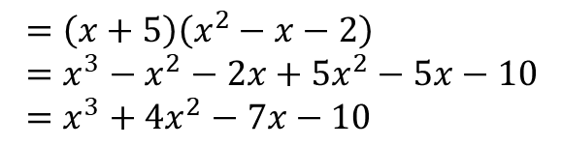
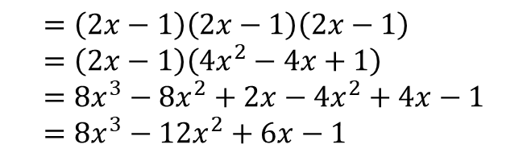
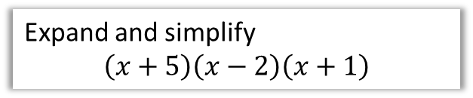
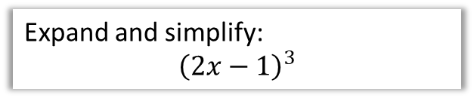
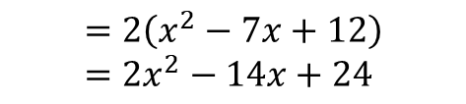
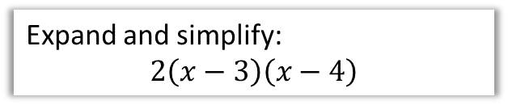
Test Your Understanding
1
Expand and simplify
$$\left(x+5\right)\left(x−2\right)\left(x+1\right)$$
2
Expand and simplify:
$$2\left(x−3\right)\left(x−4\right)$$
?
?
$$=\left(x+5\right)\left(x^{2}−x−2\right) \\ =x^{3}−x^{2}−2x+5x^{2}−5x−10 \\ =x^{3}+4x^{2}−7x−10$$
$$=2\left(x^{2}−7x+12\right) \\ =2x^{2}−14x+24$$
3
Expand and simplify:
$${\left(2x−1\right)}^{3}$$
?
$$=\left(2x−1\right)\left(2x−1\right)\left(2x−1\right) \\ =\left(2x−1\right)\left(4x^{2}−4x+1\right) \\ =8x^{3}−8x^{2}+2x−4x^{2}+4x−1 \\ =8x^{3}−12x^{2}+6x−1$$

Slide 9
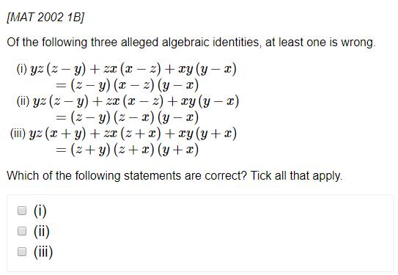
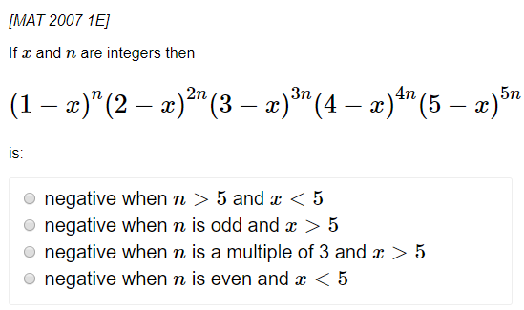

Exercise 1B – See slide for Ex1C
Pearson Pure Mathematics Year 1/AS
Page 5
Extension (Full Database: http://www.drfrostmaths.com/resources/resource.php?rid=268 )
1
2
?
?
Solution: (ii) only
Solution: $n$ is odd and $x>5$

Slide 10
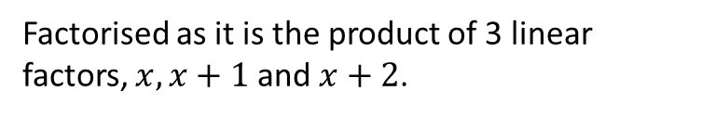

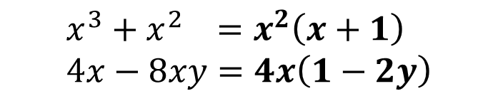

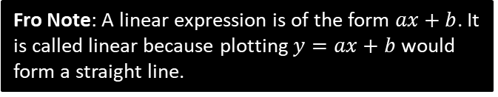
3 :: Factorising
Informally, factorising is the opposite of expanding brackets.
More formally, a factorised expression is one which is expressed as a product of expressions.
$$x(x+1)(x+2)$$
Factorised as it is the product of 3 linear factors, $x, x+1$ and $x+2$.
Fro Note: A linear expression is of the form $ax+b$. It is called linear because plotting $y=ax+b$ would form a straight line.
$$x\left(x+1\right)+\left(x−1\right)\left(x+1\right)$$
Not factorised because the outer-most operation is a sum, not a product.
Basic Examples:
?
$$x^{3}+x^{2} =x^{2}\left(x+1\right) \\ 4x−8xy=4x\left(1−2y\right)$$
?

Slide 11
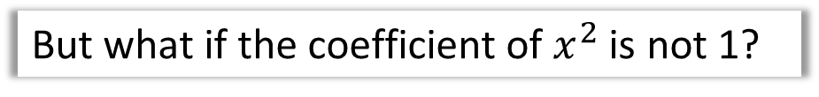



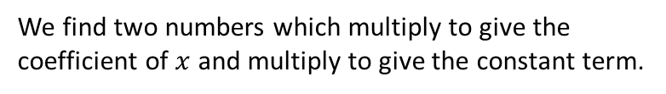


Factorising Quadratics
Recap:
We find two numbers which multiply to give the coefficient of $x$ and multiply to give the constant term.
$$⊕$$
$$⊗$$
?
$$x^{2}−5x−14=\left(x−7\right)\left(x+2\right)$$
Fro Note: The coefficient of a term is the constant on front of it, e.g. the coefficient of $4x^{2}$ is 4.
But what if the coefficient of $x^{2}$ is not 1?
$${2x}^{2}+5x−12=\left(2x−3\right)\left(x+4\right)$$
?
The easiest way is to use your common sense to guess the brackets. What multiplies to give the $2x^{2}$? What multiplies to give the constant term of $−12$?
?
Or you can ‘split the middle term’ (don’t be embarrassed if you’ve forgotten how to!)
$$⊕5 \\ ⊗−24$$
$${2x}^{2}+5x−12 \\ =2x^{2}+8x−3x−12 \\ =2x\left(x+4\right)−3\left(x+4\right) \\ =(x+4)(2x−3)$$
?
STEP 1: Find two numbers which add to give the middle number and multiply to give the first times last.
?
STEP 2: Split the middle term.
?
STEP 3: Factorise first half and second half ensuring bracket is duplicated..
?
STEP 4: Factorise out bracket.

Slide 12


Other Factorisations
Difference of two squares:
?
$$4x^{2}−9=\left(2x+3\right)\left(2x−3\right)$$
Using multiple factorisations:
$$x^{3}−x \\ =x\left(x^{2}−1\right) \\ =x(x+1)(x−1)$$
Fro Tip: Always look for a common factor first before using other factorisation techniques.
?
$$x^{3}+3x^{2}+2x \\ =x\left(x^{2}+3x+2\right) \\ =x\left(x+2\right)\left(x+1\right)$$
?

Slide 13
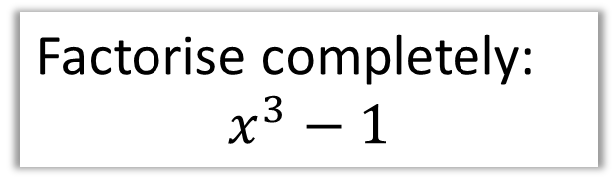

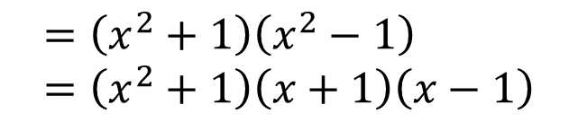
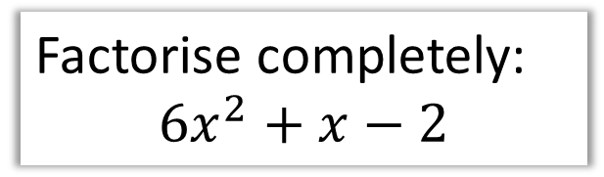

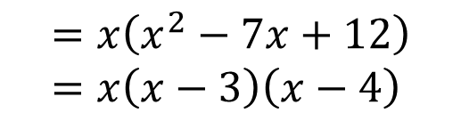
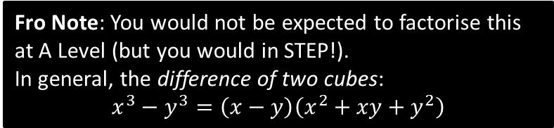
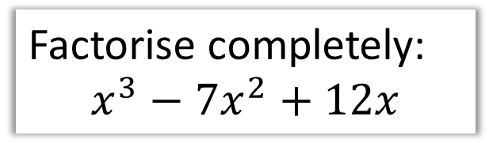

Test Your Understanding
1
Factorise completely:
$$6x^{2}+x−2$$
2
Factorise completely:
$$x^{3}−7x^{2}+12x$$
$$6x^{2}+x−2 ⊕1 ⊗−12 \\ =6x^{2}+4x−3x−2 \\ =2x\left(3x+2\right)−1\left(3x+2\right) \\ =\left(3x+2\right)\left(2x−1\right)$$
$$=x\left(x^{2}−7x+12\right) \\ =x\left(x−3\right)\left(x−4\right)$$
?
?
N
Factorise completely:
$$x^{4}−1$$
N
Factorise completely:
$$x^{3}−1$$
?
?
$$=\left(x^{2}+1\right)\left(x^{2}−1\right) \\ =\left(x^{2}+1\right)\left(x+1\right)\left(x−1\right)$$
$$=(x−1)(x^{2}+x+1)$$
Fro Note: You would not be expected to factorise this at A Level (but you would in STEP!).
In general, the difference of two cubes:
$$x^{3}−y^{3}=\left(x−y\right)\left(x^{2}+xy+y^{2}\right)$$

Slide 14
Exercise 1B&C
Complete before the lesson Ex1B
In Class Ex1C:
Green Q1-2
Amber Q3-5
Red Challenge &Extension
Pearson Pure Mathematics Year 1/AS Page 5
Extension (Full Database: http://www.drfrostmaths.com/resources/resource.php?rid=268 )
1
2
?
?
Solution: (ii) only
Solution: $n$ is odd and $x>5$

Slide 15
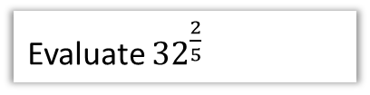
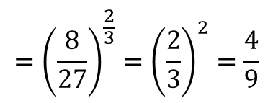

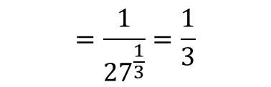










4 :: Negative and Fractional Indices
$$a^{0}=1 \\ a^{\frac{1}{m}}=\sqrt[m]{a} \\ a^{\frac{n}{m}}={\left(\sqrt[m]{a}\right)}^{n} \\ a^{−m}=\frac{1}{a^{m}}$$
Fro Note: $\sqrt{9}$ only means the positive square root of 9, i.e. 3 not -3.
Otherwise, what would be the point of the $±$ in the quadratic formula before the $\sqrt{b^{2}−4ac}$?
Prove that $x^{\frac{1}{2}}=\sqrt{x}$
Evaluate ${27}^{−\frac{1}{3}}$
Evaluate ${32}^{\frac{2}{5}}$
?
?
?
$$x^{\frac{1}{2}}×x^{\frac{1}{2}}=x^{1}$$
But $\sqrt{x}×\sqrt{x}=x$
$$∴x^{\frac{1}{2}}=\sqrt{x}$$
$$=\frac{1}{{27}^{\frac{1}{3}}}=\frac{1}{3}$$
$$=2^{2}=4$$
Simplify ${\left(\frac{1}{9}x^{6}y\right)}^{\frac{1}{2}}$
Evaluate ${\left(\frac{27}{8}\right)}^{−\frac{2}{3}}$
If $b=\frac{1}{9}a^{2}$, determine $3b^{−2}$ in the form $kb^{n}$ where $k,n$ are constants.
?
$$={\left(\frac{8}{27}\right)}^{\frac{2}{3}}={\left(\frac{2}{3}\right)}^{2}=\frac{4}{9}$$
$$=\frac{1}{3}x^{3}y^{\frac{1}{2}}$$
?
?
$$3b^{−2}=3{\left(\frac{1}{9}a^{2}\right)}^{−2} \\ =3\left(81a^{−4}\right)=243a^{−4}$$

Slide 16


Exercise 1D
Pearson Pure Mathematics Year 1/AS
Page 11
Extension (Full Database: http://www.drfrostmaths.com/resources/resource.php?rid=268 )
?
$$=\frac{2^{r+s}×3^{r+s}×2^{2r−2s}×3^{r−s}}{2^{3r}×3^{2r+4s}} \\ =2^{−s}×3^{−4s}$$
This is an integer only if $s≤0$.
Complete before the lesson Ex1A
In Class:
Green Q1-2
Amber Q3-5
Red Extension

Slide 17



5 :: Surds
Recap:
Fro Note: A rational number is any which can be expressed as $\frac{a}{b}$ where $a,b$ are integers. $\frac{2}{3}$ and $\frac{4}{1}=4$ are rational numbers, but $π$ and $\sqrt{2}$ are not.
A surd is a root of a number that does not simplify to a rational number.
Laws:
$$\sqrt{a}×\sqrt{b}=\sqrt{ab} \\ \frac{\sqrt{a}}{\sqrt{b}}=\sqrt{\frac{a}{b}}$$
?
$$\sqrt{3}×2 =2\sqrt{3} \\ 3\sqrt{5}×2\sqrt{5} =30 \\ \sqrt{8}=\sqrt{4}\sqrt{2} =2\sqrt{2} \\ \sqrt{12}+\sqrt{27} =2\sqrt{3}+3\sqrt{3}=5\sqrt{3} \\ \left(\sqrt{8}+1\right)\left(\sqrt{2}−3\right) =\sqrt{16}−3\sqrt{8}+\sqrt{2}−3 \\ =4−6\sqrt{2}+\sqrt{2}−3 \\ =1−5\sqrt{2}$$
?
?
?
?
?
?

Slide 18




Exercise 1E – See Slide for Ex1F
Pearson Pure Mathematics Year 1/AS
Page 11
Extension (questions used with permission by the UKMT)
1
2
Note that:
$$10−3\sqrt{11}=\sqrt{100}−\sqrt{99}$$
The other options can similarly be written as $\sqrt{n+1}−\sqrt{n}$. The greater the $n$, the smaller the number, so the answer is $10−3\sqrt{11}$.
If $\sqrt{a+12\sqrt{2}}=x+y\sqrt{2}$, then squaring:
$$a+12\sqrt{2}=x^{2}+2y^{2}+2xy\sqrt{2}$$
Thus $2xy=12 → xy=6$
The only possibilities are $\left(x,y\right)=\left(1,6\right),\left(2,3\right),\left(3,2\right),\left(6,1\right)$ corresponding to the 5th, 2nd, 1st and 3rd options. Thus $54+12\sqrt{2}$ is the odd one out.
?
?

Slide 19


6 :: Rationalising The Denominator
Here’s a surd. What could we multiply it by such that it’s no longer an irrational number?
?
?
$$\sqrt{5}×\sqrt{5}=5$$
$$\frac{1}{\sqrt{2}}×\frac{\sqrt{2}}{\sqrt{2}}=\frac{\sqrt{2}}{2}$$
?
?
In this fraction, the denominator is irrational. ‘Rationalising the denominator’ means making the denominator a rational number.
What could we multiply this fraction by to both rationalise the denominator, but leave the value of the fraction unchanged?
Bro Side Note: There’s two reasons why we might want to do this:
For aesthetic reasons, it makes more sense to say “half of root 2” rather than “one root two-th of 1”. It’s nice to divide by something whole!
It makes it easier for us to add expressions involving surds.

Slide 20


Examples
$$\frac{3}{\sqrt{2}}=\frac{3\sqrt{2}}{2}$$
$$\frac{6}{\sqrt{3}}=\frac{6\sqrt{3}}{3}=2\sqrt{3}$$
$$\frac{7}{\sqrt{7}}=\frac{7\sqrt{7}}{7}=\sqrt{7}$$
$$\frac{15}{\sqrt{5}}+\sqrt{5}=3\sqrt{5}+\sqrt{5}=4\sqrt{5}$$
Test Your Understanding:
?
?
$$\frac{12}{\sqrt{3}}=4\sqrt{3}$$
$$\frac{2}{\sqrt{6}}=\frac{\sqrt{6}}{3}$$
$$\frac{4\sqrt{2}}{\sqrt{8}}=\frac{16}{8}=2$$
?
?
?
?
?

Slide 21


More Complex Denominators
You’ve seen ‘rationalising a denominator’, the idea being that we don’t like to divide things by an irrational number.
But what do we multiply the top and bottom by if we have a more complicated denominator?
$$\frac{1}{\sqrt{2}+1}×\frac{\sqrt{2}−1}{\sqrt{2}−1}=\frac{\sqrt{2}−1}{1}=\sqrt{2}−1$$
?
?
We basically use the same expression but with the sign reversed (this is known as the conjugate). That way, we obtain the difference of two squares. Since $\left(a+b\right)\left(a−b\right)=a^{2}−b^{2}$, any surds will be squared and thus we’ll end up with no surds in the denominator.

Slide 22




More Examples
$$\frac{3}{\sqrt{6}−2}×\frac{\sqrt{6}+2}{\sqrt{6}+2}=\frac{3\sqrt{6}+6}{2}$$
You can explicitly expand out $\left(\sqrt{6}−2\right)\left(\sqrt{6}+2\right)$ in the denominator, but remember that $\left(a−b\right)\left(a+b\right)=a^{2}−b^{2}$ so we can mentally obtain $6−4=2$
Just remember: ‘difference of two squares’!
?
?
$$\frac{4}{\sqrt{3}+1}×\frac{\sqrt{3}−1}{\sqrt{3}−1}=\frac{4\sqrt{3}−4}{2}=2\sqrt{3}−2$$
?
?
?
?
?
$$\frac{3\sqrt{2}+4}{5\sqrt{2}−7}×\frac{5\sqrt{2}+7}{5\sqrt{2}+7}=\frac{30+21\sqrt{2}+20\sqrt{2}+28}{1} \\ =58+41\sqrt{2}$$

Slide 23






Test Your Understanding
Rationalise the denominator and simplify
$$\frac{4}{\sqrt{5}−2}$$
?
$$8+4\sqrt{5}$$
Rationalise the denominator and simplify
$$\frac{2\sqrt{3}−1}{3\sqrt{3}+1}$$
AQA IGCSE FM June 2013 Paper 1
Solve $y\left(\sqrt{3}−1\right)=8$
Give your answer in the form $a+b\sqrt{3}$ where $a$ and $b$ are integers.
?
$$\frac{2\sqrt{3}−1}{3\sqrt{3}+1}×\frac{3\sqrt{3}−1}{3\sqrt{3}−1} \\ =\frac{18−2\sqrt{3}−3\sqrt{3}+1}{27−1} \\ =\frac{19−5\sqrt{3}}{26}$$
?
$$y=\frac{8}{\sqrt{3}−1}×\frac{\sqrt{3}+1}{\sqrt{3}+1} \\ =\frac{8\sqrt{3}+8}{2}=4+4\sqrt{3}$$

Slide 24


Exercise 1F (Page 15)
or alternatively: (not in textbook)
1
Rationalise the denominator and simplify the following:
$$\frac{1}{\sqrt{5}+2}=\sqrt{5}−2$$
$$\frac{\sqrt{3}}{\sqrt{3}−1}=\frac{3+\sqrt{3}}{2}$$
$$\frac{\sqrt{5}+1}{\sqrt{5}−2}=7+3\sqrt{5}$$
2
Expand and simplify:
$$\left(\sqrt{5}+3\right)\left(\sqrt{5}−2\right)\left(\sqrt{5}+1\right)=4$$
Rationalise the denominator, giving your answer in the form $a+b\sqrt{3}$.
$$\frac{3\sqrt{3}+7}{3\sqrt{3}−5}=31+18\sqrt{3}$$
Solve $x\left(4−\sqrt{6}\right)=10$ giving your answer in the form $a+b\sqrt{6}$.
$$x=\frac{10}{4−\sqrt{6}}=4+\sqrt{6}$$
Solve $y\left(1+\sqrt{2}\right)−\sqrt{2}=3$
$$y=\frac{3+\sqrt{2}}{1+\sqrt{2}}=2\sqrt{2}−1$$
Simplify:
$$\frac{\sqrt{a+1}−\sqrt{a}}{\sqrt{a+1}+\sqrt{a}}=2a+1−2\sqrt{a}\sqrt{a+1}$$
?
?
a
3
?
b
?
c
?
4
?
Complete before the lesson
Q1 from both Ex1E & Ex1F
In Class Ex1C:
Green Ex1E Q2-3
Amber Ex1F2-4
Red Extension Q’s
5
?
6
?

Slide 25


A final super hard puzzle
Solve $\frac{\sqrt[4]{9}}{\sqrt[5]{27}}=\sqrt[x]{3}$
N
$$\frac{\sqrt[4]{3^{2}}}{\sqrt[5]{3^{3}}}=\frac{{\left(3^{2}\right)}^{\frac{1}{4}}}{{\left(3^{3}\right)}^{\frac{1}{5}}}=\frac{3^{\frac{1}{2}}}{3^{\frac{3}{5}}}=3^{−\frac{1}{10}}$$
But $\sqrt[x]{3}=3^{\frac{1}{x}}$
$$∴\frac{1}{x}=−\frac{1}{10} → x=−10$$
?

