Slide 1





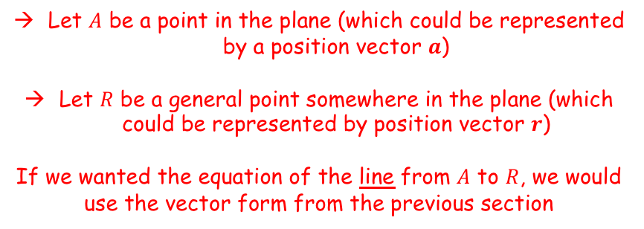
Vectors
You need to be able to use the vector and Cartesian forms of the equation of a plane
A plane is defined as a flat, two-dimensional surface that extends infinitely far…
Imagine we have a plane, which we want to find the vector equation of:
$$R$$
$$A$$
Let $A$ be a point in the plane (which could be represented by a position vector $a$)
Let $R$ be a general point somewhere in the plane (which could be represented by position vector $r$)
If we wanted the equation of the line from $A$ to $R$, we would use the vector form from the previous section
Remember that $a$ is the position vector of point $A$, and $b$ is the vector from $A$ to $R$. $λ$ is a scalar value, and determines how far along the line we would go from point $A$ to get to a specified point on the line
Note that a capital letter is usually used to represent a point, and a bold lowercase letter represents the position vector of that point!
$$r=a+λb$$
However, this would give us any point on the line $AR$, rather than in the plane
To account for the fact that it is a plane, we need 2 different non-parallel vectors in the plane…
9B

Slide 2






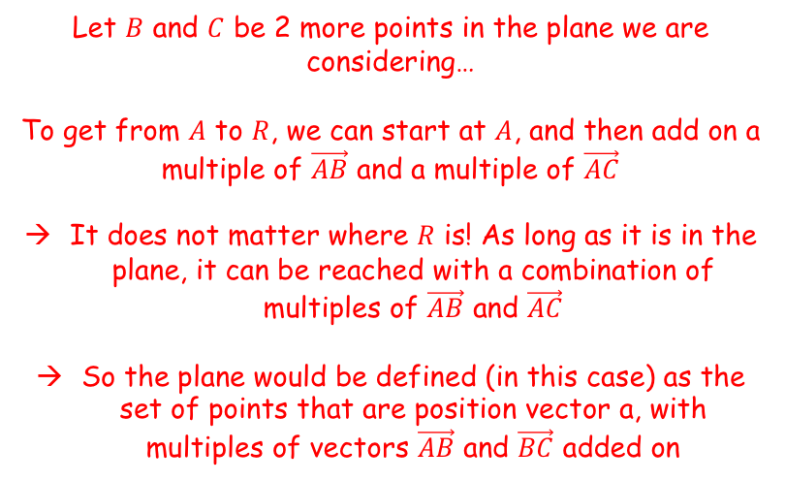




Vectors
$$r=a+λb$$
You need to be able to use the vector and Cartesian forms of the equation of a plane
A plane is defined as a flat, two-dimensional surface that extends infinitely far…
Imagine we have a plane, which we want to find the vector equation of:
$$R$$
$$C$$
$$\vec{AC}$$
Multiple of $\vec{AC}$
Multiple of $\vec{AB}$
$$A$$
$$B$$
$$\vec{AB}$$
Multiple of $\vec{AC}$
Multiple of $\vec{AB}$
$$R$$
Let $B$ and $C$ be 2 more points in the plane we are considering…
To get from $A$ to $R$, we can start at $A$, and then add on a multiple of $\vec{AB}$ and a multiple of $\vec{AC}$
It does not matter where $R$ is! As long as it is in the plane, it can be reached with a combination of multiples of $\vec{AB}$ and $\vec{AC}$
So the plane would be defined (in this case) as the set of points that are position vector a, with multiples of vectors $\vec{AB}$ and $\vec{BC}$ added on
9B

Slide 3


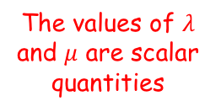
Vectors
$$r=a+λb$$
$$r=a+λb+μc$$
You need to be able to use the vector and Cartesian forms of the equation of a plane
A plane is defined as a flat, two-dimensional surface that extends infinitely far…
Imagine we have a plane, which we want to find the vector equation of:
$$R$$
$$C$$
$$A$$
$$B$$
$\text{The} \text{vector} \text{form} \text{of} \text{the} \text{equation} \text{of} \text{a} \text{plane} \text{is} \text{as} \text{follows}\text{:}$
$$r=a+λb+μc$$
The values of $λ$ and $μ$ are scalar quantities
→ Remember that fundamentally, any equation describes a set of coordinates that follow a rule
The equation form above describes a set of coordinates that all lie in the same plane
That plane’s location is determined by the values of the coordinates used
A general point in the plane
The position vector of a point in the plane
Two non-parallel, non-zero vectors in the plane
In this form, any position in the plane can be reached!
9B

Slide 4

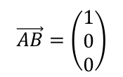
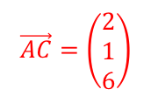

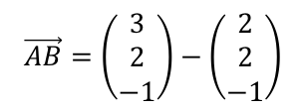
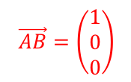
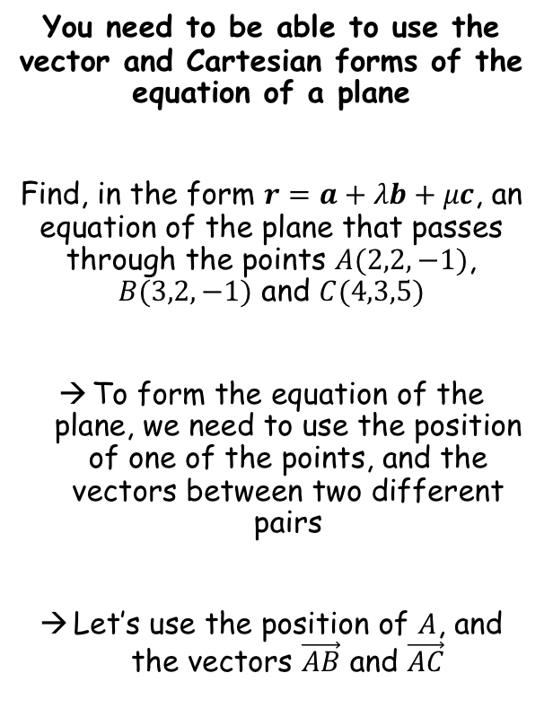
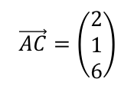



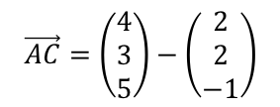
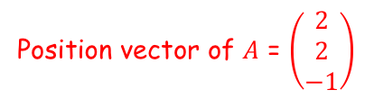


Vectors
$$r=a+λb$$
$$r=a+λb+μc$$
Imagine the diagram we had before, but with the actual positions of $A$, $B$ and $C$…
You need to be able to use the vector and Cartesian forms of the equation of a plane
Find, in the form $r=a+λb+μc$, an equation of the plane that passes through the points $A(2,2,−1)$, $B(3,2,−1)$ and $C(4,3,5)$
To form the equation of the plane, we need to use the position of one of the points, and the vectors between two different pairs
Let’s use the position of $A$, and the vectors $\vec{AB}$ and $\vec{AC}$
$$C(4,3,5)$$
$$R$$
$$A(2,2,−1)$$
$$B(3,2,−1)$$
$$\vec{AB}=b−a$$
$$\vec{AC}=c−a$$
Sub in values
Sub in values
$$\vec{AB}=\left(\begin{matrix}3 \\ 2 \\ −1\end{matrix}\right)−\left(\begin{matrix}2 \\ 2 \\ −1\end{matrix}\right)$$
$$\vec{AC}=\left(\begin{matrix}4 \\ 3 \\ 5\end{matrix}\right)−\left(\begin{matrix}2 \\ 2 \\ −1\end{matrix}\right)$$
$$\vec{AB}=\left(\begin{matrix}1 \\ 0 \\ 0\end{matrix}\right)$$
Calculate
$$\vec{AC}=\left(\begin{matrix}2 \\ 1 \\ 6\end{matrix}\right)$$
Calculate
Position vector of $A$ = $\left(\begin{matrix}2 \\ 2 \\ −1\end{matrix}\right)$
$$\vec{AB}=\left(\begin{matrix}1 \\ 0 \\ 0\end{matrix}\right)$$
$$\vec{AC}=\left(\begin{matrix}2 \\ 1 \\ 6\end{matrix}\right)$$
9B

Slide 5

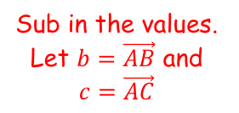
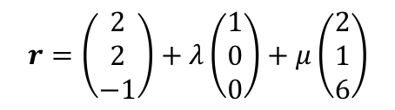
Vectors
$$r=a+λb$$
$$r=a+λb+μc$$
Imagine the diagram we had before, but with the actual positions of $A$, $B$ and $C$…
You need to be able to use the vector and Cartesian forms of the equation of a plane
Find, in the form $r=a+λb+μc$, an equation of the plane that passes through the points $A(2,2,−1)$, $B(3,2,−1)$ and $C(4,3,5)$
To form the equation of the plane, we need to use the position of one of the points, and the vectors between two different pairs
Let’s use the position of $A$, and the vectors $\vec{AB}$ and $\vec{AC}$
$$C(4,3,5)$$
$$R$$
$$A(2,2,−1)$$
$$B(3,2,−1)$$
$$r=a+λb+μc$$
Sub in the values. Let $b=\vec{AB}$ and $c=\vec{AC}$
$$r=\left(\begin{matrix}2 \\ 2 \\ −1\end{matrix}\right)+λ\left(\begin{matrix}1 \\ 0 \\ 0\end{matrix}\right)+μ\left(\begin{matrix}2 \\ 1 \\ 6\end{matrix}\right)$$
Remember that other forms are also acceptable!
$$r=2i+2j+2k+λi+μ\left(2i+j+6k\right)$$
Position vector of $A$ = $\left(\begin{matrix}2 \\ 2 \\ −1\end{matrix}\right)$
$$\vec{AB}=\left(\begin{matrix}1 \\ 0 \\ 0\end{matrix}\right)$$
$$\vec{AC}=\left(\begin{matrix}2 \\ 1 \\ 6\end{matrix}\right)$$
9B

Slide 6
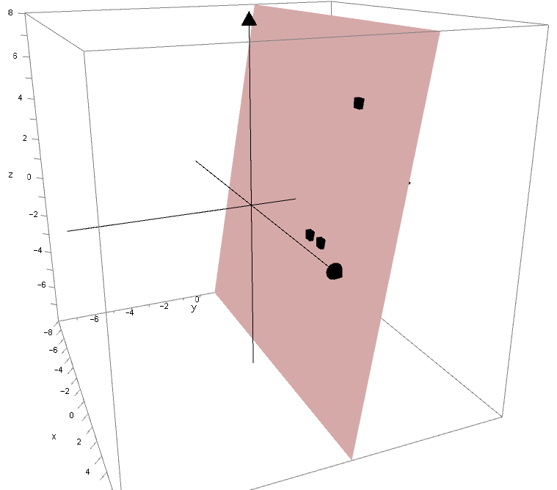



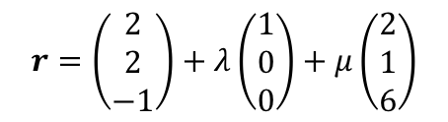


Vectors
$$r=a+λb$$
$$r=a+λb+μc$$
You need to be able to use the vector and Cartesian forms of the equation of a plane
Find, in the form $r=a+λb+μc$, an equation of the plane that passes through the points $A(2,2,−1)$, $B(3,2,−1)$ and $C(4,3,5)$
$$(4,3,5)$$
$$(2,2,−1)$$
$$(3,2,−1)$$
$$r=\left(\begin{matrix}2 \\ 2 \\ −1\end{matrix}\right)+λ\left(\begin{matrix}1 \\ 0 \\ 0\end{matrix}\right)+μ\left(\begin{matrix}2 \\ 1 \\ 6\end{matrix}\right)$$
$$r=\left(\begin{matrix}2 \\ 2 \\ −1\end{matrix}\right)+λ\left(\begin{matrix}1 \\ 0 \\ 0\end{matrix}\right)+μ\left(\begin{matrix}2 \\ 1 \\ 6\end{matrix}\right)$$
9B

Slide 7



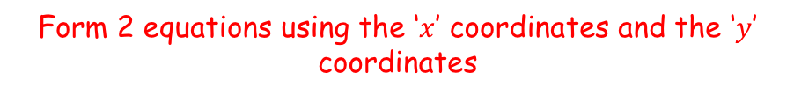



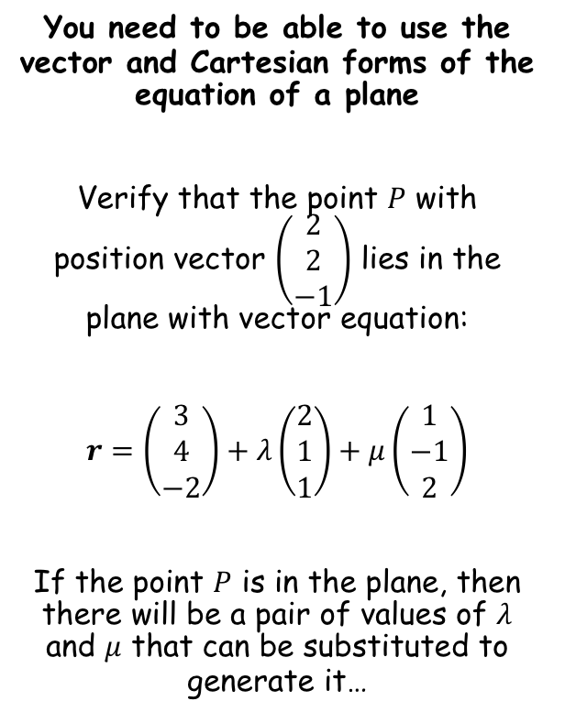


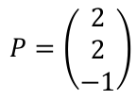

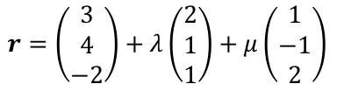






Vectors
$$r=a+λb$$
$$r=a+λb+μc$$
You need to be able to use the vector and Cartesian forms of the equation of a plane
Verify that the point $P$ with position vector $\left(\begin{matrix}2 \\ 2 \\ −1\end{matrix}\right)$ lies in the plane with vector equation:
$r=\left(\begin{matrix}3 \\ 4 \\ −2\end{matrix}\right)+λ\left(\begin{matrix}2 \\ 1 \\ 1\end{matrix}\right)+μ\left(\begin{matrix}1 \\ −1 \\ 2\end{matrix}\right)$
If the point $P$ is in the plane, then there will be a pair of values of $λ$ and $μ$ that can be substituted to generate it…
$$r=\left(\begin{matrix}3 \\ 4 \\ −2\end{matrix}\right)+λ\left(\begin{matrix}2 \\ 1 \\ 1\end{matrix}\right)+μ\left(\begin{matrix}1 \\ −1 \\ 2\end{matrix}\right)$$
$$P=\left(\begin{matrix}2 \\ 2 \\ −1\end{matrix}\right)$$
$$−1=λ$$
$$1=μ$$
Form 2 equations using the ‘$x$’ coordinates and the ‘$y$’ coordinates
$$3+2λ+μ=2$$
Subtract 3
Subtract $2μ$
$$4+λ−μ=2$$
Subtract 2
Add $μ$
$$μ=−1−2λ$$
$$2+λ=μ$$
$$−1−2λ=2+λ$$
Subtract 2
Add $2μ$
$$−3=3λ$$
$$−1=λ$$
Divide by 3
Find the value of $μ$
$$1=μ$$
We now need to use these values and check they also work for the ‘$z$’ coordinate
9B

Slide 8
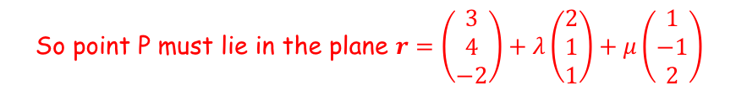




Vectors
$$r=a+λb$$
$$r=a+λb+μc$$
You need to be able to use the vector and Cartesian forms of the equation of a plane
Verify that the point $P$ with position vector $\left(\begin{matrix}2 \\ 2 \\ −1\end{matrix}\right)$ lies in the plane with vector equation:
$r=\left(\begin{matrix}3 \\ 4 \\ −2\end{matrix}\right)+λ\left(\begin{matrix}2 \\ 1 \\ 1\end{matrix}\right)+μ\left(\begin{matrix}1 \\ −1 \\ 2\end{matrix}\right)$
If the point $P$ is in the plane, then there will be a pair of values of $λ$ and $μ$ that can be substituted to generate it…
$$r=\left(\begin{matrix}3 \\ 4 \\ −2\end{matrix}\right)+λ\left(\begin{matrix}2 \\ 1 \\ 1\end{matrix}\right)+μ\left(\begin{matrix}1 \\ −1 \\ 2\end{matrix}\right)$$
$$P=\left(\begin{matrix}2 \\ 2 \\ −1\end{matrix}\right)$$
$$−1=λ$$
$$1=μ$$
$$−2+λ+2μ=−1$$
Sub in values of $λ$ and $μ$
$$−2+(−1)+2(1)=−1$$
Calculate
$$−1=−1$$
So point P must lie in the plane $r=\left(\begin{matrix}3 \\ 4 \\ −2\end{matrix}\right)+λ\left(\begin{matrix}2 \\ 1 \\ 1\end{matrix}\right)+μ\left(\begin{matrix}1 \\ −1 \\ 2\end{matrix}\right)$
9B

Slide 9
Vectors
$$r=a+λb$$
$$r=a+λb+μc$$
You need to be able to use the vector and Cartesian forms of the equation of a plane
A way to find the equation of a plane in Cartesian form is to use the normal vector to the plane
It is best to start by learning about this in 2D…
9B

Slide 10
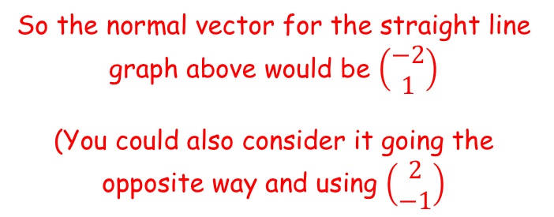



Vectors
$$r=a+λb$$
$$r=a+λb+μc$$
The normal vector is the vector which is perpendicular to a line at a given point
→ For a straight line, this vector will be the same anywhere
$$y$$
$$y=2x+1$$
You need to be able to use the vector and Cartesian forms of the equation of a plane
Consider the graph of $y=2x+1$…
1
2
2
1
$$x$$
So the normal vector for the straight line graph above would be $\left(\begin{matrix}−2 \\ 1\end{matrix}\right)$
(You could also consider it going the opposite way and using $\left(\begin{matrix}2 \\ −1\end{matrix}\right)$
9B

Slide 11
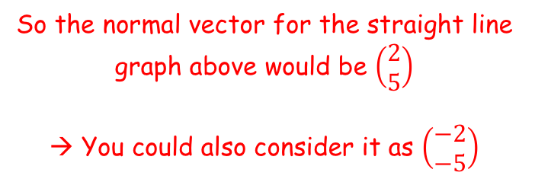


Vectors
$$r=a+λb$$
$$r=a+λb+μc$$
$$y$$
You need to be able to use the vector and Cartesian forms of the equation of a plane
Consider the graph of $y=−\frac{2}{5}x−3$…
5
2
$$x$$
5
2
$$y=−\frac{2}{5}x−3$$
So the normal vector for the straight line graph above would be $\left(\begin{matrix}2 \\ 5\end{matrix}\right)$
→ You could also consider it as $\left(\begin{matrix}−2 \\ −5\end{matrix}\right)$
9B

Slide 12
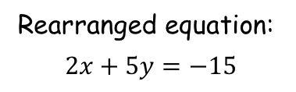

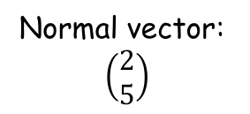

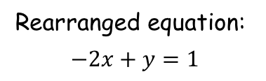
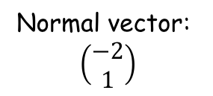


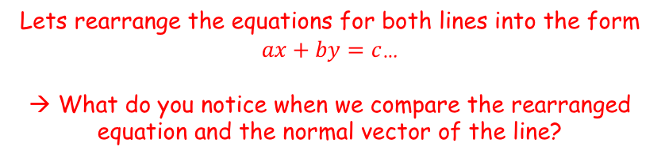
Vectors
$$r=a+λb$$
$$r=a+λb+μc$$
Lets rearrange the equations for both lines into the form $ax+by=c$…
→ What do you notice when we compare the rearranged equation and the normal vector of the line?
You need to be able to use the vector and Cartesian forms of the equation of a plane
$$y$$
$$y=2x+1$$
$$y$$
$$x$$
$$x$$
$$y=−\frac{2}{5}x−3$$
Normal vector:
$$\left(\begin{matrix}−2 \\ 1\end{matrix}\right)$$
Rearranged equation:
$$−2x+y=1$$
Normal vector:
$$\left(\begin{matrix}2 \\ 5\end{matrix}\right)$$
Rearranged equation:
$$2x+5y=−15$$
9B

Slide 13
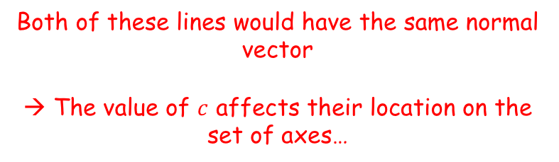
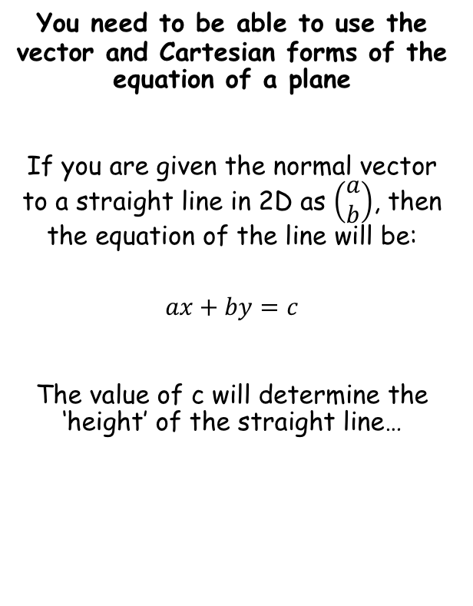
Vectors
$$r=a+λb$$
For the normal vector $\left(\begin{matrix}a \\ b\end{matrix}\right)$, the equation of the straight line will be $ax+by=c$
$$r=a+λb+μc$$
Both of these lines would have the same normal vector
→ The value of $c$ affects their location on the set of axes…
You need to be able to use the vector and Cartesian forms of the equation of a plane
If you are given the normal vector to a straight line in 2D as $\left(\begin{matrix}a \\ b\end{matrix}\right)$, then the equation of the line will be:
$$ax+by=c$$
The value of c will determine the ‘height’ of the straight line…
$$y$$
$$x$$
9B

Slide 14


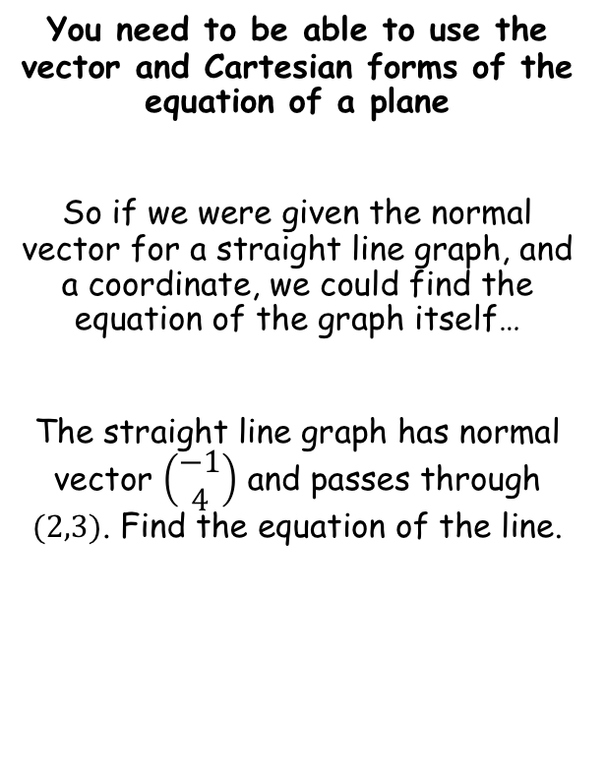




Vectors
$$r=a+λb$$
For the normal vector $\left(\begin{matrix}a \\ b\end{matrix}\right)$, the equation of the straight line will be $ax+by=c$
$$r=a+λb+μc$$
You need to be able to use the vector and Cartesian forms of the equation of a plane
So if we were given the normal vector for a straight line graph, and a coordinate, we could find the equation of the graph itself…
The straight line graph has normal vector $\left(\begin{matrix}−1 \\ 4\end{matrix}\right)$ and passes through $(2,3)$. Find the equation of the line.
$$ax+by=c$$
Sub in the values of $a$ and $b$ from the normal vector
$$−x+4y=c$$
Sub in the coordinate
$$−(2)+4(3)=c$$
$$10=c$$
Calculate
So the equation of the line is $−x+4y=10$
9B

Slide 15
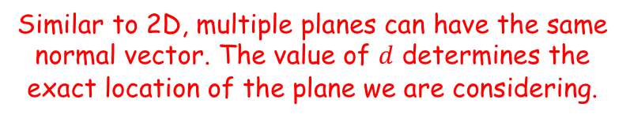
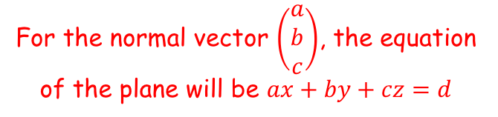


Vectors
$$r=a+λb$$
For the normal vector $\left(\begin{matrix}a \\ b\end{matrix}\right)$, the equation of the straight line will be $ax+by=c$
$$r=a+λb+μc$$
$$\left(\begin{matrix}a \\ b \\ c\end{matrix}\right)$$
$$n$$
You need to be able to use the vector and Cartesian forms of the equation of a plane
It is possible to use the same idea in 3D to find the equation of a plane in Cartesian form
The normal vector is the vector which is perpendicular to the surface of the plane
We use a similar process as in 2D to find the Cartesian equation of the plane…
For the normal vector $\left(\begin{matrix}a \\ b \\ c\end{matrix}\right)$, the equation of the plane will be $ax+by+cz=d$
Similar to 2D, multiple planes can have the same normal vector. The value of $d$ determines the exact location of the plane we are considering.
9B

Slide 16
Vectors
For the normal vector $\left(\begin{matrix}a \\ b \\ c\end{matrix}\right)$, the equation of the plane will be $ax+by+cz=d$
$$r=a+λb$$
For the normal vector $\left(\begin{matrix}a \\ b\end{matrix}\right)$, the equation of the straight line will be $ax+by=c$
$$r=a+λb+μc$$
You need to be able to use the vector and Cartesian forms of the equation of a plane
You will see how to derive the result above in section 9D!
9B

Slide 17

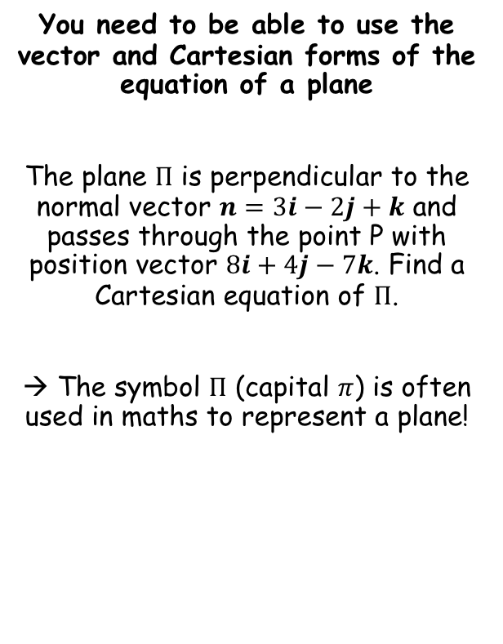




Vectors
$$r=a+λb$$
For the normal vector $\left(\begin{matrix}a \\ b \\ c\end{matrix}\right)$, the equation of the plane will be $ax+by+cz=d$
$$r=a+λb+μc$$
You need to be able to use the vector and Cartesian forms of the equation of a plane
The plane $Π$ is perpendicular to the normal vector $n=3i−2j+k$ and passes through the point P with position vector $8i+4j−7k$. Find a Cartesian equation of $Π$.
→ The symbol $Π$ (capital $π$) is often used in maths to represent a plane!
$$3x−2y+z=d$$
Sub in values from the coordinate
$$3(8)−2(4)+(−7)=d$$
Calculate $d$
$$9=d$$
We can now write the equation of the plane…
$$3x−2y+z=9$$
9B

Slide 18
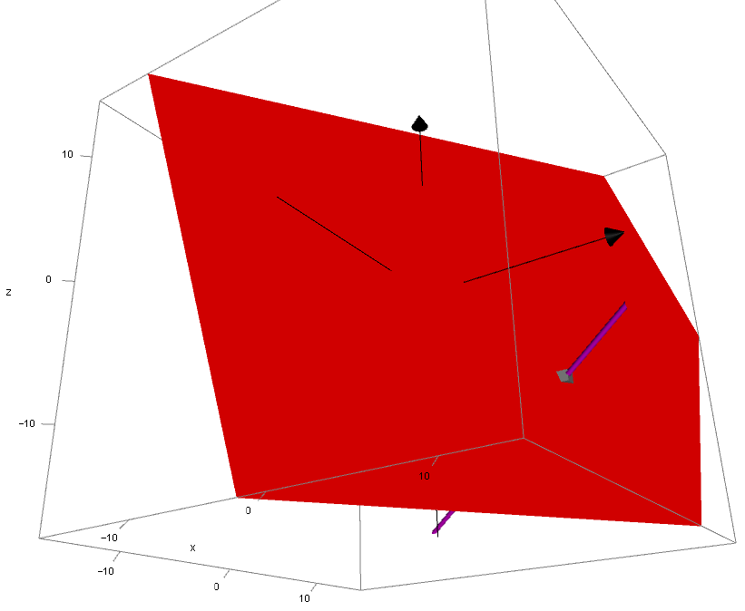



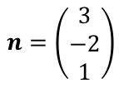
Vectors
$$r=a+λb$$
For the normal vector $\left(\begin{matrix}a \\ b \\ c\end{matrix}\right)$, the equation of the plane will be $ax+by+cz=d$
$$r=a+λb+μc$$
You need to be able to use the vector and Cartesian forms of the equation of a plane
The plane $Π$ is perpendicular to the normal vector $n=3i−2j+k$ and passes through the point P with position vector $8i+4j−7k$. Find a Cartesian equation of $Π$.
$$n=\left(\begin{matrix}3 \\ −2 \\ 1\end{matrix}\right)$$
$$(8,4,−7)$$
$$3x−2y+z=9$$
CLICK
9B

Slide 19
Exercise 9B
Pearson Pure Mathematics Year 1/AS
Pages 3-5
Complete before the lesson Q1-2
In Class:
Green Q3-5
Amber Q6-8
Red Q9-10 & challenge

