Slide 1
Year 1 Pure Mathematics
Differentiation
- Introduction
Chapter 12
(Part 1 of 6)

Slide 2
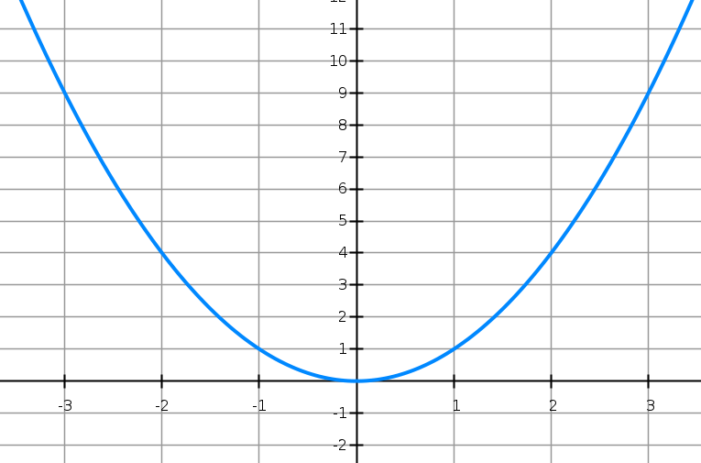
Differentiation
What is the gradient of the curve?
It is different at any given point.

Slide 3
Differentiation
The gradient at any given point is given by the tangent at that point

Slide 4







Differentiation
What things do you notice about
the gradients?
$$m=6$$
$$m=−6$$
$$m=−4$$
$$m=4$$
$$m=−2$$
$$m=2$$
$$m=0$$

Slide 5
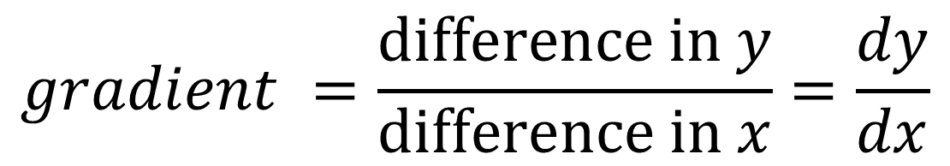





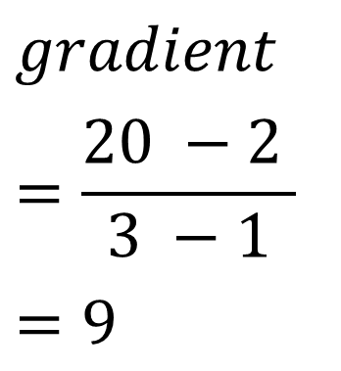
Differentiation
Gradient of the Tangent.
$$\left(3,20\right)$$
$$gradient$$
$$=\frac{20 −2 }{3 −1}$$
$$=9$$
$$18$$
$$y=x^{2}$$
$$\left(1,2 \right)$$
$$2$$
$$gradient =\frac{difference in y}{difference in x}=\frac{dy}{dx}$$

Slide 6
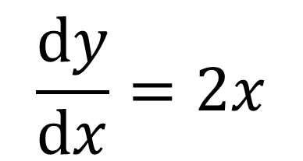
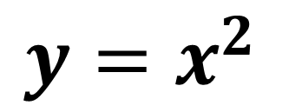
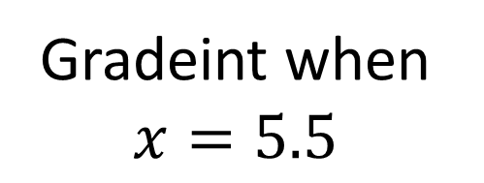
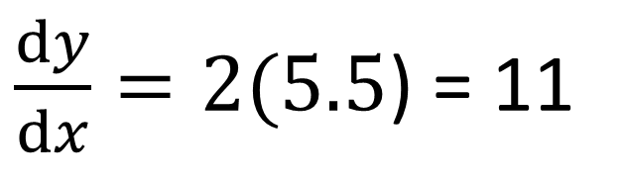
Differentiation
Differentiating is the process of taking
the equation of the curve and
coming up with a formula that calculates the gradient
of the curve (at any given point).
$$y=x^{2}$$
$$\frac{dy}{dx}=2x$$
Gradeint when $x=5.5$
$\frac{dy}{dx}=2(5.5$) = 11

Slide 7
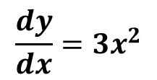
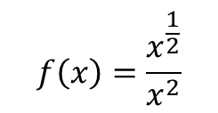





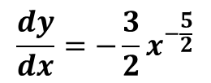
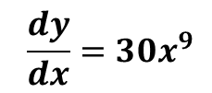



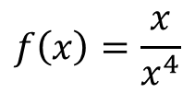
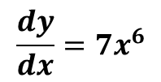
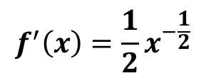


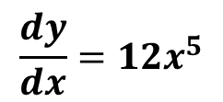


Differentiation
$$f(x)=x^{\frac{1}{2}}$$
$$f^{′}\left(x\right)=\frac{1}{2}x^{−\frac{1}{2}}$$
$$\frac{dy}{dx}=7x^{6}$$
$$y=x^{7}$$
$$\frac{dy}{dx}=12x^{5}$$
$$\frac{dy}{dx}=30x^{9}$$
$$y=3x^{10}$$
$$y={2x}^{6}$$
$$f\left(x\right)=\frac{x^{\frac{1}{2}}}{x^{2}}$$
$$\frac{dy}{dx}=−\frac{3}{2}x^{−\frac{5}{2}}$$
$$y=\sqrt{x^{6}}$$
$$=x^{3}$$
$$\frac{dy}{dx}=3x^{2}$$
$$=x^{−\frac{3}{2}}$$
$$f\left(x\right)=\frac{x}{x^{4}}$$
$$=x^{−3}$$
$$f^{′}\left(x\right)=−3x^{−2}$$
$$f(x)=\sqrt{49x^{4}}$$
$$=7x^{2}$$
$$f′(x)=14x$$

Slide 8
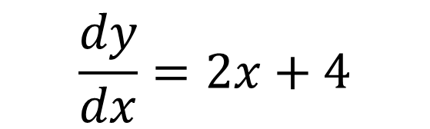
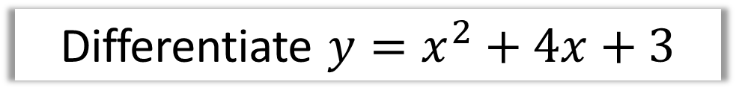
Differentiation – Multiple Terms
Dealing with multiple terms.
Differentiate $y=x^{2}+4x+3$
differentiate each term individually
$$\frac{dy}{dx}=2x+4$$

Slide 9
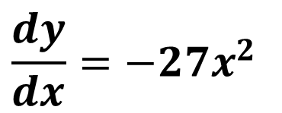

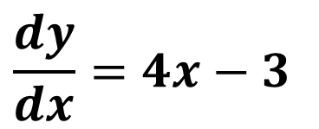


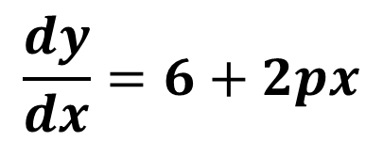
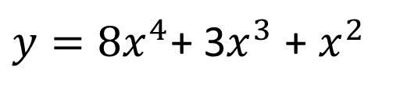
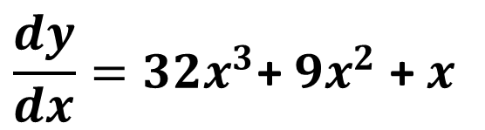

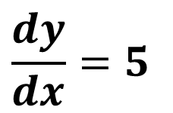
Differentiation - Multiple Terms
$$\frac{dy}{dx}=4x−3$$
$$y=2x^{2}−3x$$
$$y=4−9x^{3}$$
$$\frac{dy}{dx}=−27x^{2}$$
$$y=5x+1$$
$$\frac{dy}{dx}=5$$
$$\frac{dy}{dx}={32x}^{3}\text{+ }9x^{2}\text{ + }x$$
$y={8x}^{4}$+ 3$x^{3}$ + $x^{2}$
$$\frac{dy}{dx}=6+2px$$
$$y=6x−3+px^{2}$$

Slide 10
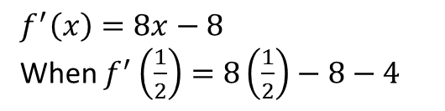
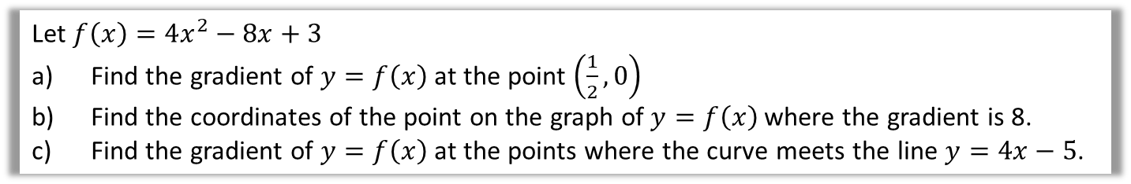
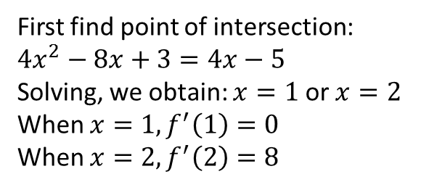
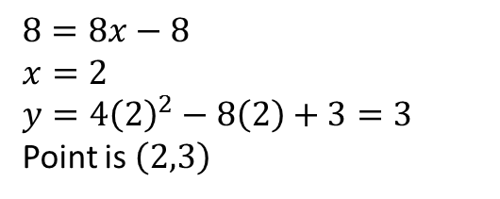
Differentiation – Exam Question and Answers
Let $f\left(x\right)=4x^{2}−8x+3$
Find the gradient of $y=f\left(x\right)$ at the point $\left(\frac{1}{2},0\right)$
Find the coordinates of the point on the graph of $y=f\left(x\right)$ where the gradient is 8.
Find the gradient of $y=f\left(x\right)$ at the points where the curve meets the line $y=4x−5$.
a
$$f^{′}\left(x\right)=8x−8$$
When $f^{′}\left(\frac{1}{2}\right)=8\left(\frac{1}{2}\right)−8−4$
b
$$8=8x−8 \\ x=2 \\ y=4{\left(2\right)}^{2}−8\left(2\right)+3=3$$
Point is $\left(2,3\right)$
c
First find point of intersection:
$$4x^{2}−8x+3=4x−5$$
Solving, we obtain: $x=1$ or $x=2$
When $x=1, f^{′}\left(1\right)=0$
When $x=2, f^{′}\left(2\right)=8$

Slide 11
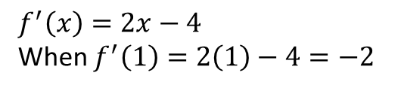
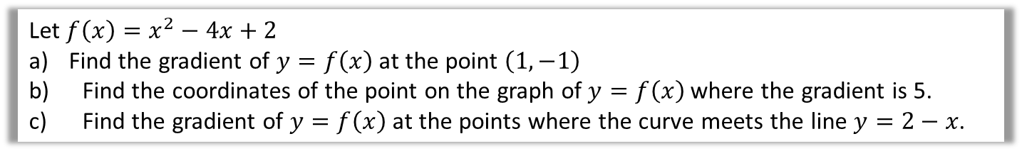
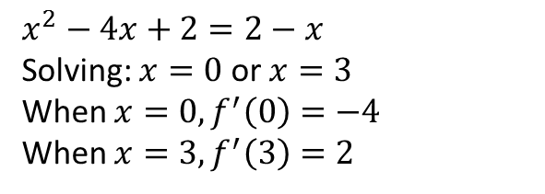
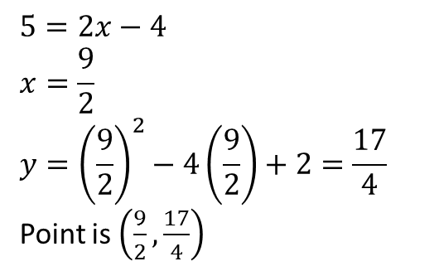
Differentiation – Exam Question and Answers
Let $f\left(x\right)=x^{2}−4x+2$
Find the gradient of $y=f\left(x\right)$ at the point $\left(1,−1\right)$
Find the coordinates of the point on the graph of $y=f\left(x\right)$ where the gradient is 5.
Find the gradient of $y=f\left(x\right)$ at the points where the curve meets the line $y=2−x$.
a
$$f^{′}\left(x\right)=2x−4$$
When $f^{′}\left(1\right)=2\left(1\right)−4=−2$
b
$$5=2x−4 \\ x=\frac{9}{2} \\ y={\left(\frac{9}{2}\right)}^{2}−4\left(\frac{9}{2}\right)+2=\frac{17}{4}$$
Point is $\left(\frac{9}{2},\frac{17}{4}\right)$
c
$$x^{2}−4x+2=2−x$$
Solving: $x=0$ or $x=3$
When $x=0, f^{′}\left(0\right)=−4$
When $x=3, f^{′}\left(3\right)=2$

Slide 12
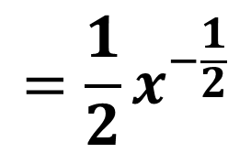
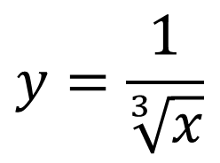
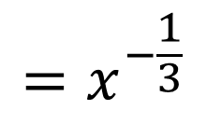

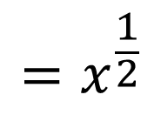
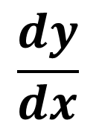
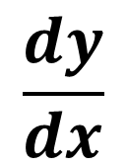
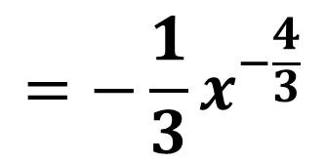
Differentiation – Harder Expressions
1. Turn roots into powers:
$$=x^{\frac{1}{2}}$$
$$\frac{dy}{dx}$$
$$=\frac{1}{2}x^{−\frac{1}{2}}$$
$$y=\sqrt{x}$$
$$y=\frac{1}{\sqrt[3]{x}}$$
$$=x^{−\frac{1}{3}}$$
$$\frac{dy}{dx}$$
$$=−\frac{1}{3}x^{−\frac{4}{3}}$$

Slide 13
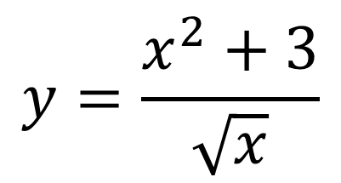
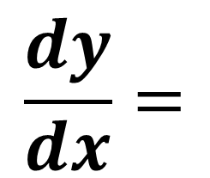
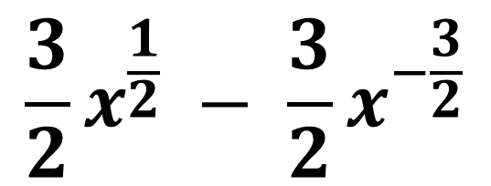
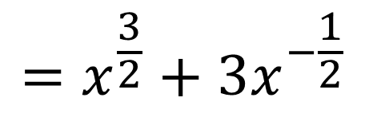
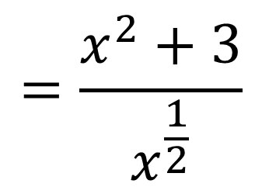
Differentiation – Harder Expressions
2. Split up fractions.
$$y=\frac{x^{2}+3}{\sqrt{x}}$$
$$=\frac{x^{2}+3}{x^{\frac{1}{2}}}$$
$$=x^{\frac{3}{2}}+3x^{−\frac{1}{2}}$$
$$\frac{dy}{dx}=$$
$$\frac{3}{2}x^{\frac{1}{2}} − \frac{3}{2}x^{−\frac{3}{2}}$$

Slide 14
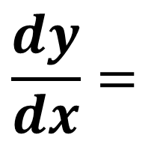
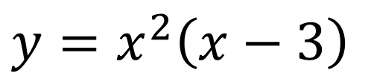
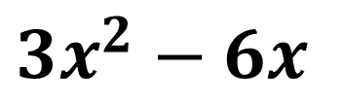
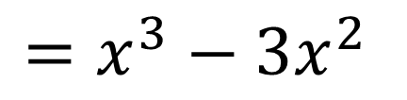
Differentiation – Harder Expressions
3. Expand out brackets.
$$y=x^{2}\left(x−3\right)$$
$$=x^{3}−3x^{2}$$
$$\frac{dy}{dx}=$$
$$3x^{2}−6x$$

Slide 15
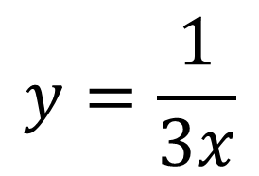
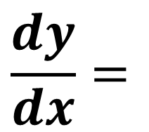
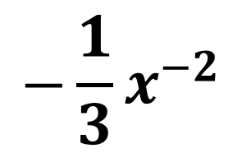

Differentiation – Harder Expressions
4. Beware of numbers in denominators!
$$y=\frac{1}{3x}$$
$$=\frac{1}{3}x^{−1}$$
$$\frac{dy}{dx}=$$
$$−\frac{1}{3}x^{−2}$$

Slide 16













Differentiation – Harder Expressions
Differentiate the following.
$$y=\frac{1}{\sqrt{x}}$$
$${= x}^{−\frac{1}{2}}$$
$$\frac{dy}{dx}=$$
$$−\frac{1}{2}x^{−\frac{3}{2}}$$
$$y=\frac{2+x^{3}}{x^{2}}=$$
$$\frac{dy}{dx}=$$
$$2x^{−2}+x$$
$$−4x^{−3}+1$$
$$y=\frac{1+2x}{3x\sqrt{x}}$$
$$=\frac{1+2x}{3x^{\frac{3}{2}}}$$
$$=\frac{1}{3}x^{−\frac{3}{2}}+\frac{2}{3}x^{−\frac{1}{2}}$$
$$\frac{dy}{dx}=$$
$$−\frac{1}{2}x^{−\frac{5}{2}}−\frac{1}{3}x^{−\frac{3}{2}}$$

Slide 17
Exercise 12D
Pearson Pure Mathematics Year 1/AS
Pages 265-266
(Note that Exercise 12C was skipped in these slides)
Complete before the lesson Q1
Green Q2
Amber Q3
Red

Slide 18

Exercise 12E
Complete before the lesson Q1
Green Q2
Amber Q3
Red
Pearson Pure Mathematics
Pages 267-268
Extension
[MAT 2013 1E]
The expression $\frac{d^{2}}{dx^{2}}\left[{\left(2x−1\right)}^{4}{\left(1−x\right)}^{5}\right]+\frac{d}{dx}\left[{\left(2x+1\right)}^{4}{\left(3x^{2}−2\right)}^{2}\right]$
is a polynomial of degree:
9
8
7
less than 7
Full expansion is not needed. The highest power term in the first polynomial is $16x^{4}×{\left(−x\right)}^{5}=−16x^{9}$, differentiating twice to give ${\left(−16×9×8\right)}^{9}x^{7}$.
The highest power term in the second polynomial is $16x^{4}×9x^{2}=\left(16×9\right)x^{8}$, differentiating once to give $\left(16×9×8\right)x^{7}$. These terms cancel leaving a polynomial of order (at most) 6. The answer is (D).
This just means “differentiate twice”. We’ll be looking at the ‘second derivative’ later in this chapter.
?

