Slide 1
Year 1 Applied Mathematics
Variable Acceleration
- Using Differentiation
Chapter 11
(Part 2 of 4)

Slide 2
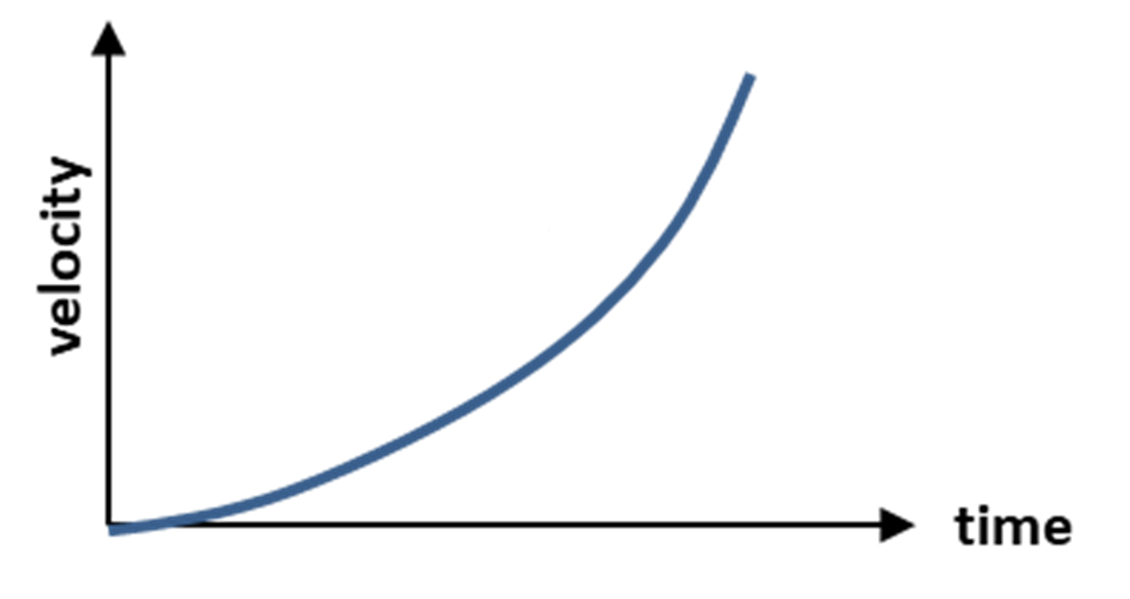
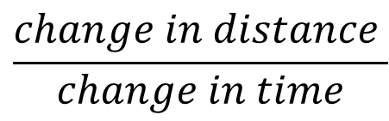
Variable Acceleration
s
displacement
t
What does the gradient of the tangent tell you?
Gradient of the tangent
=
$$\frac{change in distance }{change in time}$$
=
velocity

Slide 3
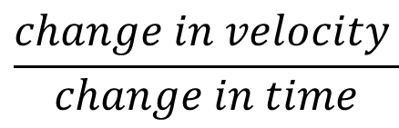
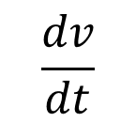
Variable Acceleration
v
t
What does the gradient of the tangent tell you?
Gradient of the tangent
$$\frac{change in velocity }{change in time}$$
=
$$\frac{dv}{dt}$$
=
=
acceleration

Slide 4
Variable Acceleration - Using Calculus
Displacement (s)
differentiate
integration
Velocity (v)
differentiate
integration
Acceleration (a)

Slide 5
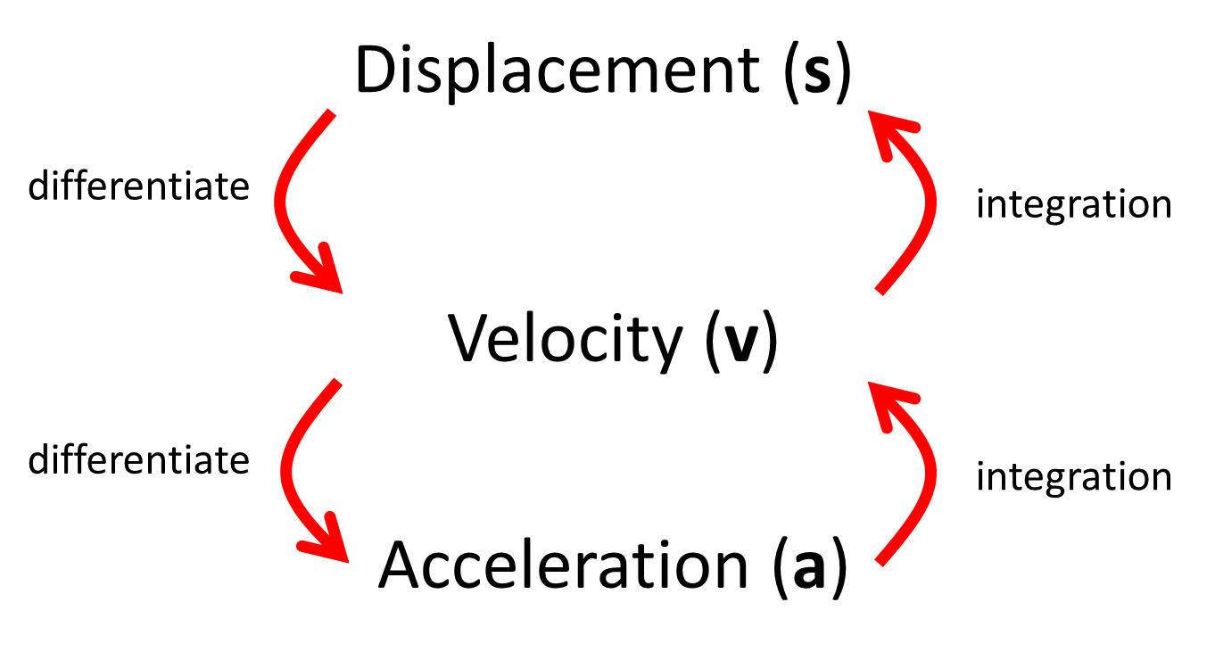


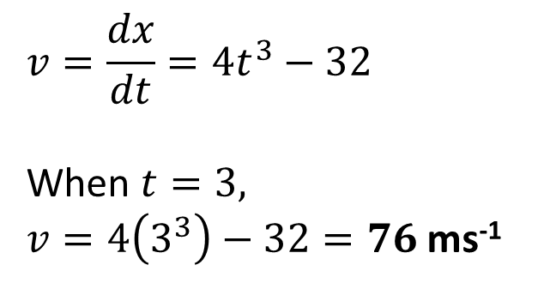
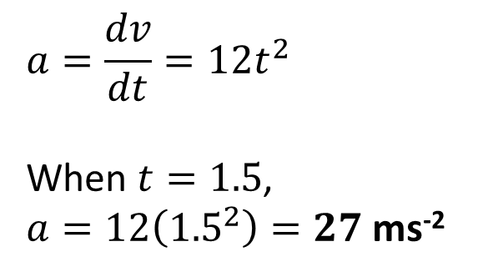
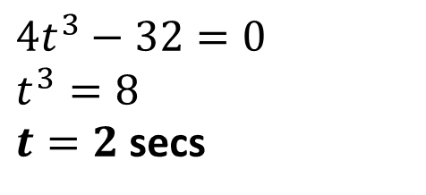
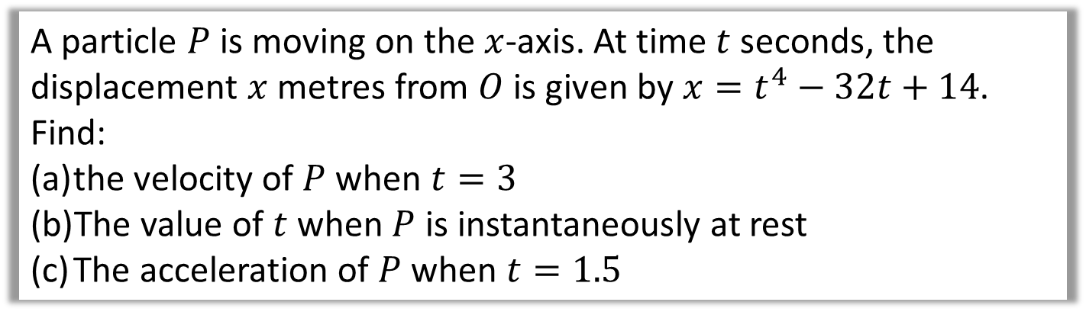
Variable Acceleration - Using differentiation
A particle $P$ is moving on the $x$-axis. At time $t$ seconds, the displacement $x$ metres from $O$ is given by $x=t^{4}−32t+14$.
Find:
the velocity of $P$ when $t=3$
The value of $t$ when $P$ is instantaneously at rest
The acceleration of $P$ when $t=1.5$
$$v=\frac{dx}{dt}=4t^{3}−32$$
When $t=3,$
$v=4\left(3^{3}\right)−32=76$ ms⁻¹
a
$$∫a dt$$
$$\frac{d}{dt}$$
$$a=\frac{dv}{dt}=12t^{2}$$
When $t=1.5$,
$a=12\left({1.5}^{2}\right)=27$ ms⁻²
c
b
$$4t^{3}−32=0$$
$$t^{3}=8$$
$t=2$ secs

Slide 6
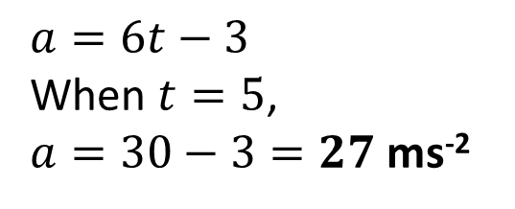
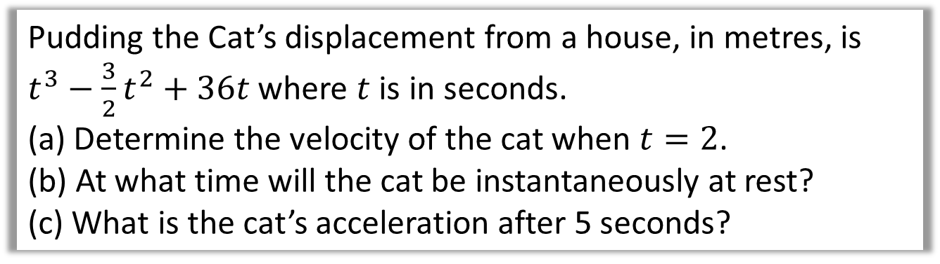
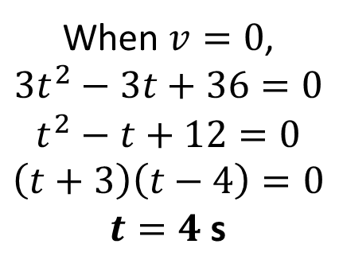
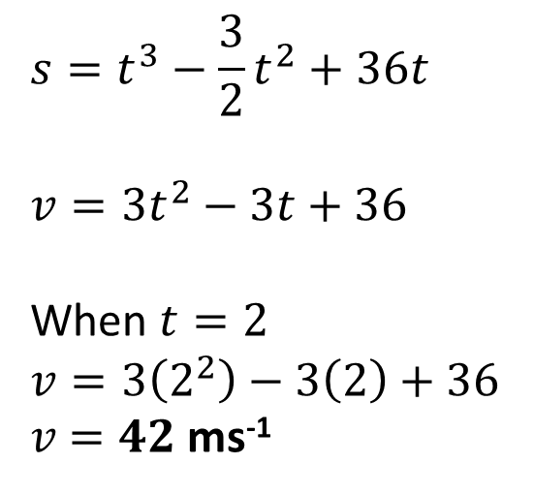
Variable Acceleration - Using differentiation
Pudding the Cat’s displacement from a house, in metres, is $t^{3}−\frac{3}{2}t^{2}+36t$ where $t$ is in seconds.
(a) Determine the velocity of the cat when $t=2$.
(b) At what time will the cat be instantaneously at rest?
(c) What is the cat’s acceleration after 5 seconds?
$$s=t^{3}−\frac{3}{2}t^{2}+36t$$
$$v=3t^{2}−3t+36$$
When $t=2$
$$v=3\left(2^{2}\right)−3\left(2\right)+36$$
$v$ $=42$ ms⁻¹
a
b
When $v=0$,
$$3t^{2}−3t+36=0 \\ t^{2}−t+12=0 \\ \left(t+3\right)\left(t−4\right)=0$$
$t=4$ s
$$a=6t−3$$
When $t=5$,
$a=30−3=27$ ms⁻²
c

Slide 7
Exercise 11B
Pearson Stats/Mechanics Year 1
Page 185-186
Complete before the lesson Q1
In Class:
Green Q2-3
Red Q4-6

