Slide 1
Year 1 Applied Mathematics
Statistical Distributions
- Probability Distributions
Chapter 6 (Part 1)

Slide 2

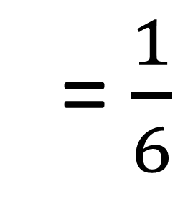

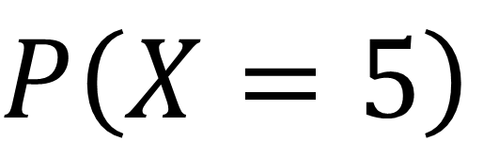
Probability Distributions
Notation you need to know:
$$P\left(X=x\right)$$
Probability
Outcome
Required Outcome
= $\frac{1}{6}$
$$P\left(X=5\right)$$

Slide 3
Probability Distributions
A probability distribution gives the probability of
any possible outcome of an event.
There are a number of way you can present
a probability distribution.
as a table
as a diagram
as a function

Slide 4
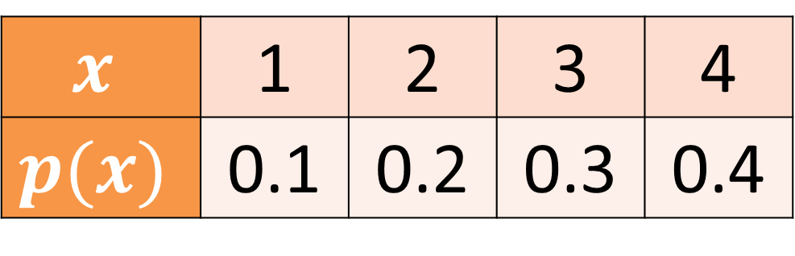
Probability Distributions
As a table:
$$x$$ | 1 | 2 | 3 | 4
$$p(x)$$ | 0.1 | 0.2 | 0.3 | 0.4

Slide 5
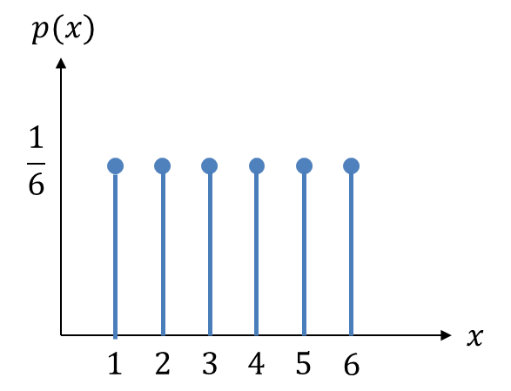

Probability Distributions
As a diagram:

Slide 6
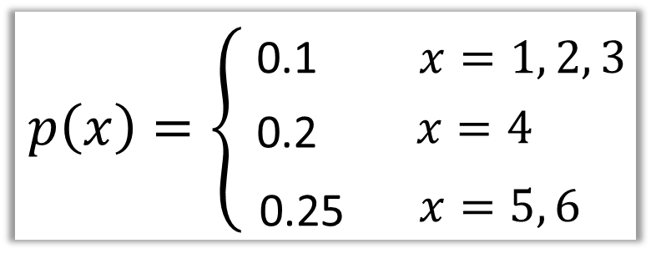
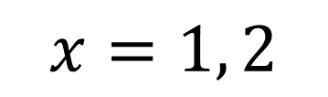
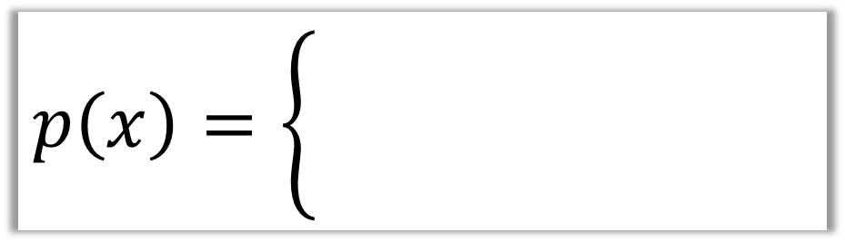
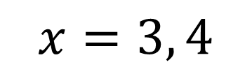
Probability Distributions
As a function:
$$p\left(x\right)=\left\{\begin{aligned}0.1, \\ x=1,2,3,\end{aligned}\right.$$
0.1
$$x=1, 2$$
0.4
$$x=3, 4$$

Slide 7
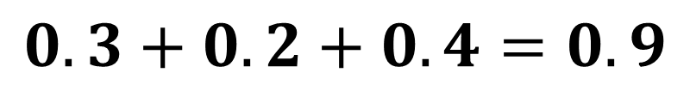
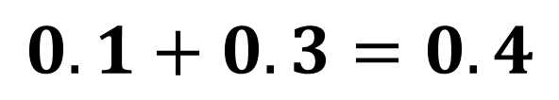
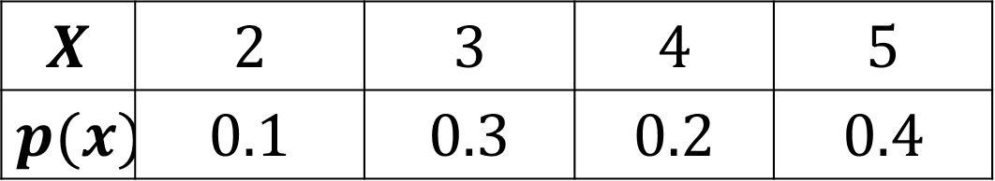
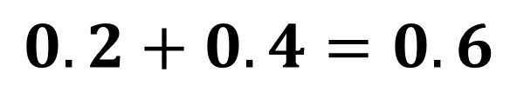

Probability Distributions
$$X$$ | $$2$$ | $$3$$ | $$4$$ | $$5$$
$$p(x)$$ | $$0.1$$ | $$0.3$$ | $$0.2$$ | $$0.4$$
$$P\left(X>3\right)=$$
$$0.2+0.4=0.6$$
$$P\left(2≤X<4\right)=$$
$$0.1+0.3=0.4$$
$$P\left(X≥2.5\right)=$$
$$0.3+0.2+0.4=0.9$$

Slide 8
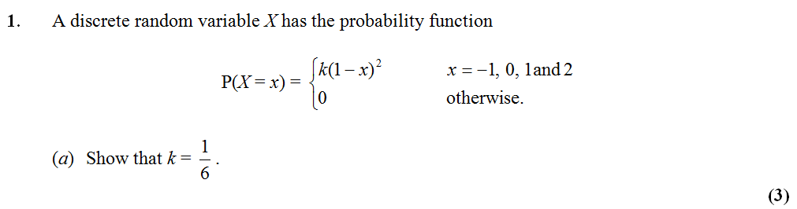

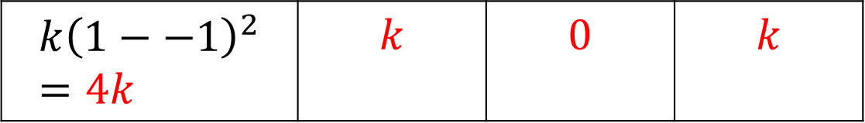
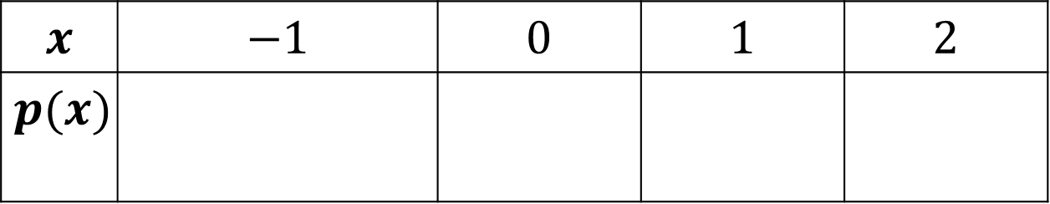
Probability Distributions – Exam Question
$$x$$ | $$−1$$ | $$0$$ | $$1$$ | $$2$$
$$p(x)$$ | $$k{\left(1−−1\right)}^{2}=4k$$ | $$k$$ | $$0$$ | $$k$$
$$k{\left(1−−1\right)}^{2}=4k$$ | $$k$$ | $$0$$ | $$k$$
$$4k+k+0+k=1$$
$$6k=1$$
$$k=\frac{1}{6}$$

Slide 9
Exercise 6A
Pearson Pure Mathematics Year 1/AS
Pages 86-88
Complete before the lesson Q1-4
In Class:
Green Q5-6
Amber Q7-10
Red Q11-13 & Challenge

