Slide 1
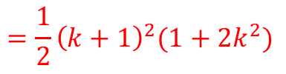
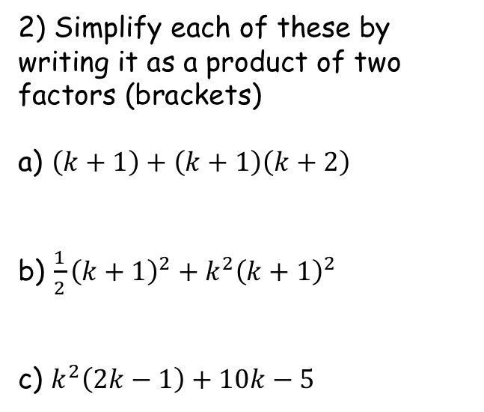

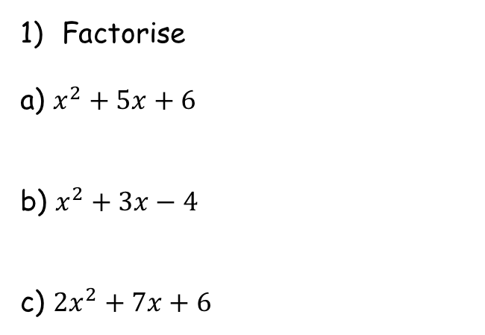




Prior Knowledge Check
Factorise
a) $x^{2}+5x+6$
b) $x^{2}+3x−4$
c) ${2x}^{2}+7x+6$
2) Simplify each of these by writing it as a product of two factors (brackets)
a) $\left(k+1\right)+\left(k+1\right)\left(k+2\right)$
b) $\frac{1}{2}{\left(k+1\right)}^{2}+k^{2}{\left(k+1\right)}^{2}$
c) $k^{2}\left(2k−1\right)+10k−5$
$$=(x+2)(x+3)$$
$$=(k+1)(k+3)$$
$$=(x+4)(x−1)$$
$$=\frac{1}{2}{\left(k+1\right)}^{2}(1+{2k}^{2})$$
$$=(2x+3)(x+2)$$
$$= (2k−1)(k^{2}+5)$$

Slide 2

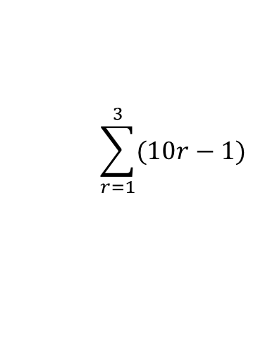

Series
You can use the sigma notation to write the sum of a series clearly and concisely
The last value we put into the sequence formula (put in every integer in between as well!)
$$\sum_{r=1}^{3}{(10r−1)}$$
The sequence of numbers we are finding the sum of
The first value we put into the sequence formula
$$=9+19+29$$
$$=57$$
3A

Slide 3

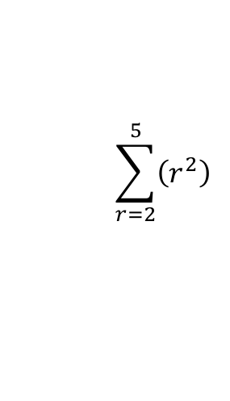

Series
You can use the sigma notation to write the sum of a series clearly and concisely
The last value we put into the sequence formula (put in every integer in between as well!)
$$\sum_{r=2}^{5}{\left(r^{2}\right)}$$
The sequence of numbers we are finding the sum of
$$=4+9+16+25$$
The first value we put into the sequence formula
$$=54$$
3A

Slide 4
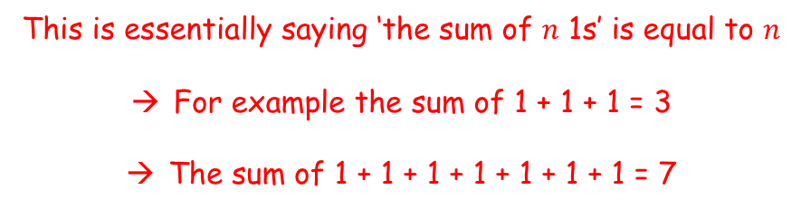
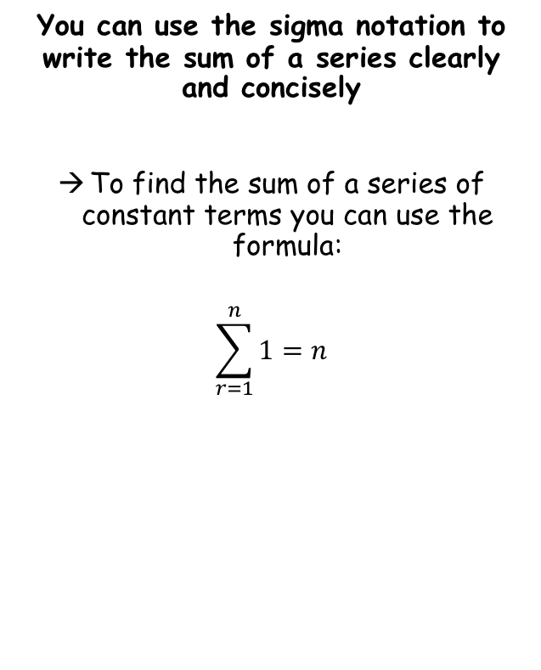
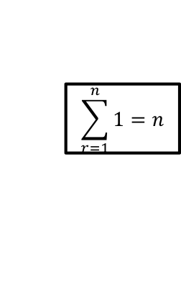
Series
$$\sum_{r=1}^{n}{1}=n$$
You can use the sigma notation to write the sum of a series clearly and concisely
To find the sum of a series of constant terms you can use the formula:
$$\sum_{r=1}^{n}{1}=n$$
This is essentially saying ‘the sum of $n$ 1s’ is equal to $n$
For example the sum of 1 + 1 + 1 = 3
The sum of 1 + 1 + 1 + 1 + 1 + 1 + 1 = 7
3A

Slide 5
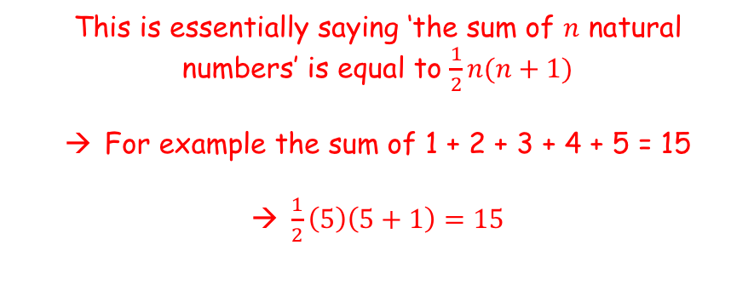
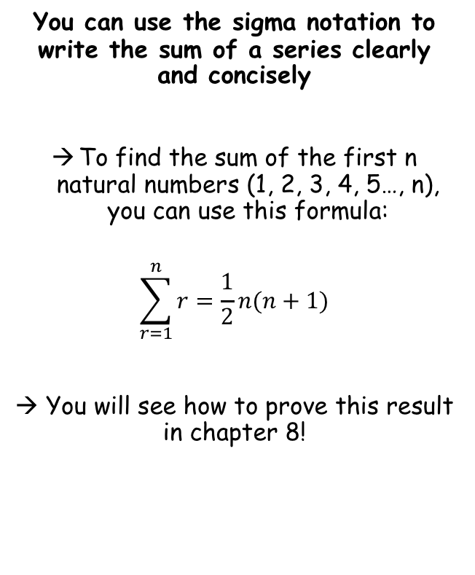
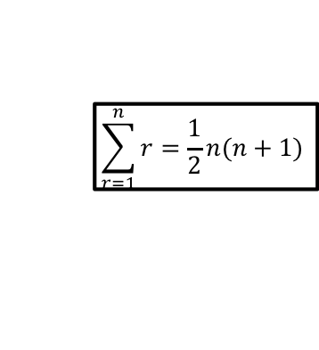
Series
$$\sum_{r=1}^{n}{1}=n$$
$$\sum_{r=1}^{n}{r}=\frac{1}{2}n(n+1)$$
You can use the sigma notation to write the sum of a series clearly and concisely
To find the sum of the first n natural numbers (1, 2, 3, 4, 5…, n), you can use this formula:
$$\sum_{r=1}^{n}{r}=\frac{1}{2}n(n+1)$$
→ You will see how to prove this result in chapter 8!
This is essentially saying ‘the sum of $n$ natural numbers’ is equal to $\frac{1}{2}n(n+1)$
For example the sum of 1 + 2 + 3 + 4 + 5 = 15
$\frac{1}{2}\left(5\right)\left(5+1\right)=15$
3A

Slide 6
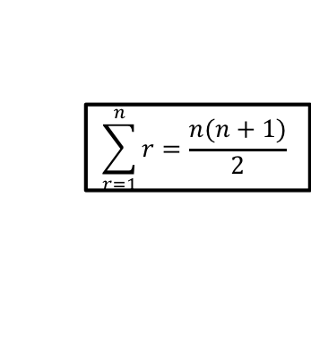
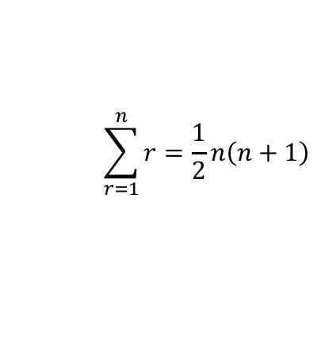
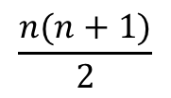
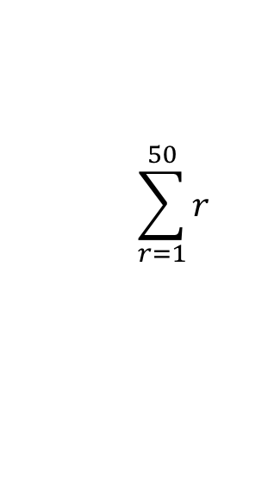

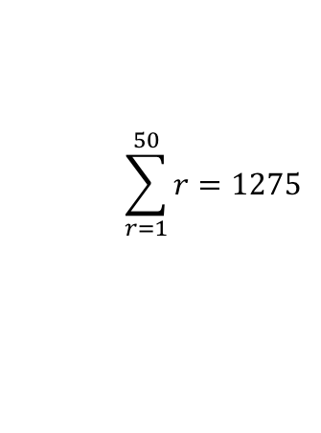
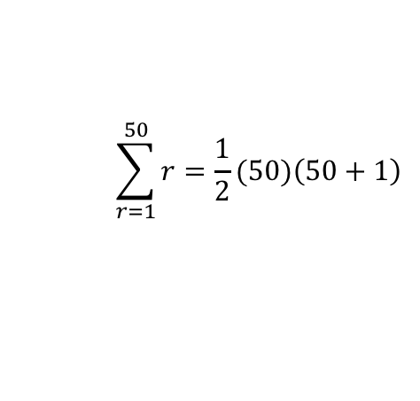
Series
$$\sum_{r=1}^{n}{1}=n$$
$$\sum_{r=1}^{n}{r}=\frac{1}{2}n(n+1)$$
$$\sum_{r=1}^{n}{r}=\frac{n(n+1)}{2}$$
You can use the sigma notation to write the sum of a series clearly and concisely
Calculate the sum of the series indicated below:
$$\sum_{r=1}^{n}{r}=\frac{1}{2}n\left(n+1\right)$$
We want the sum of the first 50 terms, so n = 50
$$\sum_{r=1}^{50}{r}=\frac{1}{2}(50)\left(50+1\right)$$
$$\sum_{r=1}^{50}{r}$$
Calculate
$$\sum_{r=1}^{50}{r}=1275$$
$$\frac{1}{2}n(n+1)$$
$$\frac{n(n+1)}{2}$$
It is fine (and sometimes easier) to use the formula in this form!
3A

Slide 7
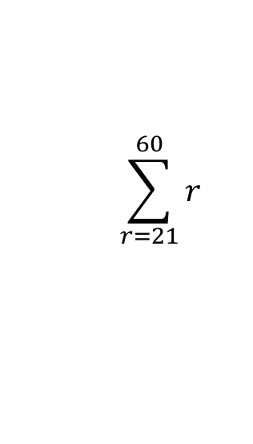
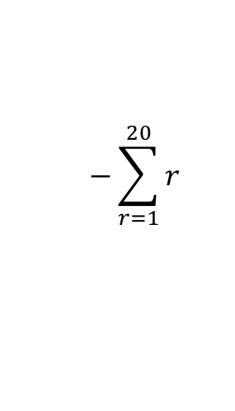
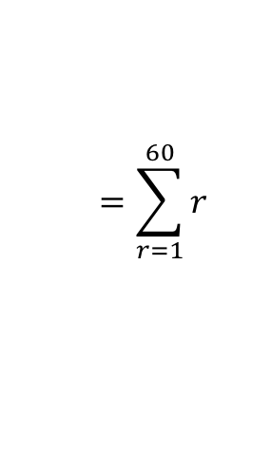
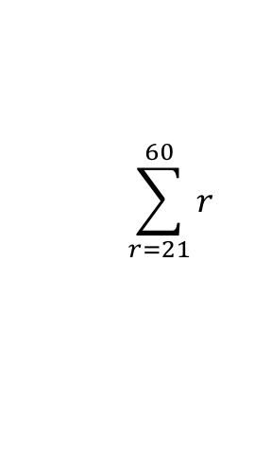
Series
$$\sum_{r=1}^{n}{1}=n$$
$$\sum_{r=1}^{n}{r}=\frac{1}{2}n(n+1)$$
$$\sum_{r=1}^{n}{r}=\frac{n(n+1)}{2}$$
The sum of the numbers from 21 to 60…
You can use the sigma notation to write the sum of a series clearly and concisely
Calculate the sum of the series indicated below:
0
10
20
30
40
50
60
-
$$\sum_{r=21}^{60}{r}$$
… Will be equal to the sum of the numbers from 1 to 60, subtract the numbers from 1 to 20…
The notation will look like this…
Notice the number here will always be one less than the one at the start!
$$\sum_{r=21}^{60}{r}$$
$$=\sum_{r=1}^{60}{r}$$
$$−\sum_{r=1}^{20}{r}$$
This is asking you to find the sum of the numbers from 21 to 60
Sum from 21 to 60
Sum from 1 to 60
Sum from 1 to 20
3A

Slide 8
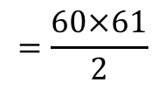
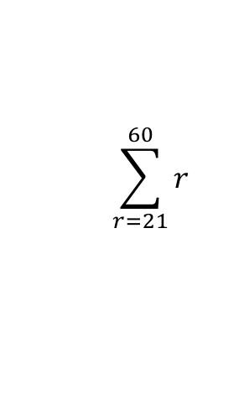
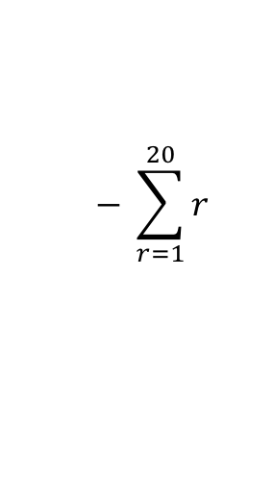
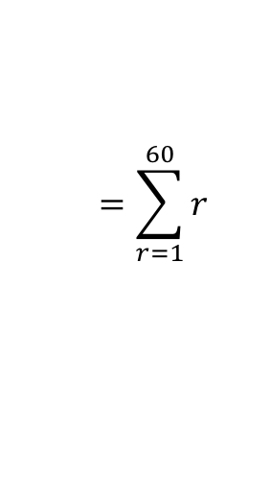

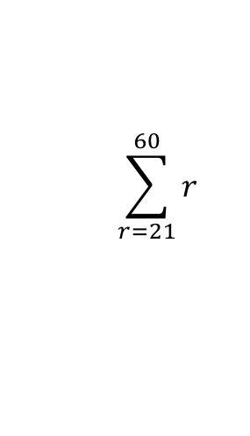
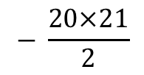
Series
$$\sum_{r=1}^{n}{1}=n$$
$$\sum_{r=1}^{n}{r}=\frac{1}{2}n(n+1)$$
$$\sum_{r=1}^{n}{r}=\frac{n(n+1)}{2}$$
You can use the sigma notation to write the sum of a series clearly and concisely
Calculate the sum of the series indicated below:
$$\sum_{r=21}^{60}{r}$$
$$=\sum_{r=1}^{60}{r}$$
$$− \sum_{r=1}^{20}{r}$$
Sub in values for each part
$$\sum_{r=21}^{60}{r}$$
$$\sum_{r=21}^{60}{r}$$
$$=\frac{60×61}{2}$$
$$− \frac{20×21}{2}$$
Calculate
$$=1620$$
This is asking you to find the sum of the numbers from 21 to 60
So the sum of the numbers from 21 to 60 is 1620!
3A

Slide 9
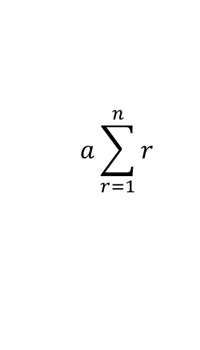
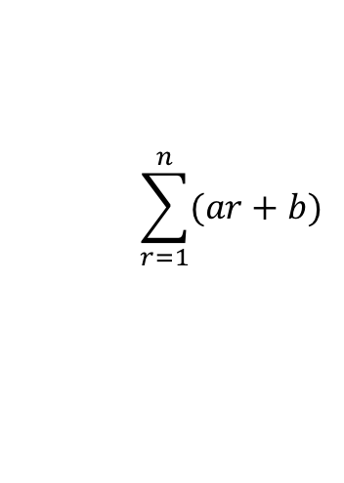
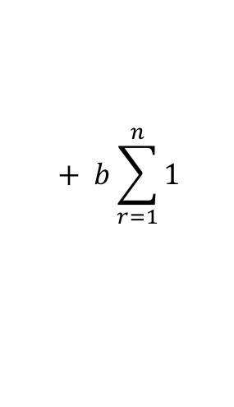
Series
$$\sum_{r=1}^{n}{1}=n$$
$$\sum_{r=1}^{n}{r}=\frac{1}{2}n(n+1)$$
$$\sum_{r=1}^{n}{r}=\frac{n(n+1)}{2}$$
You need to be able to split up parts of a sequence and sum them separately
You can split up series sums of the form:
into 2 separate ‘series sums’ as follows:
This allows you to then use the sum formulae for the sequence overall!
$$\sum_{r=1}^{n}{(ar+b)}$$
$$a\sum_{r=1}^{n}{r}$$
$$+ b\sum_{r=1}^{n}{1}$$
3A

Slide 10


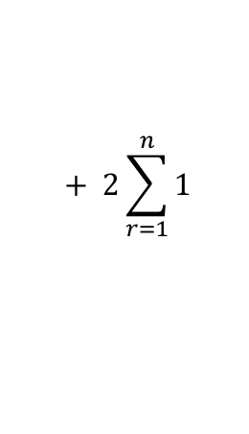
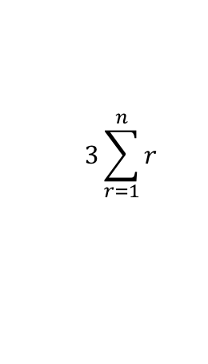


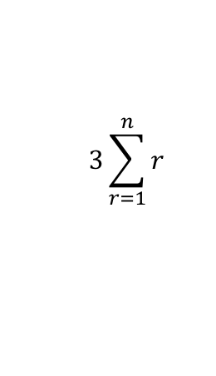
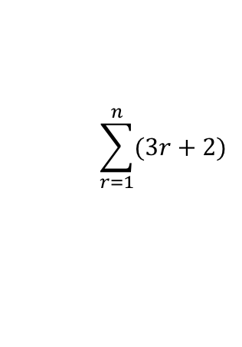



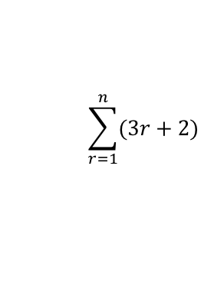


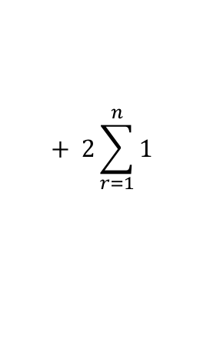


Series
$$\sum_{r=1}^{n}{1}=n$$
$$\sum_{r=1}^{n}{r}=\frac{1}{2}n(n+1)$$
$$\sum_{r=1}^{n}{r}=\frac{n(n+1)}{2}$$
You need to be able to split up parts of a sequence and sum them separately
Show that:
Can be written as:
$$\sum_{r=1}^{n}{(3r+2)}$$
If we wrote out the first few terms of this sequence…
$$\sum_{r=1}^{n}{(3r+2)}$$
$$=\left(3×1+2\right)$$
$$+ \left(3×2+2\right)$$
$$+ \left(3×3+2\right)$$
$$+ \left(3×4+2\right)………$$
This is equal to the sum of the multiplied terms, added to the sum of the 2s
$$=\left(3×1\right)$$
$$+ \left(3×2\right)$$
$$+ \left(3×3\right)$$
$$+ \left(3×4\right)$$
$$+ \left(2+2+2+2\right) ……$$
We can ‘factorise’ the 3 out of the multiplied terms and factorise a 2 from the added terms…
$$3\sum_{r=1}^{n}{r}$$
$$+ 2\sum_{r=1}^{n}{1}$$
$$=3×\left(1+2+3+4\right)………$$
$$+ 2\left(1+1+1+1\right)………$$
This is 3 multiplied by the sum of the first ‘n’ numbers represented by the formula ‘r’
This is 2 multiplied by ‘n’ 1s
$$3\sum_{r=1}^{n}{r}$$
$$+ 2\sum_{r=1}^{n}{1}$$
3A

Slide 11

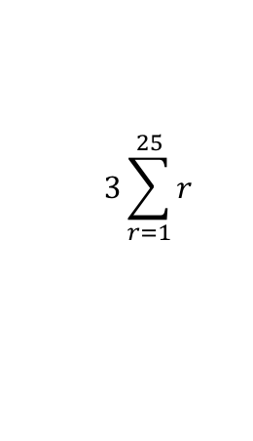

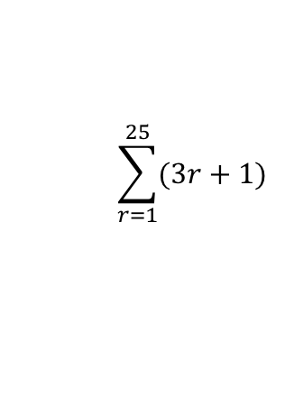


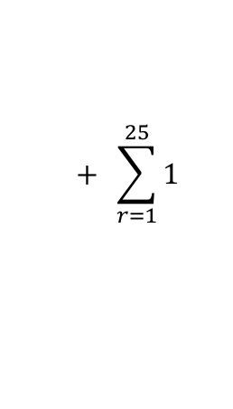

Series
$$\sum_{r=1}^{n}{1}=n$$
$$\sum_{r=1}^{n}{r}=\frac{1}{2}n(n+1)$$
$$\sum_{r=1}^{n}{r}=\frac{n(n+1)}{2}$$
$$\sum_{r=1}^{25}{(3r+1)}$$
You need to be able to split up parts of a sequence and sum them separately
Evaluate:
You need to split this up and sum the parts separately!
Split into two separate parts as you have seen
$$3\sum_{r=1}^{25}{r}$$
$$+ \sum_{r=1}^{25}{1}$$
$$\sum_{r=1}^{25}{(3r+1)}$$
Write the formulae for the sums. Remember the 3 at the start of the first one!
→ We will also have ‘n’ lots of 1
$$=\frac{3n(n+1)}{2}$$
$$+ n(1)$$
Sub in n = 25 (25 terms to add up)
$$=\frac{3(25)(25+1)}{2}$$
$$+ 25(1)$$
Calculate
$$=1000$$
So the first 25 terms of the sequence with the formula (3r + 1) will add up to 1000!
3A

Slide 12





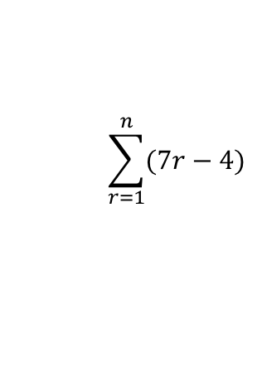
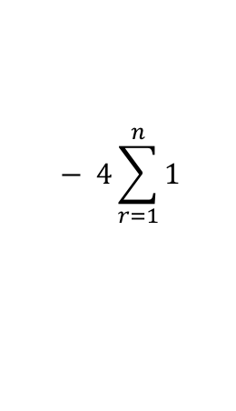

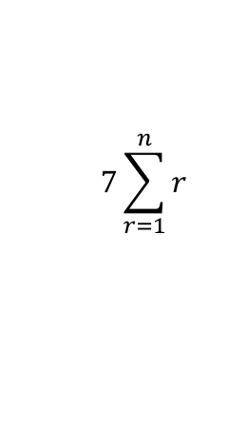

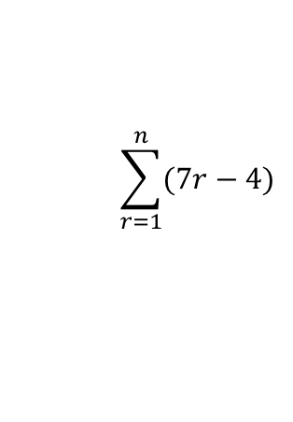


Series
$$\sum_{r=1}^{n}{1}=n$$
$$\sum_{r=1}^{n}{r}=\frac{1}{2}n(n+1)$$
$$\sum_{r=1}^{n}{r}=\frac{n(n+1)}{2}$$
$$\sum_{r=1}^{n}{(7r−4)}$$
You need to be able to split up parts of a sequence and sum them separately
Show that:
In this case you should proceed as normal, but use ‘n’ instead!
Split up as two separate sums
$$7\sum_{r=1}^{n}{r}$$
$$− 4\sum_{r=1}^{n}{1}$$
$$\sum_{r=1}^{n}{(7r−4)}$$
Remember the 7 on the first expression!
→ We also have n lots of 4
$$= \frac{n}{2}\left(7n−1\right)$$
$$=\frac{7n(n+1)}{2}$$
$$− 4n$$
Write ‘4n’ as fraction over 2 (for grouping)
$$=\frac{7n(n+1)}{2}$$
$$− \frac{8n}{2}$$
The sum of the first ‘n’ terms of this sequence
Is given by this formula, where ‘n’ is the number of terms
$$=\frac{7n\left(n+1\right)−8n}{2}$$
Group terms
Expand the bracket
$$=\frac{7n^{2}+7n−8n}{2}$$
$$=\frac{7n^{2}−n}{2}$$
Group terms
The two expressions are equivalent!
Factorise
$$=\frac{n(7n−1)}{2}$$
3A

Slide 13


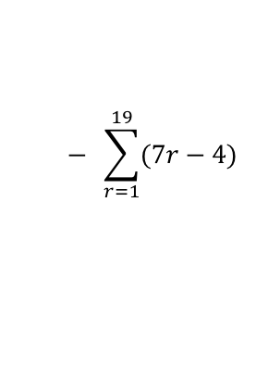

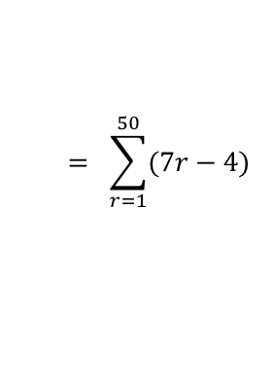

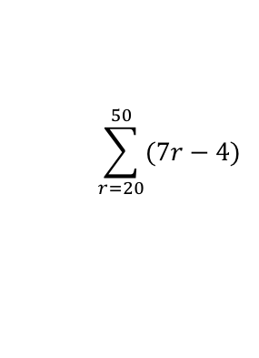

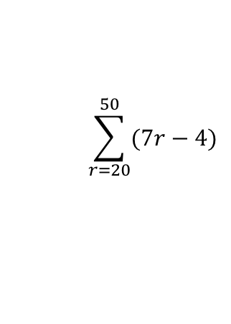


Series
$$\sum_{r=1}^{n}{1}=n$$
$$\sum_{r=1}^{n}{r}=\frac{1}{2}n(n+1)$$
$$\sum_{r=1}^{n}{r}=\frac{n(n+1)}{2}$$
Write as one sum subtract another
You need to be able to split up parts of a sequence and sum them separately
Show that:
Hence, calculate the value of:
Here, you can use the formula you’re given – remember that this will be the sum of the first 50 terms subtract the sum of the first 19!
$$\sum_{r=20}^{50}{(7r−4)}$$
$$= \sum_{r=1}^{50}{(7r−4)}$$
$$− \sum_{r=1}^{19}{(7r−4)}$$
Write the formula separately for each sum
$$=\frac{n(7n−1)}{2}$$
$$− \frac{n(7n−1)}{2}$$
Sub 50 into the first and 19 into the second
$$\sum_{r=1}^{n}{(7r−4)}$$
$$= \frac{n}{2}\left(7n−1\right)$$
$$=\frac{50(7(50)−1)}{2}$$
$$− \frac{19(7(19)−1)}{2}$$
Calculate each
$$=8725$$
$$− 1254$$
$$\sum_{r=20}^{50}{(7r−4)}$$
Calculate
$$=7471$$
3A

Slide 14
Exercise 3A
Pearson Further Core Mathematics Year 1/AS
Complete before the lesson Q1-3
In Class:
Green Q4-7
Amber Q8-11
Red Q12-14 & challenge

