Slide 1
Year 1 Pure Mathematics
Differentiation
Gradient Functions
Chapter 12
(Part 5 of 6)

Slide 2



Gradient Functions
$$y$$
$$y=f\left(x\right)$$
$$x$$
4
For what values of x is f(x) increasing?
x > 4

Slide 3

Gradient Functions
$$y$$
$$y=f\left(x\right)$$
$$x$$
4
For what values of x is f(x) decreasing?
x < 4

Slide 4


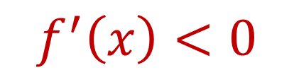

Gradient Functions
$$y$$
$$y=f\left(x\right)$$
$$x$$
For what values of x is f(x) decreasing?
$$f^{′}\left(x\right)<0$$
Gradient is negative when decreasing.
Now solve

Slide 5
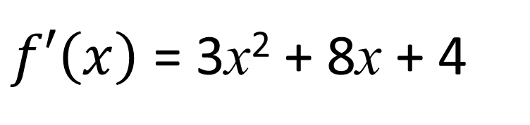
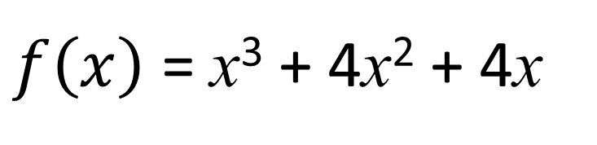
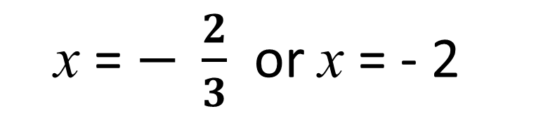
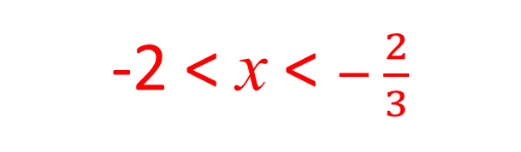
Gradient Functions
$f\left(x\right)$ = x³ + 4x² + 4x
For what values of x is f(x) decreasing?
$f′\left(x\right)$ = 3x² + 8x + 4
3x² + 8x + 4 = 0
x = $− \frac{2}{3}$ or x = - 2
3x² + 8x + 4 < 0
-2 < x < $− \frac{2}{3}$

Slide 6
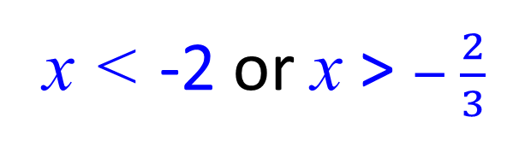
Gradient Functions
$f\left(x\right)$ = x³ + 4x² + 4x
For what values of x is f(x) increasing?
$f′\left(x\right)$ = 3x² + 8x + 4
3x² + 8x + 4 = 0
x = $− \frac{2}{3}$ or x = - 2
3x² + 8x + 4 > 0
x < -2 or x > $− \frac{2}{3}$

Slide 7


Gradient Functions
gradient
$$f′\left(x\right)$$
$$x$$
3
5
When is the gradient decreasing?
3 < x < 5
When is the gradient increasing?
x < 3 or x > 5

Slide 8
Exercise 12G
Pearson Pure Mathematics Year 1/AS
Page 271
Complete before the lesson Q1
Green Q2
Amber Q3
Red

Slide 9

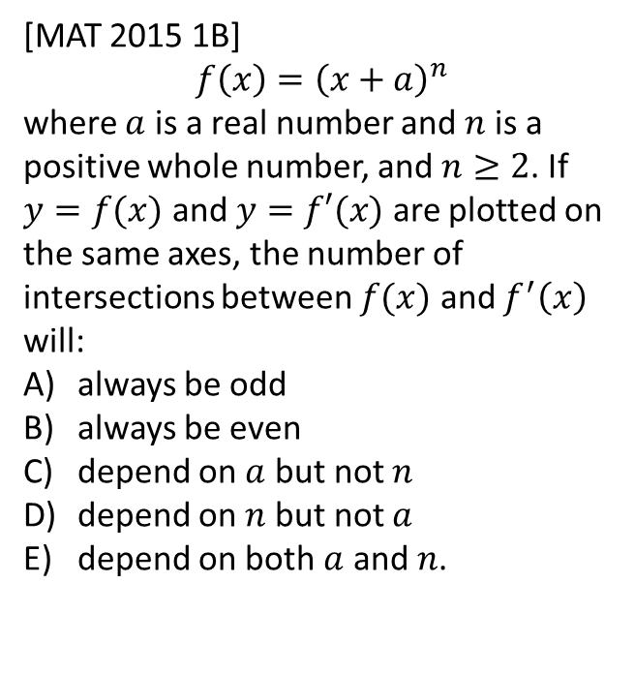
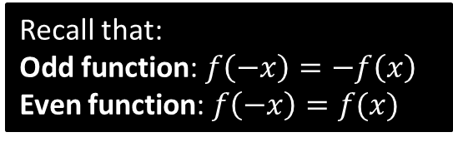
Exercise 12J
Complete before the lesson Q1
Green Q2
Amber Q3
Red
Pearson Pure Mathematics
Page 278
Extension
?
(Official solution)
If $f(x)$ is an even function then $f^{′}\left(x\right)$ will be an odd function, and vice versa. $f(x)$ and $f^{′}\left(x\right)$ will cross the $x$-axis at $\left(−a,0\right)$ and will have one further intersection when $y$ and $x$ are greater than 0.
The answer is (b).
1
[MAT 2015 1B]
$$f\left(x\right)={\left(x+a\right)}^{n}$$
where $a$ is a real number and $n$ is a positive whole number, and $n≥2$. If $y=f(x)$ and $y=f′(x)$ are plotted on the same axes, the number of intersections between $f(x)$ and $f^{′}\left(x\right)$ will:
always be odd
always be even
depend on $a$ but not $n$
depend on $n$ but not $a$
depend on both $a$ and $n$.
Recall that:
Odd function: $f\left(−x\right)=−f\left(x\right)$
Even function: $f\left(−x\right)=f(x)$

