Slide 1
Year 2 Pure Mathematics
Sequences and Series
- Sigma Notation
Chapter 3
(Part 6 of 7)

Slide 2
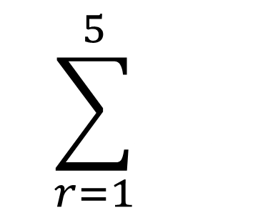
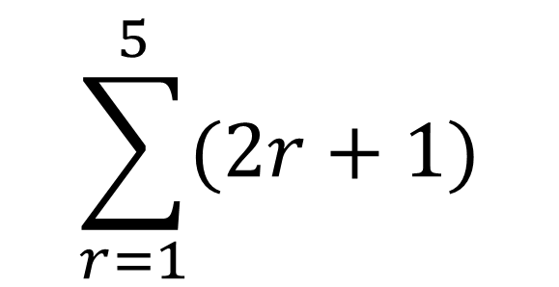
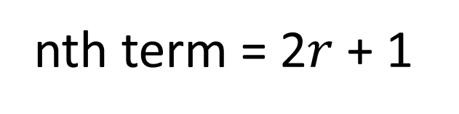
Sum of the Series - Sigma Notation
∑
The Greek letter, sigma,
means ‘sum’.
Sum of terms 1 to 5
$$\sum_{r=1}^{5}{(2r+1)}$$
nth term = 2$r$ + 1

Slide 3
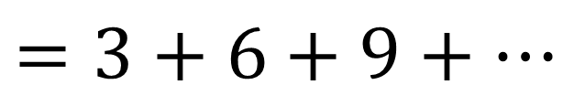
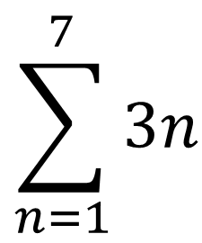
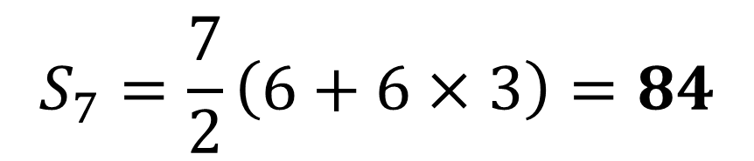
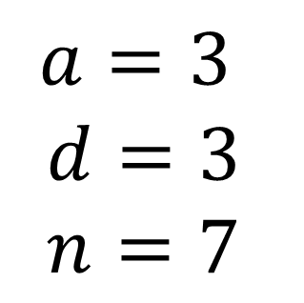
Sum of the Series - Sigma Notation
$$\sum_{n=1}^{7}{3n}$$
$$=3+6+9+…$$
$$a=3$$
$$d=3$$
$$n=7$$
$$S_{7}=\frac{7}{2}\left(6+6×3\right)=84$$

Slide 4

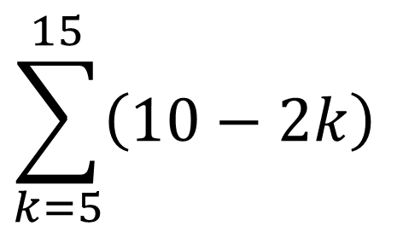
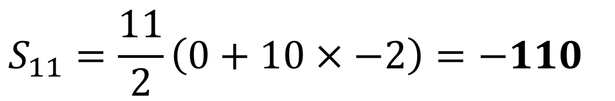
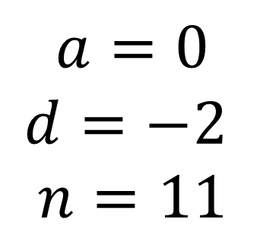
Sum of the Series - Sigma Notation
$$\sum_{k=5}^{15}{\left(10−2k\right)}$$
$$=0+\left(−2\right)+\left(−4\right)+…$$
$$a=0$$
$$d=−2$$
$$n=11$$
not 10
$$S_{11}=\frac{11}{2}\left(0+10×−2\right)=−110$$

Slide 5

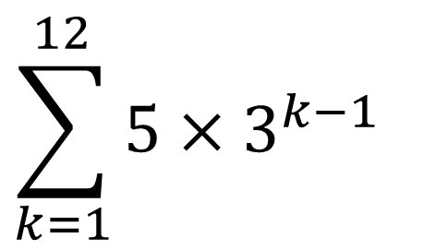
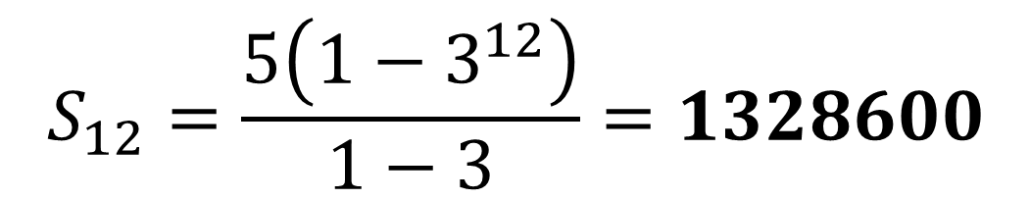
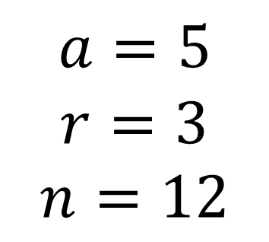
Sum of the Series - Sigma Notation
$$\sum_{k=1}^{12}{5×3^{k−1}}$$
$$=5+15+45+…$$
$$a=5$$
$$r=3$$
$$n=12$$
not 11
$$S_{12}=\frac{5\left(1−3^{12}\right)}{1−3}=1328600$$

Slide 6
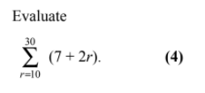
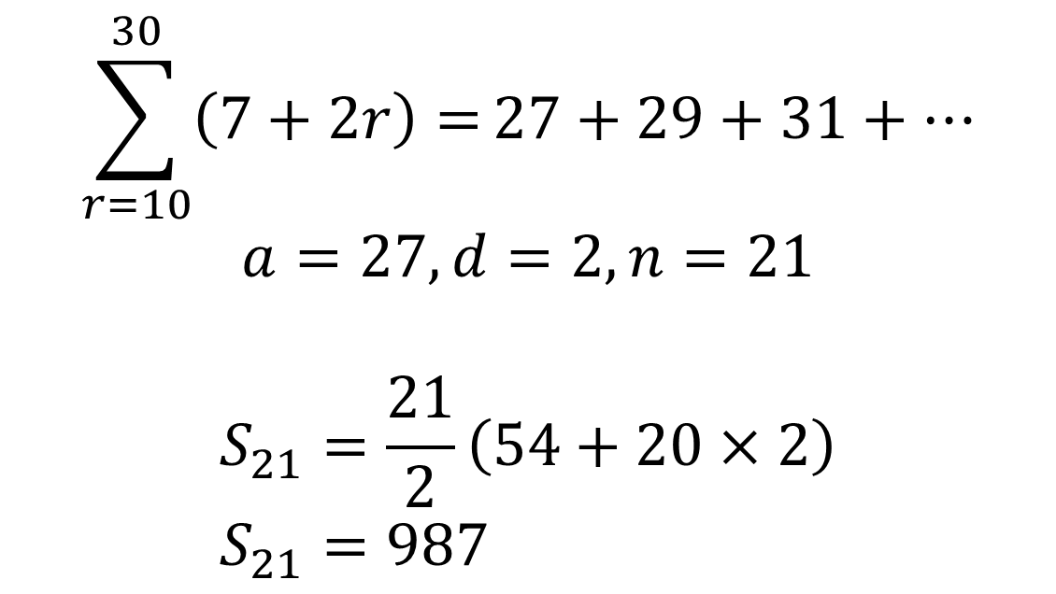
Sum of the Series - Sigma Notation
$$\sum_{r=10}^{30}{\left(7+2r\right)=}27+29+31+…$$
$$a=27, d=2, n=21$$
$$S_{21}=\frac{21}{2}\left(54+20×2\right) \\ S_{21}=987$$

Slide 7
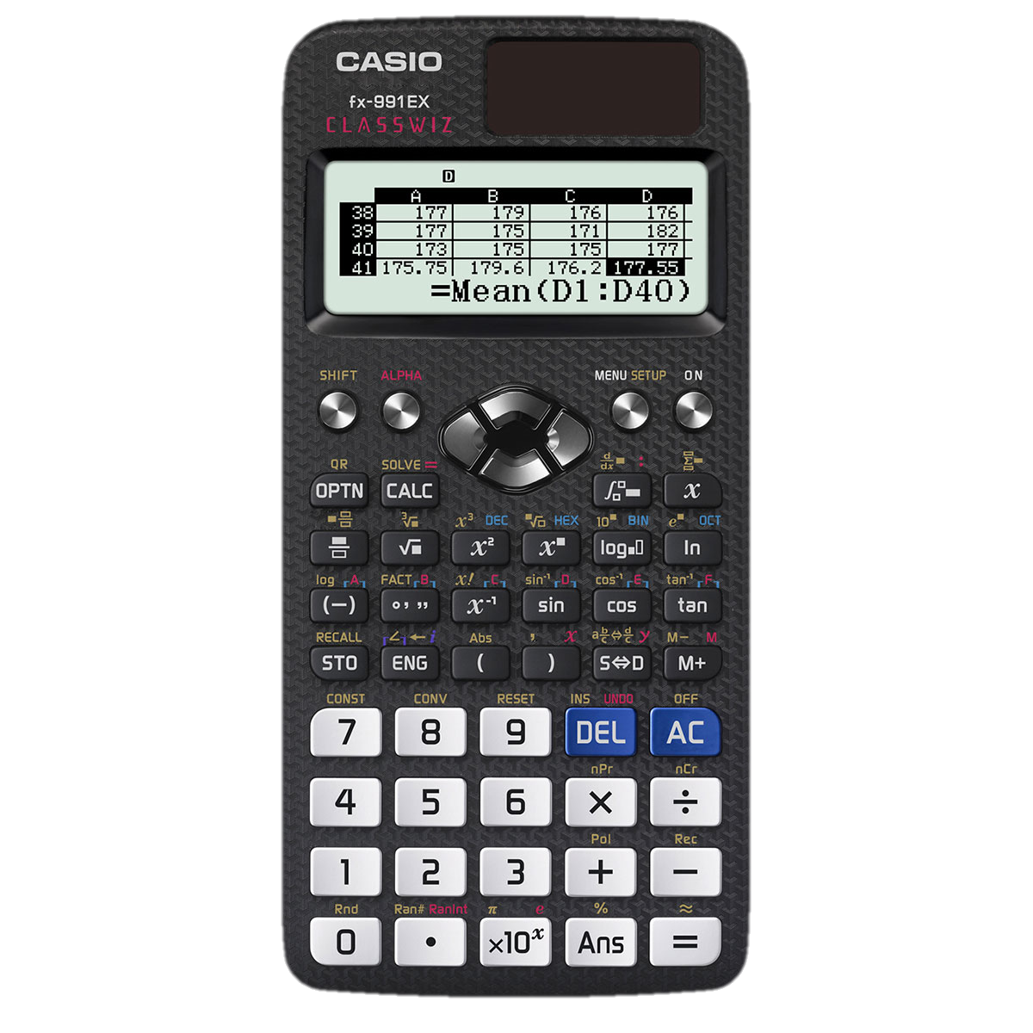
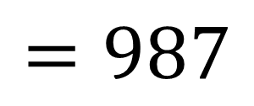
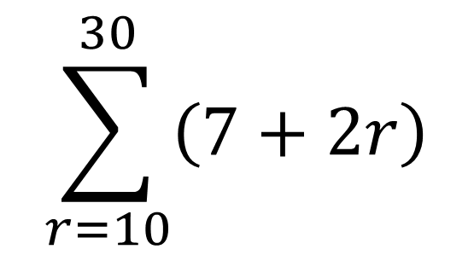
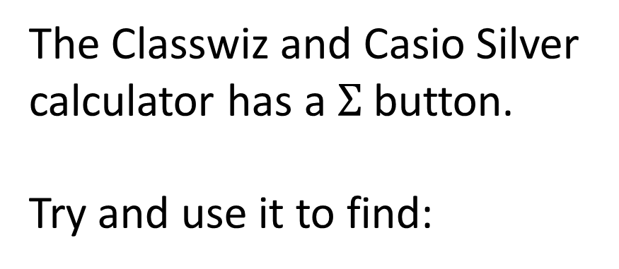
Sum of the Series - Calculator
The Classwiz and Casio Silver calculator has a $Σ$ button.
Try and use it to find:
$$\sum_{r=10}^{30}{\left(7+2r\right)}$$
$$=987$$

Slide 8
Exercise 3F
Pearson Pure Mathematics Year 2/AS
Pages 77-78
Complete before the lesson Q1-4
In Class:
Green Q5-7
Amber Q8-9
Red Q10-12 & Challenge

