Slide 1
Year 2 Pure Mathematics
Differentiation
- Second Derivative
Chapter 9
(Part 9 of 10)

Slide 2
Second derivative
Convex
(negative to positive gradient)
Concave
(positive to negative gradient)
-ve
+ve
+ve
-ve
Point of Inflection
(gradient is 0)

Slide 3
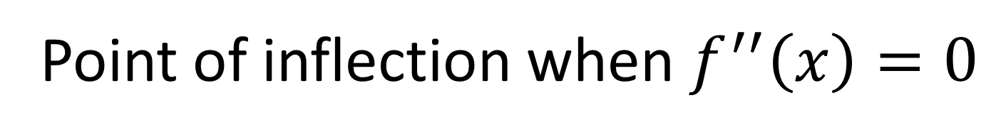
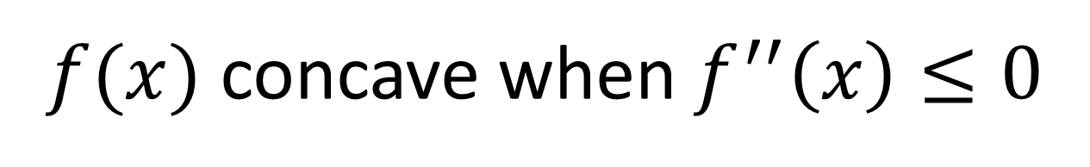
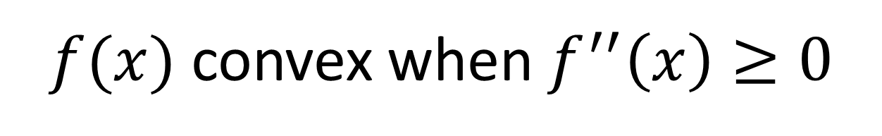
Second derivative
$f(x)$ concave when $f^{′′}\left(x\right)≤0$
$f(x)$ convex when $f^{′′}\left(x\right)≥0$
Point of inflection when $f^{′′}\left(x\right)=0$

Slide 4
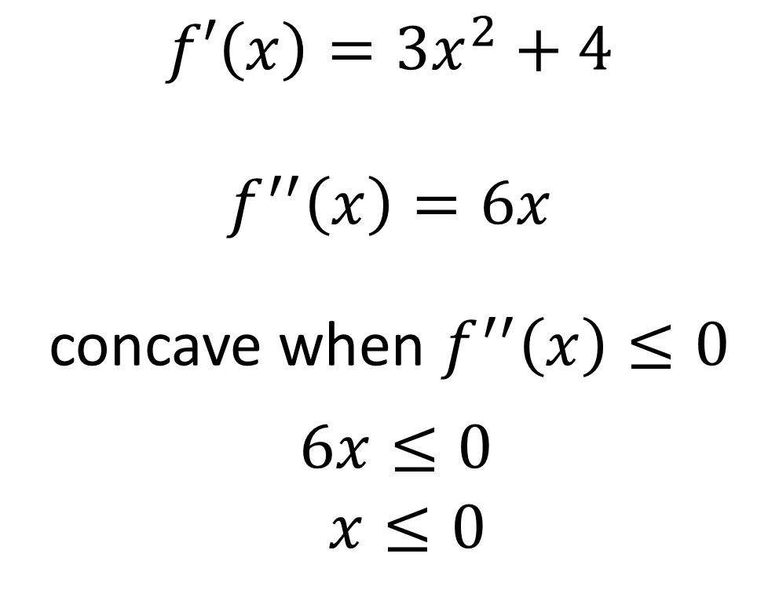

Second derivative – Example A
Find the interval on which the function
$f\left(x\right)=x^{3}+4x+3$ is concave.
$$f′\left(x\right)=3x^{2}+4$$
$$f^{′′}\left(x\right)=6x$$
concave when $f^{′′}\left(x\right)≤0$
$6x≤0$
$$6x≤0$$

Slide 5


Second derivative – Set Notation
Inequality
$$6x≤0$$
Set Notation
( - , 0]

Slide 6
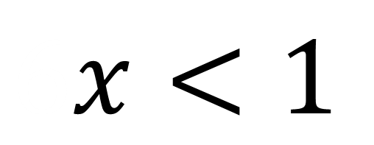
Second derivative – Set Notation
Inequality
$$6x<1$$
Set Notation
( 1 , )

Slide 7
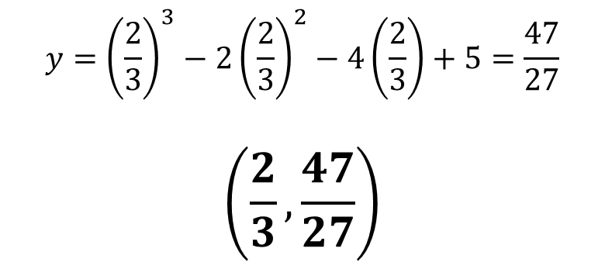
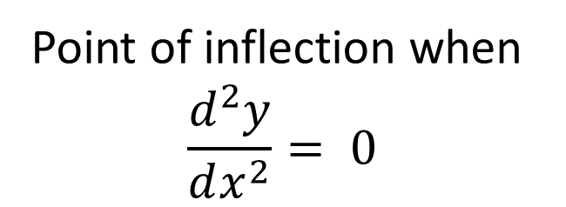
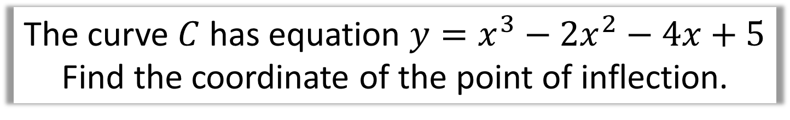

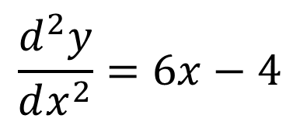
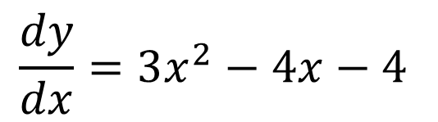
Second derivative – Example B
The curve $C$ has equation $y=x^{3}−2x^{2}−4x+5$
Find the coordinate of the point of inflection.
$$\frac{dy}{dx}=3x^{2}−4x−4$$
Hence,
$$6x−4=0$$
$$x=\frac{2}{3}$$
$$\frac{d^{2}y}{dx^{2}}=6x−4$$
$$y={\left(\frac{2}{3}\right)}^{3}−2{\left(\frac{2}{3}\right)}^{2}−4\left(\frac{2}{3}\right)+5=\frac{47}{27}$$
$$\left(\frac{2}{3},\frac{47}{27}\right)$$
Point of inflection when
$$\frac{d^{2}y}{dx^{2}}= 0$$

Slide 8
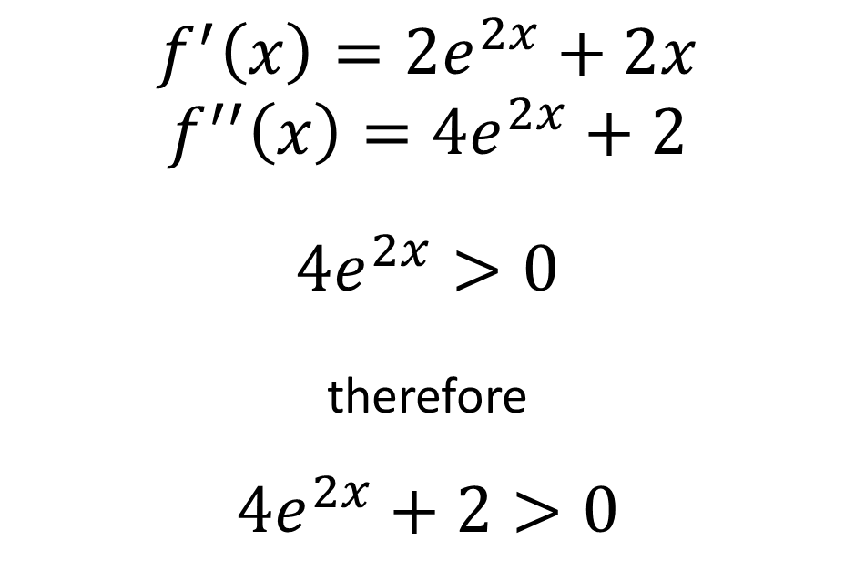


Second derivative – Example C
Show that $f\left(x\right)=e^{2x}+x^{2}$ is convex
for all real values of $x$.
$$f^{′}\left(x\right)=2e^{2x}+2x$$
$$f^{′′}\left(x\right)=4e^{2x}+2$$
$${4e}^{2x}>0$$
therefore
$$4e^{2x}+2>0$$
Hence $f(x)$ convex as $f^{′′}\left(x\right)≥0$

Slide 9
Exercise 9I
Pearson Pure Mathematics Year 2/AS
Pages 259-261
Complete before the lesson Q1-3
In Class:
Green Q4-5
Amber Q6-8
Red Q9-11 & Challenge

