Slide 1
Year 2 Pure Mathematics
Parametric Equations
- Introduction
Chapter 8
(Part 1 of 3)

Slide 2
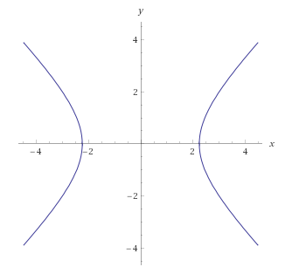
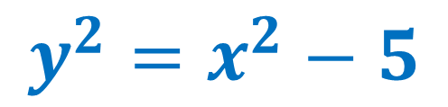
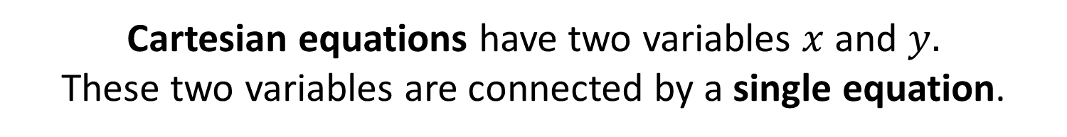
Cartesian Equations
Cartesian equations have two variables $x$ and $y.$
These two variables are connected by a single equation.
$$y^{2}=x^{2}−5$$

Slide 3
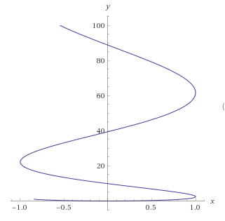
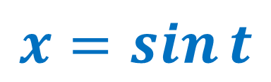
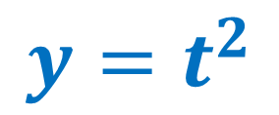
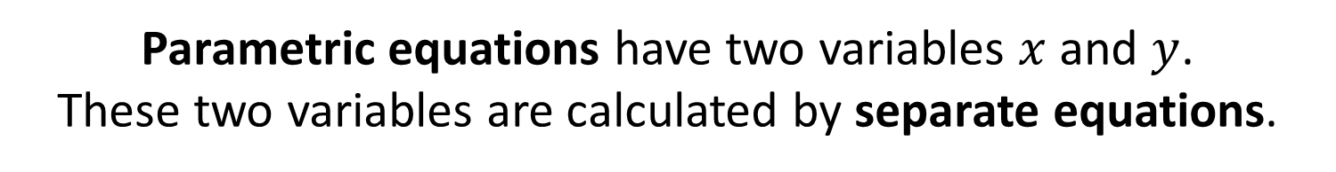
Parametric Equations
Parametric equations have two variables $x$ and $y$.
These two variables are calculated by separate equations.
$$x=\sin{t}$$
$$y=t^{2}$$

Slide 4
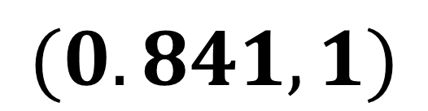
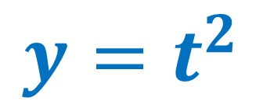
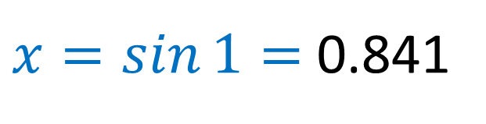

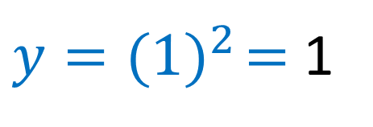


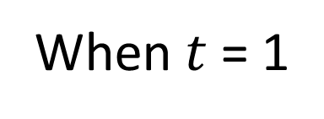
Parametric Equations
To get a co-ordinate you need to know $t$.
$$y=t^{2}$$
$y={(1)}^{2}$ $=$ 1
$$x=\sin{t}$$
$x=\sin{1}=$ 0.841
When $t$ = 1
$$(0.841,1)$$
$t$ = 1

Slide 5
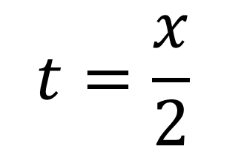
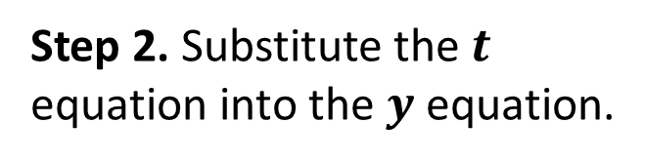
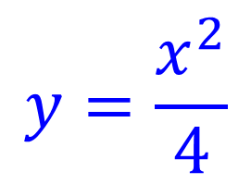
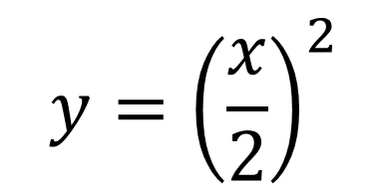
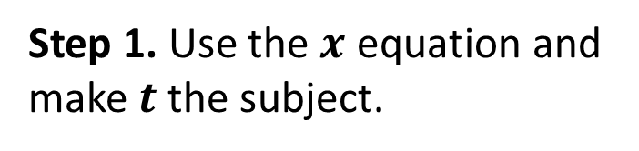
Converting Parametric to Cartesian
Convert Parametric equations into a Cartesian equation.
$$x=2t y=t^{2}$$
$$t=\frac{x}{2}$$
Step 1. Use the $x$ equation and
make $t$ the subject.
$$y={\left(\frac{x}{2}\right)}^{2}$$
Step 2. Substitute the $t$ equation into the $y$ equation.
$$y=\frac{x^{2}}{4}$$

Slide 6
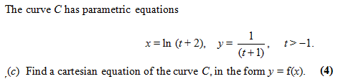
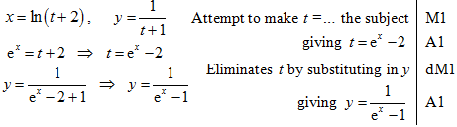
Parametric Equations – Exam Questions

Slide 7
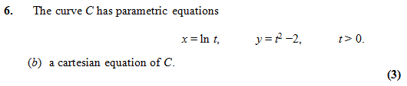
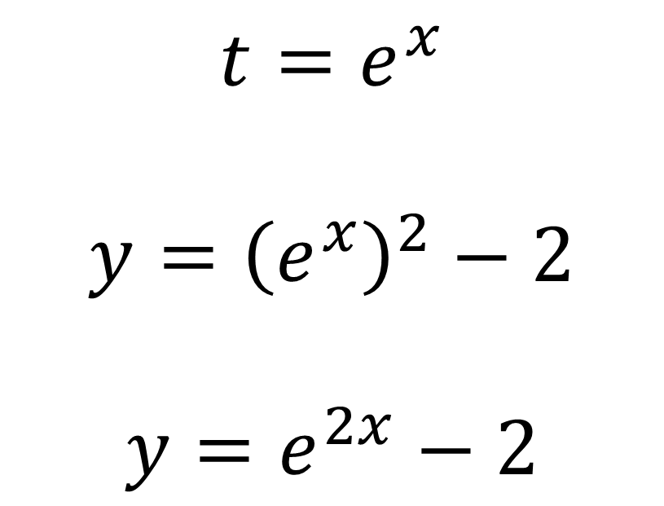
Parametric Equations – Exam Questions
$$t=e^{x}$$
$$y={\left(e^{x}\right)}^{2}−2$$
$$y=e^{2x}−2$$

Slide 8

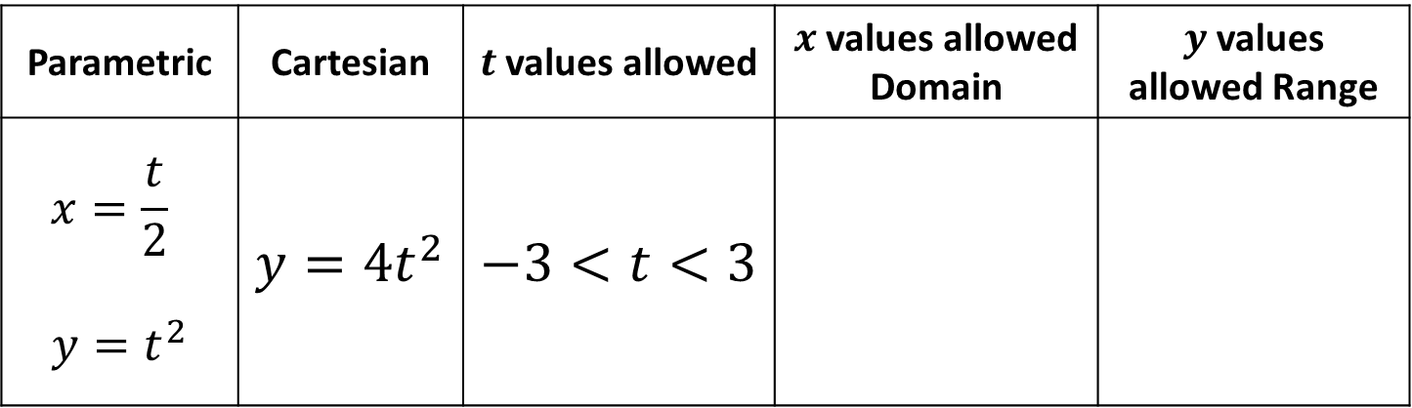


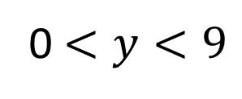
Parametric Equations – Domain and Range
Parametric | Cartesian | $t$ values allowed | $x$ values allowed Domain | $y$ values allowed Range
$$x=\frac{t}{2}$$ $$y=t^{2}$$ | $$y={4t}^{2}$$ | $$−3<t<3$$
$$\frac{−3}{2}<x<\frac{3}{2}$$
0 $<y<9$
$$y$$
Range
$$x$$
Domain

Slide 9

Test Your Understanding
Edexcel C4 Jan 2008 Q7
?
Edexcel C4 Jan 2011
?
$$t=e^{x} \\ y={\left(e^{x}\right)}^{2}−2 \\ =e^{2x}−2$$

Slide 10
Exercise 8A
Pearson Pure Mathematics Year 2/AS
Pages 200-202
Complete before the lesson Q1-2
In Class:
Green Q4
Amber Q3&5
Red Q6-9 & Challenge

