Slide 1
Year 2 Pure Mathematics
Vectors
- Angle with axis
Chapter 12
(Part 4 of 6)

Slide 2
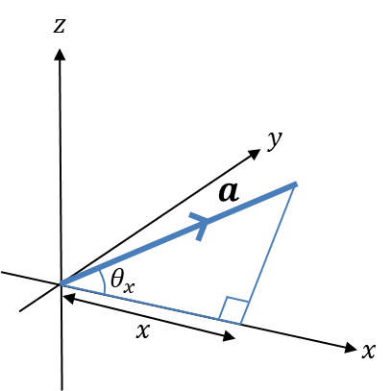
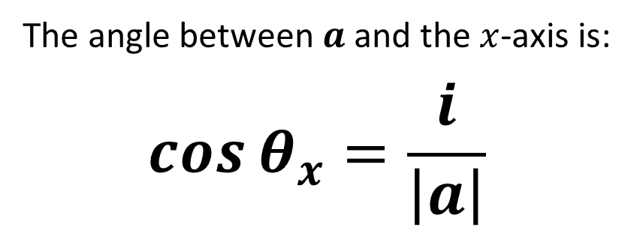
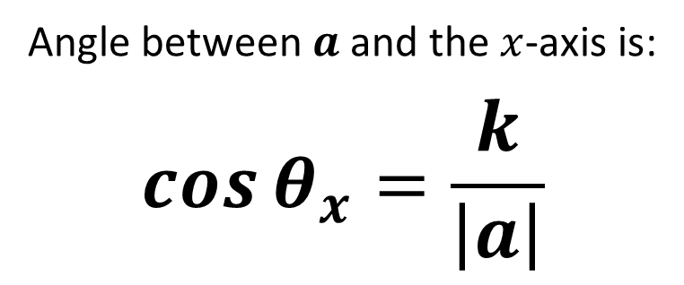
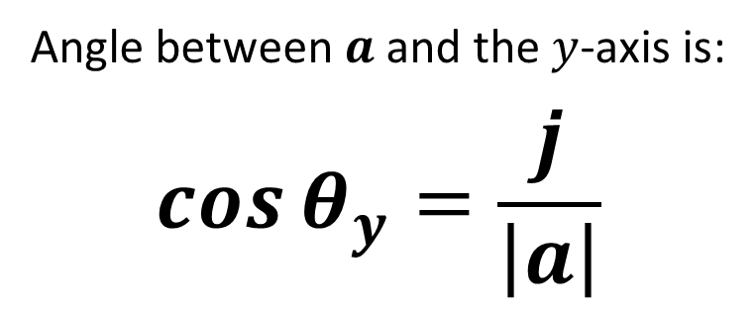
Vectors - Angles between vectors and an axis
The angle between $a$ and the $x$-axis is:
$$\cos{θ_{x}}=\frac{i}{\left|a\right|}$$
Angle between $a$ and the $y$-axis is:
$$\cos{θ_{y}}=\frac{j}{\left|a\right|}$$
Angle between $a$ and the $x$-axis is:
$$\cos{θ_{x}}=\frac{k}{\left|a\right|}$$

Slide 3
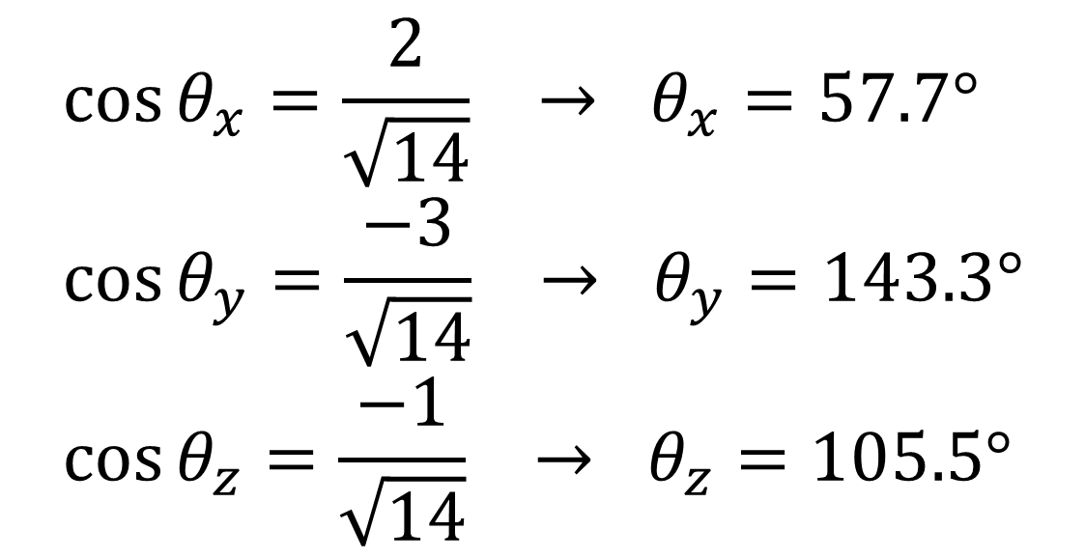

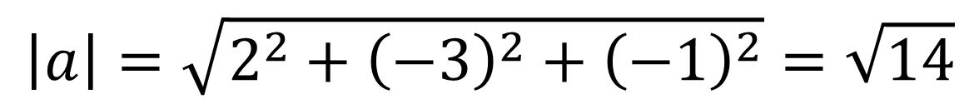
Vectors - Angles between vectors and an axis
Find the angles that the vector $a=2i−3j−k$
makes with each of the positive coordinate axis.
$$\left|a\right|=\sqrt{2^{2}+{\left(−3\right)}^{2}+{\left(−1\right)}^{2}}=\sqrt{14}$$
$$\cos{θ_{x}}=\frac{2}{\sqrt{14}} → θ_{x}=57.7° \\ \cos{θ_{y}}=\frac{−3}{\sqrt{14}} → θ_{y}=143.3° \\ \cos{θ_{z}}=\frac{−1}{\sqrt{14}} → θ_{z}=105.5°$$

Slide 4
Exercise 12B
Pearson Pure Mathematics Year 2/AS
Pages 341-343
In Class:
Green Q7-9
Red Q13-17 Challenge

