Slide 1



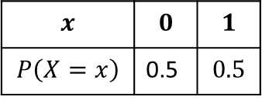

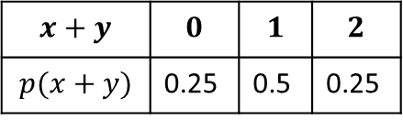
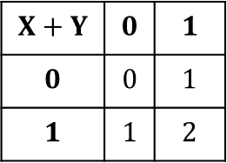
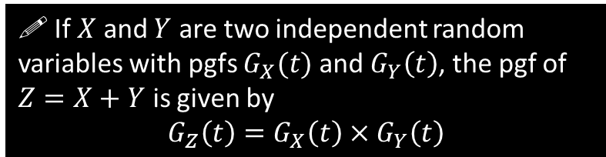
Sum of Independent Random Variables
At the start of this chapter we previewed a very remarkable (and very useful!) property of probability generating functions: that the product of these functions gives a new function which represents the sum of the two original distributions:
$$x$$ | $$0$$ | $$1$$
$$P\left(X=x\right)$$ | 0.5 | $$0.5$$
$$X+Y$$ | $$0$$ | $$1$$
$$0$$ | $$0$$ | $$1$$
$$1$$ | $$1$$ | $$2$$
$$x+y$$ | $$0$$ | $$1$$ | $$2$$
$$p(x+y)$$ | 0.25 | 0.5 | 0.25
Working out using GCSE method
?
?
$$X$$
$$+$$
$$Y$$
0
1
0
1
Convert back to distribution
Using probability generating functions
?
$$G_{X}\left(t\right)=G_{Y}\left(t\right)=0.5+0.5t$$
$∴$ Product of two pgfs:
$$\left(0.5+0.5t\right)\left(0.5+0.5t\right) \\ =0.25+0.5t+0.25t^{2}$$
Two fair spinners.
?
! If $X$ and $Y$ are two independent random variables with pgfs $G_{X}(t)$ and $G_{Y}\left(t\right)$, the pgf of $Z=X+Y$ is given by
$$G_{Z}\left(t\right)=G_{X}\left(t\right)×G_{Y}\left(t\right)$$
We will not cover the proof.

Slide 2

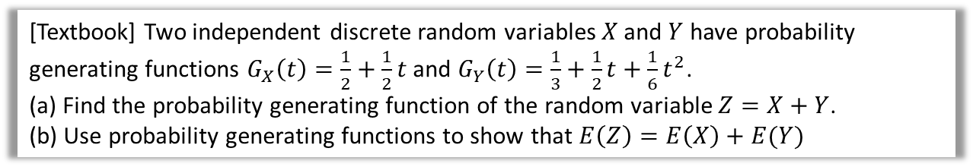

Examples
[Textbook] Two independent discrete random variables $X$ and $Y$ have probability generating functions $G_{X}\left(t\right)=\frac{1}{2}+\frac{1}{2}t$ and $G_{Y}\left(t\right)=\frac{1}{3}+\frac{1}{2}t+\frac{1}{6}t^{2}$.
(a) Find the probability generating function of the random variable $Z=X+Y$.
(b) Use probability generating functions to show that $E\left(Z\right)=E\left(X\right)+E(Y)$
a
?
$$G_{Z}\left(t\right)=G_{X}\left(t\right)×G_{Y}\left(t\right) \\ =\left(\frac{1}{2}+\frac{1}{2}t\right)\left(\frac{1}{3}+\frac{1}{2}t+\frac{1}{6}t^{2}\right) \\ =\frac{1}{6}+\frac{5}{12}t+\frac{1}{3}t^{2}+\frac{1}{12}t^{3}$$
b
Recall that $G_{X}^{′}\left(1\right)=E(X)$
$$G_{X}^{′}\left(t\right)=\frac{1}{2} → G_{X}^{′}\left(1\right)=\frac{1}{2} \\ G_{Y}^{′}\left(t\right)=\frac{1}{2}+\frac{1}{3}t → G_{Y}^{′}\left(1\right)=\frac{5}{6} \\ G_{Z}^{′}\left(t\right)=\frac{5}{12}+\frac{2}{3}t+\frac{1}{4}t^{2} → G_{Z}^{′}\left(1\right)=\frac{4}{3}$$
$\frac{1}{2}+\frac{5}{6}=\frac{4}{3}$ $∴E\left(Z\right)=E\left(X\right)+E(Y)$
?

Slide 3
Exercise 7D
Pearson Further Statistics 1
Pages 141-142
Complete before the lesson Q1
In Class:
Green Q2
Amber Q3
Red Q4-5 & Challenge

