Slide 1
Year 1 Pure Mathematics
Sketching Graphs
- Points of Intersection
Chapter 4
(Part 4 of 4)

Slide 2

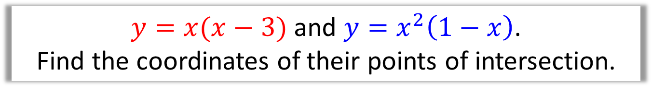


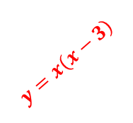





Points of Intersection
If $y=f(x)$ and $y=g(x)$
then the points of intersection can be found
using $f\left(x\right)=g(x)$
$y=x(x−3)$ and $y=x^{2}\left(1−x\right)$.
Find the coordinates of their points of intersection.
$$y$$
$$x\left(x−3\right)=x^{2}\left(1−x\right)$$
$$x^{2}−3x=x^{2}−x^{3} \\ x^{3}−3x=0 \\ x\left(x^{2}−3\right)=0$$
$$y=x^{2}\left(1−x\right)$$
$$y=x\left(x−3\right)$$
$$x$$
$$x=0$$
$x=−\sqrt{3}$
$$x=+\sqrt{3}$$
1
3
Substituting x back into either equation, to find y
$$\left(−\sqrt{3}, 3+3\sqrt{3}\right), \left(0,0\right), \left(\sqrt{3}, 3−3\sqrt{3}\right)$$

Slide 3

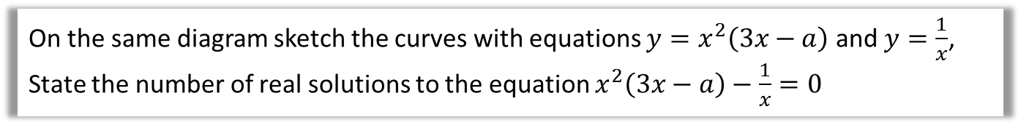
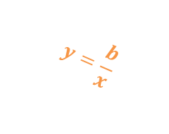
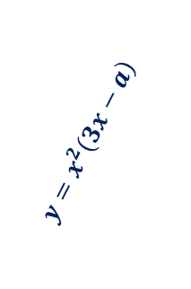

Points of Intersection
On the same diagram sketch the curves with equations $y=x^{2}\left(3x−a\right)$ and $y=\frac{1}{x}$, State the number of real solutions to the equation $x^{2}\left(3x−a\right)−\frac{1}{x}=0$
$$y$$
$$y=x^{2}\left(3x−a\right)$$
$$y=\frac{b}{x}$$
$$x$$
There are 2 points of intersection,
thus 2 solutions to this equation.

Slide 4
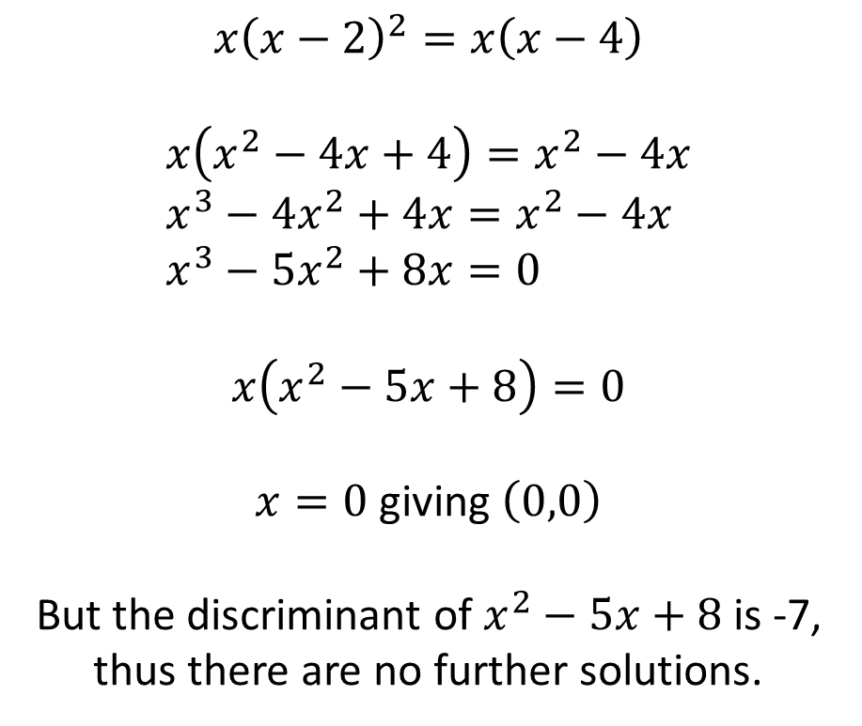
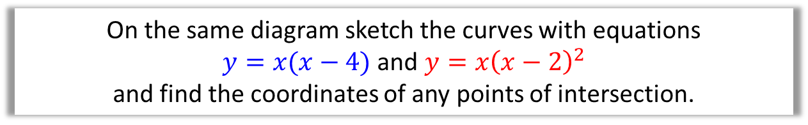



Points of Intersection
On the same diagram sketch the curves with equations
$y=x(x−4)$ and $y=x{\left(x−2\right)}^{2}$
and find the coordinates of any points of intersection.
$$y$$
$$x{\left(x−2\right)}^{2}=x\left(x−4\right)$$
$$x\left(x^{2}−4x+4\right)=x^{2}−4x \\ x^{3}−4x^{2}+4x=x^{2}−4x \\ x^{3}−5x^{2}+8x=0$$
$$x\left(x^{2}−5x+8\right)=0$$
$x=0$ giving $\left(0,0\right)$
But the discriminant of $x^{2}−5x+8$ is -7,
thus there are no further solutions.
$$y=x{\left(x−2\right)}^{2}$$
2
4
$$x$$
$$y=x\left(x−4\right)$$

Slide 5
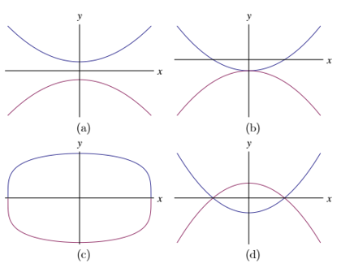


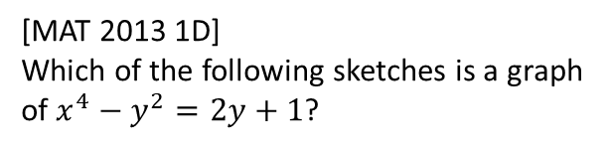
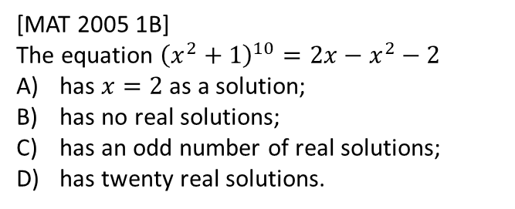
Exercise 4D
Pearson Pure Mathematics Year 1/AS, Pages 69-71
2
[MAT 2010 1A] The values of $k$ for which the line $y=kx$ intersects the parabola $y={\left(x−1\right)}^{2}$ are precisely
$k≤0$ B) $k≥−4$
C) $k≥0$ or $k≤−4$ D) $−4≤k≤0$
Equating:
$${\left(x−1\right)}^{2}=kx \\ x^{2}−2x+1=kx \\ x^{2}+\left(−2−k\right)x+1=0$$
Discriminant:
$$a=1, b=−2−k, c=1 → k^{2}+4k+4−4≥0 \\ k\left(k+4\right)≥0 \\ k≤−4 or k≥0$$
Extension
?
1
[MAT 2005 1B]
The equation ${\left(x^{2}+1\right)}^{10}=2x−x^{2}−2$
has $x=2$ as a solution;
has no real solutions;
has an odd number of real solutions;
has twenty real solutions.
3
[MAT 2013 1D]
Which of the following sketches is a graph of $x^{4}−y^{2}=2y+1$?
Complete before the lesson
Q1
Green Q2-4
Amber Q5-8
Red Q9-10 & Ext
?
$$x^{4}=y^{2}+2y+1={\left(y+1\right)}^{2} \\ ∴x^{2}=±(y+1)$$
i.e. $y=x^{2}−1$
$$or y=−x^{2}−1$$
Answer is (b).

