Slide 1
Hyperbolic
Functions
Twitter: @Owen134866
www.mathsfreeresourcelibrary.com

Slide 2
Teachings for
Exercise 6C

Slide 3





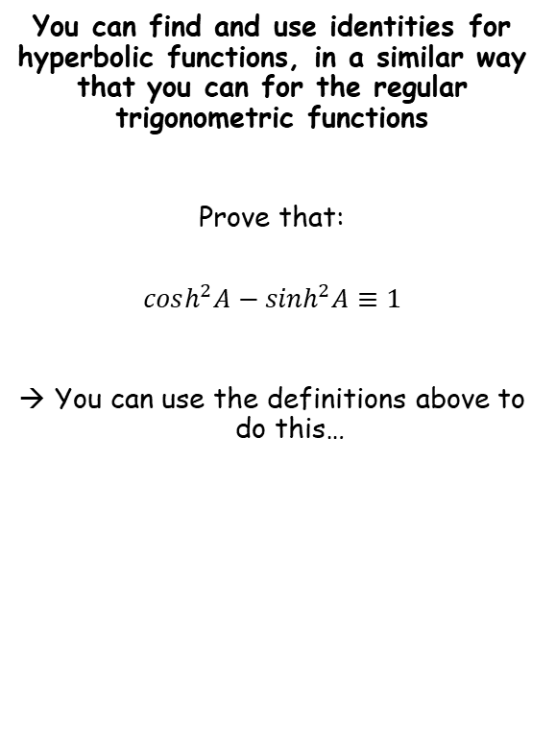







Hyperbolic Functions
$$sinhx=\frac{e^{x}−e^{−x}}{2}$$
$$arsinh x=ln\left(x+\sqrt{x^{2}+1}\right)$$
$$arcosh x=ln\left(x+\sqrt{x^{2}−1}\right), x≥1$$
$$artanhx=\frac{1}{2}ln\left|\frac{1+x}{1−x}\right|, \left|x\right|<1$$
$$coshx=\frac{e^{x}+e^{−x}}{2}$$
$$tanhx=\frac{e^{2x}−1}{e^{2x}+1}$$
You can find and use identities for hyperbolic functions, in a similar way that you can for the regular trigonometric functions
Prove that:
$$cosh^{2}A−\sinh^{2}A≡1$$
You can use the definitions above to do this…
$$cosh^{2}A−\sinh^{2}A$$
Replace using the expressions above
$$={\left(\frac{e^{A}+e^{−A}}{2}\right)}^{2}−{\left(\frac{e^{A}−e^{−A}}{2}\right)}^{2}$$
Write as double brackets (if needed)
$$=\left(\frac{e^{A}+e^{−A}}{2}\right)\left(\frac{e^{A}+e^{−A}}{2}\right)−\left(\frac{e^{A}−e^{−A}}{2}\right)\left(\frac{e^{A}−e^{−A}}{2}\right)$$
Multiply out
$$=\left(\frac{e^{2A}+2+e^{−2A}}{4}\right)−\left(\frac{e^{2A}−2+e^{−2A}}{4}\right)$$
Most of the terms will cancel out
$$=\frac{4}{4}$$
Simplify
$$=1$$
6C

Slide 4










Hyperbolic Functions
$$sinhx=\frac{e^{x}−e^{−x}}{2}$$
$$arsinh x=ln\left(x+\sqrt{x^{2}+1}\right)$$
$$arcosh x=ln\left(x+\sqrt{x^{2}−1}\right), x≥1$$
$$artanhx=\frac{1}{2}ln\left|\frac{1+x}{1−x}\right|, \left|x\right|<1$$
$$coshx=\frac{e^{x}+e^{−x}}{2}$$
$$tanhx=\frac{e^{2x}−1}{e^{2x}+1}$$
You can find and use identities for hyperbolic functions, in a similar way that you can for the regular trigonometric functions
Prove that:
Again, we can use the relationships above…
$$\sinh{A}\cosh{B}+\cosh{A}\sinh{B}$$
Replace using the expressions above
$$=\left(\frac{e^{A}−e^{−A}}{2}\right)\left(\frac{e^{B}+e^{−B}}{2}\right)+\left(\frac{e^{A}+e^{−A}}{2}\right)\left(\frac{e^{B}−e^{−B}}{2}\right)$$
Expand
$$=\left(\frac{e^{A+B}+e^{A−B}−e^{−A+B}−e^{−A−B}}{4}\right)+\left(\frac{e^{A+B}−e^{A−B}+e^{−A+B}−e^{−A−B}}{4}\right)$$
$$\sinh\left(A+B\right)≡\sinh{A}\cosh{B}+\cosh{A}\sinh{B}$$
Simplify
$$=\frac{2e^{A+B}−2e^{−A−B}}{4}$$
Divide all by 2
$$=\frac{e^{A+B}−e^{−A−B}}{2}$$
Rewrite the negative power
$$sinhx=\frac{e^{x}−e^{−x}}{2}$$
$$=\frac{e^{A+B}−e^{−(A+B)}}{2}$$
Let $x=A+B$
Use the expression shown to the left
$$sinh⁡(A+B)=\frac{e^{A+B}−e^{−(A+B)}}{2}$$
$$=\sinh{(A+B)}$$
6C

Slide 5






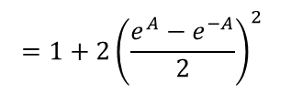


Hyperbolic Functions
$$sinhx=\frac{e^{x}−e^{−x}}{2}$$
$$arsinh x=ln\left(x+\sqrt{x^{2}+1}\right)$$
$$arcosh x=ln\left(x+\sqrt{x^{2}−1}\right), x≥1$$
$$artanhx=\frac{1}{2}ln\left|\frac{1+x}{1−x}\right|, \left|x\right|<1$$
$$coshx=\frac{e^{x}+e^{−x}}{2}$$
$$tanhx=\frac{e^{2x}−1}{e^{2x}+1}$$
You can find and use identities for hyperbolic functions, in a similar way that you can for the regular trigonometric functions
Prove that:
Yes – use the relationships above again!
$$1+2\sinh^{2}A$$
Replace using the expressions above
$$=1+2{\left(\frac{e^{A}−e^{−A}}{2}\right)}^{2}$$
Square the bracket (if needed write as a double bracket first)
$$=1+2\left(\frac{e^{2A}−2+e^{−2A}}{4}\right)$$
$$\cosh{2A≡1+2si{nh}^{2}A}$$
Multiply out
$$=1+\frac{e^{2A}−2+e^{−2A}}{2}$$
Write 1 as $\frac{2}{2}$
$$=\frac{2}{2}+\frac{e^{2A}−2+e^{−2A}}{2}$$
Group up
$$=\frac{e^{2A}+e^{−2A}}{2}$$
Using the expressions above, this is equivalent to $\cosh{2A}$
$$=\cosh{2A}$$
6C

Slide 6





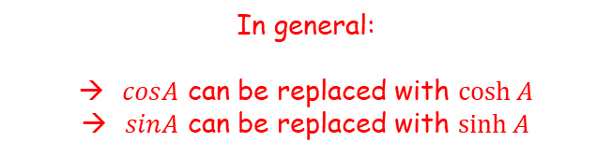
Hyperbolic Functions
$$sinhx=\frac{e^{x}−e^{−x}}{2}$$
$$arsinh x=ln\left(x+\sqrt{x^{2}+1}\right)$$
$$arcosh x=ln\left(x+\sqrt{x^{2}−1}\right), x≥1$$
$$artanhx=\frac{1}{2}ln\left|\frac{1+x}{1−x}\right|, \left|x\right|<1$$
$$coshx=\frac{e^{x}+e^{−x}}{2}$$
$$tanhx=\frac{e^{2x}−1}{e^{2x}+1}$$
You can find and use identities for hyperbolic functions, in a similar way that you can for the regular trigonometric functions
$$cos^{2}A+\sin^{2}A≡1$$
$$sin⁡(A+B)≡sinAcosB+cosAsinB$$
$$cos2A≡1−2\sin^{2}A$$
$$cosh^{2}A−\sinh^{2}A≡1$$
$$\sinh\left(A+B\right)≡\sinh{A}\cosh{B}+\cosh{A}\sinh{B}$$
$$\cosh{2A≡1+2si{nh}^{2}A}$$
In general:
$cosA$ can be replaced with $\cosh{A}$
$sinA$ can be replaced with $\sinh{A}$
However, any product/implied product of two sine terms must have the sign swapped
$\sin^{2}A$ can be replaced with $−sinh^{2}{A}$
This is known as Osborn’s rule (we will see why it works at the end of this section)
6C

Slide 7



Hyperbolic Functions
$$sinhx=\frac{e^{x}−e^{−x}}{2}$$
$$arsinh x=ln\left(x+\sqrt{x^{2}+1}\right)$$
$$arcosh x=ln\left(x+\sqrt{x^{2}−1}\right), x≥1$$
$$artanhx=\frac{1}{2}ln\left|\frac{1+x}{1−x}\right|, \left|x\right|<1$$
$$coshx=\frac{e^{x}+e^{−x}}{2}$$
$$tanhx=\frac{e^{2x}−1}{e^{2x}+1}$$
You can find and use identities for hyperbolic functions, in a similar way that you can for the regular trigonometric functions
Write down the hyperbolic identity corresponding to:
$$cos2A≡2\cos^{2}A−1$$
$$cos2A≡2\cos^{2}A−1$$
Cos terms can be replaced directly
$$cosh2A≡2\cosh^{2}A−1$$
6C

Slide 8


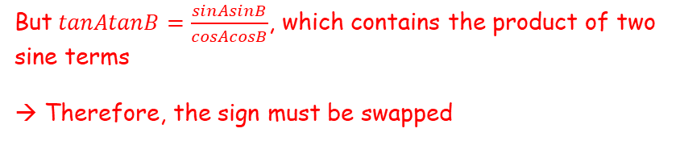


Hyperbolic Functions
$$sinhx=\frac{e^{x}−e^{−x}}{2}$$
$$arsinh x=ln\left(x+\sqrt{x^{2}+1}\right)$$
$$arcosh x=ln\left(x+\sqrt{x^{2}−1}\right), x≥1$$
$$artanhx=\frac{1}{2}ln\left|\frac{1+x}{1−x}\right|, \left|x\right|<1$$
$$coshx=\frac{e^{x}+e^{−x}}{2}$$
$$tanhx=\frac{e^{2x}−1}{e^{2x}+1}$$
You can find and use identities for hyperbolic functions, in a similar way that you can for the regular trigonometric functions
Write down the hyperbolic identity corresponding to:
$$tan⁡(A−B)≡\frac{tanA−tanB}{1+tanAtanB}$$
$$tan⁡(A−B)≡\frac{tanA−tanB}{1+tanAtanB}$$
Replace, being careful of the implied product of two sine terms
$$tanh⁡(A−B)≡\frac{\tanh{A}−\tanh{B}}{1−\tanh{A}\tanh{B}}$$
Be careful…
$tanA=\frac{sinA}{cosA}$ so it can be directly replaced
But $tanAtanB=\frac{sinAsinB}{cosAcosB}$, which contains the product of two sine terms
→ Therefore, the sign must be swapped
6C

Slide 9
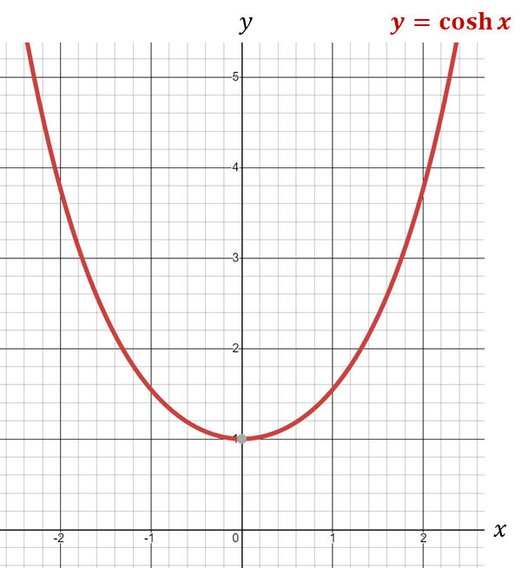







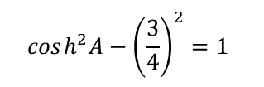
Hyperbolic Functions
$$sinhx=\frac{e^{x}−e^{−x}}{2}$$
$$arsinh x=ln\left(x+\sqrt{x^{2}+1}\right)$$
$$arcosh x=ln\left(x+\sqrt{x^{2}−1}\right), x≥1$$
$$artanhx=\frac{1}{2}ln\left|\frac{1+x}{1−x}\right|, \left|x\right|<1$$
$$coshx=\frac{e^{x}+e^{−x}}{2}$$
$$tanhx=\frac{e^{2x}−1}{e^{2x}+1}$$
You can find and use identities for hyperbolic functions, in a similar way that you can for the regular trigonometric functions
Given that $\sinh{x}=\frac{3}{4}$, find the exact value of:
a) $\cosh{x}$
$$cosh^{2}A−\sinh^{2}A≡1$$
In this question, $\sinh{x}=\frac{3}{4}$
$$cosh^{2}A−{\left(\frac{3}{4}\right)}^{2}=1$$
Rearrange
$$cosh^{2}A=\frac{25}{16}$$
Square root
$$\cosh{A}=±\frac{5}{4}$$
Remember that $\cosh{x}≥1$
$$\cosh{A}=\frac{5}{4}$$
6C

Slide 10





Hyperbolic Functions
$$sinhx=\frac{e^{x}−e^{−x}}{2}$$
$$arsinh x=ln\left(x+\sqrt{x^{2}+1}\right)$$
$$arcosh x=ln\left(x+\sqrt{x^{2}−1}\right), x≥1$$
$$artanhx=\frac{1}{2}ln\left|\frac{1+x}{1−x}\right|, \left|x\right|<1$$
$$coshx=\frac{e^{x}+e^{−x}}{2}$$
$$tanhx=\frac{e^{2x}−1}{e^{2x}+1}$$
You can find and use identities for hyperbolic functions, in a similar way that you can for the regular trigonometric functions
Given that $\sinh{x}=\frac{3}{4}$, find the exact value of:
b) $\tanh{x}$
$$\tanh{x}≡\frac{\sinh{x}}{\cosh{x}}$$
Replace (we know $\cosh{x}$ from part a))
$$=\frac{\frac{3}{4}}{\frac{5}{4}}$$
Simplify
$$=\frac{3}{5}$$
6C

Slide 11





Hyperbolic Functions
$$sinhx=\frac{e^{x}−e^{−x}}{2}$$
$$arsinh x=ln\left(x+\sqrt{x^{2}+1}\right)$$
$$arcosh x=ln\left(x+\sqrt{x^{2}−1}\right), x≥1$$
$$artanhx=\frac{1}{2}ln\left|\frac{1+x}{1−x}\right|, \left|x\right|<1$$
$$coshx=\frac{e^{x}+e^{−x}}{2}$$
$$tanhx=\frac{e^{2x}−1}{e^{2x}+1}$$
You can find and use identities for hyperbolic functions, in a similar way that you can for the regular trigonometric functions
Given that $\sinh{x}=\frac{3}{4}$, find the exact value of:
c) $\sinh{2x}$
$$sin2x=2sinxcosx$$
Write the equivalent hyperbolic identity
$$\sinh{2x}=2\sinh{x}\cosh{x}$$
Replace using previous answers where needed
$$=2\left(\frac{3}{4}\right)\left(\frac{5}{4}\right)$$
Simplify
$$=\frac{15}{8}$$
6C

Slide 12












Hyperbolic Functions
$$sinhx=\frac{e^{x}−e^{−x}}{2}$$
$$arsinh x=ln\left(x+\sqrt{x^{2}+1}\right)$$
$$arcosh x=ln\left(x+\sqrt{x^{2}−1}\right), x≥1$$
$$artanhx=\frac{1}{2}ln\left|\frac{1+x}{1−x}\right|, \left|x\right|<1$$
$$coshx=\frac{e^{x}+e^{−x}}{2}$$
$$tanhx=\frac{e^{2x}−1}{e^{2x}+1}$$
You can find and use identities for hyperbolic functions, in a similar way that you can for the regular trigonometric functions
Solve the equation below for real values of $x$.
$$6\sinh{x}−2\cosh{x}=7$$
$$6\sinh{x}−2\cosh{x}=7$$
You can use the identities above if there isn’t a clear way to rewrite the equation
$$6\left(\frac{e^{x}−e^{−x}}{2}\right)−2\left(\frac{e^{x}+e^{−x}}{2}\right)=7$$
Simplify
$$3\left(e^{x}−e^{−x}\right)−\left(e^{x}+e^{−x}\right)=7$$
Multiply out and group terms
$$2e^{x}−4e^{−x}=7$$
Multiply by $e^{x}$
$$2e^{2x}−4=7e^{x}$$
Subtract ${7e}^{x}$
$$2e^{2x}−7e^{x}−4=0$$
Factorise
$$\left(2e^{x}+1\right)\left(e^{x}−4\right)=0$$
Solve
→ But the negative can be ruled out
$e^{x}=−\frac{1}{2}$ or $e^{x}=4$
Solve
$$x=ln4$$
6C

Slide 13









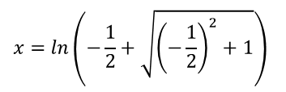




Hyperbolic Functions
$$sinhx=\frac{e^{x}−e^{−x}}{2}$$
$$arsinh x=ln\left(x+\sqrt{x^{2}+1}\right)$$
$$arcosh x=ln\left(x+\sqrt{x^{2}−1}\right), x≥1$$
$$artanhx=\frac{1}{2}ln\left|\frac{1+x}{1−x}\right|, \left|x\right|<1$$
$$coshx=\frac{e^{x}+e^{−x}}{2}$$
$$tanhx=\frac{e^{2x}−1}{e^{2x}+1}$$
You can find and use identities for hyperbolic functions, in a similar way that you can for the regular trigonometric functions
Solve the equation below, giving answers as natural logarithms.
$$2cosh^{2}x−5\sinh{x}=5$$
$$2cosh^{2}{x} −5\sinh{x}=5$$
Replace using an identity
$\cos^{2}x+sin^{2}x≡1$
$$2\left(1+sinh^{2}{x}\right)−5\sinh{x}=5$$
$\cosh^{2}x−sinh^{2}x≡1$
Multiply out and rearrange
$$2\sinh^{2}x−5\sinh{x}−3=0$$
Factorise
$$\left(2\sinh{x}+1\right)\left(\sinh{x}−3\right)=0$$
Solve
$\sinh{x}=−\frac{1}{2}$ or $\sinh{x}=3$
$$x=arsinh\left(−\frac{1}{2}\right)$$
$$x=arsinh\left(3\right)$$
Use the relationship above
Use the relationship above
$$x=ln\left(−\frac{1}{2}+\sqrt{{\left(−\frac{1}{2}\right)}^{2}+1}\right)$$
$$x=ln\left(3+\sqrt{{\left(3\right)}^{2}+1}\right)$$
Simplify
$$x=ln\left(−\frac{1}{2}+\frac{\sqrt{5}}{2}\right)$$
Simplify
$$x=ln\left(3+\sqrt{10}\right)$$
6C

Slide 14














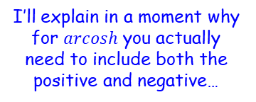
Hyperbolic Functions
$$sinhx=\frac{e^{x}−e^{−x}}{2}$$
$$arsinh x=ln\left(x+\sqrt{x^{2}+1}\right)$$
$$arcosh x=ln\left(x+\sqrt{x^{2}−1}\right), x≥1$$
$$artanhx=\frac{1}{2}ln\left|\frac{1+x}{1−x}\right|, \left|x\right|<1$$
$$coshx=\frac{e^{x}+e^{−x}}{2}$$
$$tanhx=\frac{e^{2x}−1}{e^{2x}+1}$$
$$\cosh{2x}−5\cosh{x}+4=0$$
Replace using an identity
You can find and use identities for hyperbolic functions, in a similar way that you can for the regular trigonometric functions
Solve the equation below, giving answers as natural logarithms where appropriate.
$$\cosh{2x}−5\cosh{x}+4=0$$
$cos2x≡2cos^{2}x−1$
$$2cosh^{2}x−1−5\cosh{x}+4=0$$
$\cosh{2x}≡2cosh^{2}x−1$
Simplify
$$2cosh^{2}x−5\cosh{x}+3=0$$
Factorise
$$\left(2\cosh{x}−3\right)\left(\cosh{x}−1\right)=0$$
Solve
$\cosh{x}=\frac{3}{2}$ or $\cosh{x}=1$
$$x=arcosh\left(\frac{3}{2}\right)$$
$$x=arcosh\left(1\right)$$
I’ll explain in a moment why for $arcosh$ you actually need to include both the positive and negative…
Use the relationship above
Use the relationship above
$$x=ln\left(\frac{3}{2}±\sqrt{{\left(\frac{3}{2}\right)}^{2}−1}\right)$$
$$x=ln\left(1±\sqrt{{\left(1\right)}^{2}−1}\right)$$
Simplify
Simplify
$$x=ln\left(\frac{3}{2}±\frac{\sqrt{5}}{2}\right)$$
$$x=0$$
6C

Slide 15
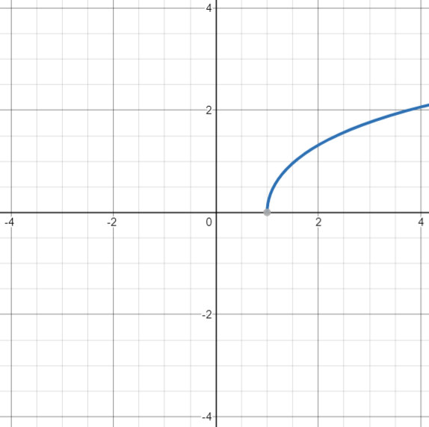
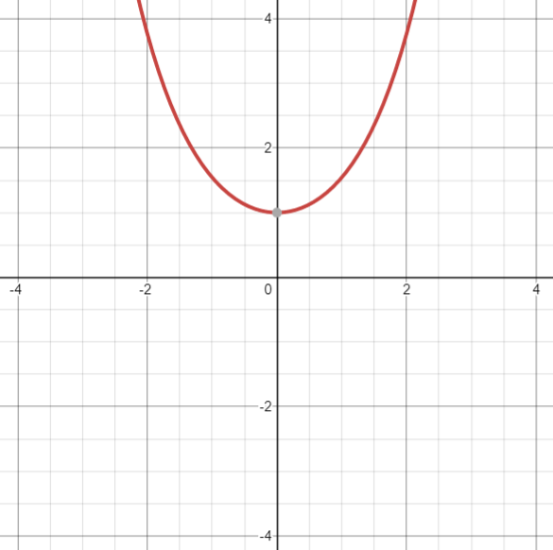
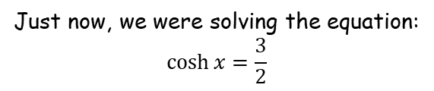





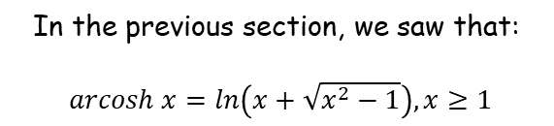
Hyperbolic Functions
$$sinhx=\frac{e^{x}−e^{−x}}{2}$$
$$arsinh x=ln\left(x+\sqrt{x^{2}+1}\right)$$
$$arcosh x=ln\left(x+\sqrt{x^{2}−1}\right), x≥1$$
$$artanhx=\frac{1}{2}ln\left|\frac{1+x}{1−x}\right|, \left|x\right|<1$$
$$coshx=\frac{e^{x}+e^{−x}}{2}$$
$$tanhx=\frac{e^{2x}−1}{e^{2x}+1}$$
Why do you need to include the $±$ for $arcosh$?
In the previous section, we saw that:
$arcosh x=ln\left(x+\sqrt{x^{2}−1}\right), x≥1$
Just now, we were solving the equation:
$$\cosh{x}=\frac{3}{2}$$
$$y=\cosh{x}$$
$$y=\operatorname{arcosh}{x}$$
$$y=\frac{3}{2}$$
The reason the negative root was eliminated was because it would mean that we would be doing $ln⁡$of a value between 0 and 1
This is possible, but it would give a negative answer, and…
…the function $arcosh≥0$
You can see that there will be 2 solutions to this
→ When solving equations, you don’t need to consider an artificial limit imposed by the definition of a function!
6C

Slide 16
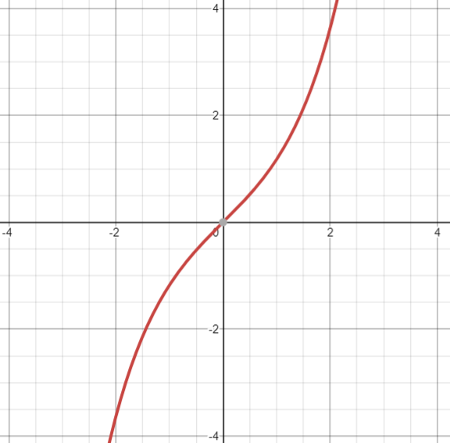



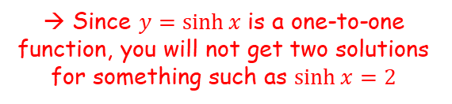


Hyperbolic Functions
$$sinhx=\frac{e^{x}−e^{−x}}{2}$$
$$arsinh x=ln\left(x+\sqrt{x^{2}+1}\right)$$
$$arcosh x=ln\left(x+\sqrt{x^{2}−1}\right), x≥1$$
$$artanhx=\frac{1}{2}ln\left|\frac{1+x}{1−x}\right|, \left|x\right|<1$$
$$coshx=\frac{e^{x}+e^{−x}}{2}$$
$$tanhx=\frac{e^{2x}−1}{e^{2x}+1}$$
What about $arsinh x$?
You can think about this in a couple of different ways…
$$y=\sinh{x}$$
$$arsinh x=ln\left(x+\sqrt{x^{2}+1}\right)$$
Alternatively, a reminder that $x−\sqrt{x^{2}+1}$ would be negative since $\sqrt{x^{2}+1}>x$
We would not be able to take ln of this and a potential solution would be immediately ruled out anyway
Hence, only the positive root has a possible solution!
$$y=2$$
→ Since $y=\sinh{x}$ is a one-to-one function, you will not get two solutions for something such as $\sinh{x}=2$
6C

Slide 17

















Hyperbolic Functions
$$sinhx=\frac{e^{x}−e^{−x}}{2}$$
$$arsinh x=ln\left(x+\sqrt{x^{2}+1}\right)$$
$$arcosh x=ln\left(x+\sqrt{x^{2}−1}\right), x≥1$$
$$artanhx=\frac{1}{2}ln\left|\frac{1+x}{1−x}\right|, \left|x\right|<1$$
$$coshx=\frac{e^{x}+e^{−x}}{2}$$
$$tanhx=\frac{e^{2x}−1}{e^{2x}+1}$$
Why does Osborn’s rule work?
We first need to show some relationships, starting with Euler’s relation…
$$e^{ix}=cosx+isinx$$
$$e^{−ix}=cosx−isinx$$
Add together
Top subtract bottom
$$e^{ix}=cosx+isinx$$
Change $x$ to $−x$
$$e^{i(−x)}=cos⁡(−x)+isin(−x)$$
$$e^{ix}+e^{−ix}=2cosx$$
$$e^{ix}−e^{−ix}=2isinx$$
Use $cos\left(−x\right)=cosx$ and $\sin\left(−x\right)=−sinx$
Divide by 2
Divide by 2
$$e^{−ix}=cosx−isinx$$
$$\frac{e^{ix}+e^{−ix}}{2}=cosx$$
$$\frac{e^{ix}−e^{−ix}}{2}=isinx$$
Replace
Replace
$$cosh⁡(ix)=cosx$$
$$sinh⁡(ix)=isinx$$
Divide by $i$
$$\frac{1}{i}sinh⁡(ix)=sinx$$
$\frac{1}{i}=−i$ since $1=−i×i$
$$−isinh⁡(ix)=sinx$$
6C

Slide 18











Hyperbolic Functions
$$sinhx=\frac{e^{x}−e^{−x}}{2}$$
$$arsinh x=ln\left(x+\sqrt{x^{2}+1}\right)$$
$$arcosh x=ln\left(x+\sqrt{x^{2}−1}\right), x≥1$$
$$artanhx=\frac{1}{2}ln\left|\frac{1+x}{1−x}\right|, \left|x\right|<1$$
$$coshx=\frac{e^{x}+e^{−x}}{2}$$
$$tanhx=\frac{e^{2x}−1}{e^{2x}+1}$$
Why does Osborn’s rule work?
$$cosx=cosh⁡(ix)$$
$$sinx=−isinh⁡(ix)$$
$$cosh⁡(ix)=cosx$$
Let $x=iy$
$$\cos\left(ix\right)=cosh⁡x$$
$$cosh⁡(i(iy))=cos⁡(iy)$$
Simplify left side
$$cosh⁡(i^{2}y)=cos⁡(iy)$$
$$i^{2}=−1$$
$$cosh⁡(−y)=cos⁡(iy)$$
Use $cosh⁡(−y)=coshy$
$$cosh⁡(y)=cos⁡(iy)$$
The letter doesn’t really matter!
$$cosh⁡(x)=cos⁡(ix)$$
6C

Slide 19








Hyperbolic Functions
$$sinhx=\frac{e^{x}−e^{−x}}{2}$$
$$arsinh x=ln\left(x+\sqrt{x^{2}+1}\right)$$
$$arcosh x=ln\left(x+\sqrt{x^{2}−1}\right), x≥1$$
$$artanhx=\frac{1}{2}ln\left|\frac{1+x}{1−x}\right|, \left|x\right|<1$$
$$coshx=\frac{e^{x}+e^{−x}}{2}$$
$$tanhx=\frac{e^{2x}−1}{e^{2x}+1}$$
Why does Osborn’s rule work?
$$cosx=cosh⁡(ix)$$
$$sinx=−isinh⁡(ix)$$
$$−isinh⁡(ix)=sinx$$
Let $x=iy$
$$\cos\left(ix\right)=cosh⁡x$$
$$\sin\left(ix\right)=sinh x$$
$$−isinh⁡(i(iy))=sin⁡(iy)$$
Simplify left side
$$−isinh⁡(i^{2}y)=sin⁡(iy)$$
$$i^{2}=−1$$
$$−isinh⁡(−y)=sin⁡(iy)$$
Use $\sinh\left(−y\right)=−sinhy$
$$isinh⁡(y)=sin⁡(iy)$$
The letter doesn’t really matter!
$$isinh⁡(x)=sin⁡(ix)$$
6C

Slide 20







Hyperbolic Functions
$$sinhx=\frac{e^{x}−e^{−x}}{2}$$
$$arsinh x=ln\left(x+\sqrt{x^{2}+1}\right)$$
$$arcosh x=ln\left(x+\sqrt{x^{2}−1}\right), x≥1$$
$$artanhx=\frac{1}{2}ln\left|\frac{1+x}{1−x}\right|, \left|x\right|<1$$
$$coshx=\frac{e^{x}+e^{−x}}{2}$$
$$tanhx=\frac{e^{2x}−1}{e^{2x}+1}$$
Why does Osborn’s rule work?
$$cosx=cosh⁡(ix)$$
$$sinx=−isinh⁡(ix)$$
So lets now see what happens when we replace sine terms with hyperbolic sine terms…
$$\cos\left(ix\right)=cosh⁡x$$
$$\sin\left(ix\right)=sinh x$$
Replace using what we just saw…
$$sin2A≡2sinAcosA$$
$$−isinh{2\left(iA\right)}≡−2isinh(iA)cosh⁡(iA)$$
Divide both sides by $−i$
$$\sinh{2\left(iA\right)}≡2sinh(iA)cosh⁡(iA)$$
Let $iA=x$
$$\sinh{2x}≡2\sinh{x}cosh x$$
Important point – if you convert from a regular trigonometrical identity to a hyperbolic trigonometrical identity like this, the angles at the end will not be the same as the ones at the start
→ However, since it is an identity, it is therefore true for all values, so will also be true when $x=A$
$$\sinh{2A}≡2\sinh{A}cosh A$$
6C

Slide 21






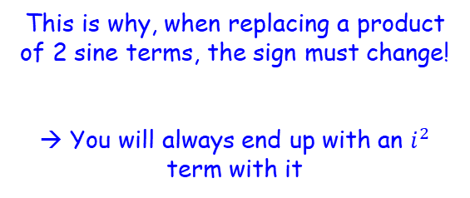

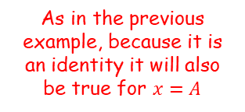



Hyperbolic Functions
$$sinhx=\frac{e^{x}−e^{−x}}{2}$$
$$arsinh x=ln\left(x+\sqrt{x^{2}+1}\right)$$
$$arcosh x=ln\left(x+\sqrt{x^{2}−1}\right), x≥1$$
$$artanhx=\frac{1}{2}ln\left|\frac{1+x}{1−x}\right|, \left|x\right|<1$$
$$coshx=\frac{e^{x}+e^{−x}}{2}$$
$$tanhx=\frac{e^{2x}−1}{e^{2x}+1}$$
Why does Osborn’s rule work?
$$cosx=cosh⁡(ix)$$
$$sinx=−isinh⁡(ix)$$
So lets now see what happens when we replace sine terms with hyperbolic sine terms…
$$\cos\left(ix\right)=cosh⁡x$$
$$\sin\left(ix\right)=sinh x$$
$$cos2A≡1−2\sin^{2}A$$
Rewrite
$$cos2A≡1−2{\left(sinA\right)}^{2}$$
Replace using the rules to the left
$$sin2A≡2sinAcosA$$
$$cosh2(iA)≡1−2{\left(−isinh(iA)\right)}^{2}$$
Square the bracket
$$\sinh{2A}≡2\sinh{A}cosh A$$
$$cosh2(iA)≡1−2\left(−i^{2}sinh⁡(iA)\right)$$
Simplify
$$cosh2\left(iA\right)≡1+2sinh^{2}⁡(iA)$$
Let $iA=x$
This is why, when replacing a product of 2 sine terms, the sign must change!
→ You will always end up with an $i^{2}$ term with it
$$cosh2x≡1+2sinh^{2}x$$
As in the previous example, because it is an identity it will also be true for $x=A$
$$cosh2A≡1+2sinh^{2}A$$
6C

Slide 22
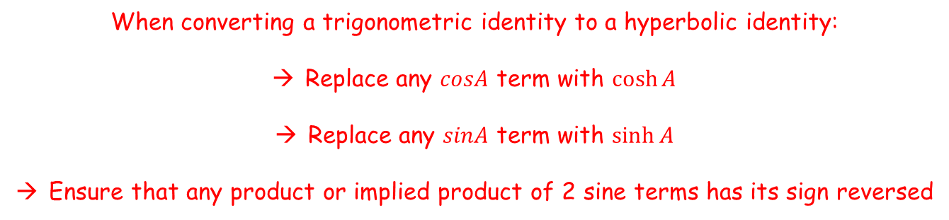


Hyperbolic Functions
$$sinhx=\frac{e^{x}−e^{−x}}{2}$$
$$arsinh x=ln\left(x+\sqrt{x^{2}+1}\right)$$
$$arcosh x=ln\left(x+\sqrt{x^{2}−1}\right), x≥1$$
$$artanhx=\frac{1}{2}ln\left|\frac{1+x}{1−x}\right|, \left|x\right|<1$$
$$coshx=\frac{e^{x}+e^{−x}}{2}$$
$$tanhx=\frac{e^{2x}−1}{e^{2x}+1}$$
Summary of Osborn’s rule
$$sin2A≡2sinAcosA$$
$$cos2A≡1−2\sin^{2}A$$
$$\sinh{2A}≡2\sinh{A}cosh A$$
$$cosh2A≡1+2sinh^{2}A$$
When converting a trigonometric identity to a hyperbolic identity:
Replace any $cosA$ term with $\cosh{A}$
Replace any $sinA$ term with $\sinh{A}$
Ensure that any product or implied product of 2 sine terms has its sign reversed
6C

Slide 23

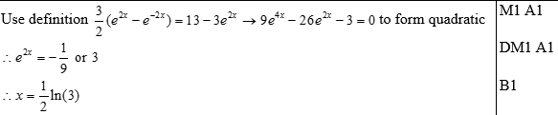
Exercise 6C
Complete before the lesson Q1
In Class:
Green Q2-5
Amber Q6-7
Red Q8-9
Pearson Core Pure Year 2
Pages 128-129
?

