Slide 1
Volumes of
Revolution
Twitter: @Owen134866
www.mathsfreeresourcelibrary.com

Slide 2
Teachings for
Exercise 4B

Slide 3

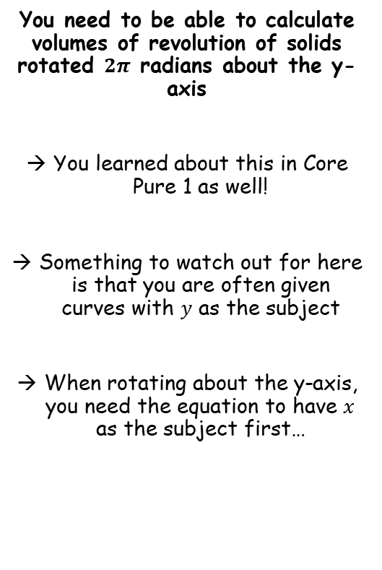

Volumes of Revolution
$$V=π\int_{a}^{b}{y^{2}} dx$$
$$V=π\int_{a}^{b}{x^{2}} dy$$
You need to be able to calculate volumes of revolution of solids rotated $2π$ radians about the y-axis
You learned about this in Core Pure 1 as well!
Something to watch out for here is that you are often given curves with $y$ as the subject
When rotating about the y-axis, you need the equation to have $x$ as the subject first…
4B

Slide 4





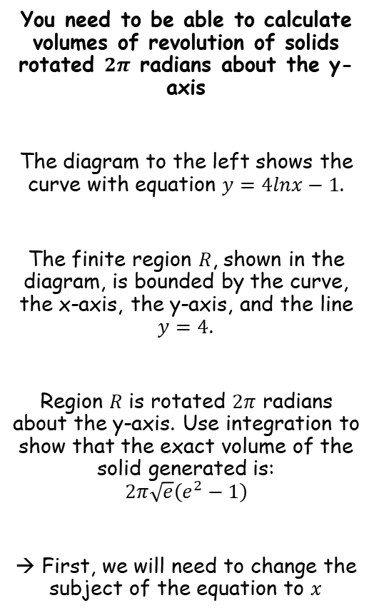









Volumes of Revolution
$$V=π\int_{a}^{b}{y^{2}} dx$$
$$V=π\int_{a}^{b}{x^{2}} dy$$
You need to be able to calculate volumes of revolution of solids rotated $2π$ radians about the y-axis
The diagram to the left shows the curve with equation $y=4lnx−1$.
The finite region $R$, shown in the diagram, is bounded by the curve, the x-axis, the y-axis, and the line $y=4$.
Region $R$ is rotated $2π$ radians about the y-axis. Use integration to show that the exact volume of the solid generated is:
$$2π\sqrt{e}\left(e^{2}−1\right)$$
→ First, we will need to change the subject of the equation to $x$
$$y=4lnx−1$$
$$y$$
$$y=4lnx−1$$
Rearrange
$$\frac{y+1}{4}=lnx$$
$$4$$
Inverse natural logarithm
$$e^{\frac{y+1}{4}}=x$$
$$R$$
$$O$$
$$x$$
$$V=π\int_{a}^{b}{x^{2}} dy$$
Sub in our expression for $x$
$$=π\int_{0}^{4}{{\left(e^{\frac{y+1}{4}}\right)}^{2}} dy$$
Square using ${\left(x^{n}\right)}^{m}=x^{nm}$
$$=π\int_{0}^{4}{e^{\frac{y+1}{2}}} dy$$
Write as separate powers of $e$
$$=π\int_{0}^{4}{e^{\frac{y}{2}}e^{\frac{1}{2}}} dy$$
Since $e^{\frac{1}{2}}$ is a constant, it can be factored out
$$=πe^{\frac{1}{2}}\int_{0}^{4}{e^{\frac{y}{2}}} dy$$
4B

Slide 5


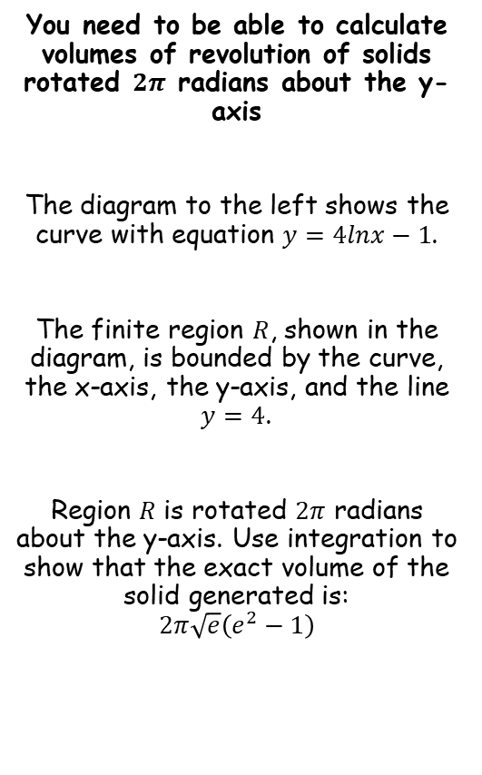




Volumes of Revolution
$$V=π\int_{a}^{b}{y^{2}} dx$$
$$V=π\int_{a}^{b}{x^{2}} dy$$
You need to be able to calculate volumes of revolution of solids rotated $2π$ radians about the y-axis
The diagram to the left shows the curve with equation $y=4lnx−1$.
The finite region $R$, shown in the diagram, is bounded by the curve, the x-axis, the y-axis, and the line $y=4$.
Region $R$ is rotated $2π$ radians about the y-axis. Use integration to show that the exact volume of the solid generated is:
$$2π\sqrt{e}\left(e^{2}−1\right)$$
$$y=4lnx−1$$
$$y$$
$$y=4lnx−1$$
Rearrange
$$\frac{y+1}{4}=lnx$$
$$4$$
Inverse natural logarithm
$$e^{\frac{y+1}{4}}=x$$
$$R$$
$$O$$
$$x$$
$$=πe^{\frac{1}{2}}\int_{0}^{4}{e^{\frac{y}{2}}} dy$$
Integrate and use a square bracket
$$=πe^{\frac{1}{2}}{\left[2e^{\frac{y}{2}}\right]}_{0}^{4}$$
The 2 can be factored out
$$=2πe^{\frac{1}{2}}{\left[e^{\frac{y}{2}}\right]}_{0}^{4}$$
Sub in limits and subtract
$$=2πe^{\frac{1}{2}}\left(e^{\frac{(4)}{2}}−e^{\frac{(0)}{2}}\right)$$
Simplify inside the bracket
$$=2πe^{\frac{1}{2}}\left(e^{2}−1\right)$$
Rewrite the $e^{\frac{1}{2}}$ term
$$=2π\sqrt{e}\left(e^{2}−1\right)$$
4B

Slide 6
Exercise 4B
Pearson Core Pure Year 2
Pages 81-83
Complete before the lesson Q1-2
In Class:
Green Q3-4
Amber Q5-6
Red Q7-8

