Slide 1
Year 1 Pure Mathematics
Exponentials and Logs
- Introduction
Chapter 14
(Part 3 of 7)

Slide 2
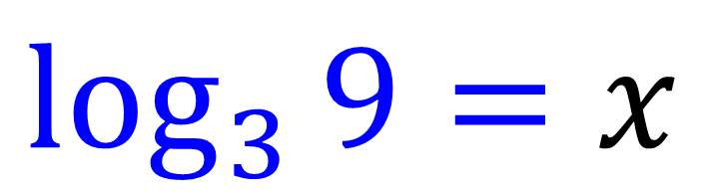
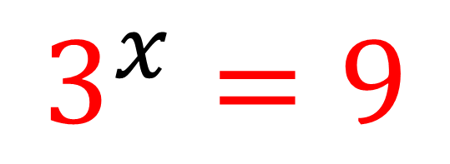
Exponentials and Logarithms
Exponential
$$3^{x}=9$$
Logarithms
$$\log_{3}{9}=x$$

Slide 3
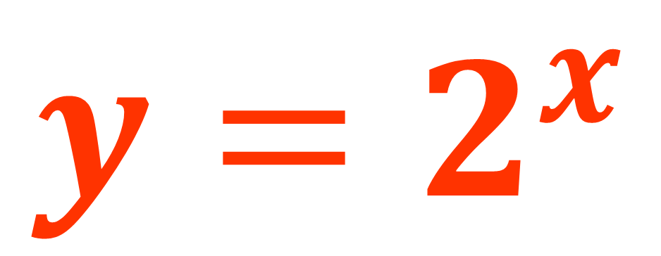
Exponentials
When the power is a variable,
you get an exponential.
Index value
$$y=2^{x}$$
Base value

Slide 4

Exponentials
A special exponential you should be
aware of is known as e.
$$e^{x}$$
e is like π, it is an irrational number and never ends.
e ≈ 2.71821
e^{x} is special because of the graph it produces
and therefore is used to model real situations
such as population growth and radioactive decay.

Slide 5




Exponentials
Find the x value for each of the exponentials.
$2^{x}$ = 16
x = 4
$3^{x}$ = 81
x = 3
$7^{x}$ = $\frac{1}{7}$
x = -1
${12}^{x}$ = 1
x = 1

Slide 6








Logarithms
Logarithms are the inverse
to exponential functions.
Function
Inverse
12
4
$$x×3$$
$$x÷3$$
4
7
4
$$x+3$$
$$x−3$$
4
16
4
$$x^{2}$$
$$\sqrt{x}$$
4
81
4
$$3^{x}$$
$$\log_{3}{x}$$
4

Slide 7
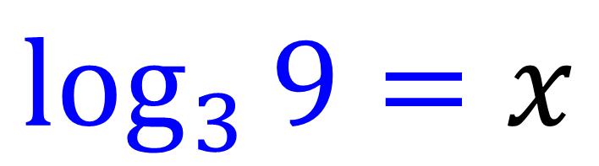
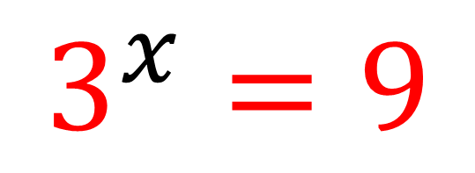
Logarithms
Logs are used to help solve
exponential equations.
$$3^{x}=9$$
$$\log_{3}{9}=x$$

Slide 8
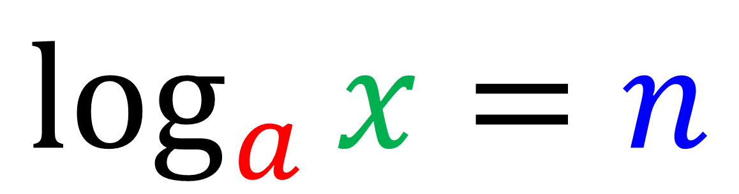
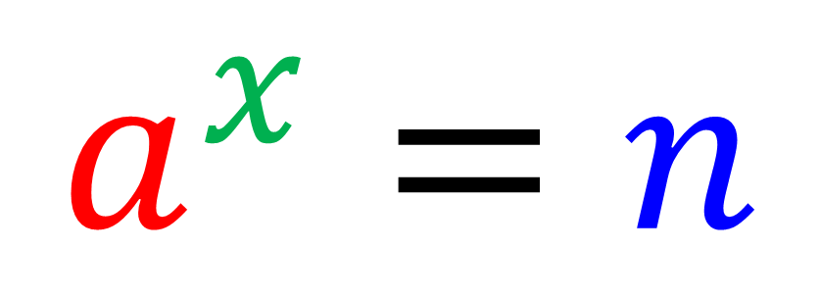
Logarithms
$$a^{x}=n$$
$$\log_{a}{x}=n$$

Slide 9
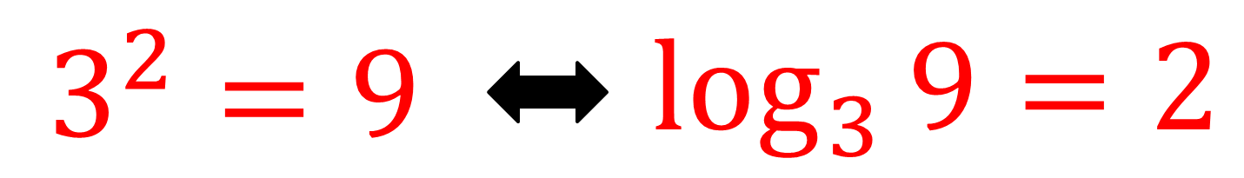
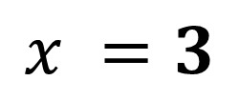
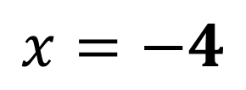
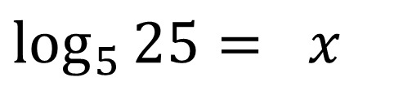
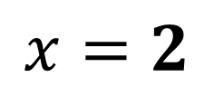
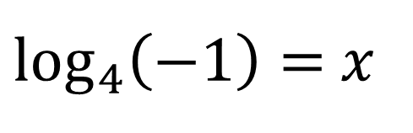
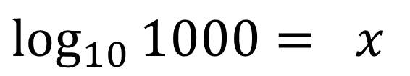
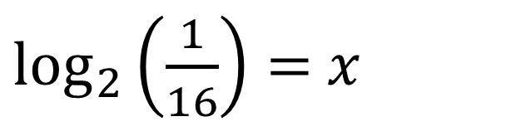
Logarithms - Examples
Without a calculator, find the values of 𝑥.
$$\log_{5}{25}= x$$
$$\log_{10}{1000}= x$$
$$x=2$$
$$x =3$$
$\log_{2}\left(\frac{1}{16}\right)=$ 𝑥
$\log_{4}\left(−1\right)=$ 𝑥
$$\text{x}=−4$$
You can’t log negative numbers.

Slide 10


Exercise 14D
Complete before the lesson Q1
Green Q2
Amber Q3
Red
Pearson Pure Mathematics
Pages 320-321
Extension
Non-calculator!
[MAT 2013 1F] Three positive numbers $a,b,c$ satisfy
$$\log_{b}{a}=2 \\ \log_{b}\left(c−3\right)=3 \\ \log_{a}\left(c+5\right)=2$$
This information:
specifies $a$ uniquely;
is satisfied by two values of $a$;
is satisfied by infinitely many values of $a$;
is contradictory
If we take exponents of the three equations:
$$a=b^{2}, c−3=b^{3}, c+5=a^{2}$$
Hence eliminating $a$ and $c$ we get
$$b^{3}+3=b^{4}−5 ⇒ b^{3}\left(b−1\right)=8$$
We are only interested in positive solutions to $b$. Note that $b^{3}\left(b−1\right)$ is negative for
$0<b<1$ and then both $b^{3}$ and $b−1$ are positive and increasing for $b>1$. So there is only one positive solution to the equation ($b=2$, so that $a=4, c=11$). Answer is (a).
2
1
[MAT 2015 1J] Which is the largest of the following numbers?
A) $\frac{\sqrt{7}}{2}$ B) $\frac{5}{4}$ C) $\frac{\sqrt{10!}}{3\left(6!\right)}$
D) $\frac{\log_{2}{30}}{\log_{3}{85}}$ E) $\frac{1+\sqrt{6}}{3}$
(Official solution) Squaring all answers results in (A) $\frac{7}{4}$ which is larger than (B) $\frac{25}{16}$. After squaring (C) it simplifies to $\frac{10×9×8×7}{9×6!}$ which further simplifies to $\frac{7}{9}$ which is smaller than (A).
$\log_{2}{30}≈5$ and $\log_{3}{(85)}≈4$, hence (D) is smaller than (A) after squaring. Comparing (A) with (E) after squaring results in a comparison of $\frac{7}{4}$ and $\frac{7+2\sqrt{6}}{9}$. As $2<\sqrt{6}<3$, (E) squared must be less than $\frac{13}{9}$ and hence less than $\frac{7}{4}$. The answer is (A).
?
?

