Slide 1


CLT with Poisson, Binomial and Geometric Distribs
[Textbook] A supermarket manager is trying to model the number of customers that visit her store each day. She observes that, on average, 20 new customers enter the store every minute.
Calculate the probability that fewer than 15 customers arrive in a given minute.
Find the probability that in one hour no more than 1150 customers arrive.
Use the Central Limit Theorem to estimate the probability that in one hour no more than 1150 customers arrive. Compare your answer to part b.
a
Let $X$ denote the number of customers that arrive in a minute. Then $X\sim Po(20)$.
$P\left(X<15\right)=0.1049 (4dp)$
Let $T$ denote the number of customers that arrive in an hour.
$$T\sim Po\left(60×20\right) → T\sim Po(1200)$$
$$P\left(T≤1150\right)=0.07589 (4dp)$$
We could consider each of the 60 minutes as a separate sample. Thus the observed average customers per minute is $\frac{1150}{60}=19.1666…$
Since $Var\left(X\right)=E\left(X\right)=λ$, by CLT, $\overline{X}≈N\left(20,{\sqrt{\frac{20}{60}}}^{2}\right)$
$P\left(\overline{X}≤1150\right)=0.0745 (4dp)$, which is close, so approximation using CLT is a good one.
?
(c) is an unusual way of solving the problem. Using the Stats Year 2 approach, we could use $T\sim Po(1200)$ and directly use a normal approximation $Y\sim N(1200,{\sqrt{1200}}^{2})$, finding $P(Y<1150.5)$
b
?
c
?

Slide 2

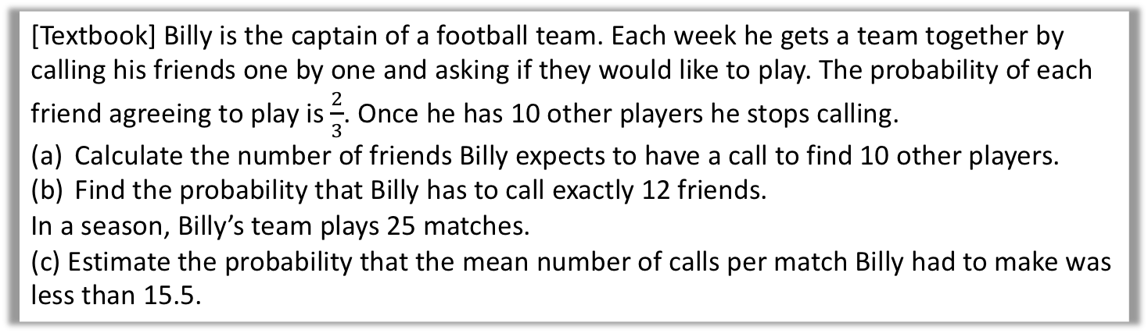
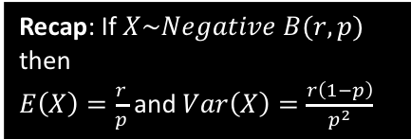
Test Your Understanding
[Textbook] Billy is the captain of a football team. Each week he gets a team together by calling his friends one by one and asking if they would like to play. The probability of each friend agreeing to play is $\frac{2}{3}$. Once he has 10 other players he stops calling.
Calculate the number of friends Billy expects to have a call to find 10 other players.
Find the probability that Billy has to call exactly 12 friends.
In a season, Billy’s team plays 25 matches.
(c) Estimate the probability that the mean number of calls per match Billy had to make was less than 15.5.
a
Let $X$ be the number of friends Billy calls. Then
$X\sim Negative\left(10,\frac{2}{3}\right)$ so $E\left(X\right)=\frac{30}{2}=5$
$P\left(X=12\right)=\left(\begin{matrix}11 \\ 9\end{matrix}\right)×{\left(\frac{2}{3}\right)}^{10}×{\left(\frac{1}{3}\right)}^{2}$
$=0.1060$
$E\left(X\right)=15$ and $Var\left(X\right)=\frac{10×\frac{1}{3}}{{\left(\frac{2}{3}\right)}^{2}}=7.5$
For a sample of size 25, the sample mean $\overline{X}$ is approximately $\sim N\left(15,\frac{7.5}{25}\right)$ or $N\left(15,0.3\right)$ by the CLT.
$$P\left(\overline{X}<15.5\right)≈0.8193$$
?
Recap: If $X\sim Negative B(r,p)$ then
$E\left(X\right)=\frac{r}{p}$ and $Var\left(X\right)=\frac{r\left(1−p\right)}{p^{2}}$
b
?
c
?

Slide 3
Exercise 5B
Pearson Further Statistics 1
Pages 81-82
Complete before the lesson Q1-2
In Class:
Green Q3-4
Red Q5-8

