Slide 1
Year 1 Pure Mathematics
Measure of
Location and Spread
– Coding
Chapter 2
(Part 5 of 4)

Slide 2
Coding - The point of coding
The jist of coding:
You want to find the mean and standard deviation
of a set of data.
You transform the values, using a rule,
to make them more user friendly.
You can then easily calculate
the mean and standard deviation of the ‘coded’ data,
and from this you can determine what
the mean and standard deviation would have been
for the original uncoded data.

Slide 3
Coding - The point of coding
Original Data (x)
Mean and SD
£1010 £1020 £1030 £1040 £1050
Coding
Coded Data (y)
Mean and SD
£1 £2 £3 £4 £5

Slide 4
Coding
What would happen to the mean
if you increase every piece of data by 0.5?
1.1 | 1.4 | 1.2 | 1.5 | 1.3 | Mean = 1.3
+0.5 | +0.5 | +0.5 | +0.5 | +0.5
1.6 | 1.9 | 1.7 | 2.0 | 1.8
Mean = 1.8
The mean would increase by 0.5.

Slide 5
Coding
What would happen to the standard deviation
if you increase every piece of data by 0.5?
1.1 | 1.4 | 1.2 | 1.5 | 1.3 | Mean = 1.3
+0.5 | +0.5 | +0.5 | +0.5 | +0.5
1.6 | 1.9 | 1.7 | 2.0 | 1.8
Mean = 1.8
The standard deviation would be the same.

Slide 6
Coding
What would happen to the mean
if you multiplied every piece of data by 3?
1.1 | 1.4 | 1.2 | 1.5 | 1.3 | Mean = 1.3
x 3 | x 3 | x 3 | x 3 | x 3
3.3 | 4.2 | 3.6 | 4.5 | 3.9
Mean = 3.9
The mean would become 3 times bigger.

Slide 7
Coding
What would happen to the standard deviation
if you multiplied every piece of data by 3?
1.1 | 1.4 | 1.2 | 1.5 | 1.3 | Mean = 1.3
x 3 | x 3 | x 3 | x 3 | x 3
3.3 | 4.2 | 3.6 | 4.5 | 3.9
Mean = 3.9
The standard deviation would become
3 times bigger.

Slide 8
Coding - Rules of coding
Coding | Mean | Standard Deviation
Add 10
Subtract 10
Multiply by 3
Divide by 3
Multiply by 2 and subtract 5
Increase by 10
Stay the same
Subtract 10
Stay the same
3 times bigger
3 times bigger
3 times smaller
3 times smaller
Double and decrease by 5
Double
Mean is effect by
multipliers, dividers, addition and subtraction.
Standard Deviation is only effect by
multipliers and dividers.

Slide 9
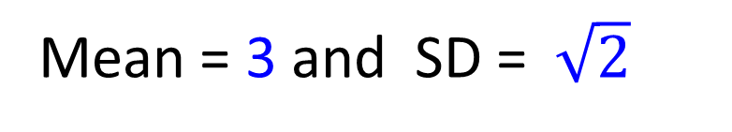
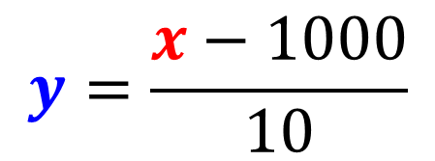

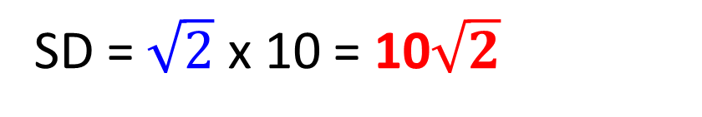
Coding - The point of coding
Original Data (x)
£1010 £1020 £1030 £1040 £1050
$$y=\frac{x−1000}{10}$$
$$10y+1000=x$$
£1 £2 £3 £4 £5
Coded Data (y)
Mean = 3 and SD =$\sqrt{2}$
Original Data (x)
Mean = 3 x 10 + 1000 = 1030
Original Data (x)
SD = $\sqrt{2}$ x 10 = 10$\sqrt{2}$

Slide 10
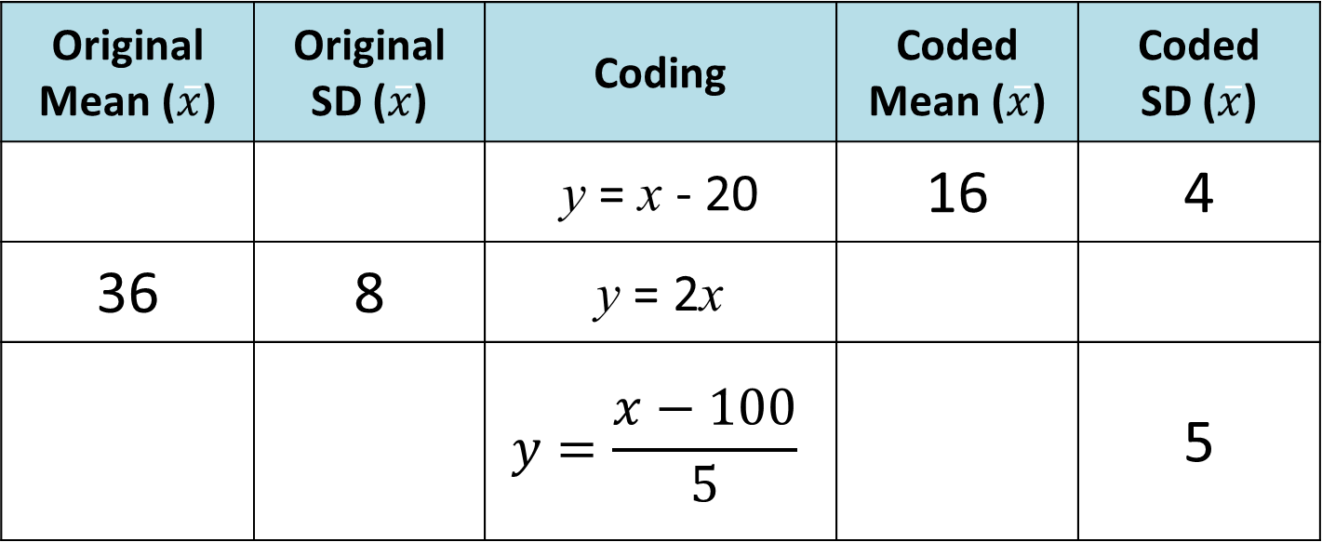
Coding - Quickfire Questions
Original Mean ($\overline{x}$) | Original SD ($\overline{x}$) | Coding | Coded Mean ($\overline{x}$) | Coded SD ($\overline{x}$)
 |  | y = x - 20 | 16 | 4
36 | 8 | y = 2x
 |  | $$y=\frac{x−100}{5}$$ |  | 5
36
4
72
16
300
25
40

Slide 11
Exercise 2F
Pearson Statistics & Mechanics Year 1/AS
Pages 34-36
Complete before the lesson Q1-2
In Class:
Green Q3-4
Amber Q5-6
Red Q7-9

